Slide 1

practical machine learning MLPs and backpropagation
Lewis SworD

Slide 2





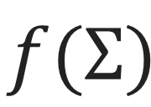
Single perceptron
Practical machine learning: MLPs and backpropagation
Originally used for all-or-nothing outputs, based on a binary activation function (Rosenblatt). 2-component input vector example:
$$x_{1}$$
Perceptron Classification Rule
$$\hat{y}$$
$$\hat{y}=f(Σ)= \left\{\begin{aligned}1 if Σ≥0 \\ −1 if Σ<0 \end{aligned}\right.$$
$$Σ$$
$$f(Σ)$$
$$x_{2}$$

Slide 3




Single perceptron
Practical machine learning: MLPs and backpropagation
Originally used for all-or-nothing outputs, based on a binary activation function (Rosenblatt). 2-component input vector example:
$x_{1},x_{2}=Input$
${ w}_{1},w_{2}=Weights$
$b=Bias$
$Σ=w_{1}x_{1}+w_{2}x_{2}+b$
$f=Activation function$
$\hat{y}=f\left(Σ\right)=Predicted output$
$y=True output$
$$b$$
$$x_{1}$$
$$w_{1}$$
$$Σ$$
$$f(Σ)$$
$$\hat{y}$$
$$w_{2}$$
$$x_{2}$$
Node/Neuron

Slide 4
Single perceptron
Practical machine learning: MLPs and backpropagation
Pros:
Can be used for continuous or discrete predictions with “linear” or “binary” activation functions.
Simple to implement.
Provides transferable knowledge to larger networks.
Cons:
Cannot be used for modelling complicated functions/problems (those that aren’t linearly separable for example, XOR) .

Slide 5
Multi-layer perceptrons (mlps)
Practical machine learning: MLPs and backpropagation
Solves the issue of the perceptron with the Universality theorem.
Universality theorem: Under certain conditions, even a shallow MLP with a non-linear activation function can represent arbitrary functions.
The building blocks for MLPs are layers of perceptrons.
Let us see just how these are constructed…

Slide 6









Multi-layer perceptrons (mlps)
Practical machine learning: MLPs and backpropagation
MLPs consist of an input layer, an output layer and any number of hidden layers in between:
$$I$$
$$H_{1}$$
$$H_{K}$$
$$O$$
$$w_{11}^{{I,H}_{1}}$$
$$x_{1}$$
$${\hat{y}}_{1}$$
$$x_{n}$$
$${\hat{y}}_{m}$$

Slide 7

Multi-layer perceptrons (mlps)
Practical machine learning: MLPs and backpropagation
MLPs consist of an input layer, an output layer and any number of hidden layers in between:
$$I$$
$$H_{1}$$
$$H_{K}$$
$$O$$
$$w_{11}^{{I,H}_{1}}$$
$$x_{1}$$
$${\hat{y}}_{1}$$
$$x_{n}$$
$${\hat{y}}_{m}$$
Input layer: n-node input layer: one node/neuron for each input variable. Passive neurons, whose sole job is to feed the network the input.

Slide 8


Multi-layer perceptrons (mlps)
Practical machine learning: MLPs and backpropagation
MLPs consist of an input layer, an output layer and any number of hidden layers in between:
$$I$$
$$H_{1}$$
$$H_{K}$$
$$O$$
$$w_{11}^{{I,H}_{1}}$$
$$x_{1}$$
$${\hat{y}}_{1}$$
$$x_{n}$$
$${\hat{y}}_{m}$$
Hidden layer(s): K lots of hidden layers, with potentially different numbers of nodes per layer. Receives input from previous layer nodes. All outputs fed into all nodes of consequent layers.

Slide 9

Multi-layer perceptrons (mlps)
Practical machine learning: MLPs and backpropagation
MLPs consist of an input layer, an output layer and any number of hidden layers in between:
$$I$$
$$H_{1}$$
$$H_{K}$$
$$O$$
$$w_{11}^{{I,H}_{1}}$$
$$x_{1}$$
$${\hat{y}}_{1}$$
$$x_{n}$$
$${\hat{y}}_{m}$$
Output layer: m-node output layer: one for every output variable. Produces output to be used in loss function calculation.

Slide 10
Multi-layer perceptrons (mlps)
Practical machine learning: MLPs and backpropagation
MLPs consist of an input layer, an output layer and any number of hidden layers in between:
$$I$$
$$H_{1}$$
$$H_{K}$$
$$O$$
$$w_{11}^{{I,H}_{1}}$$
$$x_{1}$$
$${\hat{y}}_{1}$$
$$x_{n}$$
$${\hat{y}}_{m}$$
Input layer: n-node input layer: one node/neuron for each input variable. Passive neurons, whose sole job is to feed the network the input.
Hidden layer(s): K lots of hidden layers, with potentially different numbers of nodes per layer. Receives input from previous layer nodes. All outputs fed into all nodes of consequent layers.
Output layer: m-node output layer: one for every output variable. Produces output to be used in loss function calculation.

Slide 11
Multi-layer perceptrons (mlps)
Practical machine learning: MLPs and backpropagation
Options within the MLP framework
Number of hidden layers (depth): a deeper network allows for more trainable parameters (the weights) and can hence learn more complicated functions/models.
Number of nodes in each hidden layer (width): More nodes also allows for complexity.
Activation functions for layers: Hidden layers can have different activation functions such as tanh, sigmoid, relu e.t.c.
Since every problem is different, choosing from such options is heavily experimental/practical.

Slide 12
Weight updating
Practical machine learning: MLPs and backpropagation
The goal of a neural network is to find weights (including biases) that optimise some loss function, such that we can make accurate predictions on unseen data.
Input
Feed forward
Generate output
Weight updates
backpropagatE

Slide 13
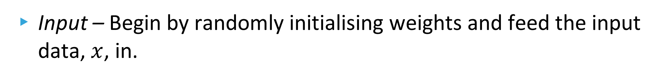
Weight updating
Practical machine learning: MLPs and backpropagation
The goal of a neural network is to find weights (including biases) that optimise some loss function, such that we can make accurate predictions on unseen data.
Input
Feed forward
Generate output
Weight updates
backpropagatE
Input – Begin by randomly initialising weights and feed the input data, $x$, in.

Slide 14
Weight updating
Practical machine learning: MLPs and backpropagation
The goal of a neural network is to find weights (including biases) that optimise some loss function, such that we can make accurate predictions on unseen data.
Input
Feed forward
Generate output
Weight updates
backpropagatE
Feed Forward – Refers to passing the data through all the nodes and layers (input to output), calculating all the weighted sums and values of activation functions.

Slide 15
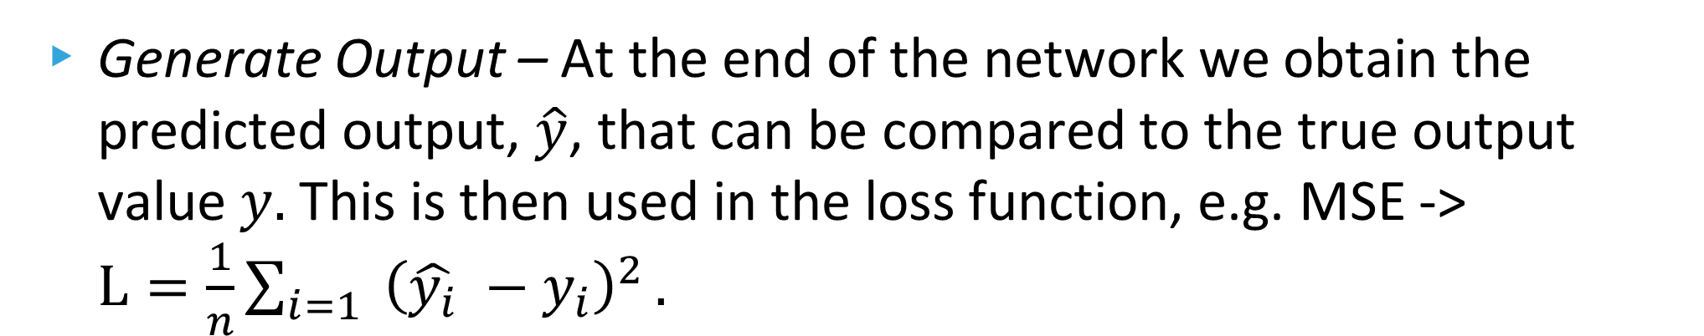
Weight updating
Practical machine learning: MLPs and backpropagation
The goal of a neural network is to find weights (including biases) that optimise some loss function, such that we can make accurate predictions on unseen data.
Input
Feed forward
Generate output
Weight updates
backpropagatE
Generate Output – At the end of the network we obtain the predicted output, $\hat{y}$, that can be compared to the true output value $y.$ This is then used in the loss function, e.g. MSE -> $L=\frac{1}{n}\sum_{i=1}{ {\left(\hat{y_{i}} −y_{i}\right)}^{2}}.$

Slide 16
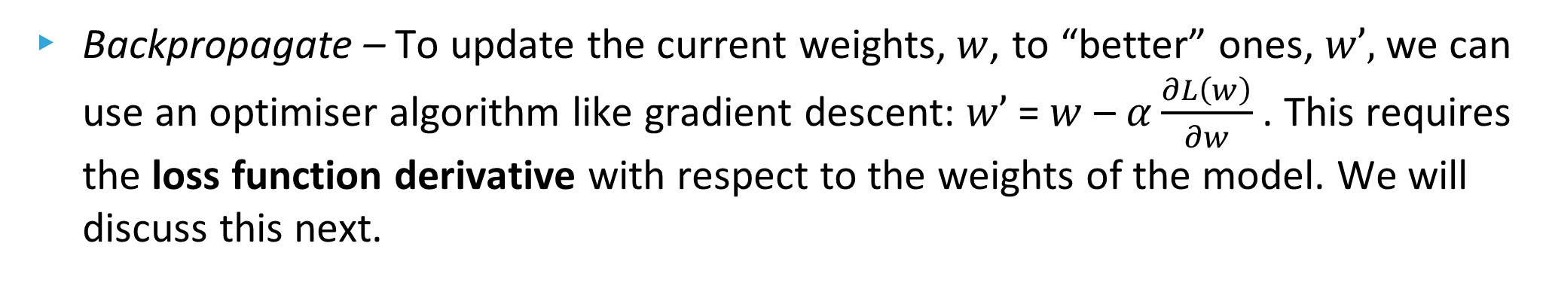
Weight updating
Practical machine learning: MLPs and backpropagation
The goal of a neural network is to find weights (including biases) that optimise some loss function, such that we can make accurate predictions on unseen data.
Input
Feed forward
Generate output
Weight updates
backpropagatE
Backpropagate – To update the current weights,$w$, to “better” ones, $w’,$we can use an optimiser algorithm like gradient descent: $w’$= $w$ – $α\frac{∂L\left(w\right)}{∂w}$ . This requires the loss function derivative with respect to the weights of the model. We will discuss this next.

Slide 17
Weight updating
Practical machine learning: MLPs and backpropagation
The goal of a neural network is to find weights (including biases) that optimise some loss function, such that we can make accurate predictions on unseen data.
Input
Feed forward
Generate output
Weight updates
backpropagatE
Weight updates – The final step is to feed these newly formed weights back into the network. The process is repeated until a desired value of the loss function is obtained.

Slide 18
Backpropagation
Practical machine learning: MLPs and backpropagation
Backpropagation requires derivatives to be computed.
Efficiency is key in this regard as we want to minimise the number of operations, the memory used, and the time taken.
So, what is the most efficient way to differentiate?
Taking the perceptron with a sigmoid activation function and one sample of data as an example, we can first symbolically identify these derivatives…

Slide 19

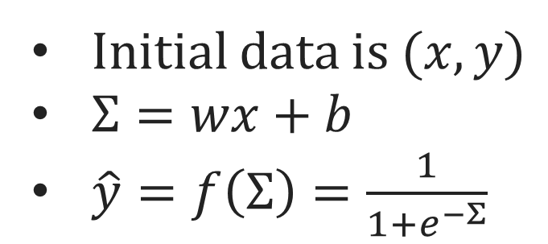
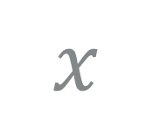
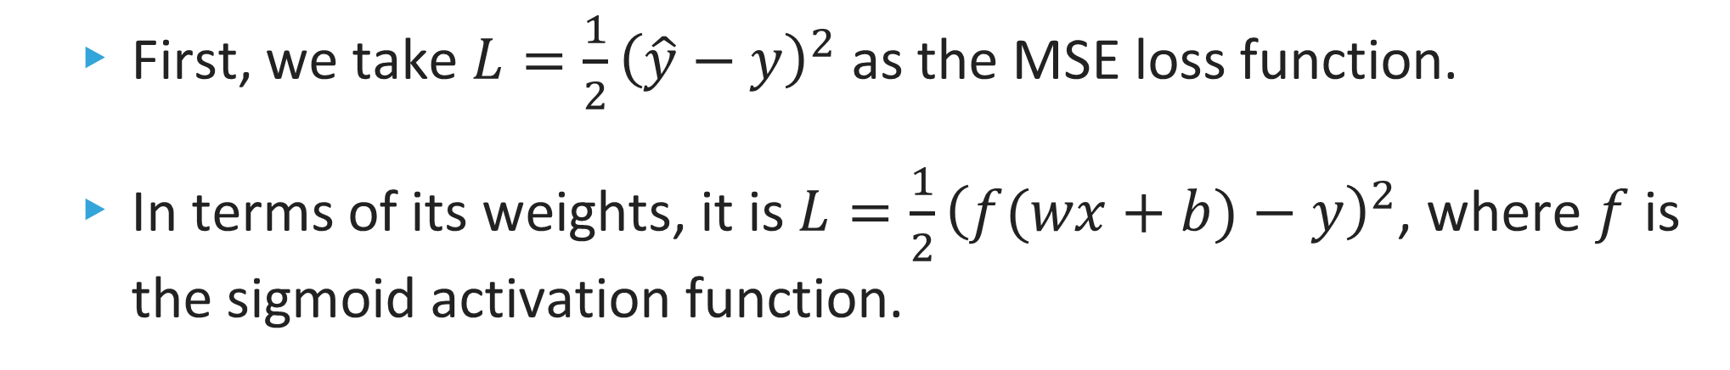

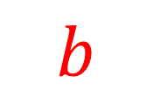


Backpropagation
Practical machine learning: MLPs and backpropagation
Node/Neuron
$$b$$
Initial data is $(x, y)$
$Σ=wx+b$
$\hat{y}=f\left(Σ\right)=\frac{1}{1+e^{−Σ}}$
$$x$$
$$w$$
$$f(Σ)$$
$$\hat{y}$$
$$Σ$$
First, we take $L=\frac{1}{2}{\left(\hat{y}−y\right)}^{2}$ as the MSE loss function.
In terms of its weights, it is $L=\frac{1}{2}{\left(f(wx+b)−y\right)}^{2}$, where $f$ is the sigmoid activation function.

Slide 20
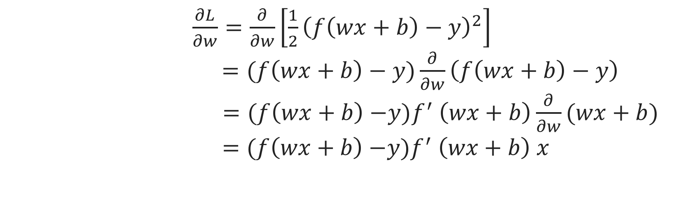

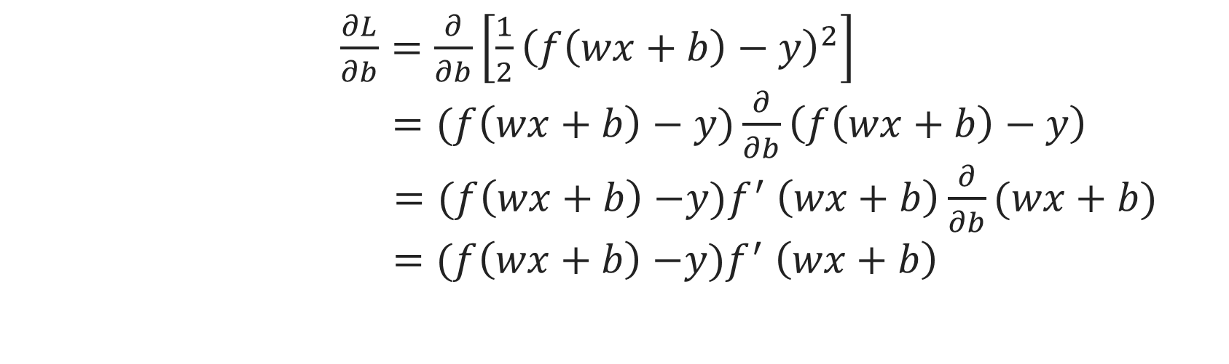
Backpropagation
Practical machine learning: MLPs and backpropagation
Let’s calculate the required weight derivatives $\frac{∂L}{∂w}$and $\frac{∂L}{∂b}$:
$\frac{∂L}{∂w}=\frac{∂}{∂w}\left[\frac{1}{2}{\left(f\left(wx+b\right)−y\right)}^{2}\right]$ $=(f\left(wx+b\right)−y)\frac{∂}{∂w}\left(f\left(wx+b\right)−y\right)$
$=(f\left(wx+b\right){−y)f}^{′}\left(wx+b\right)\frac{∂}{∂w}(wx+b)$
$=(f\left(wx+b\right){−y)f}^{′}\left(wx+b\right) x$
$\frac{∂L}{∂b}=\frac{∂}{∂b}\left[\frac{1}{2}{\left(f\left(wx+b\right)−y\right)}^{2}\right]$ $=(f\left(wx+b\right)−y)\frac{∂}{∂b}\left(f\left(wx+b\right)−y\right)$
$=(f\left(wx+b\right){−y)f}^{′}\left(wx+b\right)\frac{∂}{∂b}(wx+b)$
$=(f\left(wx+b\right){−y)f}^{′}\left(wx+b\right)$

Slide 21
Backpropagation
Practical machine learning: MLPs and backpropagation
Let’s calculate the required weight derivatives $\frac{∂L}{∂w}$and $\frac{∂L}{∂b}$:
$\frac{∂L}{∂w}=\frac{∂}{∂w}\left[\frac{1}{2}{\left(f\left(wx+b\right)−y\right)}^{2}\right]$ $=(f\left(wx+b\right)−y)\frac{∂}{∂w}\left(f\left(wx+b\right)−y\right)$
$=(f\left(wx+b\right){−y)f}^{′}\left(wx+b\right)\frac{∂}{∂w}(wx+b)$
$=(f\left(wx+b\right){−y)f}^{′}\left(wx+b\right) x$
Almost identical steps in the two different calculations
Repeated terms
$\frac{∂L}{∂b}=\frac{∂}{∂b}\left[\frac{1}{2}{\left(f\left(wx+b\right)−y\right)}^{2}\right]$ $=(f\left(wx+b\right)−y)\frac{∂}{∂b}\left(f\left(wx+b\right)−y\right)$
$=(f\left(wx+b\right){−y)f}^{′}\left(wx+b\right)\frac{∂}{∂b}(wx+b)$
$=(f\left(wx+b\right){−y)f}^{′}\left(wx+b\right)$

Slide 22
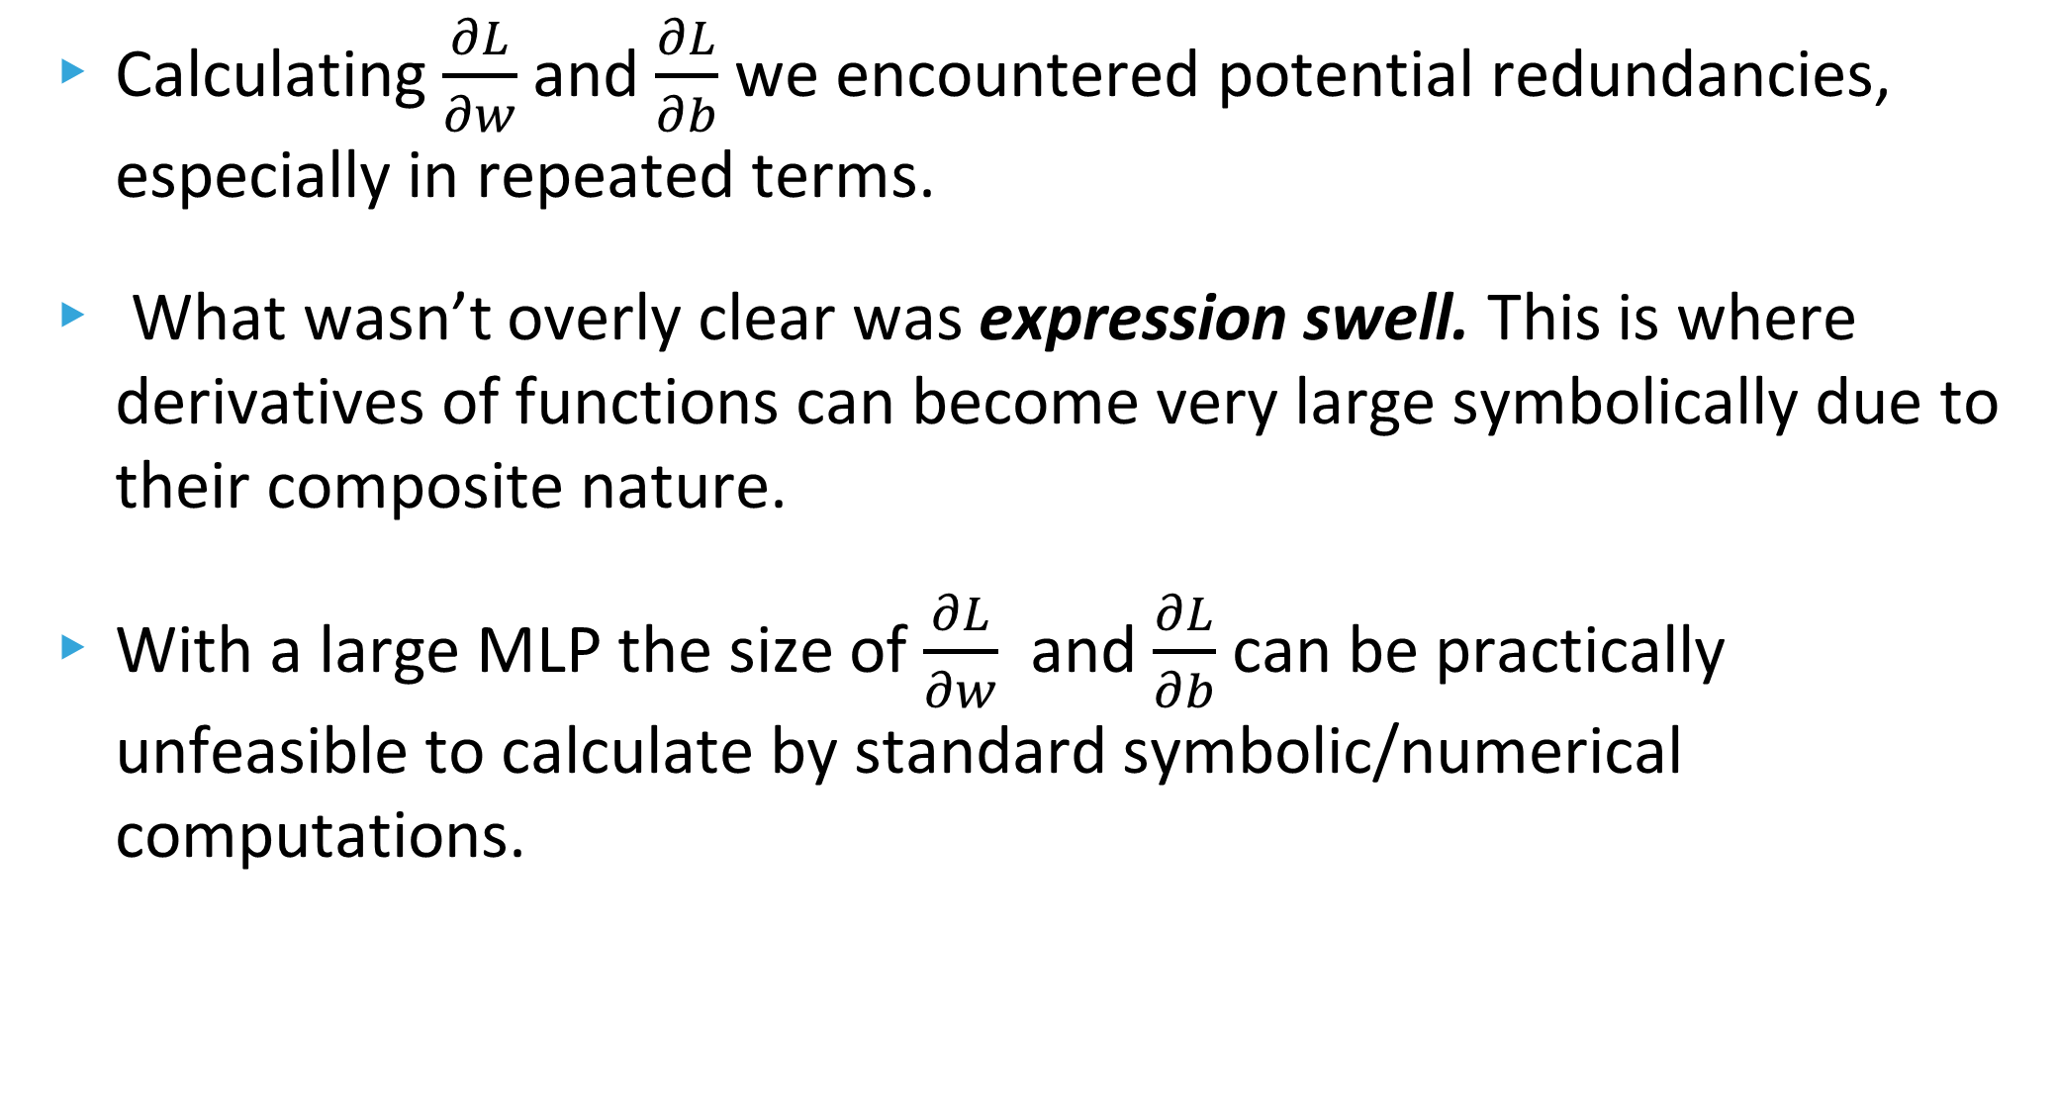
Backpropagation
Practical machine learning: MLPs and backpropagation
Calculating $\frac{∂L}{∂w}$and $\frac{∂L}{∂b}$we encountered potential redundancies, especially in repeated terms.
What wasn’t overly clear was expression swell. This is where derivatives of functions can become very large symbolically due to their composite nature.
With a large MLP the size of $\frac{∂L}{∂w}$ and $\frac{∂L}{∂b}$ can be practically unfeasible to calculate by standard symbolic/numerical computations.

Slide 23
Automatic differentiation
Practical machine learning: MLPs and backpropagation
Solution? Automatic differentiation (AD).
A “combination” of numerical and symbolic methods.
AD creates a logical set of derivatives based on primitive differentiable functions. This helps to reduce the size of the expression and remove redundancy in computation.
Heavily based on chain rule.

Slide 24

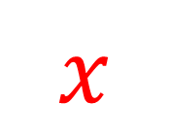

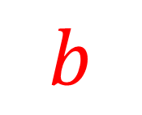

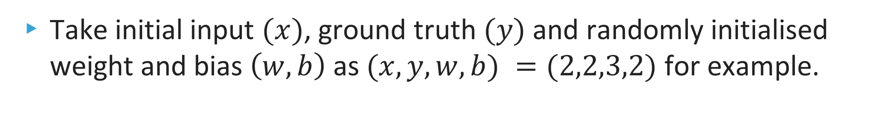

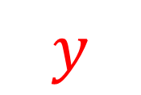
Automatic differentiation
Practical machine learning: MLPs and backpropagation
Build a graph based on the network
Red = Predefined “input” data
Blue Nodes = Computed quantities
$$y$$
$$w$$
$$x$$
$$Σ$$
$$\hat{y}$$
$$L$$
$$b$$
Take initial input $(x)$, ground truth $(y)$ and randomly initialised weight and bias $\left(w,b\right)$ as $(x, y, w, b) =(2,2,3,2)$ for example.

Slide 25




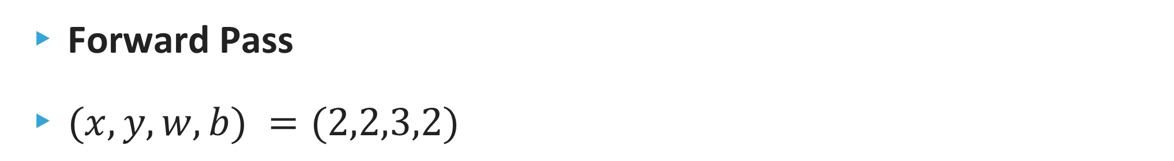




Automatic differentiation
Practical machine learning: MLPs and backpropagation
$$y$$
$$w$$
Forward Pass
$(x, y, w, b) =(2,2,3,2)$
$$x$$
$$Σ$$
$$\hat{y}$$
$$L$$
$$b$$
$Σ=w x+b=3 ×2+2=8$

Slide 26
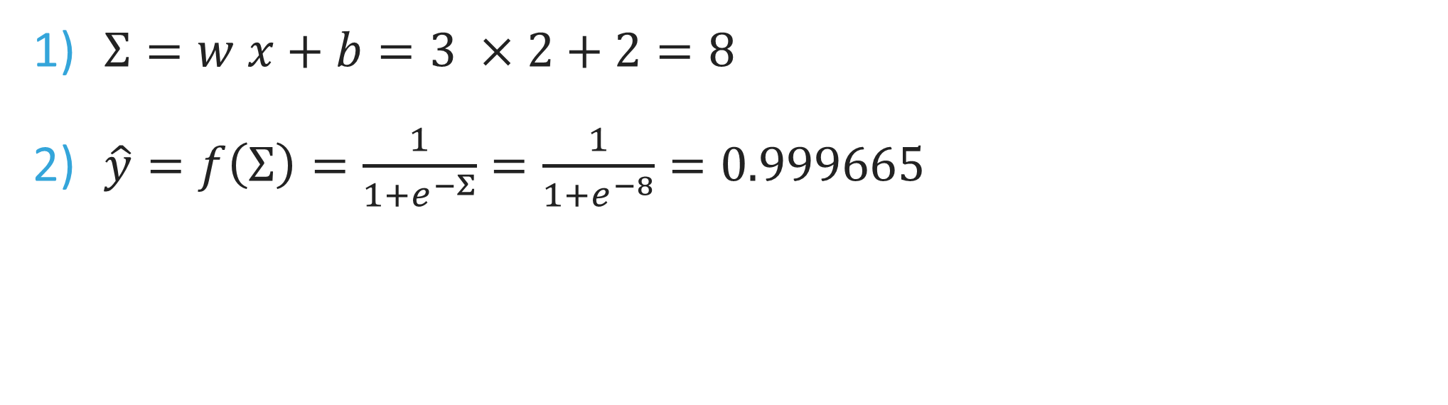
Automatic differentiation
Practical machine learning: MLPs and backpropagation
$$y$$
$$w$$
Forward Pass
$(x, y, w, b) =(2,2,3,2)$
$$x$$
$$Σ$$
$$\hat{y}$$
$$L$$
$$b$$
$Σ=w x+b=3 ×2+2=8$
$\hat{y}=f\left(Σ\right)=\frac{1}{1+e^{−Σ}}=\frac{1}{1+e^{−8}}=0.999665$

Slide 27
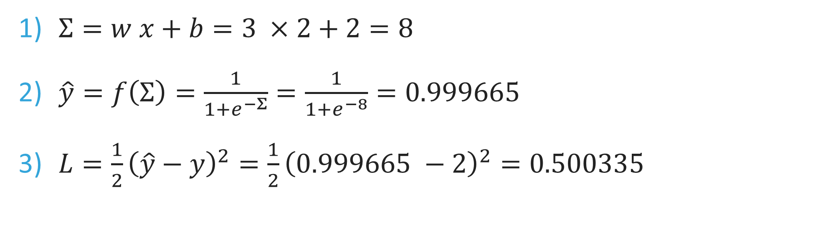
Automatic differentiation
Practical machine learning: MLPs and backpropagation
$$y$$
$$w$$
Forward Pass
$(x, y, w, b) =(2,2,3,2)$
$$x$$
$$Σ$$
$$\hat{y}$$
$$L$$
$$b$$
$Σ=w x+b=3 ×2+2=8$
$\hat{y}=f\left(Σ\right)=\frac{1}{1+e^{−Σ}}=\frac{1}{1+e^{−8}}=0.999665$
$L=\frac{1}{2}{\left(\hat{y}−y\right)}^{2}=\frac{1}{2}{\left(0.999665 −2\right)}^{2}=0.500335$

Slide 28
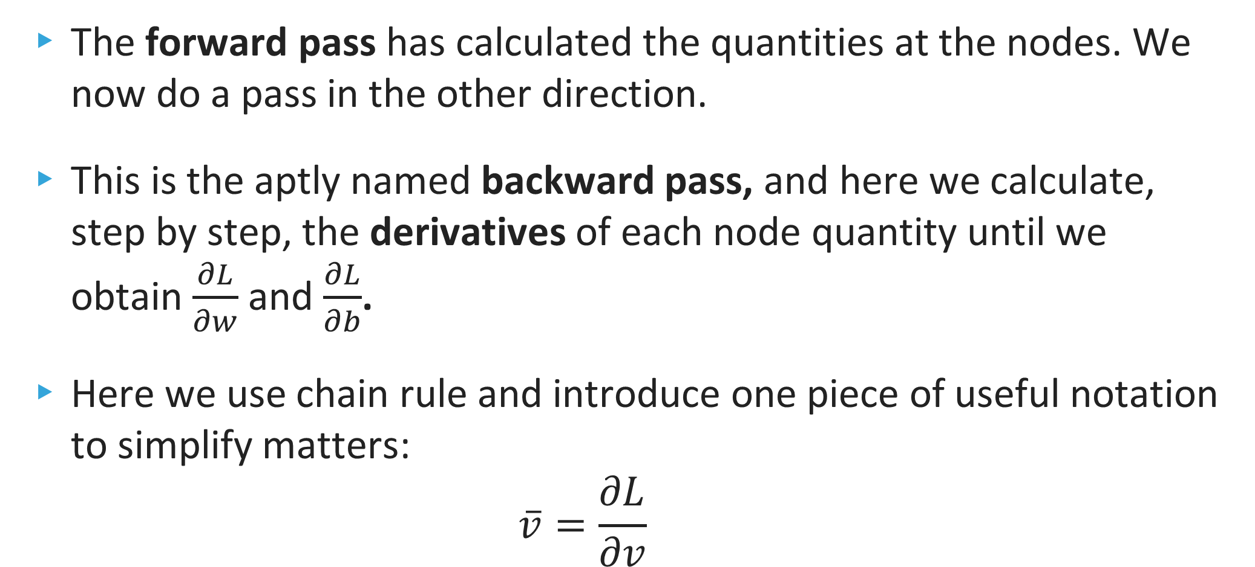
Automatic differentiation
Practical machine learning: MLPs and backpropagation
The forward pass has calculated the quantities at the nodes. We now do a pass in the other direction.
This is the aptly named backward pass, and here we calculate, step by step, the derivatives of each node quantity until we obtain $\frac{∂L}{∂w}$ and $\frac{∂L}{∂b}$.
Here we use chain rule and introduce one piece of useful notation to simplify matters:
$$\overline{v}=\frac{∂L}{∂v}$$

Slide 29
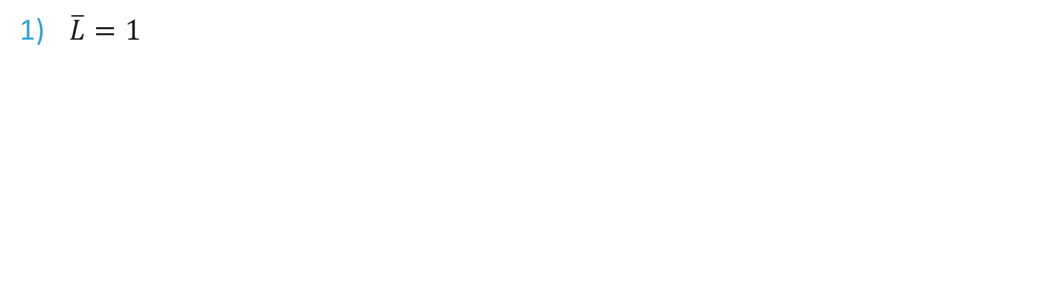
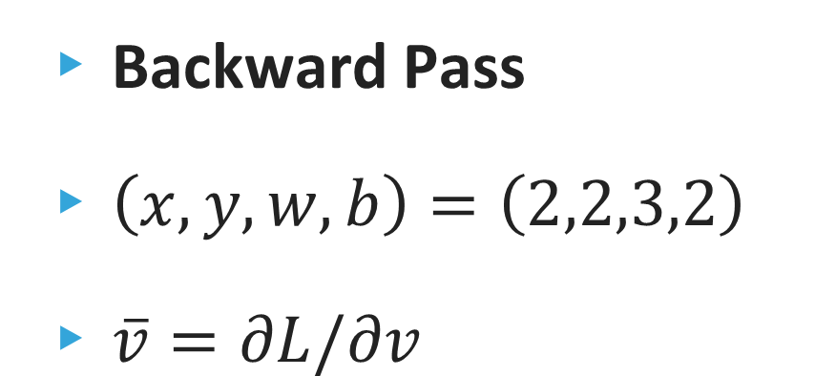
Automatic differentiation
Practical machine learning: MLPs and backpropagation
Backward Pass
$\left(x, y, w, b\right)=\left(2,2,3,2\right)$
$\overline{v}=∂L/∂v$
$$y$$
$$w$$
$$x$$
$$Σ$$
$$\hat{y}$$
$$L$$
$$b$$
$\overline{L}=1$

Slide 30
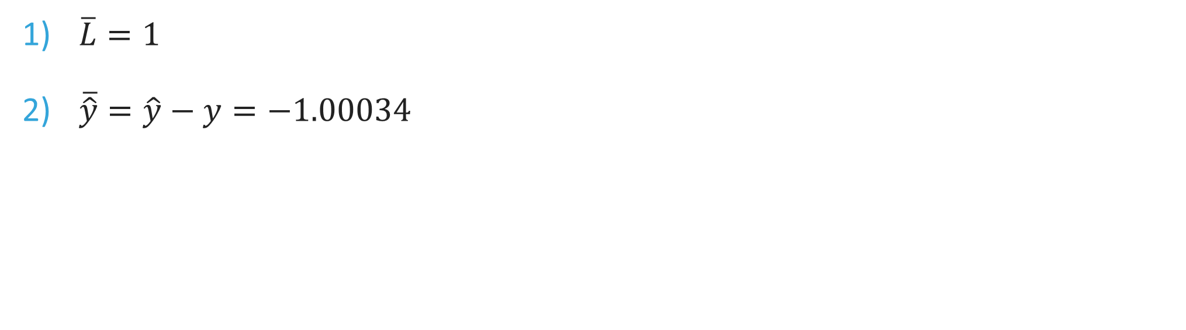
Automatic differentiation
Practical machine learning: MLPs and backpropagation
Backward Pass
$\left(x, y, w, b\right)=\left(2,2,3,2\right)$
$\overline{v}=∂L/∂v$
$$y$$
$$w$$
$$x$$
$$Σ$$
$$\hat{y}$$
$$L$$
$$b$$
$\overline{L}=1$
$\overline{\hat{y}}=\hat{y}−y=−1.00034$

Slide 31

Automatic differentiation
Practical machine learning: MLPs and backpropagation
Backward Pass
$\left(x, y, w, b\right)=\left(2,2,3,2\right)$
$\overline{v}=∂L/∂v$
$$y$$
$$w$$
$$x$$
$$Σ$$
$$\hat{y}$$
$$L$$
$$b$$
$\overline{L}=1$
$\overline{\hat{y}}=\hat{y}−y=−1.00034$
$\overline{Σ}=\frac{∂L}{∂Σ}=\frac{∂L}{∂\hat{y}}\frac{∂\hat{y}}{∂Σ}=\overline{\hat{y}}\frac{∂f(Σ)}{∂Σ}=\overline{\hat{y}}\frac{e^{−Σ}}{{\left(1+e^{−Σ}\right)}^{2}}=−0.00033535$

Slide 32

Automatic differentiation
Practical machine learning: MLPs and backpropagation
Backward Pass
$\left(x, y, w, b\right)=\left(2,2,3,2\right)$
$\overline{v}=∂L/∂v$
$$y$$
$$w$$
$$x$$
$$Σ$$
$$\hat{y}$$
$$L$$
$$b$$
$\overline{L}=1$
$\overline{\hat{y}}=\hat{y}−y=−1.00034$
$\overline{Σ}=\frac{∂L}{∂Σ}=\frac{∂L}{∂\hat{y}}\frac{∂\hat{y}}{∂Σ}=\overline{\hat{y}}\frac{∂f(Σ)}{∂Σ}=\overline{\hat{y}}\frac{e^{−Σ}}{{\left(1+e^{−Σ}\right)}^{2}}=−0.00033535$
$\overline{w}=\frac{∂L}{∂w}=\frac{∂L}{∂Σ}\frac{∂Σ}{∂w}=\overline{Σ} x=−0.0006707$

Slide 33
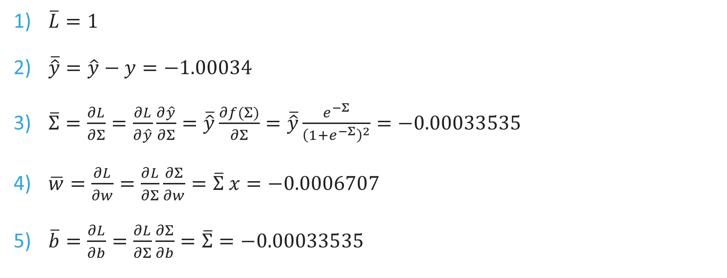
Automatic differentiation
Practical machine learning: MLPs and backpropagation
Backward Pass
$\left(x, y, w, b\right)=\left(2,2,3,2\right)$
$\overline{v}=∂L/∂v$
$$y$$
$$w$$
$$x$$
$$Σ$$
$$\hat{y}$$
$$L$$
$$b$$
$\overline{L}=1$
$\overline{\hat{y}}=\hat{y}−y=−1.00034$
$\overline{Σ}=\frac{∂L}{∂Σ}=\frac{∂L}{∂\hat{y}}\frac{∂\hat{y}}{∂Σ}=\overline{\hat{y}}\frac{∂f(Σ)}{∂Σ}=\overline{\hat{y}}\frac{e^{−Σ}}{{\left(1+e^{−Σ}\right)}^{2}}=−0.00033535$
$\overline{w}=\frac{∂L}{∂w}=\frac{∂L}{∂Σ}\frac{∂Σ}{∂w}=\overline{Σ} x=−0.0006707$
$\overline{b}=\frac{∂L}{∂b}=\frac{∂L}{∂Σ}\frac{∂Σ}{∂b}=\overline{Σ}=−0.00033535$

Slide 34

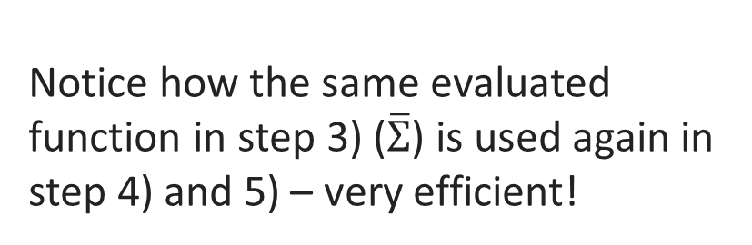
Automatic differentiation
Practical machine learning: MLPs and backpropagation
Backward Pass
$\left(x, y, w, b\right)=\left(2,2,3,2\right)$
$\overline{v}=∂L/∂v$
$$y$$
$$w$$
$$x$$
$$Σ$$
$$\hat{y}$$
$$L$$
$$b$$
Some symbolic derivatives are unavoidable, but the size of the expressions are minimal.
$\overline{L}=1$
$\overline{\hat{y}}=\hat{y}−y=−1.00034$
$\overline{Σ}=\frac{∂L}{∂Σ}=\frac{∂L}{∂\hat{y}}\frac{∂\hat{y}}{∂Σ}=\overline{\hat{y}}\frac{∂f(Σ)}{∂Σ}=\overline{\hat{y}}\frac{e^{−Σ}}{{\left(1+e^{−Σ}\right)}^{2}}=−0.00033535$
$\overline{w}=\frac{∂L}{∂w}=\frac{∂L}{∂Σ}\frac{∂Σ}{∂w}=\overline{Σ} x=−0.0006707$
$\overline{b}=\frac{∂L}{∂b}=\frac{∂L}{∂Σ}\frac{∂Σ}{∂b}=\overline{Σ}=−0.00033535$
Notice how the same evaluated function in step 3) ($\overline{Σ}$) is used again in step 4) and 5) – very efficient!

Slide 35
Automatic differentiation
Practical machine learning: MLPs and backpropagation
Each of the functions created in the back pass are small/primitive, so their derivatives are reasonably small too.
AD shows that values computed once are resourcefully reused in multiple places.
Very powerful and accurate technique, especially when there are many inputs and few outputs. It only requires one forward and one backward pass per output to compute all the partial derivatives for all outputs with regards to all the inputs!

Slide 36
Further reading
Practical machine learning: MLPs and backpropagation
“Automatic Differentiation in Machine Learning: a Survey” – Baydin et. al – (5 Feb, 2018) – arXiv:1502.05767.
“Introduction to Neural Networks” - Roger Grosse - https://sgfin.github.io/files/notes/CS321_Grosse_Lecture_Notes.pdf
Thanks for listening!

