Slide 1
Module 22: Endpoint Protection
Instructor Materials
CyberOps Associate v1.0
Notes:
Cisco Networking Academy Program
CyberOps Associate v1.0
Module 22: Endpoint Protection

Slide 2
Module Objectives
Module Title: Endpoint Protection
Module Objective: Explain how a malware analysis website generates a malware analysis report.
Topic | Topic Objective
Antimalware Protection | Explain methods of mitigating malware
Host-based Intrusion Prevention | Explain host-based IPS/IDS log entries
Application Security | Explain how a sandbox is used to analyze malware
Notes:
2
CyberOps Associate v1.0
22 – Endpoint Protection
22.0 – Introduction
22.0.2 – What Will I Learn in this Module?

Slide 3
22.1 Antimalware Protection
Notes:
Source:
22 – Endpoint Protection
22.1 – Antimalware Protection
In-Session Activities / Explanations:
Time: 10 mins
Instructor Notes:
Discuss the endpoint threats and how to secure them.
Discuss the host-based and network-based malware protections.
Encourage the learners to complete the CYU on the ‘Identify the Antimalware Terms and Concepts.’
Key Points: Endpoints, Antimalware

Slide 4
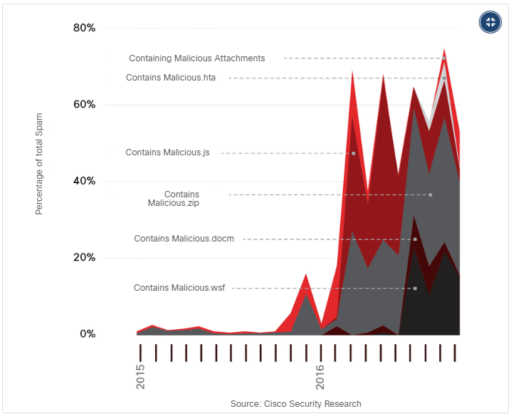
Endpoint Protection
Endpoint Threats
Endpoints can be defined as hosts on the network that can access or be accessed by other hosts on the network.
Each endpoint is potentially a way for malicious software to gain access to a network.
Devices that remotely access networks through VPNs are also endpoints that could inject malware into the VPN network from the public network.
Several common types of malware have been found to significantly change features in less than 24 hours in order to evade detection.
Malicious Spam Percentage
Notes:
22 – Endpoint Protection
22.1 – Antimalware Protection
22.1.1 – Endpoint Threats

Slide 5
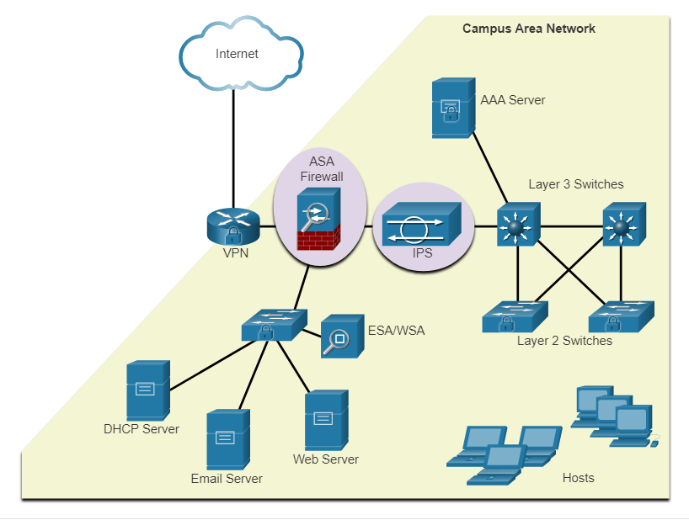
Endpoint Protection
Endpoint Security
As many attacks originate from inside the network, securing an internal LAN is nearly as important as securing the outside network perimeter.
After an internal host is infiltrated, it can become a starting point for an attacker to gain access to critical system devices, such as servers and sensitive information.
There are two internal LAN elements to secure:
Endpoints - Hosts are susceptible to malware-related attacks.
Network infrastructure - LAN infrastructure devices interconnect endpoints
Notes:
22 – Endpoint Protection
22.1 – Antimalware Protection
22.1.2 – Endpoint Security

Slide 6
Endpoint Protection
Host-Based Malware Protection
Host-based antimalware/antivirus software and host-based firewalls are used to protect mobile devices using VPN.
Antivirus/Antimalware Software
It is a software that is installed on a host to detect and mitigate viruses and malware. For example, Windows Defender Virus & Threat Protection, Cisco AMP for Endpoints, Norton Security, McAfee, Trend Micro, and others.
Antimalware programs may detect viruses using three different approaches:
Signature-based: Recognizes various characteristics of known malware files
Heuristics-based: Recognizes general features shared by various types of malware
Behavior-based: Employs analysis of suspicious behavior
Host-based antivirus protection, also known as agent-based, runs on every protected machine.
Notes:
22 – Endpoint Protection
22.1 – Antimalware Protection
22.1.3 – Host-Based Malware Protection

Slide 7
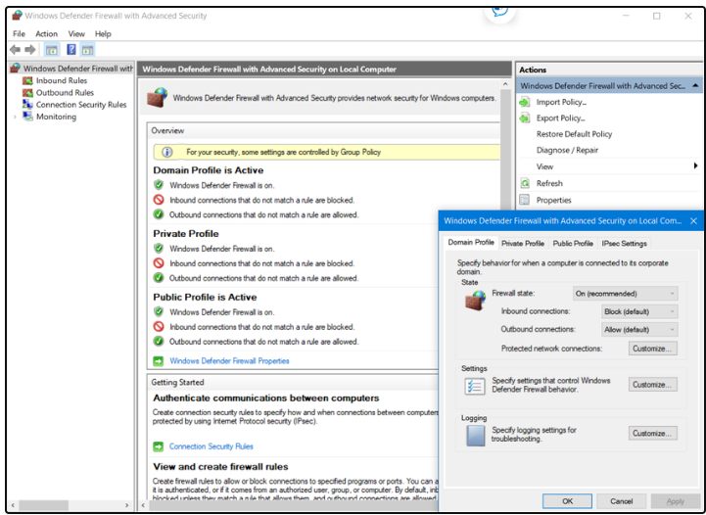
Endpoint Protection
Host-Based Malware Protection (Contd.)
Host-based Firewall
This software is installed on a host.
It restricts incoming and outgoing connections to connections initiated by that host only.
Some firewall software can prevent a host from becoming infected and stop infected hosts from spreading malware to other hosts. This function is included in some operating systems.
For example, Windows includes Windows Defender Firewall with Advanced Security.
Notes:
22 – Endpoint Protection
22.1 – Antimalware Protection
22.1.3 – Host-Based Malware Protection

Slide 8
Endpoint Protection
Host-Based Malware Protection (Contd.)
Host-based Security Suites
It is recommended to install a host-based suite of security products on home and business networks to provide a layered defense that will protect against most common threats.
These include antivirus, anti-phishing, safe browsing, Host-based intrusion prevention system, and firewall capabilities.
Host-based security products also provide telemetry function.
Most host-based security software includes robust logging functionality that is essential to cyber security operations.
The independent testing laboratory AV-TEST provides high-quality reviews of host-based protections, as well as information about many other security products.
Notes:
22 – Endpoint Protection
22.1 – Antimalware Protection
22.1.3 – Host-Based Malware Protection

Slide 9
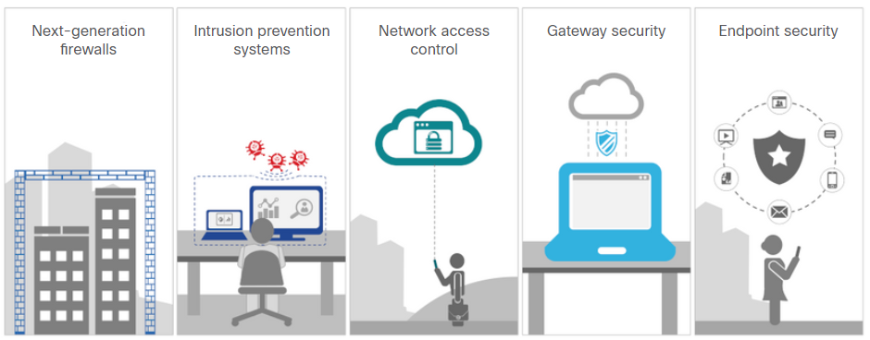
Endpoint Protection
Network-Based Malware Protection
Network-based malware prevention devices are capable of sharing information among themselves to make better informed decisions.
Protecting endpoints in a borderless network can be accomplished using network-based, as well as host-based techniques.
Advanced Malware Protection Everywhere
Notes:
22 – Endpoint Protection
22.1 – Antimalware Protection
22.1.4 – Network-Based Malware Protection

Slide 10
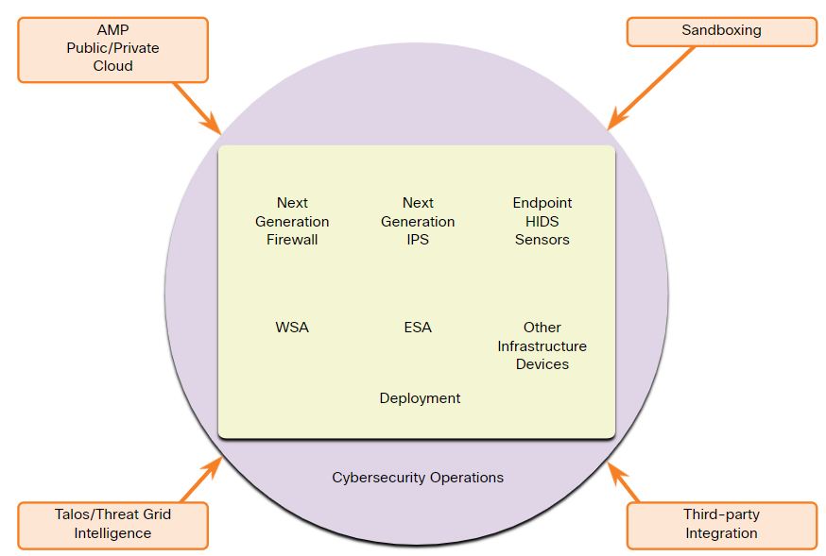
Endpoint Protection
Network-Based Malware Protection (Contd.)
Some examples of devices and techniques that implement host protections at the network level:
Advanced Malware Protection (AMP) - Provides endpoint protection from viruses and malware.
Email Security Appliance (ESA) - Provides filtering of SPAM and potentially malicious emails before they reach the endpoint.
Web Security Appliance (WSA) - Provides filtering of websites and blacklisting
Network Admission Control (NAC) - Permits only authorized and compliant systems to connect to the network.
Notes:
22 – Endpoint Protection
22.1 – Antimalware Protection
22.1.4 – Network-Based Malware Protection
22.1.5 – Check Your Understanding - Identify Antimalware Terms and Concepts

Slide 11
22.2 Host-Based Intrusion Protection
Notes:
Source:
22 – Endpoint Protection
22.2 – Host-Based Intrusion Protection
In-Session Activities / Explanations:
Time: 10 mins
Instructor Notes:
Explain the host-based firewalls.
Provide an overview of HIDS
Discuss HIDS operation
Explain HIDS products
Encourage the learners to complete the CYU on Identify the Host-Based Intrusion Protection Terminology.
Key Points: Host-based Firewalls, HIDS, OSSEC

Slide 12
Host-Based Intrusion Protection
Host-Based Firewalls
Host-based personal firewalls are standalone software programs that control traffic entering or leaving a computer.
Host-based firewall applications can also be configured to issue alerts to users if suspicious behavior is detected.
Some examples of host-based firewalls:
Windows Defender Firewall – First included with Windows XP, Windows Firewall (now Windows Defender Firewall) uses a profile-based approach to firewall functionality.
iptables – This is an application that allows Linux system administrators to configure network access rules that are part of the Linux kernel Netfilter modules.
nftables – The successor to iptables, nftables is a Linux firewall application that uses a simple virtual machine in the Linux kernel.
TCP Wrappers – This is a rule-based access control and logging system for Linux.
Notes:
22 – Endpoint Protection
22.2 – Host-Based Intrusion Protection
22.2.1 – Host-Based Firewalls

Slide 13
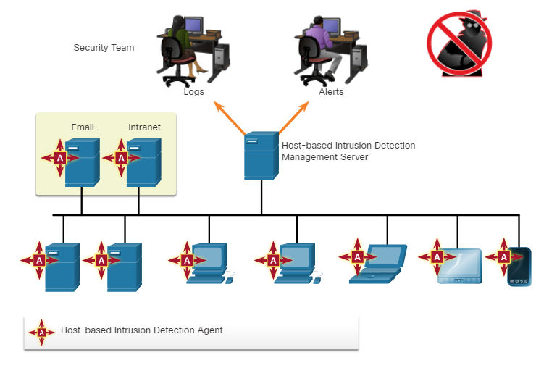
Host-Based Intrusion Protection
Host-Based Intrusion Detection
A Host-based Intrusion Detection System (HIDS) is designed to protect hosts against known and unknown malware.
A HIDS can perform detailed monitoring and reporting on the system configuration and application activity.
HIDS is a comprehensive security application that combines the functionalities of antimalware applications with firewall functionality.
As HIDS must run directly on the host, it is considered as an agent-based system.
Host-based Intrusion Detection Architecture
Notes:
22 – Endpoint Protection
22.2 – Host-Based Intrusion Protection
22.2.2 – Host-Based Intrusion Detection

Slide 14
Host-Based Intrusion Protection
HIDS Operation
A HIDS can prevent intrusion because it uses signatures to detect known malware and prevent it from infecting a system.
Some malware families exhibit polymorphism.
An additional set of strategies are used to detect the possibility of successful intrusions by malware that evades signature detection:
Anomaly based - Host system behavior is compared to a learned baseline model of normal behavior. If an intrusion is detected, the HIDS can log details of the intrusion, send alerts to security management systems, and take action to prevent the attack.
Policy based - Normal system behavior is described by rules, or the violation of rules, that are predefined. Violation of these policies will result in action by the HIDS, such as shut down of software processes.
Notes:
22 – Endpoint Protection
22.2 – Host-Based Intrusion Protection
22.2.3 – HIDS Operation

Slide 15
Host-Based Intrusion Protection
HIDS Products
Most of the HIDS utilize software on the host and some sort of centralized security management functionality that allows integration with network security monitoring services and threat intelligence.
Some examples are Cisco AMP, AlienVault USM, Tripwire, and Open Source HIDS SECurity (OSSEC).
OSSEC uses a central manager server and agents that are installed on individual hosts.
The OSSEC server, or Manager, can also receive and analyze alerts from a variety of network devices and firewalls over syslog.
OSSEC monitors system logs on hosts and also conducts file integrity checking.
Notes:
22 – Endpoint Protection
22.2 – Host-Based Intrusion Protection
22.2.4 – HIDS Products
22.2.5 – Check your Understanding - Identify the Host-Based Intrusion Protection Terminology

Slide 16
22.3 Application Security
Notes:
Source:
22 – Endpoint Protection
22.3 – Application Security
In-Session Activities / Explanations:
Time: 10 mins
Instructor Notes:
Briefly explain attack surface.
Reinforce the difference between blacklisting and whitelisting.
Encourage the learners to gather information on ‘The Spamhaus Project’ and present it in the class.
Describe system-based sandboxing
Key Points: Attack Surface, Blacklisting, Whitelisting, System-based Sandboxing

Slide 17
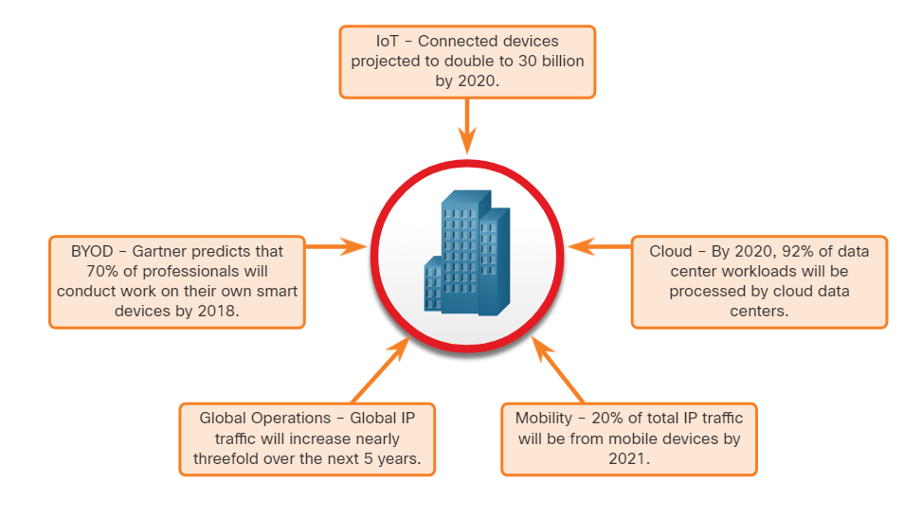
Application Security
Attack Surface
An attack surface is the total sum of the vulnerabilities in a given system that is accessible to an attacker.
It can consist of open ports on servers or hosts, software running on internet-facing servers, wireless network protocols, and users.
Components of the Attack Surface:
Network Attack Surface: Exploits vulnerabilities in networks.
Software Attack Surface: Delivered through exploitation of vulnerabilities in web, cloud, or host-based software applications.
Human Attack Surface: Exploits weaknesses in user behavior.
An Expanding Attack Surface
Notes:
22 – Endpoint Protection
22.3 – Application Security
22.3.1 – Attack Surface

Slide 18
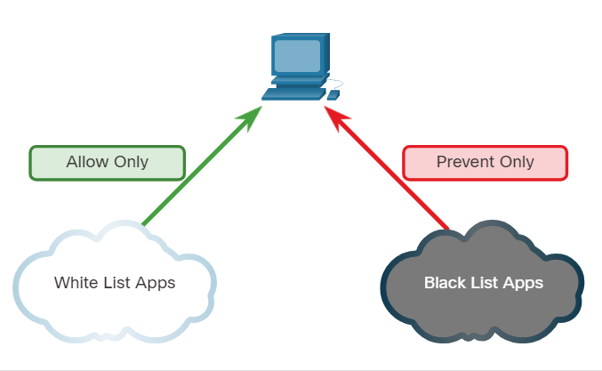
Application Security
Application Blacklisting and Whitelisting
Limiting access to potential threats by creating lists of prohibited applications is known as blacklisting.
Application blacklists can dictate which user applications are not permitted to run on a computer.
Whitelists specify which programs are allowed to run.
In this way, known vulnerable applications can be prevented from creating vulnerabilities on network hosts.
Application Blacklisting and Whitelisting
Notes:
22 – Endpoint Protection
22.3 – Application Security
22.3.2 – Application Blacklisting and Whitelisting

Slide 19
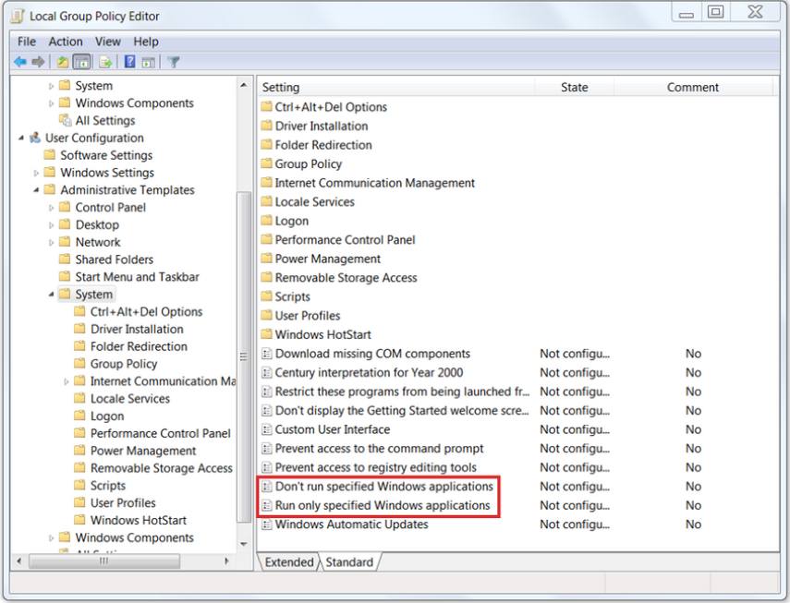
Application Security
Application Blacklisting and Whitelisting (Contd.)
Websites can also be whitelisted and
blacklisted.
These blacklists can be manually created, or they can be obtained from various security services.
Blacklists can be continuously updated by security services and distributed to
firewalls and other security systems that
use them.
Cisco’s Firepower security management
system is an example of a system that can access the Cisco Talos security intelligence service to obtain blacklists.
Notes:
22 – Endpoint Protection
22.3 – Application Security
22.3.2 – Application Blacklisting and Whitelisting

Slide 20
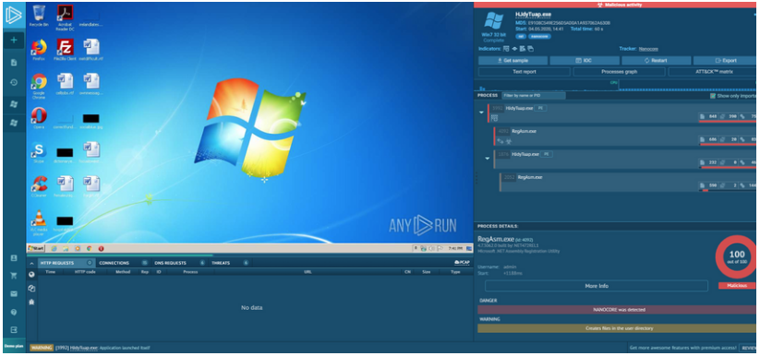
Application Security
System-Based Sandboxing
Sandboxing is a technique that allows suspicious files to be executed and analyzed in a safe environment.
Cuckoo Sandbox is a popular free malware analysis system sandbox. It can be run locally and have malware samples submitted to it for analysis.
ANY.RUN is an online tool that offers the ability to upload a malware sample for analysis like any online sandbox.
Notes:
22 – Endpoint Protection
22.3 – Application Security
22.3.3 – System-Based Sandboxing

Slide 21
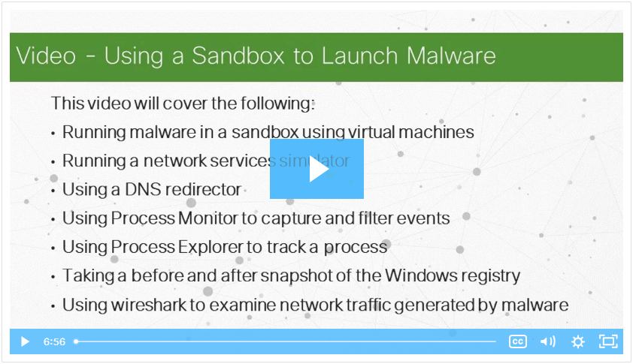
Application Security
Video - Using a Sandbox to Launch Malware
Play the video to view a demonstration of using sandbox environment to launch and analyze a malware attack.
Notes:
22 – Endpoint Protection
22.3 – Application Security
22.3.4 – Video - Using a Sandbox to Launch Malware

Slide 22
22.4 Endpoint Protection Summary
Notes:
Source:
22 – Endpoint Protection
22.4 – Endpoint Protection Summary
In-Session Activities / Explanations:
Time: 5 mins
Instructor Notes:
Read out the summary points mentioned on the slide.
Discuss the same with the participants.
Ask if they have any questions or doubts.
Ensure that the learners complete the module quiz.
Key Points: NA

Slide 23
Endpoint Protection Summary
What Did I Learn in this Module?
Endpoints are defined as hosts on the network that can access or be accessed by other hosts on the network.
There are two internal LAN elements to secure: Endpoints and Network Infrastructure.
Antivirus/Antimalware Software is installed on a host to detect and mitigate viruses and malware.
Host-based firewalls may use a set of predefined policies, or profiles, to control packets entering and leaving a computer.
Some examples of host-based firewalls include Windows Defender Firewall, iptables, nftables, and TCP Wrappers.
HIDS protects hosts against known and unknown malware.
An attack surface is the total sum of the vulnerabilities in a given system that is accessible to an attacker.
Application blacklists dictate which user applications are not permitted to run on a computer and whitelists specify which programs are allowed to run.
Notes:
22 – Endpoint Protection
22.4 – Endpoint Protection Summary
22.4.1 – What Did I Learn in this Module?
22.4.2 – Endpoint Protection Quiz

Slide 24
Module 22
New Terms and Commands
Antivirus/Antimalware Endpoint | Host-based firewall Sandboxing | Host-based Intrusion Detection System (HIDS) Attack Surface
Notes:
22 – Endpoint Protection
New Terms and Commands

