Slide 1
Network Applications
Topics for this weeks sessions:
Introduction to:
Operating Systems
Virtualisation and Containers
File systems

Slide 2
Session objectives
We’ll cover this in the lecture and you can look back at these later:
Examine some basic concepts
The practice session:
Practice-based session objectives

Slide 3
The Practice-based session
View a series of lectures from LinkedIn Learning
You can use headphones or switch on sub-titles
Focus on key concepts:
  Intro: Very brief history of Operating Systems
  Then on LinkedIn the following topics:
    Operating systems, Virtualisation and File Systems
    Note: When accessing LinkedIn don’t forget to login to LinkedIn through the Library link on the left hand side of the SOL page first!

Slide 4
Operating Systems
Presentation –
a “Very Brief history of Operating Systems”
Then on LinkedIn:
    “Network Applications Tutorials”

Slide 5
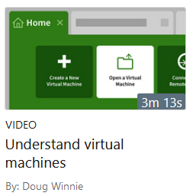
Virtualisation
A virtual machine =
Running one operating system inside of another
Virtualising:
  Memory
  Hark Disk
  CPU
  Network
  etc.
Examples:
    VMWare, VirtualBox, Hyper-V
Watch the presentation on LinkedIn:
  “Understand virtual machines”

Slide 6
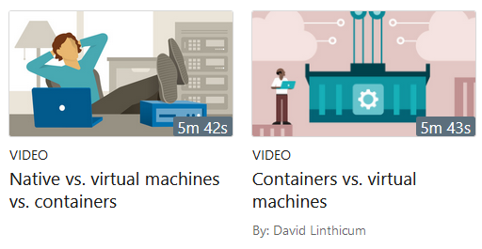
Native versus Virtual Machines and Containers
Native:
  Operating system run directly on host PC
Virtual:
  Virtualised operating system running within host OS
Container: (new concept)
    Virtualise the OS, but share resources with host
    Docker a common implementation
Watch the presentations on LinkedIn:
  “Native vs. Virtual Machines vs. Containers”
  “Containers vs. Virtual Machines”

Slide 7
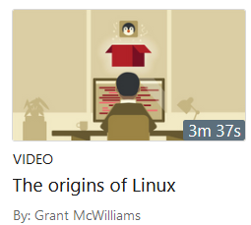
Linux
We will use this on the module so:
Watch the LinkedIn presentation:
  “The origins of Linux”

Slide 8
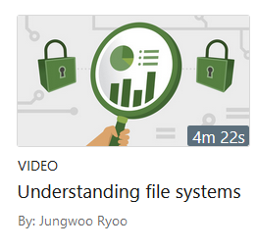
File Systems
We will need to work with file systems
  Create a user group
  Add some users
  Create a folder for the group
  Give the group permissions to use it
Watch the presentations on LinkedIn:
  “Understanding File Systems”

Slide 9
LinkedIn Learning
We’ve covered some selected presentations taken from courses available on LinkedIn
You could enrol on the whole course – they are free to you as a student of Solent University!

Slide 10
What to do in the Practice-based session
Some preparation first!
Look at the Acme case study
Then the LinkedIn Learning presentations and the Internet to answer some questions
Find out how to reference your sources (using the Harvard referencing method)
Note: also try the Windows and Linux referencing exercise

Slide 11
Questions and what to do!
Produce a Powerpoint presentation that answers the following questions:
Q1. Find the names of at least 6 common Linux distros (look on the Internet)
Q2. If Acme want to host both Linux and Windows on a server – how will they do this?
Q3. What is a virtual machine?

Slide 12
Your Powerpoint
Answer the questions on a slide for each question
Paraphrase your answers – DO NOT just cut and paste from the Internet
Cite at least one reference on each slide
Add a reference list on the last slide
Use the Solent Harvard referencing method

Slide 13
Present?
If you want to you can present your answers
If not don’t worry for now ;)

Slide 14
What to do next
Go through the Windows and Linux referencing exercise

Slide 15
Further homework Quiz:
What operating system is Linux based on?
What is the purpose of an Operating System Kernel?
What is the principle benefit of a Virtual Machine?
What are the benefits of a type 1 Hypervisor?
When we Share a folder in Windows – what do we mean by this?
What are Share or NTFS permissions?

Slide 16
Thankyou
End of Session
No need to put anything in your Personal Learning Record for today
But you will next session!

