Slide 1
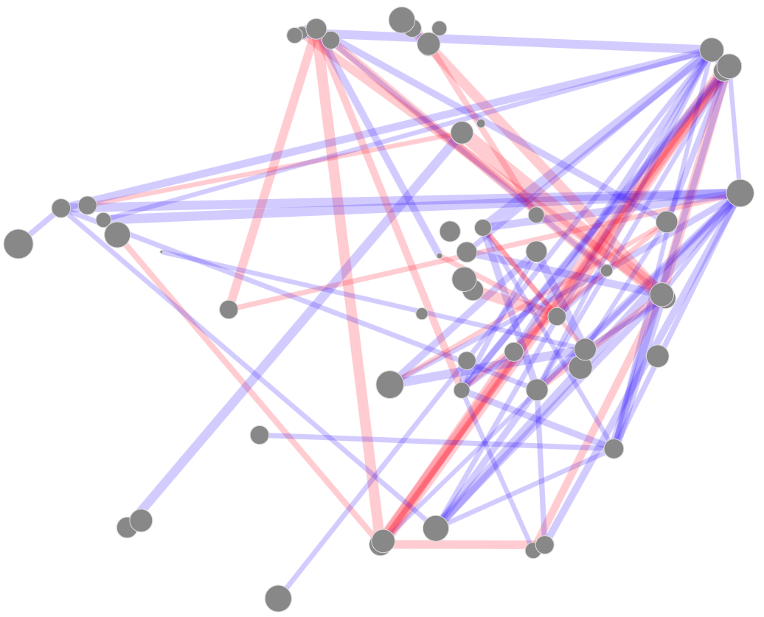
HDAC Inhibitors
PI3K/mTOR Inhibitors
Antibiotics
Antimalarials
Artemisinin Antimalarials

