Slide 1
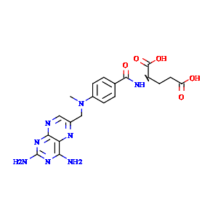
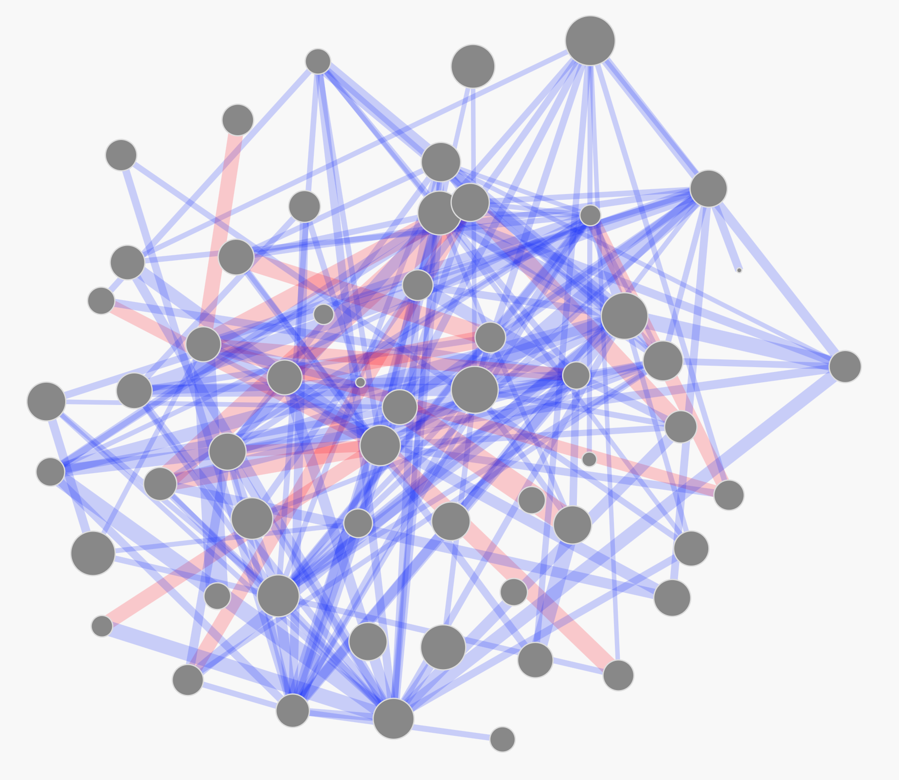
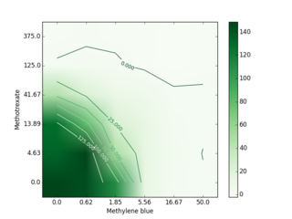
Morg2_2048
00010001…
Morg2_2048
(0.4, 1.8)
compounds
descriptors
2D coordinates
{compounds: {…},
representations: {red_alg:{…}},
combinations: {…}}
Gamma
0.8208
pGamma
0.08574
JSON
Visualization
combinations
synergy metrics
Standardized synergy metrics
Python
JavaScript

