Slide 1

Pac-Wars
Lewis Burke - 22201368
Mark Thwaite - 22202188

Slide 2
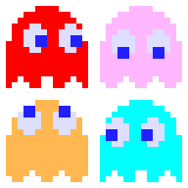

Game Introduction
The big dog PacMan himself THE Ghosts
PacMan must get as many coins as humanly possible
*accurate representation*:

Slide 3
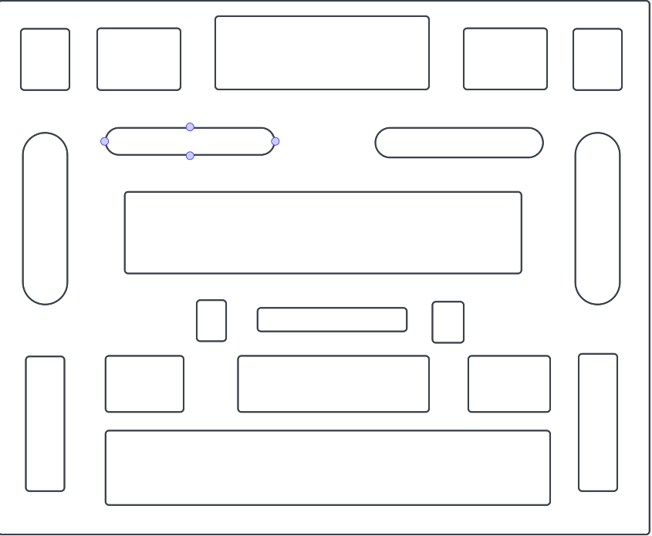
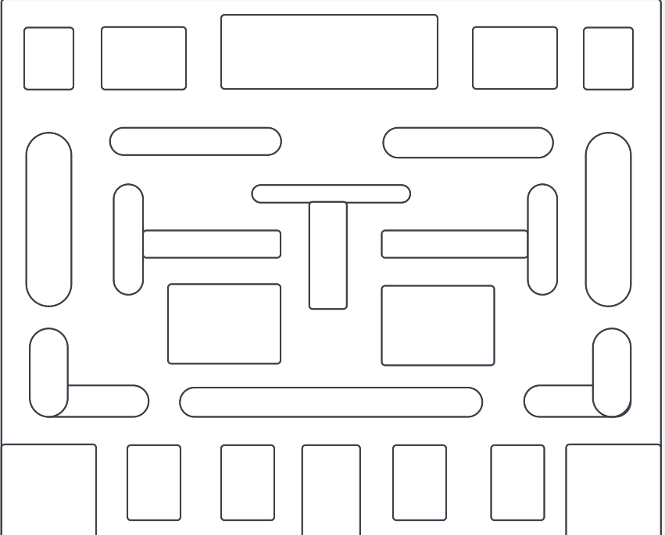
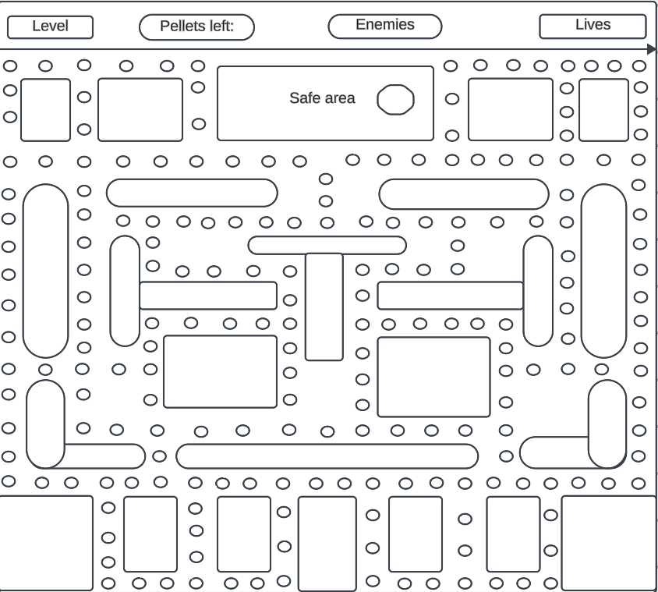
Design considerations
Preparation
Before coding, we created design mockups charts for what we ideally wanted our game to look like.
Which classes were identified any why?
Coin class - Collectable coins
PacmanPlayer - The player, logic behind the player movement, speed, model direction etc
PacmanGUI - GUI for the game
PacmanBoard - The logic for the game, where the map is created, the game rules and more.
Ghost class - logic for the ghost AI, movement speed, how it seeks a player via the best routes etc
Honourable mention: Orange class, was supposed to spawn every 25 points and give the player 10 points
Extra considerations:
Oranges that’d spawn later on that can be collected for more points, once a player reaches a certain amount of points there would be a boss battle and the ability to tank 3 ghosts (health bar)

Slide 4
Game development
Issues we overcame
The ghosts spawning based on your score (10, 30, 50, 75)
We managed to created multiple NPC’s that seek the player
We managed to stop the NPC’s from spawning inside the walls, unable to move
Coins ACTUALLY spawn inside the map, rather than outside of it
We created a clean map, rather than 2 lines
Pacman actually looks in the direction he’s moving rather than randomly looking backwards.

Slide 5
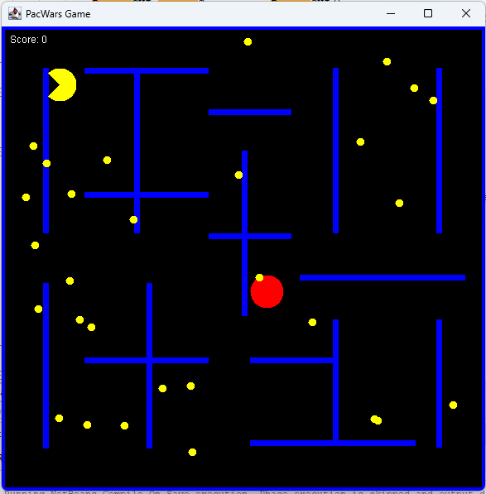
Demonstration
https://drive.google.com/drive/folders/11M1ViiSODE3bVeerlil_CiUkv5fgDm5p?usp=sharing

Slide 6
Evaluation
Lessons learned and what we would improve:
Teach the AI to be more intelligent.
Use an easier programming language, I think we made this a lot harder for ourselves by using Java.
Create way more classes to split the payload of code rather than trying to jam in heaps of it into 5 classes.

