Slide 1

Work Stealing Algorithm
Present by: Xin Yang
Hao Li Chen
Xiao Tian Wang

Slide 2
What is it?
Working stealing is a scheduling algorithm which achieves an efficient dynamic load-balancing.

Slide 3
The Classical Work-Stealing
Serveal libraries and languages like Cilk, TBB, Satin, Kaapi, Charm++, X10
Worker is a processor which has some work to do. Its stack may be empty or not. During the execution of a task, the worker creates some tasks. All such tasks are pushed onto the stack.
A thief is a processor which has no work to do. It therefore tries to steal work from others.

Slide 4
How does an idle processor choose which processor to steal
Random choice is efficient. The victim choice does not require more information than the total number of processors

Slide 5
Work-stealing algorithms can be divided into two broad classes, according to the type of information that they use for the target selection:
i) algorithms that only use static information about network topology.
ii) algorithms that also use dynamic load information.

Slide 6
Algorithms That Use Only Network Topology Information
Random Stealing (1999)
Hierarchical Stealing (1996)
Cluster-aware Random Work-Stealing (2001)

Slide 7
Random Stealing
Where a thief always selects a random target.
When looking for work, each thread first examines its own job queue. When this job queue is empty, it randomly selects another thread and takes the first job on its job queue.
This strategy is the default, and has in the past been proven to be optimal, although that might seem counter-intuitive.

Slide 8
Hierarchical Stealing
Where nodes are organized into a tree, according to communication latencies. A thief first tries stealing from closer nodes (i.e. its descendants in the tree). If it fails to obtain any work there, it attempts to steal from its parent, which then repeats the same procedure.

Slide 9
Cluster-aware Random Work-Stealing
Where each node divides the set of all other nodes into two sets:
i) nodes from the same cluster (local nodes)
ii) those outside of it (remote nodes).
A thief attempts to steal in parallel from a random local node and a random remote node.In this way, thieves hope to obtain work locally, but remote stealing will prefetch work. Thieves prefer closer clusters.

Slide 10
Disadvantages
Perform well for regular D&C applications
But have problems for highly-irregular applications.
In such applications, all the tasks may be concentrated on relatively few nodes, and the randomised way of selecting targets that is employed by these algorithm can consequently perform badly.

Slide 11
Some work-stealing algorithms use dynamic load information to estimate the size of node task pools, and so inform the choice of target.

Slide 12
Algorithms That Use Dynamic Load Information
Centralised Load Information:
Fully Centralised Methods
Hierarchical Load-Aware Stealing (2002)

Slide 13
Centralised Load Information
A fixed set of nodes is responsible for managing load information. These nodes act as routers for steal attempts, forwarding them to targets.

Slide 14
Fully Centralised Methods
Where all nodes periodically send their load information to a single central node. A thief sends a steal attempt to the central node, and this is forwarded to the victim that is nearest to the thief.

Slide 15
Hierarchical Load-Aware Stealing
Each node periodically sends its load information to its parent. Based on its load information, a thief then attempts to steal from a child with non-zero load. If all children have zero load, the steal attempt is sent to the thief’s parent, which then repeats the same procedure for finding work.

Slide 16
Disadvantages
The main appeal of such algorithms is that load information is updated regularly, and it will therefore be relatively accurate.
However, this also means that significant strain may be placed on the central nodes, since they have to communicate frequently with the rest of the system. For high-latency networks with fine-grained tasks, this information may also be inaccurate.

Slide 17
Algorithms That Use Dynamic Load Information
Distributed Load Information:
(Each node holds its own approximations of the load of all other nodes.)
Grid-GUN Stealing (2006)
Cluster-Aware Load-Based Stealing (2001)

Slide 18
Grid-GUN Stealing
In this algorithm, timestamped load information is attached to each stealing-related message.
The receiver of a message compares this information against its own load information, and updates both the information that is contained in the message (if the message is to be forwarded further) and its own load information. Provided that nodes frequently exchange load information, they will then obtain good approximations to the system load.

Slide 19
Disadvantages
However, the accuracy of the load information that a node has (and, conversely, that the rest of the system has about that node) depends on how often it communicates with the rest of the system.
An isolated node can easily have outdated load information, and the rest of the system may also have outdated information about its load.

Slide 20
Cluster-Aware Load-Based Stealing
Like the CRS algorithm, the CLS algorithm considers only two levels of communication latencies (local and remote). In each cluster, one node is nominated as a central node, and every other node in the cluster periodically sends its load information to this node. All nodes in the cluster, apart from the central node, perform only (random) local stealing. When the central node determines that the load of the cluster has dropped below some threshold, it initiates remote stealing from a randomly selected remote node.

Slide 21
Disadvantages
Firstly, tasks that are stolen remotely are always stored on central nodes, which means that additional messages are needed to distribute these tasks to their final destinations.
Secondly, as with CRS, when all tasks are concentrated on a few nodes, random remote stealing may be unacceptable.

Slide 22
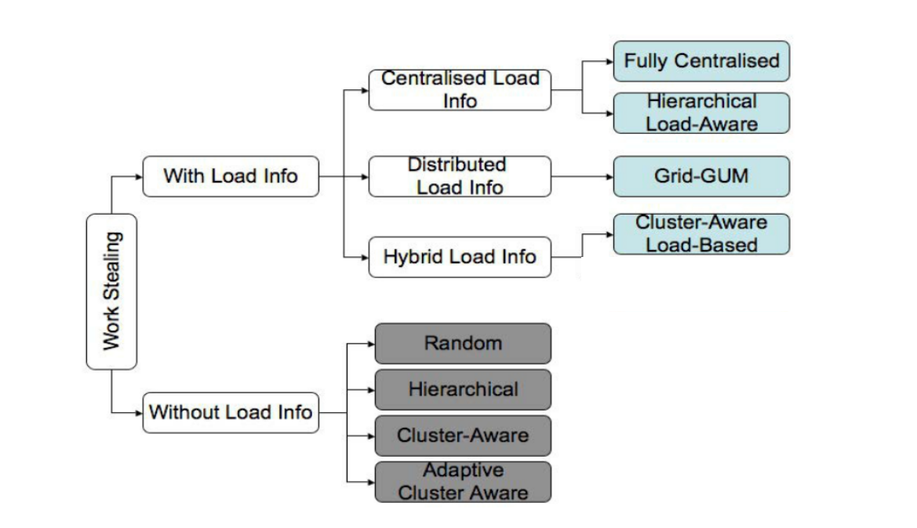
2002
2006
2001
1999
1996
2001
2001

Slide 23
Hierarchical Work-stealing Strategy
HWS has been designed after observing the behavior of the classical work-stealing algorithm on serval applications.
The main idea behind HWS is to use the same mechanism at the cluster level.
Thus, we suggest stealing in a single attempt, a large amount of work inside the target cluster.
The platform is divided in some processors groups which are sets of processors connected with a fast link. Eg. It could be a cluster or the set of cores in one processor.
In each group, only one processor sends remote steal requests which called leader

Slide 24
Each role in HWS
Leader - Send remote steal requests in HWS
Slave – Do the majority of the load
Since the number of remote steal requests is decreased, we want remote thieves to steal a larger amount of work.
Cluster 1
Cluster 2
Leader
P1
P3
Leader
P2
P4
Slave
Slave

Slide 25
Types of tasks
Global tasks
- They can be stolen between groups
- Centralized on the leader
Local task- They belong to single group
Cluster 1
Cluster 2
P1
Global task
P3
Local task
P2
P4

Slide 26
Each role of processor in cluster
To distinguish tasks with a large amount of work, a limit is given by the user.
Global tasks have a level below the limit (small tasks )
Local tasks have a level higher than the limit (big tasks)
Cluster 1
Global task
P2
Local task
P1
P3
P4
Local task
Local task

Slide 27
Each role of processor in cluster
Leader execute only global tasks and balance the loads between groups and manage the load inside the groups.
Slave perform classical work- Stealing algorithm inside the group
Cluster 1
Global task
P2
Local task
P1
P3
P4
Local task
Local task

Slide 28
Experimental validations
HWS is comparing with the classical work-stealing, Kaapi work-stealing and CRS.
Application Merge Sort, the goal is to sort an array of four GB. This was selected because it induces a large amount of communications.
Application N-queen problems, this application spawns many tasks but each task transfer only a little amount of data.

Slide 29
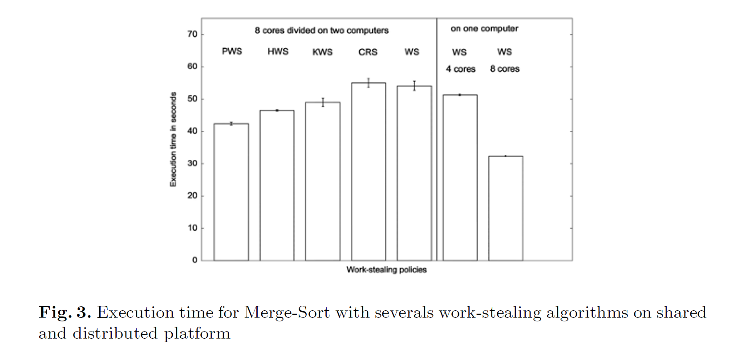
Experimental validations

Slide 30
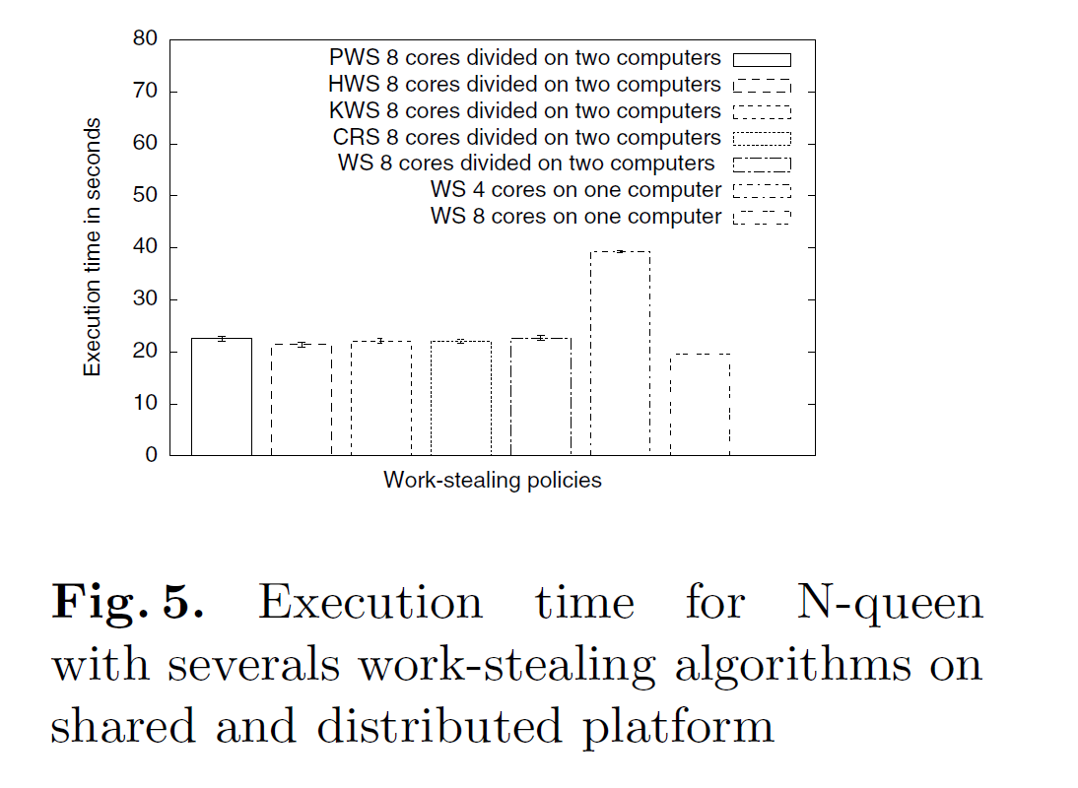
Experimental validations

