Slide 1

Fundamentals of Physics Simulation

Slide 2
Multi‑Joint dynamics with Contact
Suitable for robotics, biomechanics and reinforcement learning
Introduction to bodies, joints, actuators and contacts

Slide 3
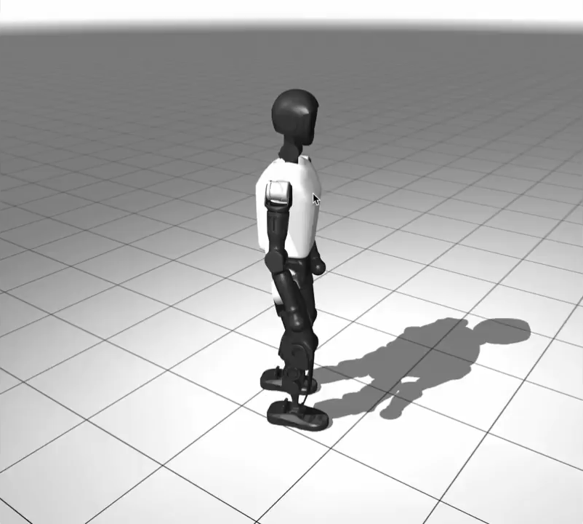
What is MuJoCo?
[1] K. Zakka et al., "Mujoco playground," arXiv preprint arXiv:2502.08844, 2025.
Notes:
Created by Emanuel Todorov, now maintained by Google DeepMind.
A simulation software allowing for reinforcement learning and sandboxing of physical robots and biomechanics.
Can achieve all sorts of things with this basic framework.
Interacts cleanly with well-known programming languages, notably Python and C.

Slide 4
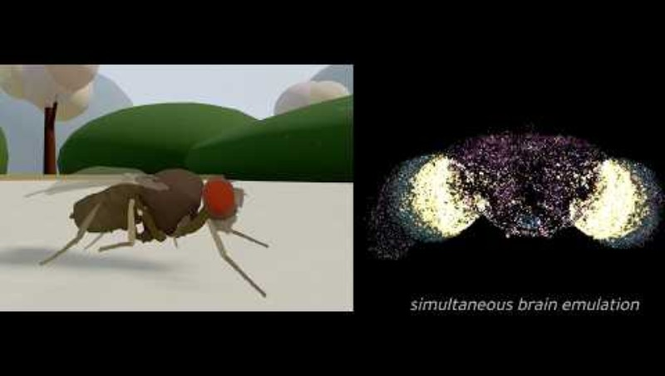
Cutting-edge

Slide 5
What does it do?
Simulates how mechanical systems move under forces
Computes motion of linked bodies (robots, mechanisms, limbs)
Handles collisions and contacts
Solves rigid body dynamics efficiently and deterministically

Slide 6
Why MuJoCo?
Fast simulation
Stable contact modelling
Flexible modelling system
Strong Python integration
Widely used in robotics research (good support)

Slide 7
Core Concept: Bodies
A body represents a physical object
Has mass and inertia
Exists within a hierarchical structure
Bodies can contain joints and geometries

Slide 8
Joints
Defines how bodies move relative to each other
Comes in various types i.e. Hinge, Slide, Ball, Free

Slide 9
Geometries (Geoms)
Define the physical shape of objects
Used for collision detection
Common types: Sphere, Box, Capsule, Mesh
Bodies move; geoms define collision

Slide 10
Actuators
Actuators apply forces or torques
Examples: Motors, Position, Velocity etc.
Used to control joints

Slide 11
World Body
World-body
Joint0
(Free or Not)
Free or Anchored Robot
Body0
Joint0x01
(Free or Not)
Body01
Joint01x010
(Free or Not)
Body010
Joint0x00
(Free or Not)
Body00
Joint00x001
(Free or Not)
Body001
Joint001x0010
(Free or Not)
Body0010
Joint00x000
(Free or Not)
Body000

Slide 12
Contacts
(aside)
Contacts occur when geoms collide
MuJoCo solves contact forces to prevent penetration
Important for robotics, locomotion and manipulation
Handled using efficient constraint solving

Slide 13
Model Definition (MJCF XML)
MuJoCo models are defined using XML
Structure includes: Bodies, Geoms, Joints, Actuators
Also Sensors, Tendons, etc.
Describes the robot and environment

Slide 14
Typical MuJoCo Workflow
1. Create model XML
2. Load model in API (i.e. Python/C)
3. Apply controls
4. Run simulation steps
5. Read sensor outputs

Slide 15
Goals for today’s session:
Practice reading and writing MuJoCo XML
Apply physics knowledge to simulated environment
Familiarise yourself with the MuJoCo documentation.
XML Reference - MuJoCo Documentation

Slide 16
Further Work
Control a MuJoCo simulation using an external API i.e. Python.
Recommended Tutorial Series:
https://youtube.com/playlist?list=PLc7bpbeTIk75dgBVd07z6_uKN1KQkwFRK&si=14EhJctPgv66PEp9

Slide 17
Task 1
Load up MuJoCo Simulate
Drag the task_1.xml file into the simulator.
Use the controls to make the box stand on it’s smallest side without modifying the xml. Hint: (CTRL left and right click will help)
Play around with the ‘Frame’ option under Rendering, can you display the body frames?
Now look at the xml, can you determine why the box can move freely but the ball is fixed? Can you edit the file to allow the ball to move?
Can you use the frame and the xml file to determine which axis corresponds to each colour?
Try adding more boxes and balls to the xml and ensure they do not overlap. Can you change the direction of gravity within the xml?

Slide 18
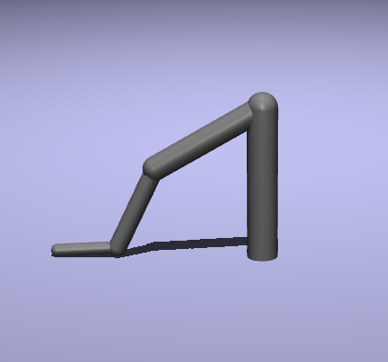
Task 2
Open task_2.xml and drag it into the simulating window.
There are 3 joints, but only one is actuated. Try to change the actuator output in the control panel on the RHS. Why doesn’t it work? Can you change the xml to increase the force of the motor?
Now add the other two actuators, note that they are contained in the same <actuator></actuator> block as the first.

Slide 19
Task 2 cont.
Change actuator_0 to be a position servo with these values:
<position name="actuator_0" joint="joint_0" gear="1.0" kp="10.0"/>
How does this actuator behave differently to the motor? Mess around with the control for it in the control panel.
Why does the system oscillate with this type of actuator?
Replace your other two actuators with identical position actuators then perturb the system.
Can you change something about the joint dynamics to keep the system stable when actuated by 0,0,0?
What can you change about the position actuators to assist in this?

Slide 20
Further Tasks
Turn your model into a projectile-launching arm. Add a box somewhere like you did in task 1.
Launch this box as far as possible under normal gravity and friction.

