Slide 1
ENTERPRISE RISK MANAGEMENT ANALYTICS • GROUP 10
Triangulating the Risk Profile
An Enterprise Risk Management Analysis of Pfizer’s $43B Acquisition of Seagen
Amaka Mary Nduka • Dike Liu • Princess Mariama Ramboyong • Stella Kafui Sabuki
Signature Assessment — Live Session, June 2026
Notes:
GROUP OPENING (Amaka). Welcome the panel. One line: 'We assessed whether Pfizer can realize the $10 billion revenue thesis behind its $43 billion Seagen acquisition, using a full ERM analytics pipeline.' Introduce the four presenters and the running order, then hand to the agenda slide.

Slide 2
AGENDA & SPEAKER ROLES
Presentation Roadmap
1
Amaka Mary Nduka
The deal, why it is a risk problem, and the risk register
Background & Risk Identification
2
Dike Liu
Scenario & Industry Fusion analytics, severity, the heatmap
Qualitative Risk Assessment
3
Princess Mariama Ramboyong
Monte Carlo, machine learning prediction, integrated situation assessment
Quantitative Risk Assessment
4
Stella Kafui Sabuki
Treatment strategies, trigger points, recommendations
Response, KRIs & Conclusion
Evaluated as a group and individually — each presenter owns and answers questions on their slot.
Notes:
Amaka walks the running order in 30 seconds. Stress that each member owns their section end-to-end and will field questions on it, since we are graded individually as well as as a group. Note we will also bridge into Module 6 themes in the live discussion. Hand to the first section divider.

Slide 3
01
PRESENTER 1
Amaka Mary Nduka
Background & Risk Identification
Slot 1 · ~4 minutes
Notes:
Transition line: 'I’ll set the scene — what Pfizer bought, why it’s risky, and how we turned that into a structured register.'

Slide 4
BACKGROUND
Pfizer–Seagen Acquisition at a Glance
$43B
4 ADCs
$71.9B
$10B
Largest biopharma deal since 2019; Pfizer’s oncology reset
ADCETRIS, PADCEV, TIVDAK, TUKYSA acquired
Post-deal debt — nearly doubled from $35.8B
Risk-adjusted ADC revenue Pfizer projects by 2030
Why Pfizer did it
Pfizer faces a ~$17B patent cliff through 2030 (Eliquis, Ibrance, Xeljanz losing exclusivity).
Seagen’s antibody-drug conjugate (ADC) linker-payload platform + Pfizer’s antibody library = a precision-oncology growth engine.
The deal doubled Pfizer’s oncology pipeline to 60 programs and is expected to deliver ~$1B in annual synergies by 2026.
Our question is whether Pfizer can execute it under competitive, financial and regulatory pressure.
Notes:
Amaka. Hit the four numbers fast — they frame everything. $43B and $10B are the promise; $71.9B debt is the strain. Then the 'why': patent cliff + ADC platform. Land the pivot: the strategic case is documented; the risk lives entirely in execution. That sentence sets up every later section.

Slide 5
BACKGROUND
Four Connected Pressures Behind the Deal’s Risk
Competitive
Financial
Organizational
Regulatory
AbbVie, Merck, BMS and Gilead committed >$15B to ADCs during Pfizer’s Seagen integration
Near-doubled debt limits the flexibility to fund the R&D needed for the deal’s upside.
A 3,400-person science-led firm is being integrated into an 80,000-person enterprise. Scientific talent is the asset.
The Inflation Reduction Act creates pricing pressure on ADCETRIS and future Seagen products.
The ERM lens
We treat these as a connected system, not a checklist — e.g., chasing the $1B synergy target can accelerate the very talent loss the deal’s science depends on. The rest of our analysis quantifies this interaction view (COSO 2017; ISO 31000).
Notes:
Amaka. Walk the four cards left to right. The payoff is the dark band: these pressures are coupled. Give the concrete loop — synergy pressure → layoffs → scientists leave → the platform you paid $43B for walks out the door. That 'connected system' idea is our thesis and earns the interaction-view framing from COSO/ISO.

Slide 6
IDENTIFICATION OF RISKS
From SWOT to a evidence-based 20-risk register
Method: evidence-based “Better SWOT”
A risk entered the register only if it was (1) grounded in verifiable evidence, (2) trackable by a leading indicator, and (3) a distinct driver — not a restatement.
What changed
Based on instructor feedback we expanded the register from 16 to 20 risks, adding cybersecurity, ESG/workforce, payer concentration and FX exposure across five categories.
One Critical and five High risks — all competitive or financial — concentrate the exposure.
Notes:
Amaka. Two ideas: (1) identification was disciplined, not brainstorming — three admission tests keep the register evidence-based. (2) The chart is the headline: severity is lopsided — 1 Critical, 5 High, and they cluster in competitive/financial risks. That is exactly why only three risks go forward to full quantification. Hand to Dike: 'Dike will show how we scored these and which three advance.'

Slide 7
02
PRESENTER 2
Dike Liu
Qualitative Risk Assessment
Slot 2 · ~4 minutes
Notes:
Transition: 'Thanks Amaka. With twenty risks identified, the question is how severe each is — and which deserve a full quantitative model.'

Slide 8
QUALITATIVE RISK ASSESSMENT
Two analytics lenses, one 1–10 scale
Scenario Analytics
Industry Fusion Analytics
Projects how each risk unfolds under Pfizer’s specific acquisition conditions— e.g., the 18–24-month window when Seagen talent is most poachable, or the IRA negotiation timeline for ADCETRIS.
Triangulates each risk against the wider oncology/ADC environment rather than Pfizer alone — this helped identify the competitive pressure: the rivals invested >$15B into ADCs in the same window.
Why a 1–10 scale, not High/Med/Low
Finer granularity lets us rank within a band and feed the numbers straight into the quantitative model. Risk Score = Likelihood × Impact. Owners were assigned by expertise; scoring disagreements were resolved against evidence, not by averaging.
Notes:
Dike. Keep it crisp. Scenario Analytics = depth on each risk's storyline; Industry Fusion = breadth against competitors. The 1–10 scale matters because it makes the qualitative output quantitative-ready — Likelihood × Impact becomes the score that the next section models. Mention the governance point (owners by expertise, evidence-based scoring) — graders reward that the scores aren't arbitrary.

Slide 9
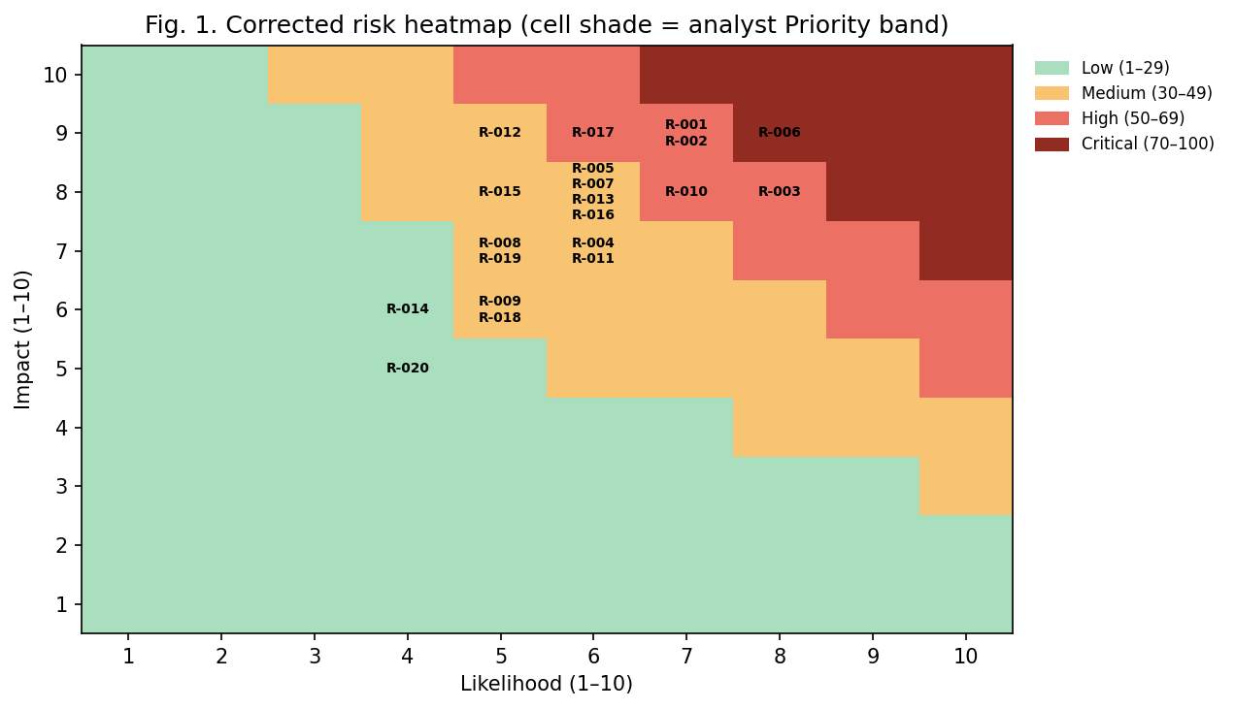
QUALITATIVE RISK ASSESSMENT
Corrected risk heatmap and risk priorities
Key takeaways
We fixed an inconsistency: the old rule-based shading contradicted the register. The map now uses the same Priority bands the register uses.
Exposure clusters in the upper-right — a few competitive and financial risks account for almost all Critical/High severity risks.
Three advance to full quantitative treatment: R-MSE (market-share erosion), R-006 (talent attrition), R-010 (combination-therapy upside).
Notes:
Dike. First, the correction — it shows we acted on feedback and care about internal consistency (good for the Mechanics/quality marks). Then read the picture: the danger lives in the top-right corner, and it's competitive/financial. Name the three risks that go forward and WHY each qualifies (large exposure, observable indicators, decision hinges on the distribution). Hand to Princess: 'Princess now puts real numbers on these three.'

Slide 10
03
PRESENTER 3
Princess Mariama Ramboyong
Quantitative Risk Assessment
Slot 3 · ~6 minutes
Notes:
Transition: 'Thanks Dike. Three risks earned a full quantitative model — here is the methodology and what the numbers say.'

Slide 11
QUANTITATIVE RISK ASSESSMENT
Our quantitative approach
1
2
3
4
Convert
Model
Measure
Validate
Covert qualitative scores into probability and impact inputs
Model uncertainty using triangular distributions (PMI 1996; Vose 2008) and 100,000 Monte Carlo iterations
Expected loss, variance, and value-at-risk for each risk
Validate results through sensitivity analysis + cross-check vs. the qualitative ranking
Why this design
The workflow mirrors our reference case study (Khadem et al., 2018): qualitative scoring → numeric inputs → simulation → validation. Triangular distributions are the standard choice when we have expert three-point estimates (min / most-likely / max) but no long historical frequency record — exactly our situation. Impact ranges come from the team’s DCF stress testing.
Notes:
Princess. Walk the four steps as a pipeline — emphasise it is the same method as the assigned Oman case study, which signals rigor. Justify triangular distributions in one breath: three-point expert estimates, no long history. Note impact ranges are not guesses — they come from DCF stress testing (a 10% revenue miss = ~$4.4B value loss; 20% = ~$9.6B).

Slide 12
QUANTITATIVE RISK ASSESSMENT
Monte Carlo results across three priority risks
−$2.66B
−$0.37B
+$0.83B
R-MSE expected loss — the largest exposure (SD $1.06B)
R-006 expected loss — highest probability at 55%
R-010 expected value — a genuine, time-limited upside
Reading the results
Biggest money risk ≠ most likely risk.
R-MSE creates the largest financial exposure; R-006 is the most likely to happen (>50%) but has a smaller dollar impact per event; R-010 provides a time-limited upside that offsets these two risks.
Variance / SD is required output — it shows R-MSE is also the most dispersed, so contingency must be sized to the tail, not the mean.
Notes:
Princess. The three callouts are the story in one line each. Then the key insight: the biggest-dollar risk and the most-likely risk are different risks — that is something a single point estimate would hide and is exactly why we simulate. Point at the VaR chart: at the 90th percentile R-MSE alone is $6.67B. Stress that variance/SD isn't decoration — it's a required deliverable and it tells the board to reserve against the tail.

Slide 13
QUANTITATIVE RISK ASSESSMENT
Sensitivity, validation, and tail risk
SENSITIVITY
TAIL RISK
VALIDATION
~80%
4.7%
Match
Around 80% of expected-loss variance is driven by IMPACT, not probability — so tightening the dollar estimate beats refining the odds.
There is a 4.7% chance that the combined threats exceed $8B in a given assessment (P90 combined ≈ $7.07B) — supporting the need for contingency planning.
The Monte Carlo ranking agrees with the qualitative ranking — the two methods corroborate each other.
Together these three checks turn a simulation into decision support: where to focus analysis (impact), how much to reserve (tail), and whether to trust the result (validation against the qualitative view).
Notes:
Princess. Three moves borrowed from the case study. Sensitivity: impact drives ~80% of variance — so refine the DCF, not the probability guess. Tail: ~4.7% chance combined threats top $8B — that is the contingency argument. Validation: the model's ranking matches the qualitative ranking, which is how we know it's not noise. End on the dark band: these three checks are what make it decision-grade, not just a number.

Slide 14
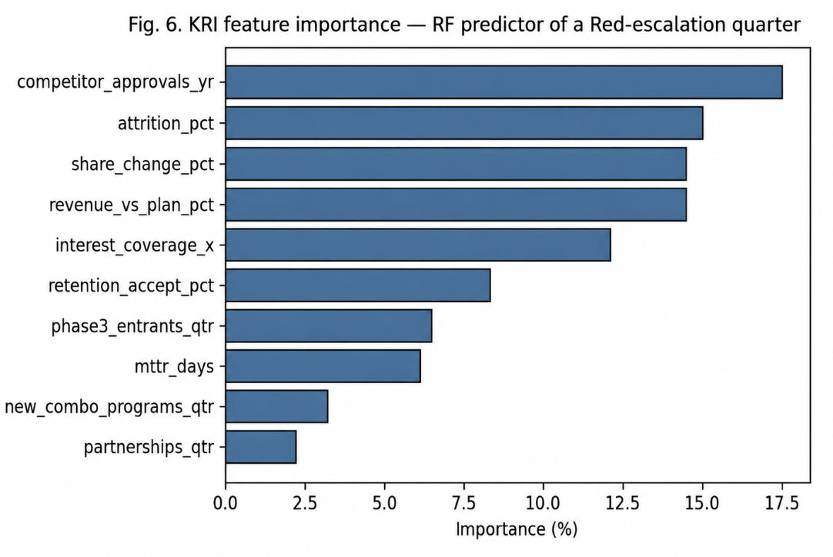
QUANTITATIVE RISK ASSESSMENT
Machine-learning risk prediction
The setup
No real Pfizer-Seagen outcome history exists, so we built a justified 600-row dataset whose features ARE our KRIs (competitor approvals, attrition, share change, coverage…) and predicted whether a quarter crosses the Red escalation threshold.
0.85
0.93
Cross-validated accuracy (Random Forest)
Cross-validated ROC-AUC
Figure 6 — KRI feature importance
The model independently re-discovers the same top-5 drivers our register flags — construct validation: the KRIs and the data agree.
Notes:
Princess. Address the obvious question up front: where's the data? We generated a documented synthetic dataset, and crucially its features are our actual KRIs — that satisfies the 'feature selection aligned with KRIs' requirement. Metrics are strong (0.85 acc, 0.93 AUC). The punchline is the chart: the model, trained only to predict escalation, ranks the same five indicators we prioritised by hand — independent corroboration. Be honest on limits: it validates the workflow, not Pfizer-specific odds.

Slide 15
QUANTITATIVE RISK ASSESSMENT
Integrated situation assessment
How the environment feeds the model inputs
Business environment
Non-business environment
ADC market growth of 9–14% CAGR → sets the R-MSE impact range (share loss is judged against an expanding market).
Near-doubled debt → reduces Pfizer’s flexibility to fund R&D that captures R-010’s upside.
Payload-conjugation capacity concentrated in a few contract manufacturers → creates a supply-chain ceiling on scale-up (R-007).
IRA litigation now closed (3rd Circuit, 2025) → the $1–3B R-003 impact is modelled as near-certain, tightening the R-002 downside.
Rapid ADC innovation (dozens of new entrants/yr) → R-010’s first-mover window is time-bound, so its probability input is held at 50%.
Geopolitical supply concentration → reinforces the manufacturing risk above.
Notes:
Princess. This is the 'so what' for the model inputs — every assumption traces to a real-world driver. Give one example each side: market CAGR sets the impact range; the IRA court ruling is why we treat R-003 as near-certain rather than a maybe. The message: our distributions aren't invented — the business and non-business environment chose them. Hand to Stella: 'Stella will turn all of this into action.'

Slide 16
04
PRESENTER 4
Stella Kafui Sabuki
Response, KRIs & Conclusion
Slot 4 · ~5 minutes
Notes:
Transition: 'Thanks Princess. Numbers only matter if they drive action — here is how we respond and monitor.'

Slide 17
RISK RESPONSE STRATEGY
Risk response strategies for priority risks
R-006 Talent Attrition
Mitigate
Retention equity, R&D independence, exec sponsorship, non-solicitation
R-MSE Share Erosion
Mitigate + bounded acceptance
Accelerate pipeline & real-world evidence; accept normal share swings
R-002 / R-001 Revenue & Coverage
Mitigate
Ex-US launch, IRA haircut built into base, pre-authorised CAPEX deferral
R-003 IRA Pricing
Accept + manage timing
Litigation foreclosed; lifecycle management + PhRMA engagement
R-010 Combination Upside
Exploit / enhance
Push 4+ programs/qtr; lock academic-center partnerships first
R-017 Cybersecurity in Integration
Mitigate
Zero-trust segmentation, same-day SOC ingestion, MFA, vendor diligence
Each choice weighs internal conditions (balance sheet, structure) against external ones (rivals, regulation) — not one default strategy applied across the board.
Notes:
Stella. Don't read every row — group them. Most are Mitigate, but two are deliberately different: R-003 we Accept (the courts closed the alternatives, so we plan around it), and R-010 we Exploit (it's a positive risk). That range shows we matched strategy to the specific risk and to internal vs external conditions, which is exactly what the rubric rewards.

Slide 18
KEY RISK INDICATORS & TRIGGER POINTS
KRIs and trigger points for priority risks
Risk / KRI
GREEN
AMBER
RED — escalate
R-006 — critical-scientist attrition
< 5% annualized
5–8%
> 8% or any named-scientist exit
R-MSE — ADC market share
≥ 22% share
18–21%
< 18% or 4+ rival Phase III/qtr
R-001 — interest coverage
≥ 1.5×
1.2–1.5×
≤ 1.0×
Thresholds are grounded in published benchmarks (EY M&A turnover, biotech baseline, ADC market CAGR) — not team guesses — and each KRI maps to a named owner and escalation action.
Notes:
Stella. The whole point of a KRI is that someone acts before the loss, not after. Walk one row end-to-end — attrition: green under 5%, amber 5–8%, red above 8% or any named scientist leaving, which escalates to the CHRO/CEO. Emphasise thresholds are benchmarked to evidence (EY, biotech baseline, market CAGR) and each has an owner. These same indicators are the ML features from Princess's section — one shared definition of risk.

Slide 19
RISK TREATMENT & RESPONSE PLAN
From risk assessment to an owned, monitored plan
Risk | Response | Residual risk after treatment | Owner
R-006 Talent attrition | Mitigate | Moderate — reduced, not eliminated (55% modeled) | CHRO / IMO
R-MSE Share erosion | Mitigate + accept | Elevated — largest dollar exposure; bounded | CSO / Commercial
R-002 Revenue target | Mitigate | Moderate — in control but IRA-pressured | CFO / CO Officer
R-003 IRA pricing | Accept + manage | Retained — $1–3B near-certain by statute | CFO / Govt Affairs
R-010 Combination upside | Exploit | Upside at risk — contingent on execution speed | CSO / Commercial
R-017 Cyber integration | Mitigate | Moderate — likelihood down; severe tail remains | CISO / IMO
Every priority risk now carries a strategy, a residual-risk position, a KRI, and a named owner — the plan management actually runs.
Notes:
Stella. This is the deliverable a board takes away. The column that matters is residual risk — we are honest that treatment reduces but never zeroes exposure (R-006 stays moderate, R-MSE stays elevated, R-003 is simply retained). And every line has an owner, so accountability is explicit. Keep it brief — the detail is in the appendix.

Slide 20
CONCLUSION
Key conclusions from the ERM analysis
Strategically sound, execution-dependent
1
The $10B thesis holds — but it rides on a handful of interconnected risks, not the deal’s overall financials.
Three risks decide the outcome
2
Market-share erosion (biggest dollars), talent attrition (most likely), combination upside (time-limited offset).
Manage the tail and the loop
3
Reserve against the ~$7B P90 combined threat; break the synergy-pressure → attrition feedback loop early.
One connected system
4
Qualitative, quantitative, ML and KRIs are four views of the same risk — that integration is the real finding.
Notes:
Stella. Land the four conclusions calmly — this is the synthesis. The single most important line is #4: the value of the project wasn't any one model, it was treating qualitative scoring, simulation, ML and KRIs as one connected system, which is how you catch the synergy-vs-talent loop before it costs you. Then move to the closing slide.

Slide 21
GROUP CLOSE
What we’d tell Pfizer’s board
Proceed — the strategic logic is sound.
Protect the science: fund retention before chasing every synergy dollar.
Reserve for the tail: combined competitive threats reach ~$7B at the 90th percentile.
Watch the leading indicators monthly — attrition, share, coverage — and act at amber, not red.
Group 10 — Enterprise Risk Management Analytics
Notes:
Stella (group close). Deliver these as the recommendation to a decision-maker — confident and specific. 'Proceed, but protect the science, reserve for the tail, and monitor leading indicators monthly.' Then open the floor: invite questions and route each to whoever owns that section.

Slide 22
Thank you — Questions?
Key sources: Khadem, Piya & Shamsuzzoha (2018) · Fleisher & Bensoussan (2015) · COSO (2017) · PMI (1996) · Vose (2008) · Grand View Research (2025) · Mordor Intelligence (2026) · Pfizer Inc. (2023a, 2023b)
Notes:
All. Thank the panel. Hold the references slide while taking Q&A. Route questions: Background/register → Amaka; qualitative/heatmap → Dike; Monte Carlo/ML/situation → Princess; response/KRI/recommendation → Stella. If a question spans sections, the owner answers and others add one line.

