Slide 1
Linking External Information to Named Entities to Assist Sensitivity Reviewers
Lewis Ponsonby – 2464980P

Slide 2

Motivation
Documents held by public authorities
Accessible through FOIA requests
Published in TNA after 20 years
Document access is subject to exemptions
Personal Information
Information Affecting International Relations
Documents reviewed by the FCDO
Reviewers examine documents to ensure no sensitive information is published
High volume of digital documents to review
Very little file structure in digital documents
Entities can be used to assist reviewers

Slide 3
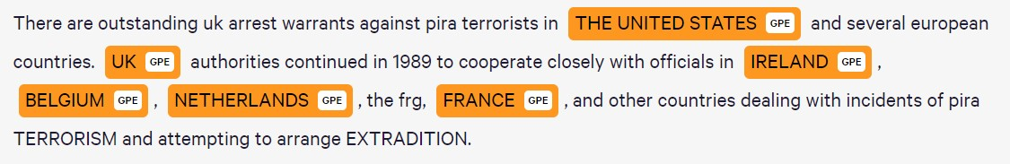
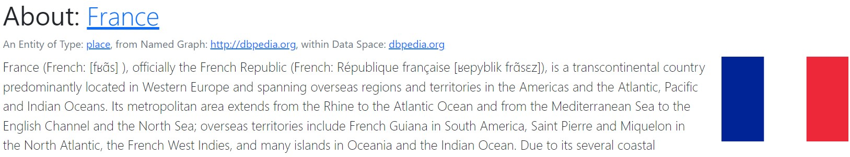
Motivation
Named entities are words or phrases like locations, countries, organisations or people.
Can be linked to external knowledge base entries
Entities paired with external knowledge can help provide valuable context to sensitivity reviewers

Slide 4
Aims
Web-based eDiscovery tool
Identify entities in documents
Pair entities with external knowledge
Provide additional context to documents
Improve sensitivity review efficiency
Improve sensitivity review accuracy

Slide 5
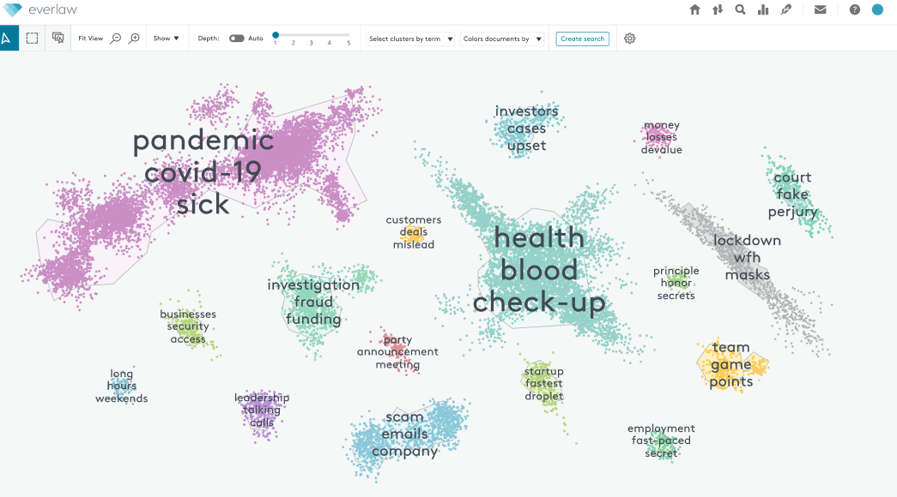
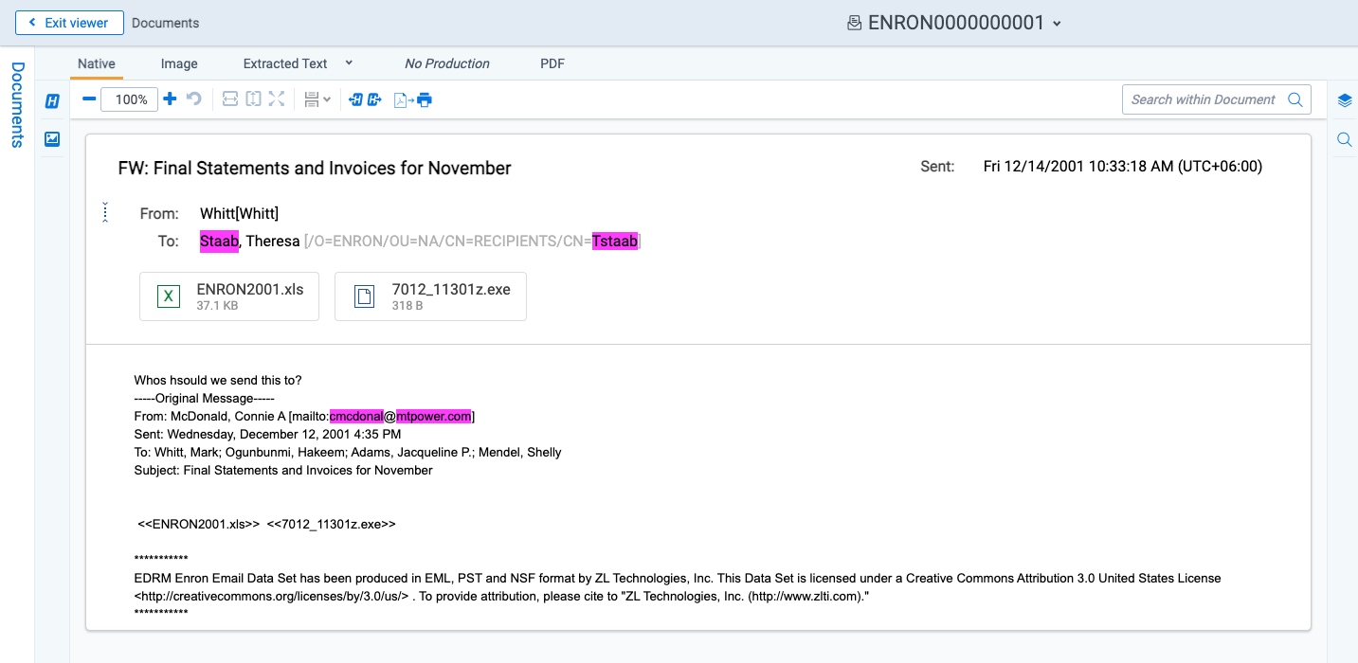
Existing Products
Relativity
Personal Information Recognition
Corpus Searching
Does not utilise NER
Targeted towards legal eDiscovery
Everlaw
Document & corpus visualisations
Document clustering
Does not utilise NER
OpenText
Document & corpus visualisations
Active learning and technology assisted review
Does not utilise document clustering or NER

Slide 6
Requirements
Web-based eDiscovery tool
Easy to use on different platforms
Doesn’t require excessive training
Named entity recognition
Identifies countries, locations & people in documents
Could help identify personal information where people are referenced
Could help identify information affecting international relations where countries & locations are referenced
External information from knowledge bases
Could help provide additional context where reviewers are unsure about documents
Entity sensitivity prediction
Could help inform reviewers if entities may cause sensitivity issues
Document & corpus visualisations
Could help reviewers understand documents at a glance
Document clustering
Could help reviewers identify related documents where files have poor structure

Slide 7
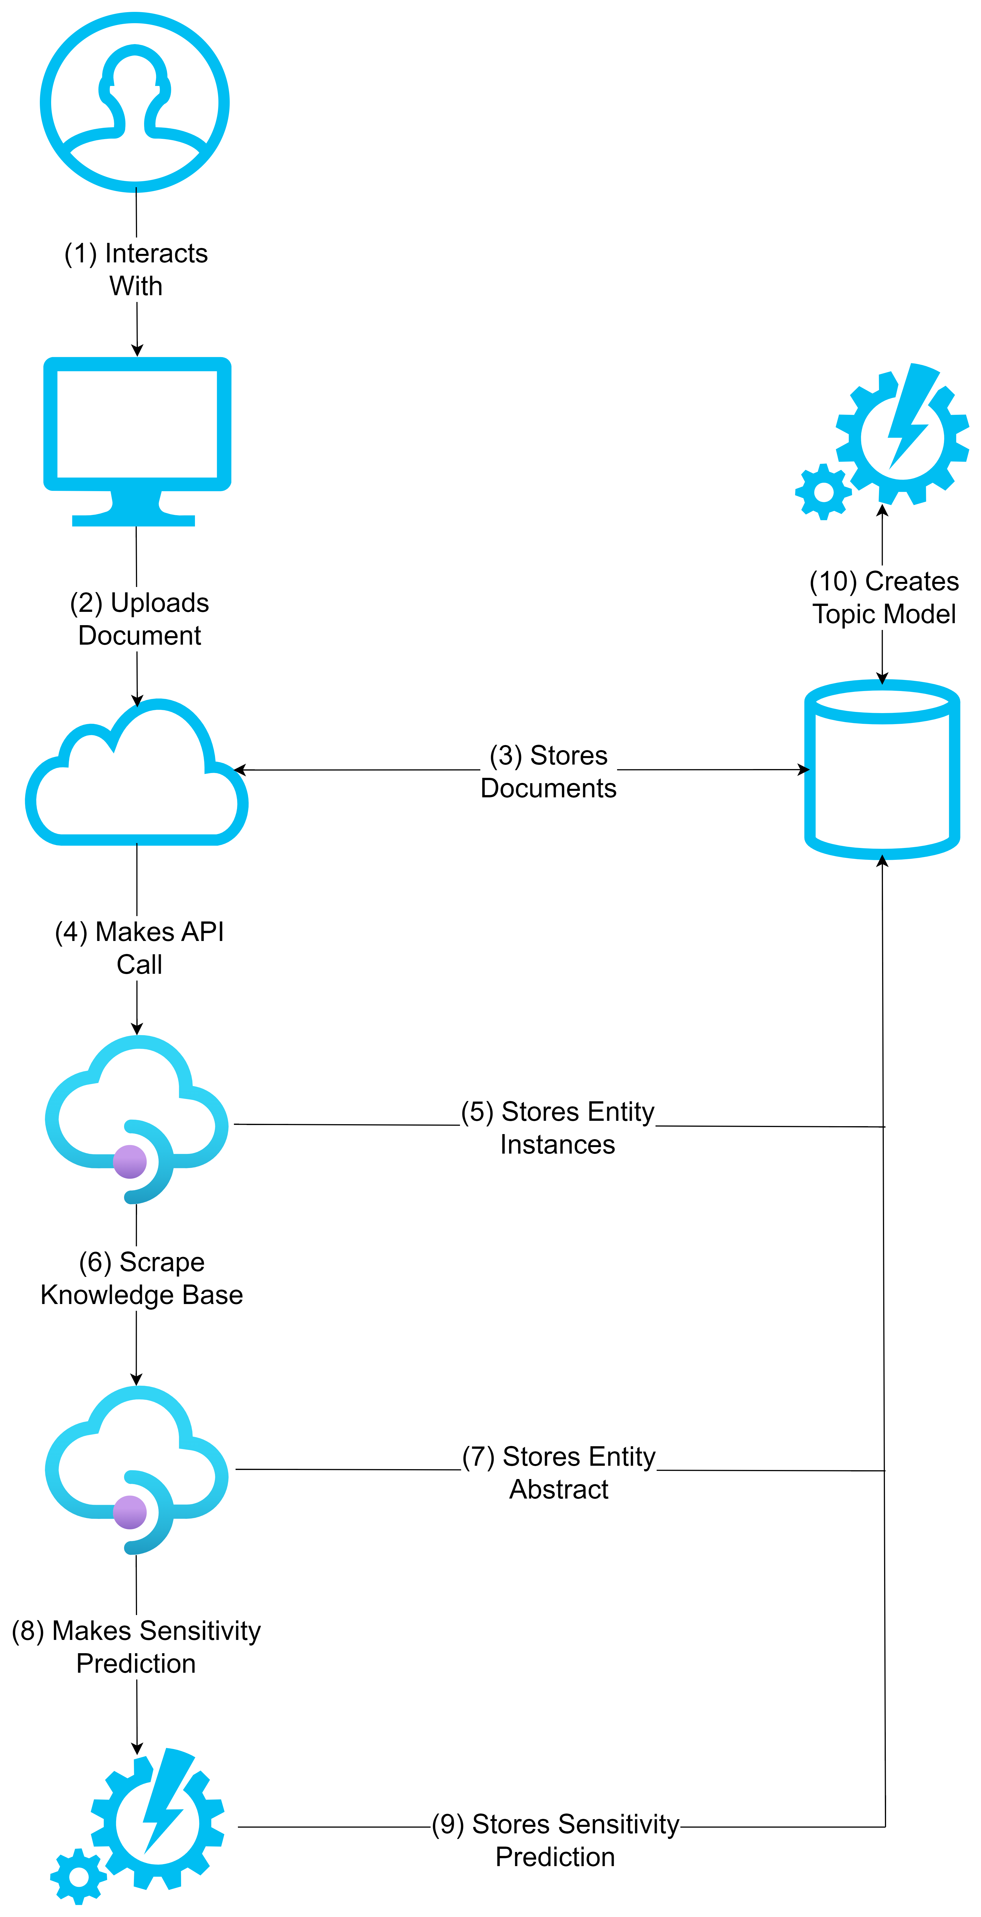
Architecture
User Interface Component
Allows the user to view and interact with the web application
Web Server Component
Acts as an intermediary between the user interface and database
Responsible for processing data
Database Component
Stores documents, entities, instances and topic model details
Data can be retrieved via the web server component
NER Component
Identifies entities in documents
Links entities to a knowledge base URL
Knowledge Base Component
Retrieves external information when given an entity URL
Sensitivity Classifier Component
Classifies the sensitivity of an entity given an entity abstract
Topic Modelling Component
Clusters documents using a topic model algorithm

Slide 8
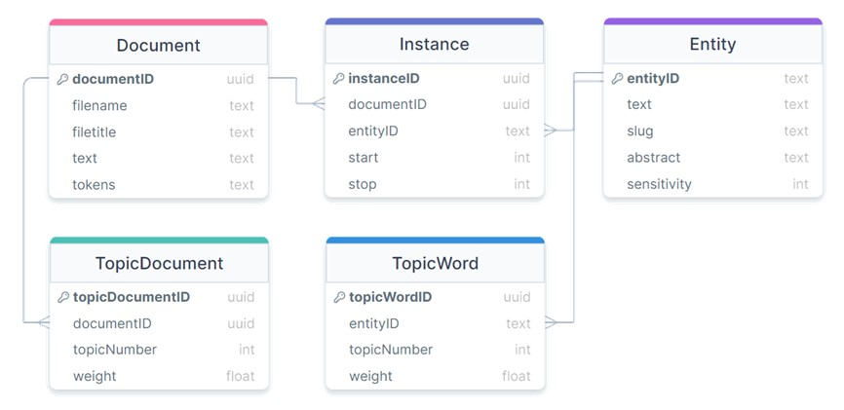
Architecture
Database component operated with relational tables
Database was normalised to avoid redundant data storage
Relational database allowed for simple SQL-like querying when retrieving data
Cascading attributes were used to avoid violating foreign key constraints

Slide 9
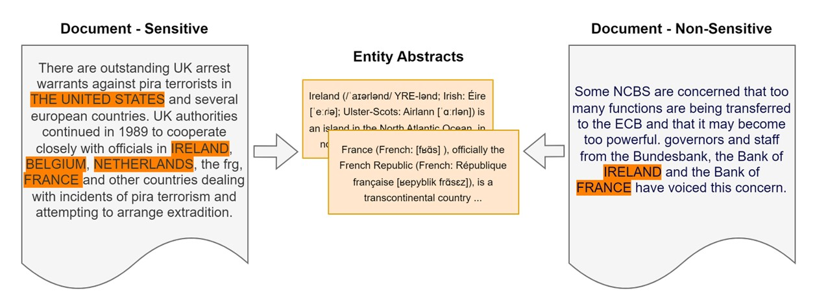
Entity Sensitivity Classifier
Classifying entities for use in sensitivity review is an unexplored area of research
Unlike typical classification tasks, classifying entities is context dependent
In some cases, an entity appears in sensitive documents as well as non-sensitive documents
An experiment was performed to evaluate the performances of two classifier approaches

Slide 10
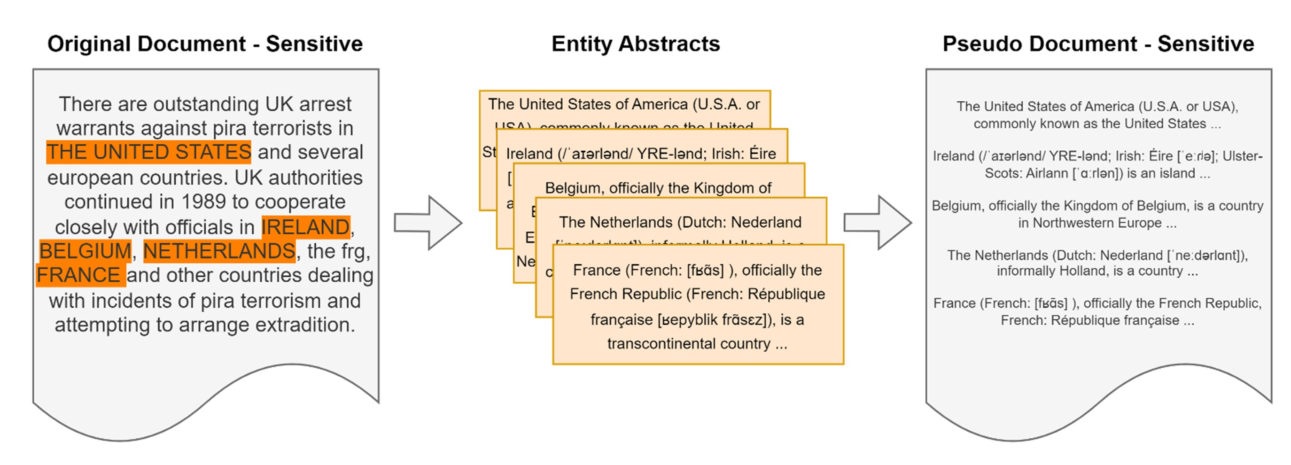
Pseudo-Document Approach
Entities are tagged in each labelled training document
Abstracts are retrieved for each entity instance in a given training document
Entity abstracts are concatenated into a new training document
Pseudo-training document is assigned the sensitivity label of its parent document

Slide 11
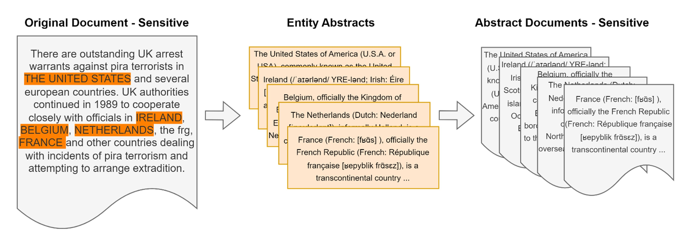
Abstract Document Approach
Entities are tagged in each labelled training document
Abstracts are retrieved for each entity instance in a given training document
Entity abstracts are converted into training documents
Each entity abstract training document is assigned the sensitivity label of its parent document

Slide 12
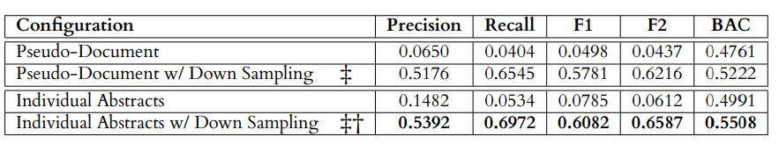
Experiment Results
Both approaches were significantly improved by down sampling
Individual abstract approach superior in all metrics
Individual abstract approach significant increase in performance over pseudo-documents
For these reasons, the individual abstract approach was selected for the entity classifier

Slide 13
Implementation

Slide 14
Evaluation

Slide 15
Future Work

