Slide 1
Deep Learning for Content Based Retrieval
army Institute of Technology, pune
Mandeep Singh
Pawan Kumar
Sachin Choudhary
by
Under Guidance of
Prof. (Dr.) S.R. Dhore

Slide 2
Introduction
News articles are very dynamic in nature and have a very short span of life.
Predicting the online popularity of online news articles is a challenging task.
Content of an article must play a significant role in its popularity.
Our work shall also help content writers to remove irrelevant, outdated, trivial and redundant content.
Notes:
2

Slide 3
BUSINESS
Content Caching and Traffic Management
Advertising
News Aggregation
Trends Forecasting
Notes:
3

Slide 4
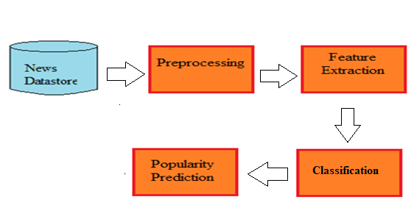
Solution Framework
Notes:
4

Slide 5
Training Dataset Sources
News Headlines of India: consists of 16 years of categorized headlines focused on India
(https://www.kaggle.com/therohk/india-headlines-news-dataset)
News Aggregator Dataset: consists of headlines and categories of 400k news stories from 2014
(https://www.kaggle.com/uciml/news-aggregator-dataset)

Slide 6
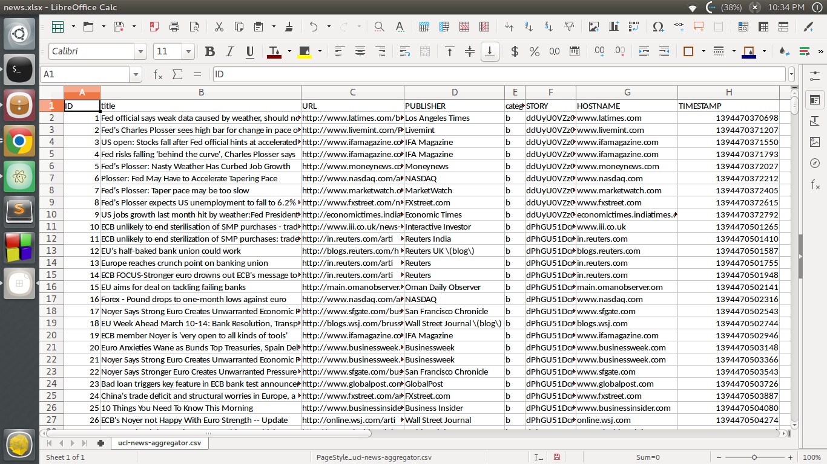
Dataset

Slide 7
Pre-processing
Filtering
Tokenization
Stemming
Stop words removal

Slide 8
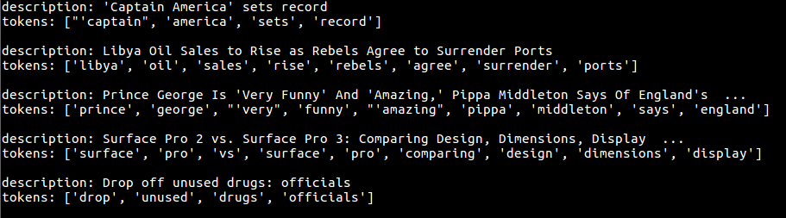
Pre-processing

Slide 9
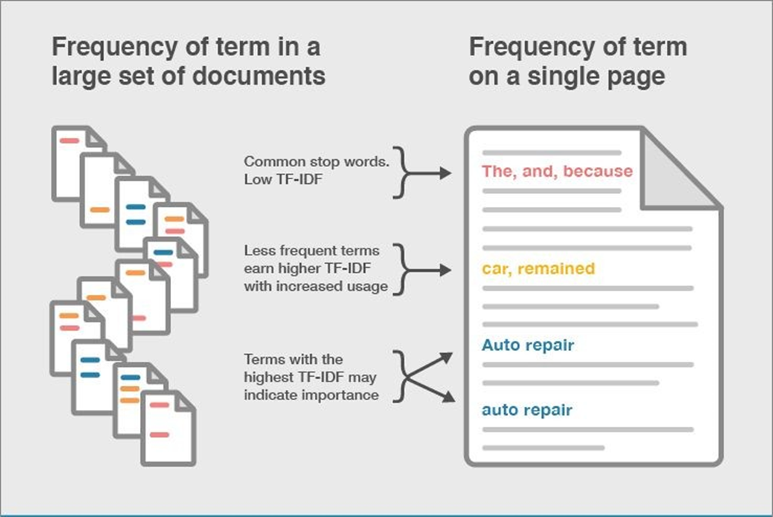
Feature Selection: TF - IDF
Term Frequency – Inverse Document Frequency

Slide 10
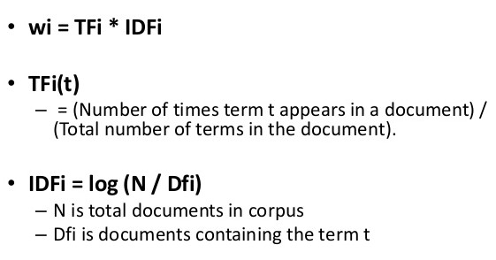
Feature Selection: TF - IDF
Term Frequency – Inverse Document Frequency
TF-IDF Formula

Slide 11
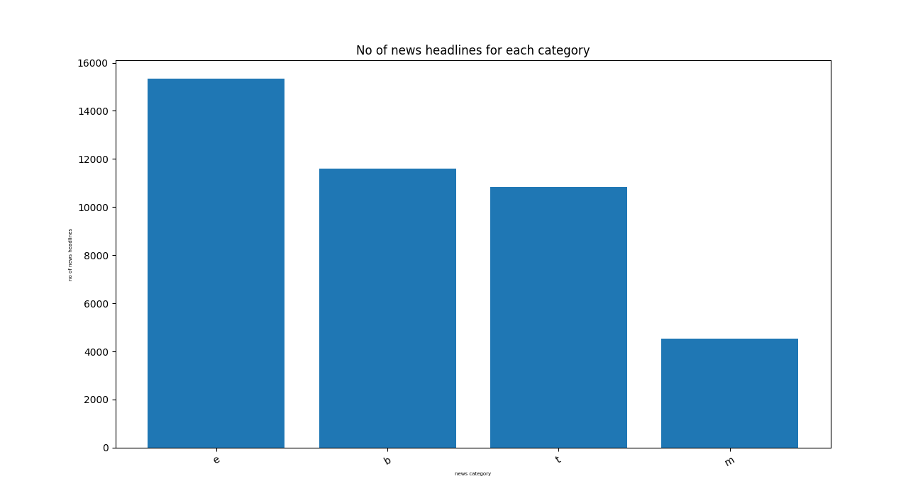
No. of headlines for each category

Slide 12
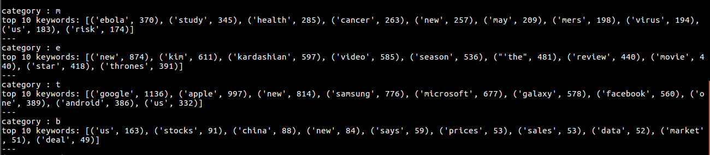
Top 10 keywords for each category

Slide 13
Text Classification
Deep Learning Model
Naïve Bayes Classifier
Support Vector Machine

Slide 14
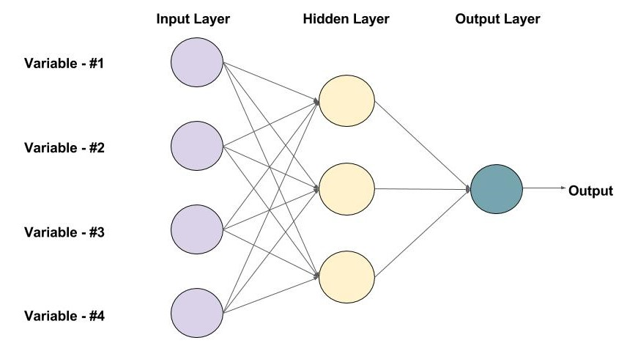
Deep Learning Model

Slide 15
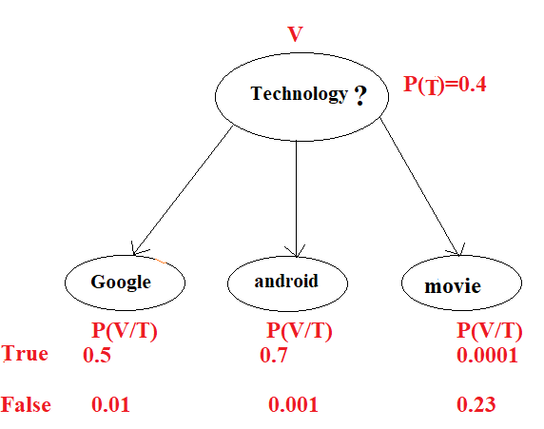
Naïve Bayes
Fig. Probability of keywords belongs to Technology domain

Slide 16
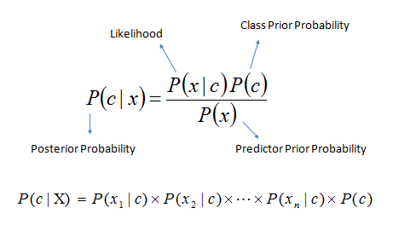
Naïve Bayes

Slide 17
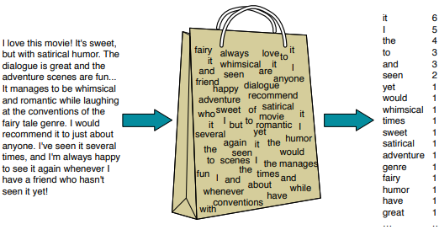
Naïve Bayes
Fig. The position of each word is ignored & make use of frequency of words

Slide 18
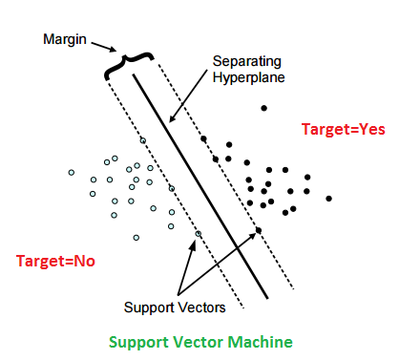
Support Vector Machine

Slide 19
Text Classification
Algorithm | Accuracy in Model
Naïve Bayes | 0.89
Support Vector Machine | 0.84
deep learning model | 0.36
Deep learning performs much better on very huge dataset and the data present for our training is already classified into categories (business, medical, entertainment and technology). So, according to our analysis Naïve Bayes Classifier is best suited.

Slide 20
Popularity Prediction
Feature | Description
Sentiment Score | Articles with positive score on top
Age | difference between published date and today’s date
Source | Source quality based on no. of visitors
Text Quality | The ratio of article data after to before pre-processing

Slide 21
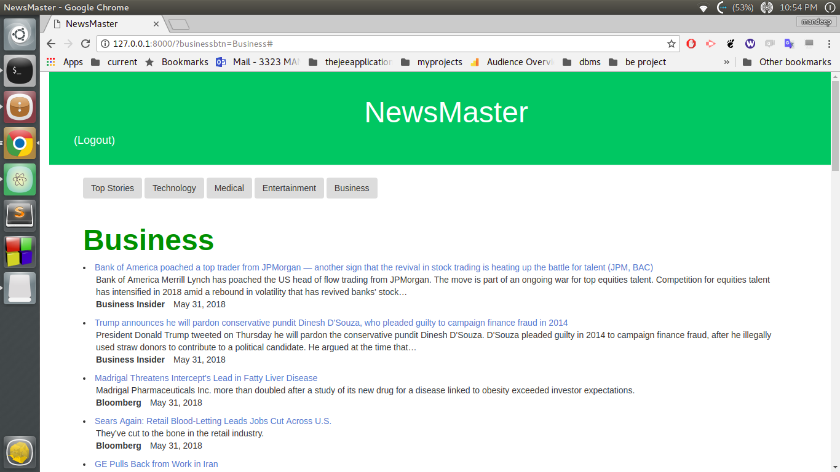
NewsMaster

Slide 22
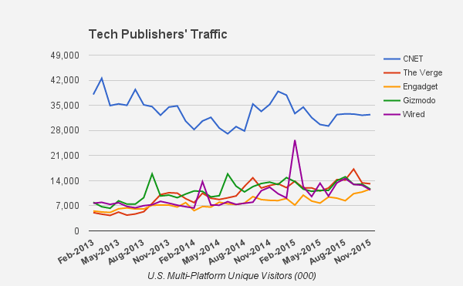
Popularity Prediction
(source quality)

Slide 23
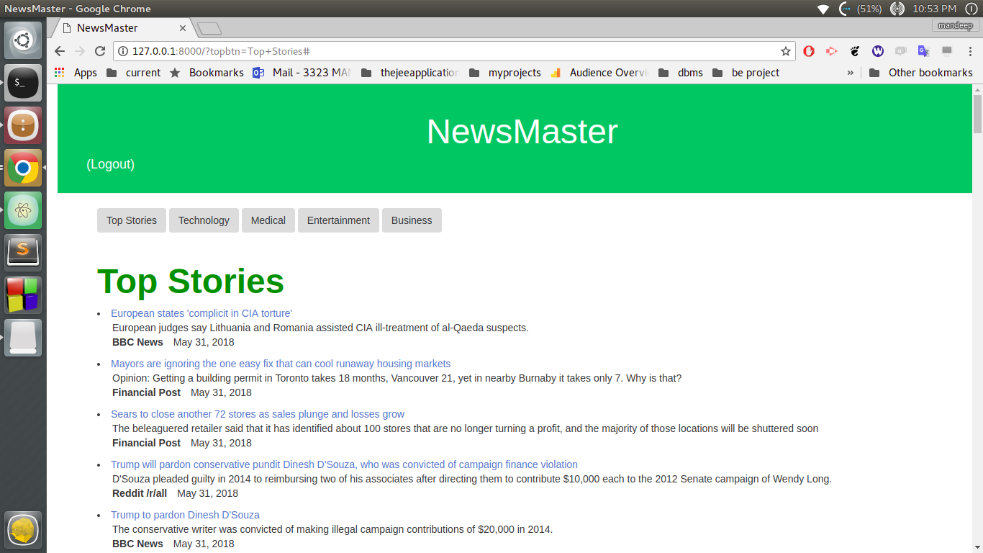
NewsMaster

Slide 24
Conclusion
We improve the quality of news cache and recommendations by predicting popularity of articles prior to publishing.
We predict the most popular pieces in different categories to provide the set of most popular articles, which is then can be used for multiple use-cases in content caching, advertising, forecasting and recommendation.

Slide 25
Future Work
For a live streaming data, though our main focus is on content but little importance can be given to online presence of article, i.e. number of retweets, Facebook shares, number of clicks to predict popularity.
Content ranking can be improved by creating user profiles.

Slide 26
Thank you

