Slide 1
Caesar Cipher
With Mr. Cassady and Mr. Alhajri

Slide 2
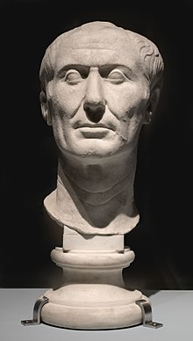
History
The Caesar Cipher was named after Julius Caesar.
He used it to encipher (or hide) private messages
he didn’t want others to read.

Slide 3

What is a cipher?

Slide 4
What is a cipher?
An algorithm that hides a message using a key
Used to encrypt important and sensitive data (passwords, credit card number, etc.)

Slide 5
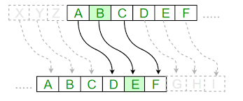
Caesar Cipher
An algorithm where all the letters of a message
are shifted forward or backward through the
alphabet to encipher (or encrypt) the
original message.
We shift the letters forward or backward by an
Integer amount called a key.

Slide 6
Caesar Cipher
Examples
We shift the letters forward or backward by an
Integer amount called a key.
If we have key = 2, encipher “banana”:
banana -> dcpcpc

Slide 7
Caesar Cipher
Examples
We shift the letters forward or backward by an
Integer amount called a key.
If we have key = 2, encipher “banana”:
banana -> dcpcpc
If we have key = 1, decipher “app”:
app -> zoo

Slide 8
ASCII Code

Slide 9
ASCII Code
Characters in Python have an integer code
called its ASCII code.

Slide 10
ASCII Code
ASCII Codes for letters:
Characters in Python have an integer code
called its ASCII code.
a
97
Our message is a string that is made up of characters each with an ASCII code.
We use the ASCII code of each character in the message to shift it through the alphabet and encipher our message.
b
98
c
99
.
.
.
y
121
z
122

Slide 11
ASCII Code
ASCII Codes for letters:
In Python, we use:
ord(character) to get the ASCII code
chr(shiftedCharacter) to get the new
character after we shifted it
Examples:
ord(‘a’) is 97
chr(122) is ‘z’
a
97
b
98
c
99
.
.
.
y
121
z
122

