Slide 1
Graphical and Tabular Methods in Descriptive Statistics
MATH 3342
Section 1.2

Slide 2
Descriptive Statistics
Graphs and Tables
Numerical Summaries
Sections 1.3 and 1.4

Slide 3
Why graph data?
The amount of data collected is overwhelming.
How do we make sense of all of this information?
Graphs can organize and display data in helpful ways.
We can summarize key features of the data.

Slide 4
Common Visual Methods
Frequency Tables
Tally Sheets
Histograms
Stem-and-Leaf Plots
Dot Plots
Pie Charts
Scatter Plots

Slide 5
Two Types of Variables
Quantitative
Takes numeric values for which arithmetic operations make sense.
Usually recorded in a unit of measurement.
Qualitative
Places an individual into one of several groups, classifications, or categories.

Slide 6
Quantitative Variables
Discrete:
Set of possible values is either finite OR can be listed in an infinite sequence.
Continuous:
The possible values consist of an entire interval on the number line.

Slide 7
Quantitative or Qualitative?
Scores on an examination.
Letter grade received for a course.
Chapters in this textbook.

Slide 8
Distribution of a Variable
Distributions tell us what values variables take and how often they take these values.
Quantitative:
Tells what values the variable takes and how often it takes these values.
Qualitative:
Lists the categories and gives either the count or the proportion of individuals in each.

Slide 9
Example
Suppose a variable X can take the values 1, 2, 3, or 4. The distribution associated with each outcome are described by the following table:
Outcome 1 2 3 4
distribution 1 3 4 2
Notes:
http://www.stat.yale.edu/Courses/1997-98/101/ranvar.htm

Slide 10
Frequency Tables
Standard frequency tables have three columns:
Categories or bins for the variable
Frequency
Relative frequency

Slide 11
Frequency Tables
Frequency:
The number of times a variable takes a value or falls within a range of values
Relative Frequency:

Slide 12
Histograms for Quantitative Data
The length and the width of the bars have specific meanings.
Length is proportional to count.
Width determined by data ranges.
The bars touch, indicating that all values of the variable are covered.

Slide 13
How to Make a Histogram (Continuous data)
Divide the range of data into classes of equal width.
Count the number of individuals in each class.
Draw a bar for each class corresponding to the count.

Slide 14
Note:To create a frequency histogram of (finite) discrete data
Determine the number, n, in the sample.
Determine the frequency, f_{i}, of each outcome i.
Center a rectangle with base of length 1 at each observed outcome i and make the height of the rectangle equal to the frequency.

Slide 15
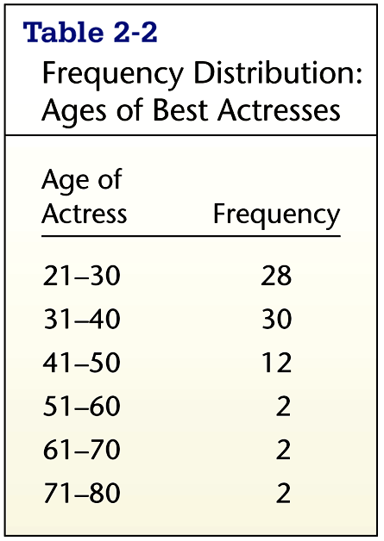
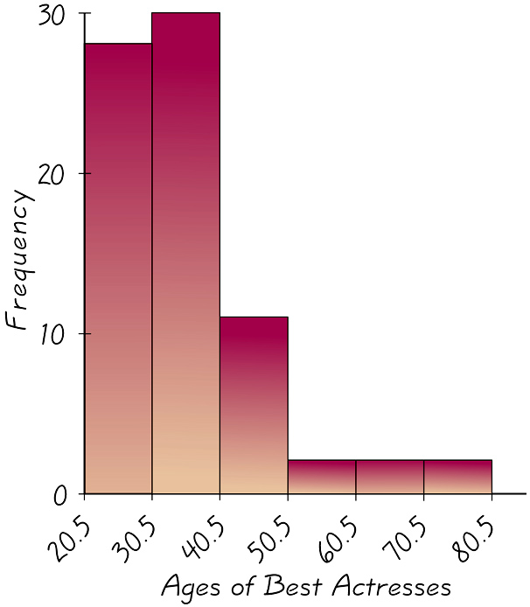
Example

Slide 16
Histograms for Qualitative Data
Consists of bars representing counts or percentages for particular categories.
The heights of the bars are proportional to the counts or percentages.
Widths have no meaning!
The bars do not touch.
This denotes the separation between categories.

Slide 17
SUV Example
The table below lists the number of SUVs sold last week (by day) for a local dealership.
Day
Number Sold
Monday
15
Tuesday
23
Wednesday
35
Thursday
11
Friday
12
Saturday
42

Slide 18
SUV Example
SUVs Sold Last Week
Frequency

Slide 19
Stem-and-Leaf Plots
Much like a histogram turned sideways.
Instead of bars, we list the individual values.
Typically used for quick analysis and/or for small data sets.

Slide 20
Making a Stem-and-Leaf Plot
Sort the data in increasing order.
Separate each observation into the stem and leaf.
Write stems in a column in increasing order.
Draw a vertical line to the right of the stems.
Place each leaf to the right of its stem, in increasing order out from the stem.
Somewhere indicate units for stems and leaves.

Slide 21
Example

Slide 22
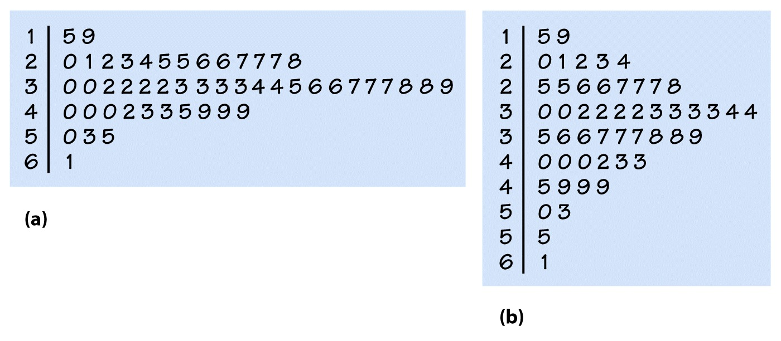
Example
Standard
Split

Slide 23
Dot Plots
Very similar to histograms.
Each individual data value is represented with a dot.
Typically used for smaller data sets.

Slide 24
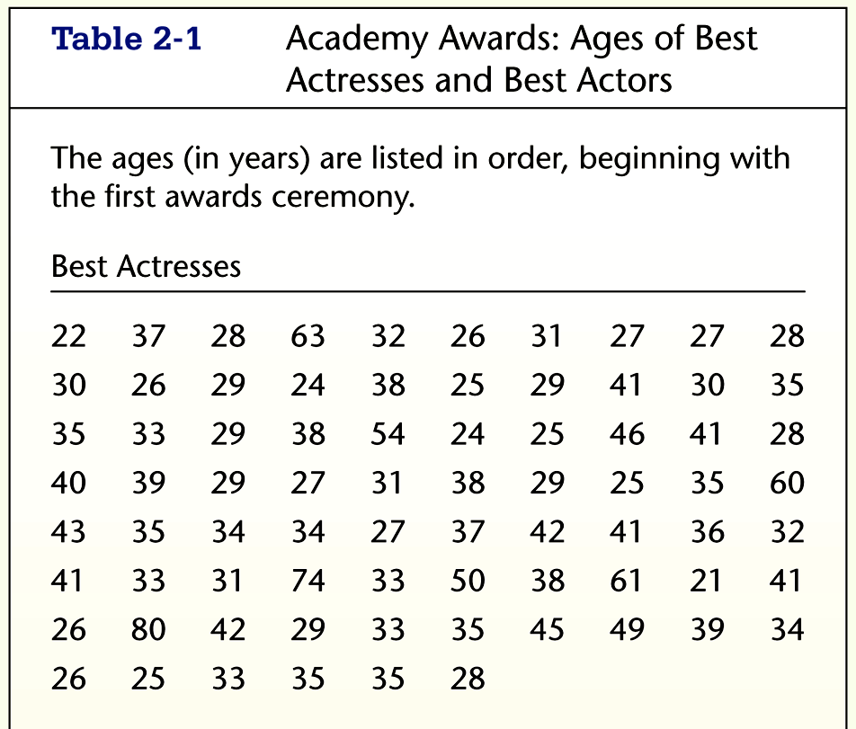
Example

Slide 25
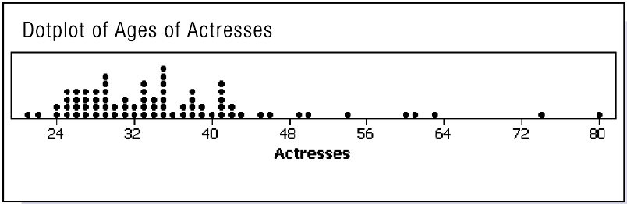
Example

Slide 26
What to Look For
Look for the overall pattern and for any striking deviations from that pattern.
Describe the overall pattern by its shape, center, and spread.
Gaps in the distribution.
Outliers:
Important kind of deviation
Individual values that fall outside the overall pattern.

Slide 27
Shape
Modality
Symmetry or Skewness

Slide 28
Modality
Unimodal
Has one peak
Bimodal
Has two peaks
Multimodal
Has more than two peaks

Slide 29
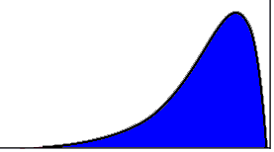
A Unimodal Distribution

Slide 30
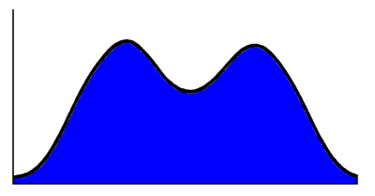
A Bimodal Distribution

Slide 31
Symmetry and Skewness
Symmetric Distributions
The left and right sides of the distribution are approximately mirror images.
Positively Skewed
Right tail extends much further out than the left.
Negatively Skewed
Left tail extends much further out than the right.

