Slide 1
Measures of Location
MATH 3342
Section 1.3

Slide 2
Location and Variability
To get a useful numerical description of a distribution, we need to have both some measure of location (or center) and some measure of variability.

Slide 3
Measures of Center
Provide some notion of what value the distribution is grouped around.
The most common measures are the mean and median.

Slide 4
The Sample Mean
Also called the arithmetic average.
Represents the balance point for a sample of quantitative data.

Slide 5
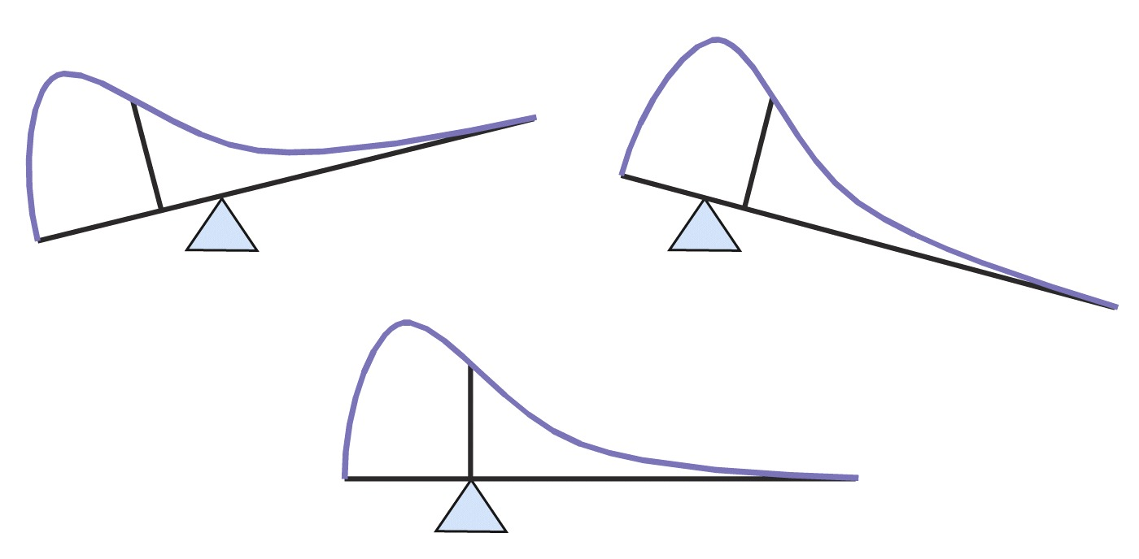
The Mean as Balance Point

Slide 6
Housing Price Example
All Values Given in Thousands of Dollars
{House Prices} = {144; 98; 204; 177; 155; 316; 100}
Compute the sample mean:

Slide 7
The Sample Median
The median is the midpoint of a distribution.
It is the number such that half the observations are smaller and the other half are larger.

Slide 8
Calculating the Median
Arrange the observations in order from smallest to largest.
If n is odd, is the center observation.
If n is even, is the mean of the two centered observations.

Slide 9
Housing Price Example
{house prices} = {$144; 98; 204; 177; 155; 316; 100}
NOTE: n is odd
Ordered:
$98; 100; 144; 155; 177; 204; 316
Middle Value
= 155

Slide 10
Another Housing Price Example
{house prices} = {144; 98; 204; 177; 155; 316; 100; 177; 177; 170}
NOTE: n is even
Ordered:
$98; 100; 144; 155; 170; 177; 177; 177; 204; 316
Middle Values
= (170 + 177)/2
= 173.5

Slide 11
Example2 (using formula)

Slide 12
Example2 (using formula)

Slide 13
Example3(using formula)

Slide 14
Population Analogues
The mean of a population is denoted by
Discussed in more depth in Ch. 3 and 4
The median of a population is denoted by

Slide 15
Mean vs. Median
The mean is GREATLY affected by outliers.
The median is NOT affected by outliers.
If the mean and median are (almost) equal, then the distribution is (approximately) symmetric.
If mean < median, distribution is left skewed.
If mean > median, distribution is right skewed.

Slide 16
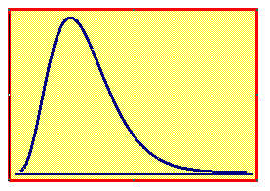
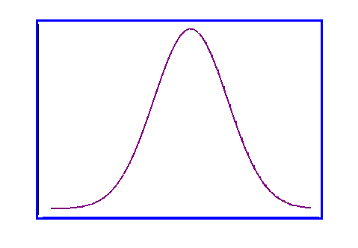
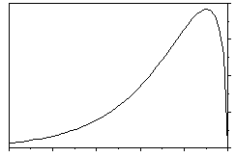
Skewness
Median Mean
Mean Median
Mean = Median
Right-Skewed
Left-Skewed
Symmetric

Slide 17
Trimmed Means
Remove a percentage of the highest and lowest values and calculate the mean from what remains.
More resistant to outliers than the mean.
Less resistant to outliers than the median.

Slide 18
Example
{house prices} = {$144; 98; 204; 177; 155; 316; 100}
Mean = 170.6 Median = 155
Ordered:
$98; 100; 144; 155; 177; 204; 316
14.3% Trimmed Mean = 156

Slide 19
Quartiles
Quartiles divide the data into four equal-sized groups.
25% of the data are less than Q₁, the first quartile.
The second quartile is the median .
75% of the data are less than Q₃, the third quartile.

Slide 20
Calculating Quartiles
Arrange data in ascending order.
Locate the median.
Q₁ is the median of all data to the left of the overall median.
Q₃ is the median of all data to the right of the overall median.
Notes:
There will be an example of this in a few slides.

Slide 21
The Five-Number Summary
Minimum, Q₁, , Q₃, Maximum
A quick summary of both center and variability.

Slide 22
Example: Quartiles
Original:
Sorted:
To the left of the median:
-12 -5.2 -1.7 -1.5 -1 1
To the right of the median:
3.2 3.5 3.7 4.9 6 7
Q₁= (-1.7+-1.5)/2= -1.6
Q₃= (3.7+4.9)/2 = 4.3
Five-Number Summary:
-12, -1.6, 1.4, 4.3, 7

Slide 23
Location for Qualitative Data
The sample proportion is the ratio of successes to number of observations:
The population proportion is p.

Slide 24
Example
A department wants to know what proportion of their 400 returning students have laptops.
They poll 40 of these students.
28 of them said yes.
What is the sample proportion of returning students that have laptops?
Solution:

Slide 25
Example

