Slide 1
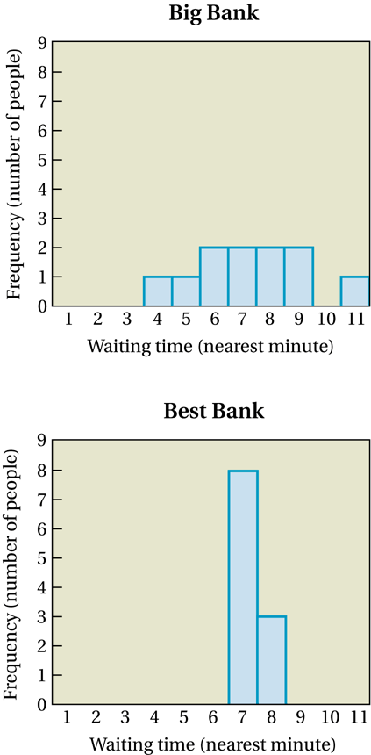

The Importance of Spread
Big Bank (wait times):
4.1 5.2 5.6 6.2 6.7 7.2 7.7 7.7 8.5 9.3 11.0
Best Bank (wait times):
6.6 6.7 6.7 6.9 7.1 7.2 7.3 7.4 7.7 7.8 7.8
Notes:
The means are the same, but the spreads are very different.

Slide 2
Measures of Variability
MATH 3342
Section 1.4

Slide 3
Measures of Spread
The spread of a distribution refers to how much variability the data has.
Common measures are the five number summary, variance, and standard deviation.
A very basic measure is to look at just the minimum and maximum values.
The range is the difference between these two.

Slide 4
Example

Slide 5
Deviation from the mean

Slide 6
Deviation from the mean

Slide 7
Sample Variance
The variance s² of a set of observations is an average of the squares of the deviations of the observations to the mean.

Slide 8
Sample Standard Deviation
The standard deviation s is the square root of the variance.

Slide 9
Standard Deviation

Slide 10
Important Facts About s² and s
Both variance and standard deviation will ALWAYS be non-negative values.
s=0 means that all observations have the same value.
The units of variance are the square of the units of the data.
The units of standard deviation are the units of the data.
Both are HEAVILY affected by outliers.

Slide 11
Proposition
Let x₁,…, x_{n} be a sample and c be a non-zero constant.
If y₁ = x₁+c, …, y_{n} = x_{n}+c, then s_{y}=s_{x}
If y₁ = cx₁, …, y_{n} = cx_{n}, then s_{y}=|c|s_{x}

Slide 12
Example
x
x - x
(x - x)²
x
Sum = 602833.5
s² = 602833.5/ (6-1) = 120566.7
s = 347.2

Slide 13
Example

Slide 14
Example

Slide 15
Calculating Quartiles
Arrange data in ascending order.
Locate the median.
Q₁ is the median of all data at or to the left of the overall median.
Q₃ is the median of all data at or to the right of the overall median.
Notes:
There will be an example of this in a few slides.

Slide 16
The Five-Number Summary
Minimum, Q₁, , Q₃, Maximum
A quick summary of both center and spread.

Slide 17
Box Plots
Max
Graphical Displays of
Five-Number Summaries
Q₃
(Vertical Display)
Min
Q₁
Q₃
Max
Q₁
(Horizontal Display)
Min

Slide 18
Example: Quartiles
Original:
Sorted:
Q₁ = -1.6
Q₃= 4.3
Median
Five-Number Summary:
-12, -1.6, 1.4, 4.3, 7

Slide 19
Example: Box Plot
Five-Number Summary:
-12, -1.5, 1.4, 3.7, 7
-10
0
10

Slide 20
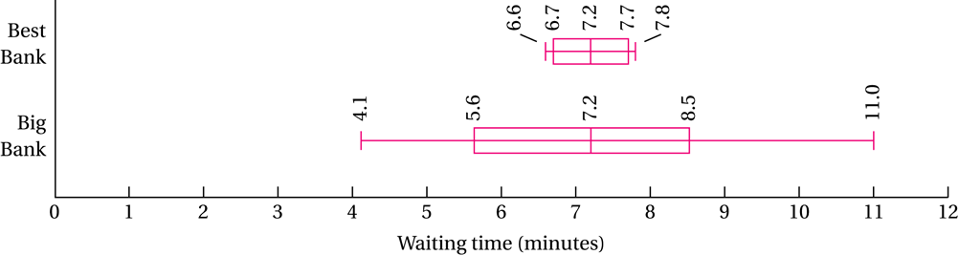
Comparisons Using Box Plots
Big Bank
Best Bank
low value (min) = 4.1
low value (min) = 6.6
lower quartile = 5.6
lower quartile = 6.7
median = 7.2
median = 7.2
upper quartile = 8.5
upper quartile = 7.7
high value (max) = 11.0
high value (max) = 7.8
Notes:
Mention the (not) optional section in the book about using IQR to check for suspected outliers.

Slide 21
Fourth Spread
The Fourth Spread (or Inter-quartile range) is a measure of variability that is resistant to outliers.
Outlier:
An observation more than 1.5f_{s} from the nearest quartile
Extreme Outlier:
An observation more than 3f_{s} or 3.5f_{s} from the nearest quartile
f_{s} = Q₃ – Q₁

Slide 22
Example
The following data is given as follows:

Slide 23
Example

Slide 24
Example

Slide 25
Choosing a Summary
s² and s are best used to describe the spread of relatively symmetric datasets with no outliers.
s should only be used with , not the median
The five-number summary is best used for skewed distributions or those having extreme outliers.

