Slide 1
Properties of Probability
MATH 3342
Section 2.2

Slide 2
Goal of Probability
Given a random process and a sample space S, the objective is to assign to each event A number P(A), called the probability of event A.
Gives a precise measure of the chance that A will occur.

Slide 3

Probability
Reflects the proportion of times an event will occur in a very long series of trials.
Always a number between 0 and 1.
1
Certain
Likely
0.5
50-50 Chance
Unlikely
0
Impossible

Slide 4
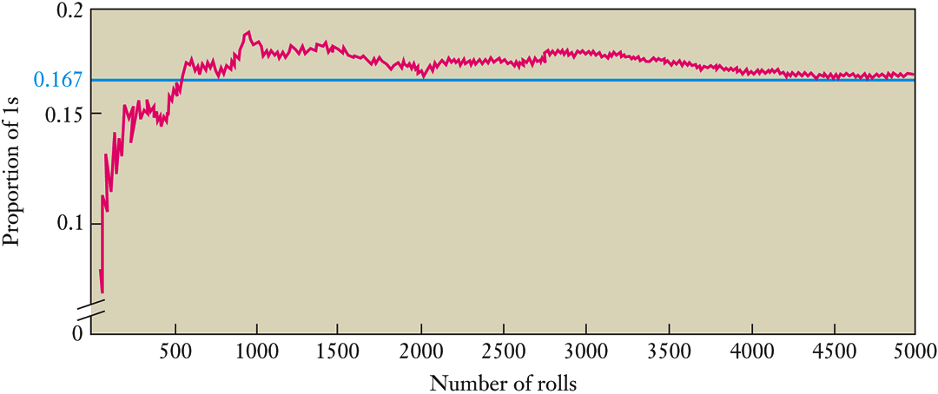
Example: Rolling a Die

Slide 5
Axioms of Probability
Axiom 1: The probability P(A) of any event A satisfies 0 ≤ P(A) ≤ 1.
Axiom 2: If S is the sample space, then P(S)=1.
Axiom 3: If A₁, A_{2,} A₃, … is an infinite collection of disjoint events:
Axiom4:

Slide 6
Results
Axiom 3 also holds for finite collections of disjoint events.
Because
For any event A,

Slide 7
Proposition
For any events A and B, the probability of either event occurring is the following:

Slide 8
Example

Slide 9
Example

Slide 10
Extension
For any events A, B, and C, the probability of any of the 3 events occurring is the following:

Slide 11
Example

Slide 12
Example

Slide 13
Example

Slide 14
Equally Likely Outcomes
Let N be the total number of outcomes in S.
The probability of any outcome is
Let N(A) be the number of outcomes in event A.

Slide 15
Equally likely Outcomes

Slide 16
Example

