Slide 1
Counting Techniques
MATH 3342
Section 2.3

Slide 2
Reminder
Let N be the total number of outcomes in S.
The probability of any outcome is
Let N(A) be the number of outcomes in event A.

Slide 3
Product Rule for ordered pairs
If O₁ and O₂ are outcomes and the pair (O₁, O₂) is different from (O₂, O₁), then we have an ordered pair.
If O₁ can be selected in n₁ ways and O₂ can be selected in n₂ ways, then the number of ordered pairs is
n₁n₂

Slide 4
Example
A person is flying into Lubbock on one of 5 airlines that serves the city.
To get to their hotel, the passenger can take a taxi cab from one of 3 different companies.
How many possible company combinations are there for the passenger to arrive to their hotel?

Slide 5
Solution for the Example tree diagram
C₁
C₃
A₅
C₁
A₁
Start
A₂
A₃
A₄
C₂
C₁
C₂
C₃
C₁
C₂
C₃
C₁
C₂
C₃
C₂
C₃

Slide 6
Example
Solution:
Notice that this is an ordered pair with 5 airlines A_{1,}A₂ ……. A₅ and 3 cabs C_{1,}C₂ ,C₃ and we want to find the number of pairs (A_{i} , C_{j} ). We have
n₁ = number of airlines=5
n₂ = number of cabs=3
n₁n₂= (3)(5)=15

Slide 7
Example
In the previous situation:
Suppose airline A₅ had a deal with cab company C₁ to provide heavily discounted cab fare
So anyone flying with A₅ would choose C₁ for their cab
How many possible pairs of companies are there now?
The product rule will not apply anymore!
Use a tree diagram to help

Slide 8
Example: A₅ Deal
C₁
C₃
A₅
C₁
A₁
Start
A₂
A₃
A₄
C₂
C₁
C₂
C₃
C₁
C₂
C₃
C₁
C₂
C₃

Slide 9
General Product Rule
An ordered collection of k outcomes is called a k-tuple.
If O₁ can be selected in n₁ ways, O₂ can be selected in n₂ ways, …, and O_{k} can be selected in n_{k} ways then the number of k-tuples is
n₁n₂…n_{k}
Notes:
https://en.wikipedia.org/wiki/Tuple

Slide 10
Permutation and Combination
Suppose a little league baseball team has 15 players on its roster.
How many ways are there to select 9 players to form a starting lineup?
The campus bookstore has 4 laptop models.
How many ways can it display 3 at a time?
Notes:
DON’T WORK OUT NOW————WILL COME BACK TO LATER

Slide 11
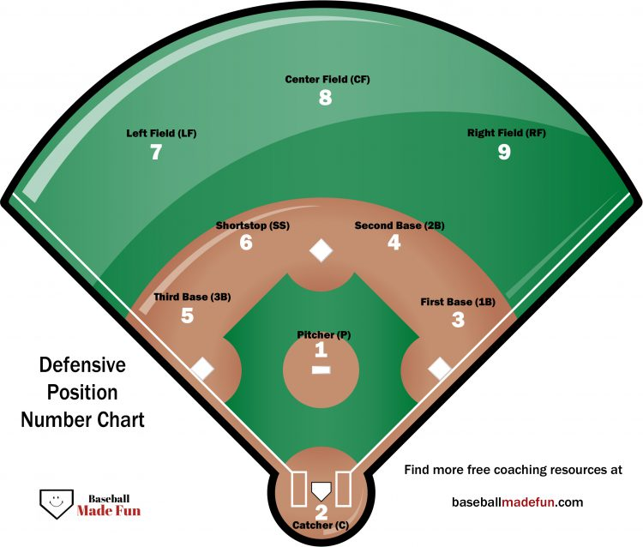
Order is Important

Slide 12
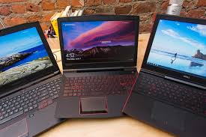
Order is Not important

Slide 13
Solution
For baseball scenario, the order is important
How many ways are there to select 9 players from 15 to form a starting lineup?
For the Display of 3 laptop, the order in NOT important.
How many ways can it display 3 out of 4 at a time?

Slide 14
Example

Slide 15
example

Slide 16
Example

Slide 17
example

Slide 18
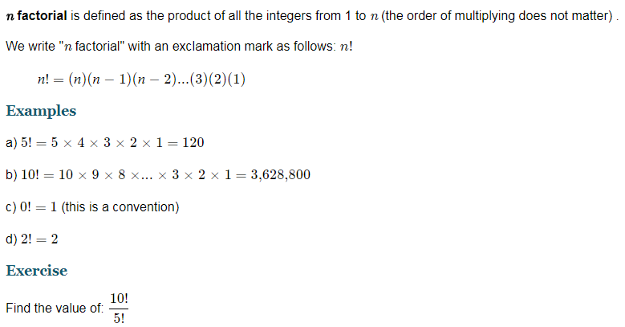
Factorial notation
https://www.intmath.com/counting-probability/1-factorial-notation.php

Slide 19
Permutation
Another word for an ordered subset
The number of permutations of size k that can be formed from the n objects in a group is denoted by P_{k,n}.
k-permutations of n

Slide 20
Example
Suppose a little league baseball team has 15 players on its roster.
How many ways are there to select 9 players to form a starting lineup?

Slide 21

example
$$P_{6,10}$$

Slide 22
Combination
Another word for an unordered subset
The number of permutations of size k that can be formed from the n objects in a group is denoted by

Slide 23
Example

Slide 24
Example

Slide 25
example

Slide 26
Example

Slide 27
Example(try on your own)
A particular iPod playlist contains 50 songs, 5 of which are by Buddy Holly.
Suppose the playlist is set to play songs randomly.
What is the probability that the first Buddy Holly song is the third song played?
What is the probability that one of the first 3 songs played is by Buddy Holly?
Notes:
A)
Denominator = (50 nCr 5)
Numerator = (47 nCr 4)
N/D = 0.0842
B)
(47 nCr 4)/(50 5) + (48 nCr 4)/(50 5) + (49 nCr 4)/(50 5) = 0.2760

Slide 28
Example(try on your own) Example 2.22 On our Textbook
A particular iPod playlist contains 50 songs, 5 of which are by Buddy Holly.
Suppose the playlist is set to play songs randomly.
What is the probability that the first Buddy Holly song is the third song played?
What is the probability that one of the first 3 songs played is by Buddy Holly?
Notes:
A)
Denominator = (50 nCr 5)
Numerator = (47 nCr 4)
N/D = 0.0842
B)
(47 nCr 4)/(50 5) + (48 nCr 4)/(50 5) + (49 nCr 4)/(50 5) = 0.2760

