Slide 1
Conditional Probability and Independence
MATH 3342
Sections 2.4 and 2.5

Slide 2
Example
What is the probability that you get an A on a test?
Would you change your answer if you studied for 1+ hour/day for the week before the exam?
How about if you did not?

Slide 3
Conditional Probability
You have defined the events A and B.
Suppose you are told that event B occurs.
Given this information, what is the probability that event A occurs?

Slide 4
Conditional Probability Using Venn Diagram
Black ‘Happens’: Eliminates All Other Outcomes
Ace
Black
Black
S
(S)
Event (Ace ∩ Black)

Slide 5
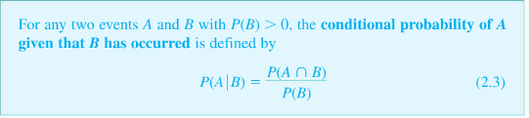
Definition

Slide 6
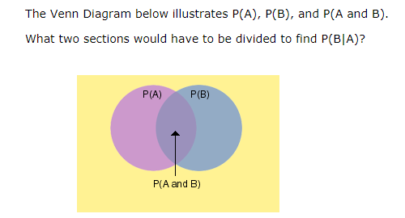
Venn Diagram
Notes:
https://www.google.com/imgres?imgurl=http://www.mathgoodies.com/sites/all/modules/custom/lessons/images/probability/conditional_venn.gif&imgrefurl=http://www.mathgoodies.com/lessons/vol6/conditional.html&h=170&w=250&tbnid=deyV8CzuoLNtQM:&tbnh=160&tbnw=235&usg=__4QEEix7-LvZLo84NKA61zbHgO2o=&vet=1&docid=qSYs0osBfENztM&sa=X&ved=0ahUKEwi32oyR_6_WAhVU0WMKHeRuBM0Q9QEILDAA

Slide 7
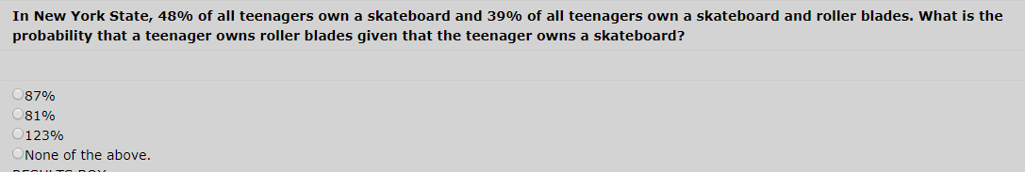
Example
Notes:
https://www.google.com/imgres?imgurl=http://www.mathgoodies.com/sites/all/modules/custom/lessons/images/probability/conditional_venn.gif&imgrefurl=http://www.mathgoodies.com/lessons/vol6/conditional.html&h=170&w=250&tbnid=deyV8CzuoLNtQM:&tbnh=160&tbnw=235&usg=__4QEEix7-LvZLo84NKA61zbHgO2o=&vet=1&docid=qSYs0osBfENztM&sa=X&ved=0ahUKEwi32oyR_6_WAhVU0WMKHeRuBM0Q9QEILDAA

Slide 8
College Attendance
 | City | Suburb | Country | Total
College | 2,550 | 4,580 | 470 | 7,600
No College | 3,450 | 920 | 430 | 4,800
Total | 6,000 | 5,500 | 900 | 12,400

Slide 9
College Attendance
If you choose a high school graduate at random, what is the probability that the person went to college?
What is the conditional probability that you choose a college attendee given that the person lived in the suburbs?
What is the conditional probability that you choose a person from the country given that they did not attend college?

Slide 10
The Multiplication Rule
For any two events A and B,

Slide 11
Example: Dollar Value
A = event that the value of the $ falls.
B = event that the supplier demands changing the contract
P(A) = 0.4
P(B|A) = 0.8
P(A and B) = ?

Slide 12
Example

Slide 13
Solution

Slide 14
Example
+P(3∩AB)
+ 0.02
+ 0.52

Slide 15
0.385
+ 0.52

Slide 16
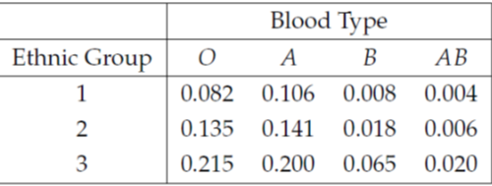
Example

Slide 17
Conditioning Complex Events Example1:
A certain system can experience three different types of defects. Let A_{i} (i = 1,2,3) denote the event that the system has a defect of type i. Suppose that the following probabilities are true
P(A₁) = 0.10 , P(A₂) = 0.08 P(A₃) = 0.05 P(A₁ ∪ A₂) = 0.12 P(A₁ ∪ A₃) = 0.12
P(A₂ ∪ A₃) = 0.11 P(A₁ ∩ A₂ ∩ A₃) = 0.01

Slide 18
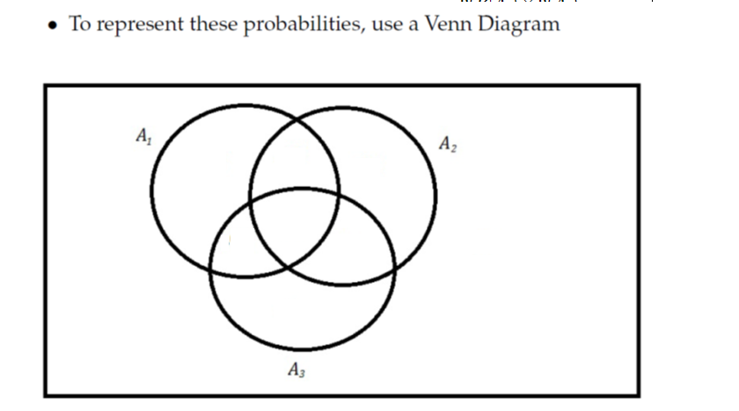
P(A₁) = 0.10 , P(A₂) = 0.08 P(A₃) = 0.05 , P(A₁ ∪ A₂) =0.12
P(A₁ ∪ A₃) = 0.12 , P(A₂ ∪ A₃) = 0.11 P(A₁ ∩ A₂ ∩ A₃) = 0.01
Given that the system has a type 1 defect, what is the probability that
it has a type 2 defect?
2. Given that the system has a type 1 defect, what is the probability that
it has all three types of defects?

Slide 19
Conditioning Complex Events Example1:
3. Given that the system has at least one type of defect, what is the probability that it has exactly one type of defect?

Slide 20
Conditioning Complex Events Example2

Slide 21
Conditioning Complex Events Example2

Slide 22
Conditioning Complex Events Example2

Slide 23
Conditioning Complex Events Example2

Slide 24
Some Facts

Slide 25
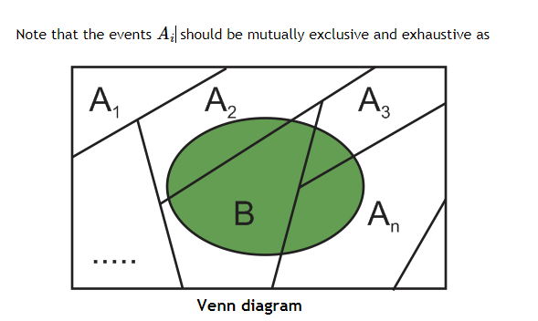
The Law of Total Probability
Notes:
https://www.projectrhea.org/rhea/index.php/From_Bayes_Theorem_to_Pattern_Recognition_via_Bayes_Rule

Slide 26
The Law of Total Probability
Let A₁,…,A_{k} be mutually exclusive and exhaustive events.
Then for any other event B:

Slide 27
Bayes’ Rule
Let A₁,…,A_{k} be mutually exclusive and exhaustive events with prior probabilities P(A_{i}).
Then for any other event B with P(B)>0, the posterior probability of A_{j} given B is:
Notes:
Follows from P(A and B) = P(A|B)P(B) = P(B|A)P(A)

Slide 28
Extension of $ Value Example
Suppose we’re also told that P(B|A^{C}) = 0.3
What is P(A|B)?
A = event that the value of the $ falls.
B = event that the supplier demands changing the contract
P(A) = 0.4
P(B|A) = 0.8
P(A and B) = ?
Notes:
Found in 5.58 itself that P(A and B) = 0.32

Slide 29
Example

Slide 30
Example

Slide 31
Independence
Events A and B are independent if
Otherwise, they are dependent.

Slide 32
Proposition
A and B are independent if and only if

Slide 33
College Attendance
Are college attendance and living in the suburbs independent?

Slide 34
College Attendance
 | City | Suburb | Country | Total
College | 2,550 | 4,580 | 470 | 7,600
No College | 3,450 | 920 | 430 | 4,800
Total | 6,000 | 5,500 | 900 | 12,400

Slide 35
Mutual Independence
Events A₁,…,A_{n} are mutually independent if:
For every k (k=2,3,…,n) AND every subset of indices i₁, i₂,…,i_{k}:
Notes:
Do example on the board

Slide 36
Example: Christmas Lights
A string of Christmas lights contains 20 lights.
If any light fails, the whole string fails.
The probability that a light fails during a 3 year period is 0.02.
The lights fail independently.
What is the probability that the string stays lit for all 3 years?

Slide 37
Example

Slide 39
Example

Slide 40
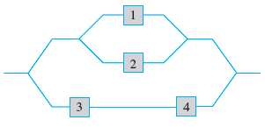
Example
Consider the system of components connected as in the accompanying picture. Components 1 and 2 are connected in parallel, so that subsystem works if and only if either 1 or 2 works; since 3 and 4 are connected in series, that subsystem works if and only if both 3 and 4 work. If components work independently of one another and P(component i works) = 0.8 for i = 1, 2 and = 0.62
for i = 3, 4,
Calculate P(system works).

