Slide 1
The Normal Distribution
MATH 3342
Section 4.3
(& a Small Part of Section 4.6)

Slide 2
Normal Distributions
“Bell shaped”
Symmetric
Mean and median of the curve are equal
Standard Deviation
σ
X
μ
Mean Median

Slide 3
Normal Distributions
Data values range from -∞ to +∞
Completely described using only μ and σ
Denoted by: N(μ,σ²)
Standard Deviation
σ
X
μ
Mean Median

Slide 4
Differences Between Normal Distributions
Different mean, same standard deviation
(a)
x
2
Same mean, different standard deviation
x
(b)
5
x
5

Slide 5
Pdf for the Normal Distributions
A continuous RV X has a Normal distribution with parameters - ∞ < μ < ∞ and σ > 0 if it has the following pdf:
There is no closed form solution for the cdf.

Slide 6
The Standard Normal Distribution
The standard normal distribution is a normal distribution where
μ= 0
σ= 1
Measures the number of standard deviations a point is from the mean.
Positive z-values are above the mean and negative z-values are below.

Slide 7
pdf for the Standard Normal Distribution
A RV is said to be a standard Normal RV and is denoted by Z if it has the following pdf:
The cdf is denoted by

Slide 8
Standard Normal Percentiles
There is no formula for calculating these.
To obtain them, either software or tables are used.
Table A provides the percentiles for Z.
Referred to as Table A.3 in the book.

Slide 9
Using Table A
Partial Cumulative Standardized Normal Distribution Table
Z
.00
.01
.02
.5478
0.0
.5000
.5040
.5080
0.1
.5398
.5438
.5478
0.2
.5793
.5832
.5871
0
Proportions
0.3
.6179
.6217
.6255
Z = 0.12

Slide 10
Using Table A
Part of Table A
.4168
Z
.00
.01
.02
-.30
.3821
.3783
.3745
-.20
.4207
.4168
.4129
-.10
.4602
.4562
.4522
0
0.0
.5000
.4960
.4920
Z = -0.21

Slide 11
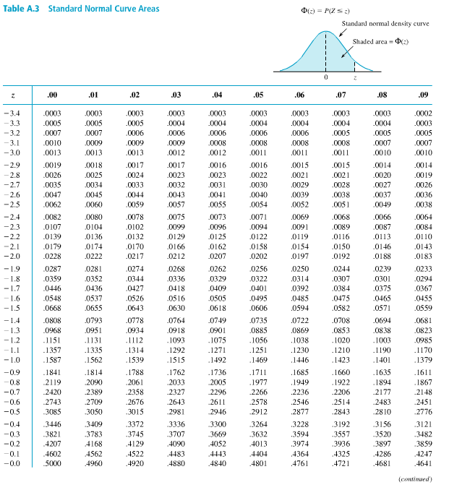
μ= 0
σ= 1

Slide 12
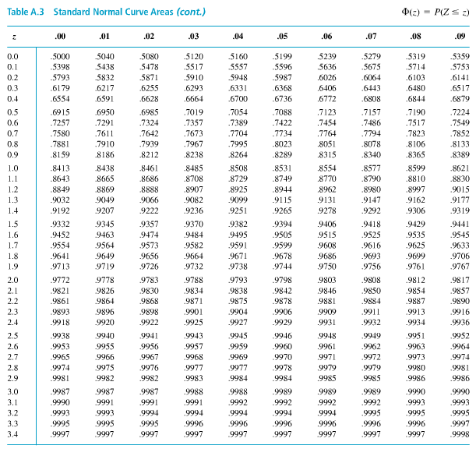

Slide 13
Example
Find the proportions corresponding to the following statements:
a) z < 2.85
b) z > 2.85
c) z > -1.66
d) -1.66 < z < 2.85

Slide 14
Example

Slide 15
Example

Slide 16
Example

Slide 17
Standardizing
If a variable x is from N(μ,σ²), then the standardized value of x, called a z-score is the following:
The variable z is from N(0,1)

Slide 18

Normal Probability Equation

Slide 19
Example

Slide 20
Example

Slide 21
Example

Slide 22
Example
Weights of baby elephants X follow a Normal distribution with mean μ=224 lbs and standard deviation σ=53 lbs.
a) P(X < 200 lbs) = ?
b) P(200 < X < 300 lbs) = ?
c) P(X> 445) = ?

Slide 23
Finding a Percentile for any Normal Distribution
State the problem and draw a picture.
What are the mean and standard deviation? What percentile is desired?
Use Table A.
Look for the entry closest to the given probability to find the z-score.
Unstandardized the z-score.
Transform z back to the desired x scale.

Slide 24
Example
The steel reinforcement bars manufactured in a foundry have lengths that follow a normal distribution with mean μ =143 in. and standard deviation σ = 29 in.
Below what length would 10% of the bars fall?
.1000
σ = 29
μ = 143
x
Notes:
found·ry: a workshop or factory for casting metal.

Slide 25
Example
Use Table A to find the z score corresponding to the region bounded by x.
.1000
σ = 29
Z
.07
.08
0.9
-1.5
.0582
.0571
.0559
-1.4
.0708
.0694
.0681
μ = 143
x
-1.3
.0853
.0838
.0823
-1.2
.1020
.1003
.0985
z
-1.28
0

Slide 26
Example
Use the following formula to translate the z score into x (in the original units).
.1000
σ = 29
x = μ + zσ
x = 143 + (-1.28) 29
μ = 143
105.88
x = 105.88 in.
-1.28
0
z

Slide 27
Symmetric Equation

Slide 28
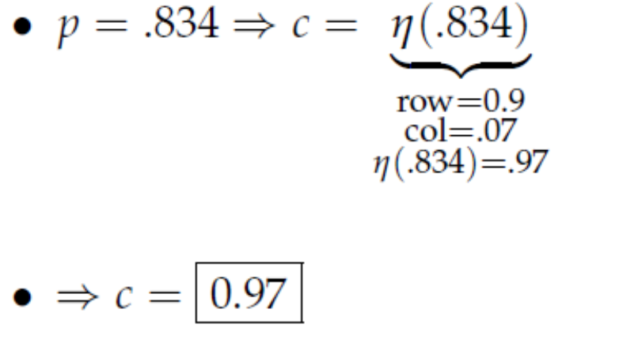
Symmetric Equation

