Slide 1
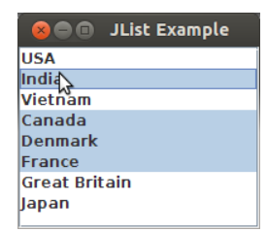
Java List Box, ComboBox
JList:
A JList presents the user with a group of items, displayed in one or more columns, to choose from. The actual list of elements to display is managed by a DefaultListModel object.
A JList object displays the contents of a DefaultListModel object
Figure 1a, JList with Elements

Slide 2
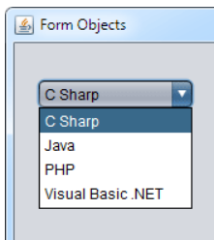
JComboBox:
A JComboBox is yet another way to display a small list of items. It appears as a pull-down menu, where the selectable items are on the menu itself.
A key idea in writing JComboBox programs is the relationship between a ComboBox and a ComboBoxModel. A ComboBoxModel holds the list elements that are to be displayed. All changes to this list are made to the ComboBoxModel (or to an instance of DefaultComboBoxModel class).
Java List Box, ComboBox
Figure1b, JComboBox with Elements

Slide 3
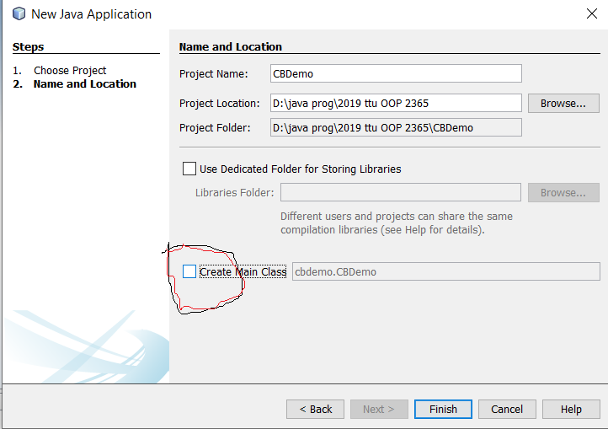
Creating ComboBox Application
Figure 1c, Creating ComboBox Application Project

Slide 4
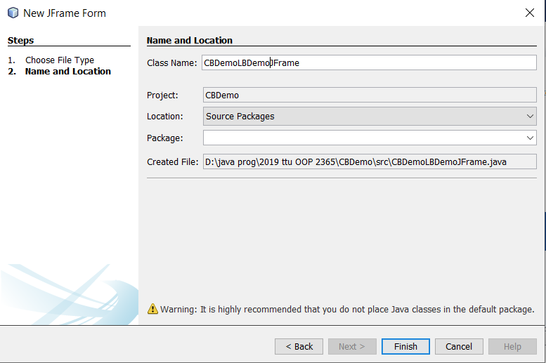
Creating Frame Class
Figure#2, Creating Frame Class

Slide 5
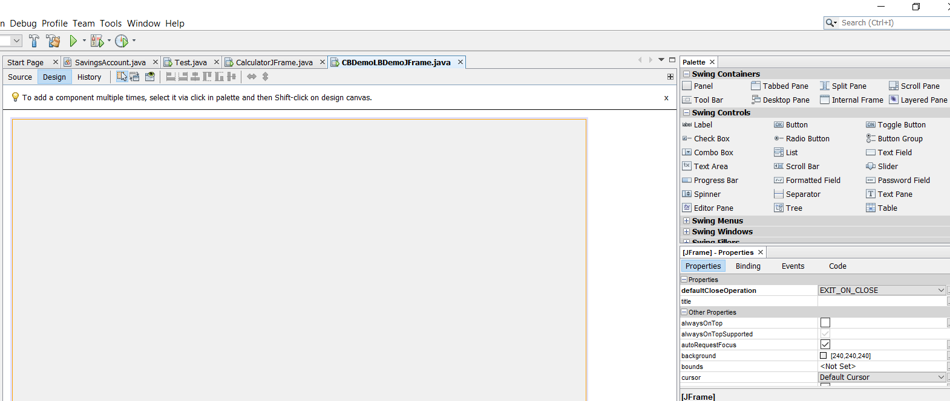
Frame Window and the Palette
Figure#3, Frame Windows and The Palette

Slide 6
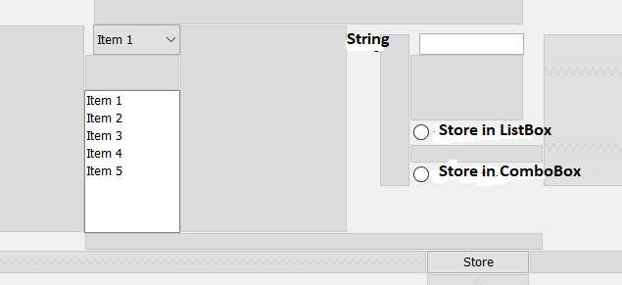
Creating GUI of Application
Create a container class. Provide instance variables for list box, combo box, text field, and two radio buttons and a push button (named “submit”). Provide the code to set the group property of radio buttons and to disable the text fields. Provide code for radio button handlers to enable the text field on selecting the radio button. Write the code for button handler. The button handler identifies whether “Store in ListBox” or “Store in ComboBox radio button is clicked. Based upon the radio button clicked, button handler stores the text field string either in the list box or in the combo box.
Figure#4, User Interface of the Application

Slide 7
Variables Associated with the GUI Components
private javax.swing.JButton btnStore;
private javax.swing.JLabel jLabel1;
private javax.swing.JScrollPane jScrollPane1;
private javax.swing.JComboBox<String> mCB;
private javax.swing.JList<String> mLB;
private javax.swing.JRadioButton mRB_CB;
private javax.swing.JRadioButton mRB_LB;
private javax.swing.JTextField mStrTF;

Slide 8
Use of Angle Brackets in Declaring Object of Jlist, and JComboBox
private javax.swing.JComboBox<String> mCB;
private javax.swing.JList<String> mLB;
<String> be read as "of type String".
That means I can add only String type object to that JComboBox or JList.
Angle brackets also mean that JComboBox and JList are generic classes or collection classes.

Slide 9
For Your Reading
In Java, "generic" means "has a type parameter". For example JComboBox is a generic class because it has a type parameter... in your example the value of the type parameter is <String>.
And in Java, a Collection is a class which can represent a collection of things. Generally it's restricted to the classes in the Java collections framework, which were added into Java when Java 2 was released in 1998.
The "generic" feature was added to Java when Java 5 was released in 2004; the majority of the Collection classes were made generic at that time.

Slide 10
Coding Steps
Initializing Code (i.e. Coding the Constructor of GUI Application)
Setting the group property for Radio Buttons
Initializing the Radio Buttons to False
Declare the Boolean variables to indicate whether the radio buttons are clicked or not (instance variables)
2. Writing the code for RadioButton handlers
Enable the radio Buttons
3. Writing the Code for Submit Button
Detects which RadioButton is enabled
Retrieve the String from TextField
Depending upon which Radio Button is selected, store the retrieved text either in the ListBox or in the ComboBox

Slide 11
Constructor Code
Initializing Code (i.e. Coding the Constructor of GUI Application)
public CBDemoLBDemoJFrame() {
initComponents();
ButtonGroup group = new ButtonGroup();
group.add(mRB_CB);
group.add(mRB_LB);
mStrTF.setEnabled(false);
}
//Declaring the instance variables to indicate if radio button clicked or //not
boolean bmRB_CB = false;
boolean bmRB_LB = false;

Slide 12
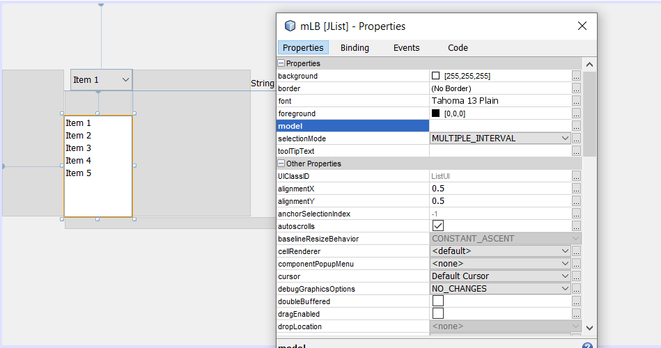
Removing the ListBox Entries
Figure#5, Removing the ListBox Entries

Slide 13
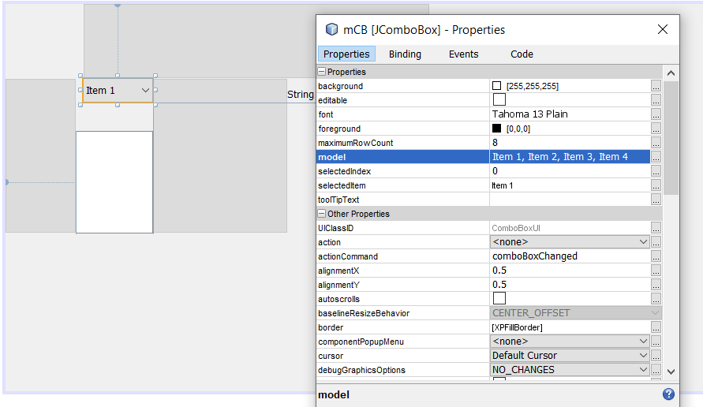
Removing the ComboBox Entries
Figure#6, Removing the ComboBox Entries

Slide 14
Writing the Code for Radio Button
private void mRB_LBActionPerformed(java.awt.event.ActionEvent evt) {
bmRB_LB = true;
bmRB_CB = false;
mStrTF.setEnabled(true);
}
private void mRB_CBActionPerformed(java.awt.event.ActionEvent evt) {
bmRB_LB = false;
bmRB_CB = true;
mStrTF.setEnabled(true);
}

Slide 15
Storing Strings in JList and JComboBox
Declare them as instance Variables
DefaultListModel<String> modelL = new DefaultListModel<String>();
DefaultComboBoxModel<String> modelC = new DefaultComboBoxModel<String>();

Slide 16
Writing the Code for Submit Button Handler
private void btnStoreActionPerformed(java.awt.event.ActionEvent evt) { if(bmRB_CB == true){ //Purpose?
String str = mStrTF.getText();
modelC.addElement(str);
mCB.setModel(modelC);
}
else if(bmRB_LB == true){ //Purpose?
String str = mStrTF.getText();
modelL.addElement(str);
mLB.setModel(modelL);
}
}
Steps for Adding Elements Using ListBox and ComboBox??

Slide 17
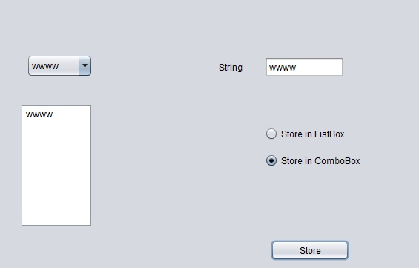
Sample Run of ListBox and ComboBox Application
Figure#7, Sample Run of the Application

