Slide 1
The Goals of Object Oriented Programming
The primary goals of object oriented language
development are:
Abstraction: partition a project into its conceptual
natural units. The base unit should describe only the
most essential qualities(i.e. ignoring unnecessary details.)
Encapsulate: isolate code from influencing or being
influenced by other code.
Reusablity: classes are self-contained code units.
Can be easily taken out and moved to other programs.
No strings attaching them to other code.
Inheritance: can create a new class that inherits the
capabilities of a class, i.e. its variables and methods,
and adds new capabilities.

Slide 2
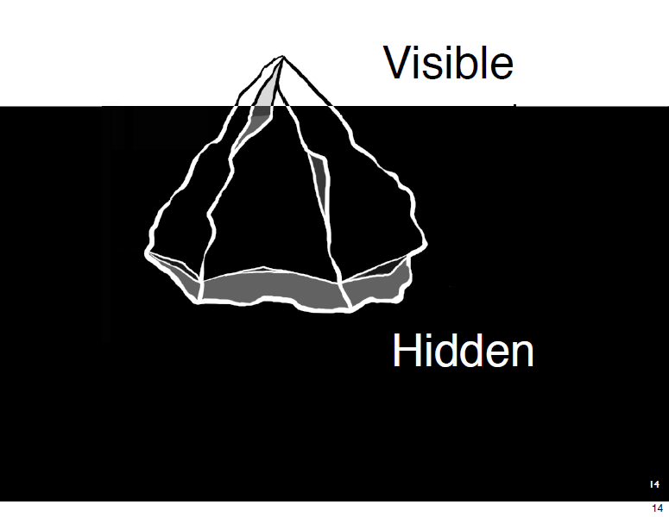

Slide 3
Example
int f(char ch) {………}
This sort of abstraction is known as procedural
abstraction
char int
Operation
Data part: Input Data, Output Data
Operation part: char converts into integer
Hidden part: implementation details are not known (Ignore it)

Slide 4
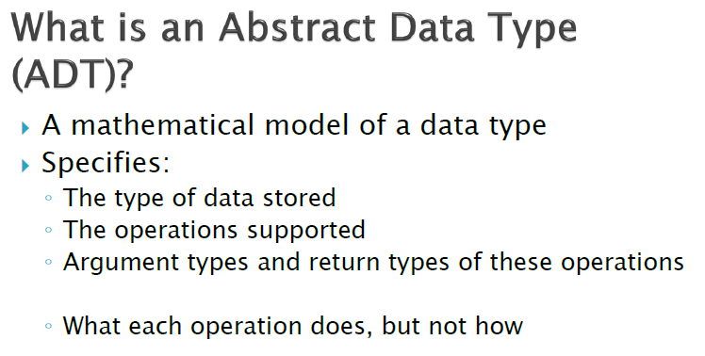
Based upon above description, we can say that
“Class is an Abstract Data Type”

Slide 5
An example Java class
class CurrencyConverter {
private double rate;
public CurrencyConverter(double theRate) {
rate = theRate;
}
public double getRate() {
return rate;
}
public double convert(double original) {
return rate*original;
}
public String toString() {
return "converts Euro to Dollar at rate "
+ rate;
}
}
How can we use this class?

Slide 6
import java.util.Scanner;
public class CurrencyConverterTester {
public static void main(String[] args) {
Scanner input = new Scanner(System.in);
System.out.printf("Please state exchange
rate for converting Euro to $: ");
double theRate = input.nextDouble();
CurrencyConverter cc = new
CurrencyConverter(theRate);//Object creation
System.out.printf("This object “+
cc.toString());
System.out.format("The rate is %s ",
cc.getRate());
System.out.printf("Type a Euro amount, or
Ctrl-C to quit:> ");
double amount;

Slide 7
while (input.hasNext()) {
amount = input.nextDouble();
System.out.format("E %f converts to $%f \n", amount,
cc.convert(amount));
System.out.printf("> ");
}
}
}
What is hasNext()?
What is an object of a class?
What is a constructor?
How you invoke method of a class other than a constructor?
How we invoke a constructor?

Slide 8
The Basic Elements of Java
The basic elements of Java include:
Keywords - words reserved for Java:
class, float, return, etc.
Primitive types - specifies how values are stored in
memory and what operations they can undergo:
int, float, boolean, double, char
Operators: +,-,/,*,
Declarations - allocate memory for an instance of
a particular type:
int x; double y=1.0; etc.

Slide 9
Literals - immediate values :
int i = 3;// <= 3 is a literal. `<=` symbol for “it implies that”
double x = 3.0;// <= 3.0 is a literal
Statements - express an action to execute:
x=5;
if( y<5) x= 3;
etc.
Classes - provide the data structure and operations for a new type. Objects are instances of a class.

Slide 10
Objects
  the world consists of objects
    some are tangible – you, this projector, my car ...
    some are intangible – my bank account, this lecture
  a Java program, when running, populates the world with objects, and specifies how they will interact
  this (partial) correspondence between real-world objects and software objects is the first step towards making programs easier to design and communicate

Slide 11

Example object
myCar
my car
engine size:1.2
num doors:3
colour: maroon
Properties
engine size: 1.2
num doors: 3
colour: maroon
...
Things it can do
drive
reverse
lock
...
drive()
reverse()
lock()

Slide 12
Objects in java
In the real world, an object is a thing which has attributes and which behaves in particular ways.
In java, an object is a collection of data and methods.
The object encapsulates the data and methods.
In a software model, the object provides an abstraction of the real-world entity
attributes
behaviours

Slide 13
What is a class?
A class is simply a specification of an object. This allows us to create multiple objects all of the same type.
For example, we might say there is a class "Car", describing cars in general. It has attributes (engine size, number of doors, colour, etc.) and behaviours (drive, reverse, open door, etc.).
We can then talk about particular objects in this class - for example, "Ken's car", "John's car" - they all have the same attributes and behaviour, but are different objects – they may
have different values for the attributes, and they will behave separately.

Slide 14

Example class and object
Car
engine size:
#doors:
colour:
...
drive()
reverse()
lock()
...
class:
objects
Ken's car
Colin McRae's car

Slide 15
Object references
  to refer to an object, we use a name or referring phrase
  a reference is a phrase used to refer to an object
    "CS2200"
    "my car"
    "Ken Brown"
    "CS2200 lecturer"
  most objects we create in java will have at least one reference, and many of them will have multiple references
  ‘reference’ are useful in creating LL
CurrencyConverter cc = new CurrencyConverter(theRate);
CurrencyConverter ref1, ref2;
ref1 = cc; ref2 = cc;

Slide 16
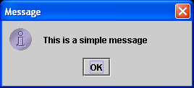
The JOptionPane class
  in a user interface, a dialog box is for interaction which must be completed before computation continues
  the JOptionPane class specifies dialog boxes for simple input/output interaction with the user
  it is a specialisation of the standard JOptionPane class
  we will use it in the early part of the course to get started; later we will see how the class is implemented, and we will develop more sophisticated user interfaces

Slide 17
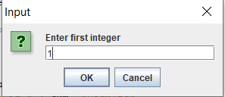
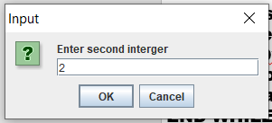
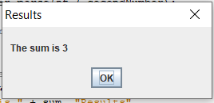
import javax.swing.JOptionPane; //import class JOptionPane
public class Addition {
public static void main ( String args[] )
{
String strFirstNumber, //first string entered by user
strSecondNumber; // second string entered by user
int iNumber1, // first number to add
iNumber2, //second number to add
iSum; //sum of number1 and number2
//read in the first number from user as a string
strFirstNumber = JOptionPane.showInputDialog ( "Enter first integer" );
//read in the second number from user as a string
strSecondNumber = JOptionPane.showInputDialog ( "Enter second interger" );
//convert numbers from type String to type int
iNumber1 = Integer.parseInt ( strFirstNumber);
iNumber2 = Integer.parseInt ( strSecondNumber);
//add the numbers
iSum = iNumber1 + iNumber2;
//display the results
JOptionPane.showMessageDialog ( null, "The sum is"+ iSum, "Results", JOptionPane.PLAIN_MESSAGE);
OR JOptionPane.showMessageDialog ( null, "The sum is " + iSum );
System.exit ( 0 ); //ends the program
}
}

Slide 18
class OurNewType {
// Define some properties of our class
int i;
float x;
// A constructor - special sort of method called when an //instance of a class is first created.
OurNewType (){
i = 10;
x = 0.0;
}
// A method that our type needs
void doSomething (float f){
x = i * f;
}
} // Finished defining
Use this class???

Slide 19
Creating an object
To create an object,
  we must specify what class it will be an instance of
  we should give it a reference, so that we can refer to it
Example: to create an object from the UserDialog class, type:
UserDialog ud;
ud = new UserDialog();
Declare ud to be a reference to an object of the UserDialog class
Create a new object of the UserDialog class, and associate the reference ud with it.

Slide 20
Objects vs References
Java handles objects by reference. This is opposed
to C++ where pointers and their manipulation are
used extensively.
Pointers in C and C++
hold the actual addresses of data in memory.
can be cast to different data types
altered to point to other memory locations
A Java reference also holds the memory address of
an object.
However:
reference values can not be obtained.
reference values can not be altered
references can only be recast to super or sub-class
of that object, never to other data types (i.e for
Polymorphism).

Slide 21
Object behaviour
The methods of an object are the pieces of behaviour it can be asked to carry out (or decides to carry out itself):
  the tasks a person will perform
    delivering a lecture, completing an assignment, pouring a pint, ...
  the functions of a machine
    accelerate, wash clothes on cycle 5, play track 3, ...
  the facilitates abstraction of an object
    display your bank balance, increase your balance when you deposit money, …
    get an number from the user (i.e. we are hiding all but
    the relevant details of an object)

Slide 22
Results from methods
  some methods produce a result that they return to the client (indicated by return type)
    E.g. Moira's credit check returns "OK" or "not OK" to Barry
    E.g. once my car's engine has started, information is returned to me on the instrument panel
  other methods don't return any result
    E.g. my "teeth brushing" method does not return any information (indicated by void)

Slide 23
Method signatures
  if object A is to invoke one of object B's methods, it must know the method signature:
    method name
    the parameters, in the correct order and with the correct data type
    the data type of the result
  E.g. Barry must know that Moira's credit check method
    is called "do a credit check
    requires a customer reference and an amount
    returns "OK" or "not OK"
  A must also have a correct reference for B

Slide 24
Statements
Logical test & flow control:
if( i > 10) {
j++:
} else {
j=0;
}
A method (a function belonging to a class) call:
a.setText("foo");
Iterative flow control:
for(i=0; i<10; i++) j++;
while ( i < 5) {
i=a.doSomething();
}
do {
i=a.doSomething();
} while ( i < 5)

Slide 25
Flow commands:
while ( i < 5) {
i=a.doSomething();
if(i<0) break;
}
===
public class ContinueLabel2 {
public static void main(String[] args) {
int b=10;
int a= 5;
jmp0:
while (b> 10)
{ if (a>5)
continue jmp0;
else
continue jmp1;
}
jmp1: System.out.print("Zulfi");
}
}

Slide 26
switch( i ){
case 1: b.func();
case 2: a.func();
default: c:func();
}

