Slide 1
Chapter 8 The Enhanced
Entity-Relationship (EER) Model

Slide 2
EER Model
The ER model concepts are sufficient for representing many database schemas for traditional database applications, which mainly include data-processing applications in business and industry.
However, designers of database applications have tried to design more accurate database schemas
  Reflect the data properties and constrains more precisely
  User's perspective of the data and what could be more important
This chapter describes features that have been proposed for semantic data models, and shows how the ER model can be enhanced to include these concepts.

Slide 3
Basic Concepts
EER model includes all modeling concepts of the ER model
In addition, EER includes:
  Subclasses and superclasses
  Specialization and generalization
  Attribute and relationship inheritance
  Category or union type

Slide 4
Subclasses and Superclasses
In many cases an entity type has numerous subgroupings of its entities that are meaningful and need to be represented explicitly because of their significance to the database application.
For example: EMPLOYEE may be further grouped into:
    SECRETARY, ENGINEER, TECHNICIAN, …
      Based on the EMPLOYEE’s Job
    MANAGER
      EMPLOYEEs who are managers
    SALARIED_EMPLOYEE, HOURLY_EMPLOYEE
      Based on the EMPLOYEE’s method of pay

Slide 5
Subclasses, Superclasses and Inheritance
We call each of these subgroupings a subclass of the EMPLOYEE entity type, and the EMPLOYEE entity type is called the superclass for each of these subclasses.
These are called superclass/subclass (as well as simply class/subclass) relationships:
  EMPLOYEE/SECRETARY
  EMPLOYEE/TECHNICIAN
  EMPLOYEE/MANAGER
  …
These are also called IS-A relationships
  SECRETARY IS-A EMPLOYEE, TECHNICIAN IS-A EMPLOYEE, ….

Slide 6
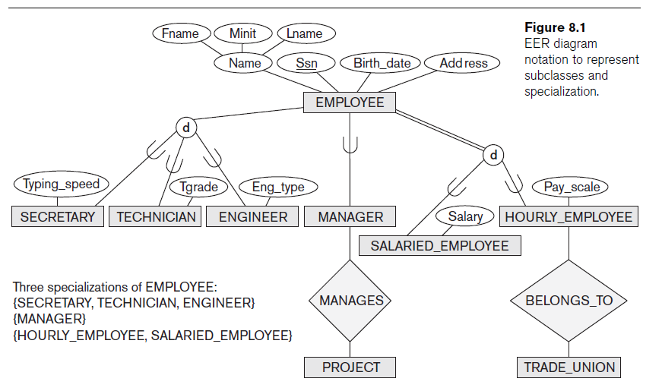

Slide 7
Subclasses, Superclasses and Inheritance
An Entity CANNOT exist in the database merely by being a member of a subclass; it must also be a member of the superclass
A member of the superclass can be optionally included as a member of any number of its subclasses

Slide 8
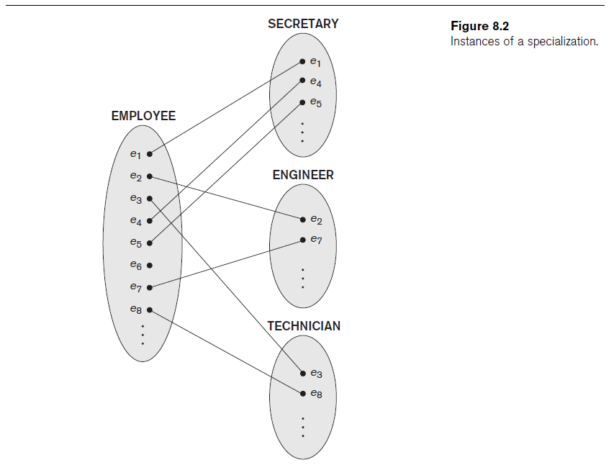

Slide 9
Subclasses and Superclasses Example
A member of the superclass can be optionally included as a member of any number of its subclasses
  A salaried employee who is also an engineer belongs to the two subclasses:
    ENGINEER, and
    SALARIED_EMPLOYEE
  A salaried employee who is also an engineering manager belongs to the three subclasses:
    MANAGER,
    ENGINEER, and
    SALARIED_EMPLOYEE
It is not necessary that every entity in a superclass be a member of some subclass

Slide 10
Inheritance
Type inheritance
  Subclass entity inherits all attributes and relationships of superclass
Example:
  In the previous slide, SECRETARY (as well as TECHNICIAN and ENGINEER) inherit the attributes Name, SSN, …, from EMPLOYEE
  Every SECRETARY entity will have values for the inherited attributes
  Every SECRETARY entity will also keep all relationships

Slide 12
Specialization
Specialization
  Process of defining a set of subclasses of an entity type
  Defined on the basis of some distinguishing characteristic of the entities in the superclass
Subclass can define:
  Specific attributes (local attributes)
  Specific relationship types

Slide 14
Specialization
Specific attributes
  Certain attributes may apply to some but not all entities of the superclass
Specific relationship
  Some relationship types may be participated in only by members of the subclass

Slide 15
Specialization
In summary, the specialization process allows us to do the following:
  Define a set of subclass of an entity type
  Establish additional specific attributes with each subclass
  Establish additional specific relationship types between each subclass and other entity types or other subclasses

Slide 16
Generalization
Reverse process of abstraction
Generalize into a single superclass
  Original entity types are special subclasses
Generalization
  Process of defining a generalized entity type from the given entity types

Slide 17
Generalization
Example: CAR, TRUCK generalized into VEHICLE;
  both CAR, TRUCK become subclasses of the superclass VEHICLE.
  We can view {CAR, TRUCK} as a specialization of VEHICLE
  Alternatively, we can view VEHICLE as a generalization of CAR and TRUCK

Slide 18


Slide 19
Constraints on Specialization and Generalization
Two basic constraints
  Disjointness constraint
    Specifies that the subclasses of the specialization must be disjoint
  Completeness (or totalness) constraint
    May be total or partial
  Disjointness and completeness constraints are independent

Slide 20
Disjointness constraint
Disjointness Constraint:
  Specifies that the subclasses of the specialization must be disjoint: an entity can be a member of at most one of the subclasses of the specialization
Specified by d in EER diagram

Slide 21
Disjointness constraint
If not disjoint, specialization is overlapping:
  that is the same entity may be a member of more than one subclass of the specialization
Specified by o in EER diagram

Slide 22
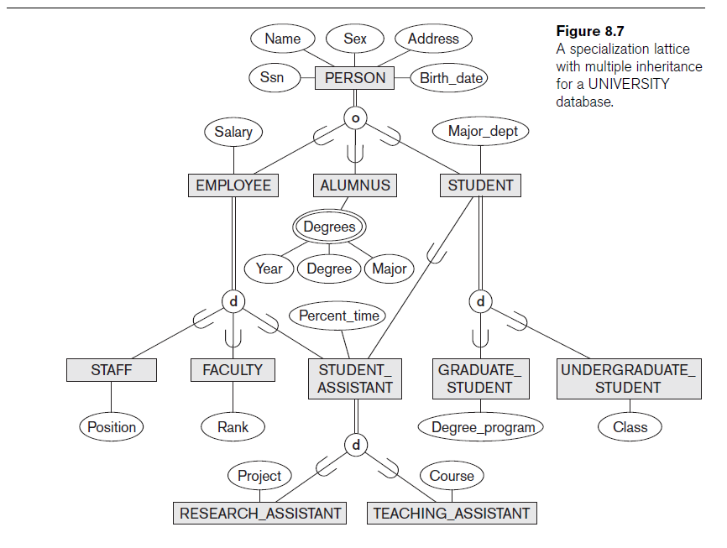

Slide 23
Completeness Constraint
Completeness Constraint:
  Total specifies that every entity in the superclass must be a member of some subclass
  Shown in EER diagrams by a double line
  Partial allows an entity not to belong to any of the subclasses
  Shown in EER diagrams by a single line
  In general, a superclass that was identified through the generalization process usually total, because the superclass is derived from the subclasses and hence contains only the entities that are in the subclass

Slide 25
Constraints on Specialization and Generalization
Hence, we have four types of specialization/generalization:
  Disjoint, total
  Disjoint, partial
  Overlapping, total
  Overlapping, partial

Slide 26
Constraints on Specialization and Generalization
Some general rules:
  Deleting an entity from a superclass implies that it is automatically deleted from all the subclasses to which it belongs
  Inserting an entity in a superclass of a total specialization implies that the entity is mandatorily inserted in at least one of the subclasses of the specialization

Slide 27
Hierarchies and Lattices
A subclass may itself have further subclasses specified on it
Leaf node is a class that has no subclasses of its own
Hierarchy has a constraint that every subclass has only one superclass (called single inheritance); this is basically a tree structure
In a lattice, a subclass can be subclass (shared subclass ) of more than one superclass (called multiple inheritance)
Notice that the existence of at least one shared subclass leads to a lattice, otherwise, it’s a hierarchy

Slide 28
Shared Subclass “Engineering_Manager”

Slide 29
Lattice Example (UNIVERSITY)

Slide 30
Basic Concepts
EER model includes all modeling concepts of the ER model
In addition, EER includes:
  Subclasses and superclasses
  Specialization and generalization
  Attribute and relationship inheritance
  Category or union type

Slide 31
Union
All of the superclass/subclass relationships we have seen so far origin from a single superclass
Sometimes we may need more than one superclass
In this case, the subclass will represent a collection of objects that is a subset of the UNION of distinct entity types
We call such a subclass a UNION TYPE

Slide 32
Union
Example: In a database for vehicle registration, a vehicle owner can be a PERSON, a BANK (holding a lien on a vehicle) or a COMPANY.
  A UNION type called OWNER is created to represent a subset of the union of the three superclasses COMPANY, BANK, and PERSON

Slide 33
Two categories (UNION types): OWNER, REGISTERED_VEHICLE

Slide 34
Modeling of UNION Types Using Categories
  Union type or a category
  Represents a single superclass/subclass relationship with more than one superclass
  Subclass represents a collection of objects that is a subset of the UNION of distinct entity types
  Attribute inheritance works more selectively
  Category can be total or partial
Some modeling methodologies do not have union types

Slide 35
Union vs. Shared Subclass
We can compare a UNION (OWNER) with shared subclass (ENGINEERING_MANAGER)
The latter is a subclass of each of the three superclass ENGINEER, MANAGER and SALARIED_EMPLOYEE, so an entity that is a member of ENGINEERING_MANAGER must exist in all three
This means that an engineering manager must be an ENGINEER, a MANAGER, and a SALARIED_EMPLOYEE
On the other hand, in Union, an entity that is a member of OWNER must exist in only one of the superclass

Slide 36
Shared Subclass “Engineering_Manager”

Slide 37
Two categories (UNION types): OWNER, REGISTERED_VEHICLE

Slide 38
Union vs. Shared Subclass
Attribute inheritance works more selectively in the case of UNION.
For example, OWNER entity inherits attributes of a COMPANY, a PERSON OR a BANK
A shared subclass such as ENGINEERING_MANAGER inherits ALL the attributes of its superclasses

Slide 39
Design Choices for Specialization/Generalization
Many specializations and subclasses can be defined to make the conceptual model accurate
If all the subclasses of a specialization/generalization have few specific attributes and no specific relationships
  Can be merged into the superclass

Slide 40
Design Choices for Specialization/Generalization
Choice of disjoint/overlapping and total/partial constraints on specialization/generalization
  Driven by rules in miniworld being modeled
Union types and categories should generally be avoided

