Slide 1
Chapter 9 Relational Database Design by ER- and EER-to-Relational Mapping

Slide 2
Chapter Outline
ER-to-Relational Mapping Algorithm
  Step 1: Mapping of Regular Entity Types
  Step 2: Mapping of Weak Entity Types
  Step 3: Mapping of Binary 1:1 Relationship Types
  Step 4: Mapping of Binary 1:N Relationship Types.
  Step 5: Mapping of Binary M:N Relationship Types.
  Step 6: Mapping of Multivalued attributes.
  Step 7: Mapping of N-ary Relationship Types.
Mapping EER Model Constructs to Relations (additional steps)
  Step 8: Options for Mapping Specialization or Generalization.
  Step 9: Mapping of Union Types (Categories).

Slide 3
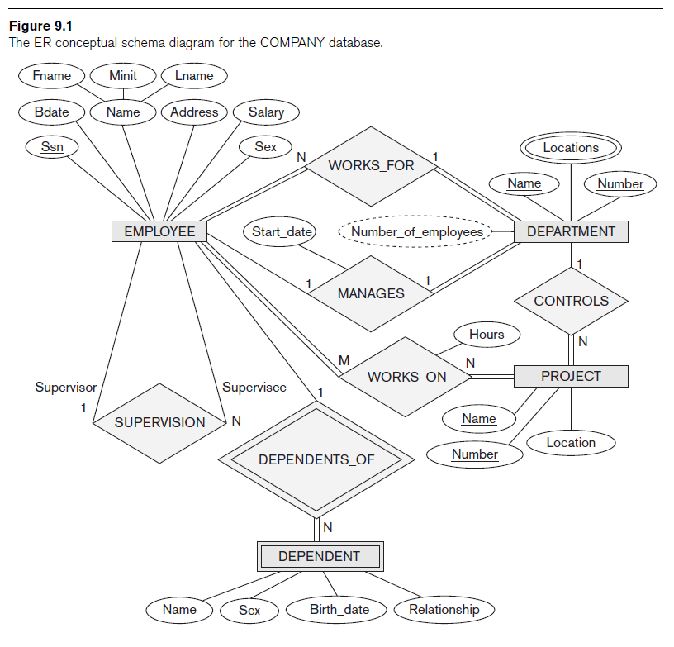
COMPANY database example

Slide 4
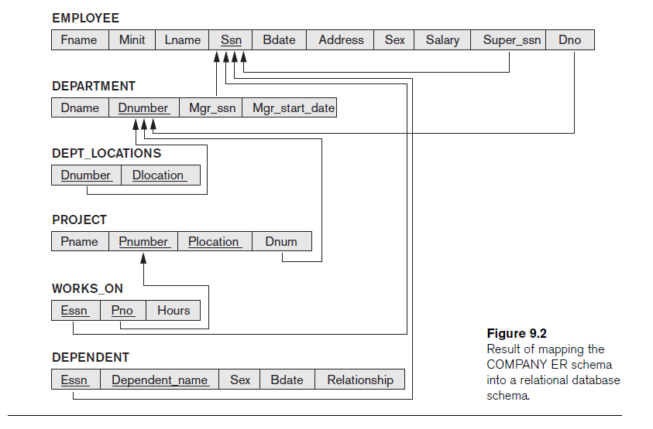

Slide 5
ER-to-Relational Mapping Algorithm
COMPANY database example
  Assume that the mapping will create tables with simple single-valued attributes

Slide 6
Step 1: Mapping of Regular Entity Types
Step 1: Mapping of Regular Entity Types.
  For each regular (strong) entity type E in the ER schema, create a relation R that includes all the simple attributes of E.
  Choose one of the key attributes of E as the primary key for R.
  If the chosen key of E is composite, the set of simple attributes that form it will together form the primary key of R.

Slide 7
Step 1: Mapping of Regular Entity Types (cont’d)
Example: We create the relations EMPLOYEE, DEPARTMENT, and PROJECT in the relational schema corresponding to the regular entities in the ER diagram. (entity relation)
  SSN, DNUMBER, and PNUMBER are the primary keys for the relations EMPLOYEE, DEPARTMENT, and PROJECT as shown.

Slide 8
COMPANY database example

Slide 9
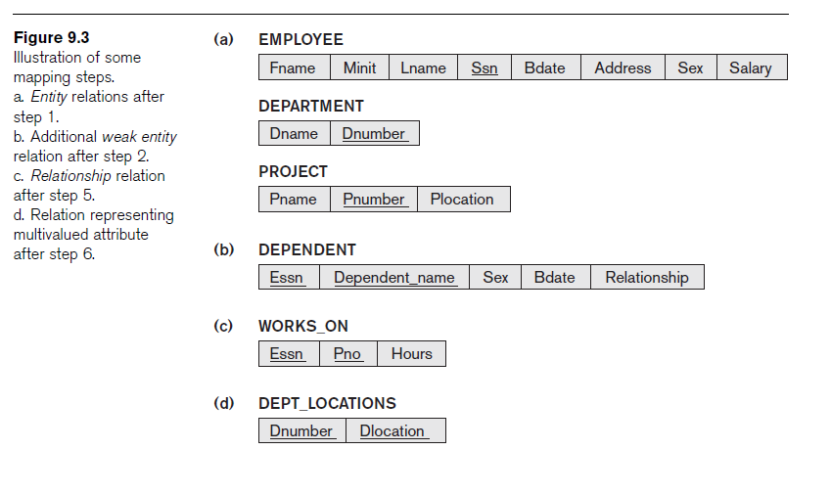
ER-to-Relational Mapping Algorithm (cont’d.)

Slide 10
Step 2: Mapping of Weak Entity Types
  For each weak entity type W in the ER schema with owner entity type E, create a relation R & include all simple attributes (or simple components of composite attributes) of W as attributes of R.
  Also, include the primary key attribute(s) of the relation(s) that correspond to the owner entity type(s) as foreign key attributes of R.
  The primary key of R is the combination of the primary key(s) of the owner(s) and the partial key of the weak entity type W, if any.

Slide 11
Step 2: Mapping of Weak Entity Types
Example: Create the relation DEPENDENT in this step to correspond to the weak entity type DEPENDENT.
  Include the primary key SSN of the EMPLOYEE relation as a foreign key attribute of DEPENDENT (renamed to ESSN).
  The primary key of the DEPENDENT relation is the combination {ESSN, DEPENDENT_NAME} because DEPENDENT_NAME is the partial key of DEPENDENT

Slide 12
COMPANY database example

Slide 13
ER-to-Relational Mapping Algorithm (cont’d.)

Slide 14
Step 3: Mapping of Binary 1:1 Relationship Types
For each binary 1:1 relationship type R in the ER schema, identify the relations S and T that correspond to the entity types participating in R.
Three possible approaches
  Foreign key approach
  Merged relationship approach
  Cross-reference or relationship relation approach

Slide 15
Step 3: Mapping of Binary 1:1 Relationship Types
  Foreign Key approach:
    Choose one of the relations, saying S
    Include the primary key of T as a foreign key in S.
    It is better to choose an entity type with total participation in R in the role of S.
    Example: 1:1 relation MANAGES is mapped by choosing the participating entity type DEPARTMENT to serve in the role of S, because its participation in the MANAGES relationship type is total.

Slide 16
COMPANY database example

Slide 18
Step 3: Mapping of Binary 1:1 Relationship Types
Merge relation approach
  Merger the two entity types and the relationship into a single relation
  Possible when both participations are total
Cross-reference or relationship relation approach
  Set up a third relation R (RELATIONSHIP RELATION) for the cross-referencing the primary keys of the two relations S and T representing the entity types
  For binary M:N relationships

Slide 19
Step 4: Mapping of Binary 1:N Relationship Types
  For each regular binary 1:N relationship type R, identify the relation S that represent the participating entity type at the N-side of the relationship type.
  Include the primary key of the relation T that represents the other entity type participating in R as a foreign key in S.
  Include any simple attributes of the 1:N relation type as attributes of S.

Slide 20
Step 4: Mapping of Binary 1:N Relationship Types
Example: 1:N relationship types WORKS_FOR, CONTROLS, and SUPERVISION in the figure.
  For WORKS_FOR we include the primary key DNUMBER of the DEPARTMENT relation as foreign key in the EMPLOYEE relation and call it DNO.

Slide 21
COMPANY database example

Slide 23
Step 5: Mapping of Binary M:N Relationship Types
  For each regular binary M:N relationship type R, create a new relation S to represent R.
  Include the primary keys of the relations that represent the participating entity types as foreign key attributes in S; their combination will form the primary key of S.
  Also include any simple attributes of the M:N relationship type (or simple components of composite attributes) as attributes of S.

Slide 24
Step 5: Mapping of Binary M:N Relationship Types
Example: The M:N relationship type WORKS_ON from the ER diagram is mapped by creating a relation WORKS_ON in the relational database schema.
  The primary keys of the PROJECT and EMPLOYEE relations are included as foreign keys in WORKS_ON and renamed PNO and ESSN, respectively.
  Attribute HOURS in WORKS_ON represents the HOURS attribute of the relation type. The primary key of the WORKS_ON relation is the combination of the foreign key attributes {ESSN, PNO}.

Slide 25
COMPANY database example

Slide 27
Step 6: Mapping of Multivalued attributes
  For each multivalued attribute A, create a new relation R.
  This relation R will include an attribute corresponding to A, plus the primary key attribute K of the relation that represents the entity type of relationship type that has A as an attribute as a foreign key in R.
  The primary key of R is the combination of A and K. If the multivalued attribute is composite, we include its simple components.

Slide 28

Step 6: Mapping of Multivalued attributes
Example: The relation DEPT_LOCATIONS is created.
  The attribute DLOCATION represents the multivalued attribute LOCATIONS of DEPARTMENT, while DNUMBER-as foreign key-represents the primary key of the DEPARTMENT relation.
  The primary key of R is the combination of {DNUMBER, DLOCATION}.

Slide 29
COMPANY database example

Slide 31
Step 7: Mapping of N-ary Relationship Types
  For each n-ary relationship type R, where n>2, create a new relationship S to represent R.
  Include the primary keys of the relations that represent the participating entity types as foreign key attributes in S.
  Also include any simple attributes of the n-ary relationship type (or simple components of composite attributes) as attributes of S.

Slide 32
Step 7: Mapping of N-ary Relationship Types
Example: The relationship type SUPPY in the ER on the next slide.
  This can be mapped to the relation SUPPLY shown in the relational schema, whose primary key is the combination of the three foreign keys {SNAME, PARTNO, PROJNAME}

Slide 33

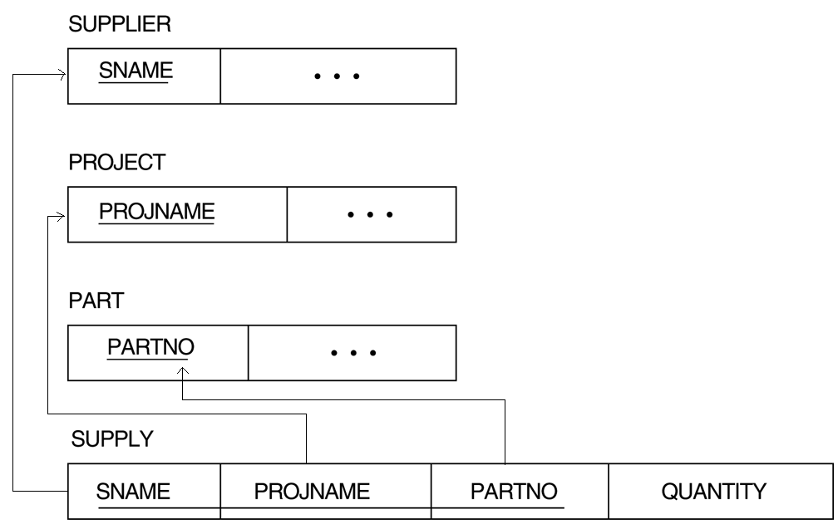
Step 7: Mapping of N-ary Relationship Types

Slide 34
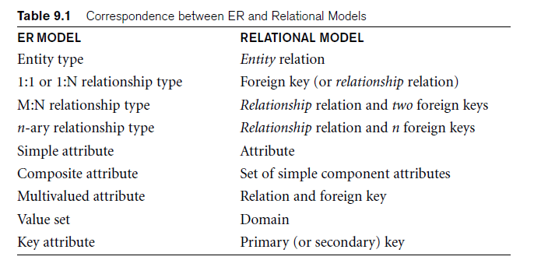
Summary of Mapping constructs and constraints

Slide 35
Discussion and Summary of Mapping for ER Model Constructs (cont’d.)
In a relational schema, relationship types are not represented explicitly
  Represented by having two attributes: one a primary key and the other a foreign key

Slide 36
Mapping EER Model Constructs to Relations
Extending ER-to-relational mapping algorithm
  Step 8: Options for Mapping Specialization or Generalization.
  Step 9: Mapping of Union Types (Categories).

Slide 37
Mapping of Specialization or Generalization
Step 8: Four options for Mapping Specialization or Generalization
  Option 8A: Multiple relations—superclass and subclasses
    For any specialization (total or partial, disjoint or overlapping)
  Option 8B: Multiple relations—subclass relations only
    Superclass is total
    Specialization has disjointedness constraint

Slide 38
Mapping of Specialization or Generalization (cont’d.)
Option 8C: Single relation with one type attribute
  Type or discriminating attribute indicates subclass of tuple
  Subclasses are disjoint
    Potential for generating many NULL values if many specific attributes exist in the subclasses
Option 8D: Single relation with multiple type attributes
  Subclasses are overlapping
  Will also work for a disjoint specialization

Slide 39
Option 8A: Multiple relations - superclass and subclasses
Create a relation L for superclass C with attributes Attrs(L) = {k,a₁,…a_{n}} and PK(L) = k. Create a relation Li for each subclass S_{i}, 1 <= i <= m, with the attributes Attrs(L_{i}) = {k} U {attributes of S_{i}} and PK(L_{i})=k.
This option works for any specialization (total or partial, disjoint or over-lapping).

Slide 40

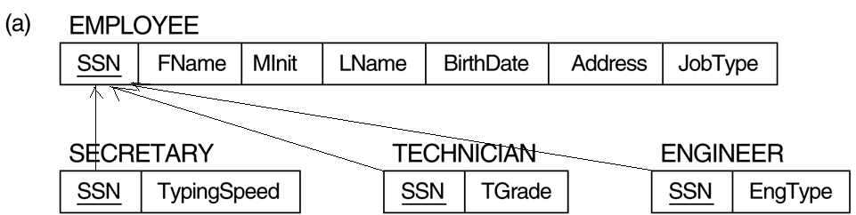
Option 8A: Multiple relations-Superclass and subclasses
d

Slide 41
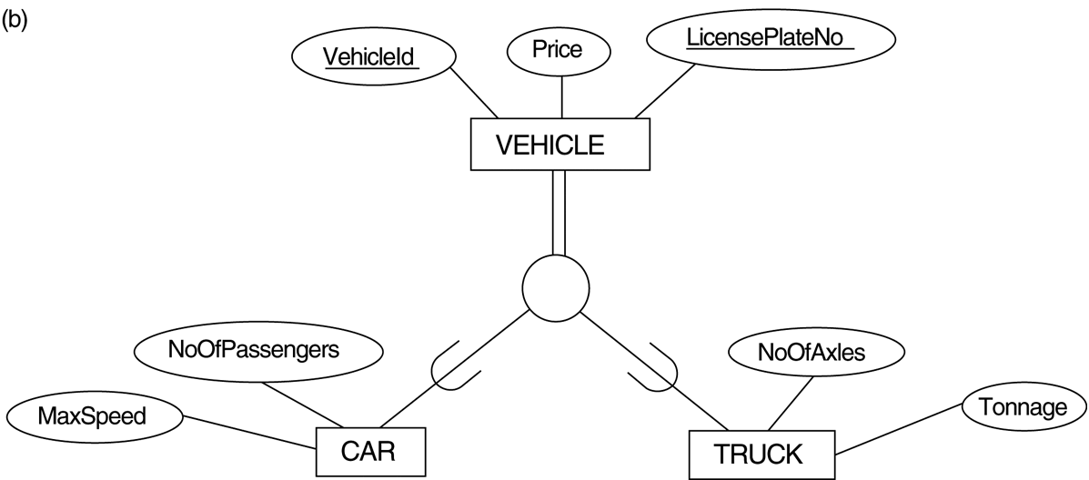
Option 8B: Multiple relations-Subclass relations only
d

Slide 42
Option 8B: Multiple relations-Subclass relations only
Create a relation L_{i} for each subclass S_{i}, 1 <= i <= m, with the attributes Attr(L_{i}) = {attributes of S_{i}} U {k,a₁…,a_{n}} and PK(L_{i}) = k.
This option only works for a specialization where the superclass is total (every entity in the superclass must belong to (at least) one of the subclasses.

Slide 43
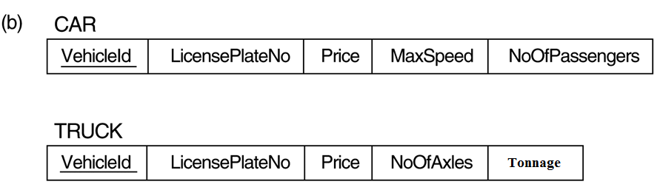
Option 8B: Multiple relations-Subclass relations only
d

Slide 44
Option 8C: Single relation with one type attribute
Create a single relation L with attributes Attrs(L) = {k,a₁,…a_{n}} U {attributes of S₁} U…U {attributes of S_{m}} U {t} and PK(L) = k. The attribute t is called a type (or discriminating) attribute that indicates the subclass to which each tuple belongs
This option only works for a specialization whose subclasses are disjoint, and has many NULL values for specific attributes.

Slide 45
Option 8C: Single relation with one type attribute
d

Slide 46

Option 8D: Single relation with multiple type attributes
o

Slide 47
Option 8D: Single relation with multiple type attributes
Create a single relation schema L with attributes Attrs(L) = {k,a₁,…a_{n}} U {attributes of S₁} U…U {attributes of S_{m}} U {t₁, t₂,…,t_{m}} and PK(L) = k. Each t_{i}, 1 <= i <= m, is a Boolean type attribute indicating whether a tuple belongs to the subclass S_{i}.
This option is for a specialization whose subclasses are overlapping (also work for a disjoint specialization)

Slide 48
Option 8D: Single relation with multiple type attributes
o

Slide 49
Mapping of Categories (Union Types)
Step 9: Mapping of Union Types (Categories)
  Create superclasses corresponding relations with primary keys
  Create a relation to correspond to the category
    If superclasses have the same key, the same key is the key of the category
    If superclasses have different keys, create Surrogate key -- specify a new key attribute

Slide 50


Slide 51
Step 9: Mapping of Union Types (Categories)
Create superclasses corresponding relations with primary keys
For the category OWNER, we can create a relation OWNER to correspond to the OWNER category and include any attributes of the category in this relation. The primary key of the OWNER relation is the surrogate key, which we called OwnerId.
For the category REGISTERED_VEHICAL whose superclasses have the same key, there is no need for a surrogate key. The same key is the key of the category

Slide 52
