Slide 1

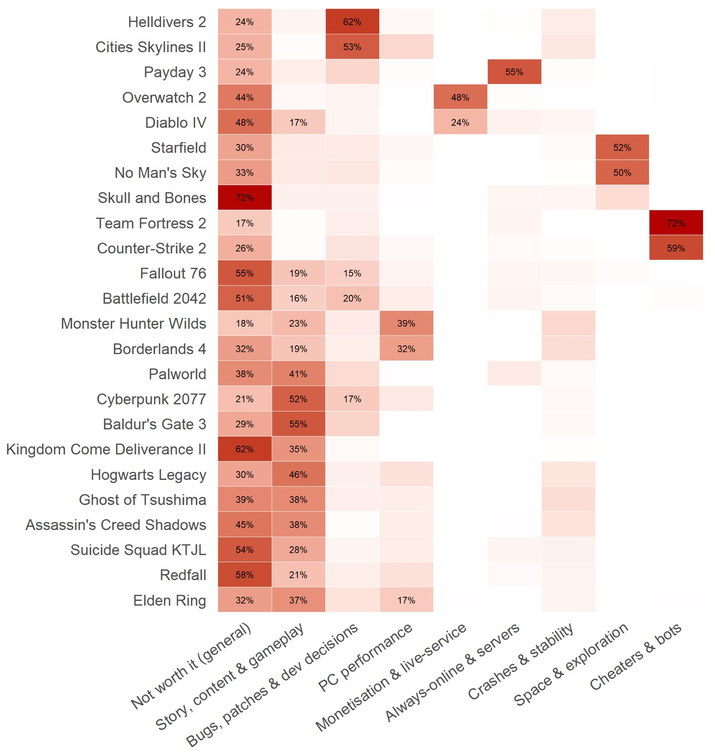
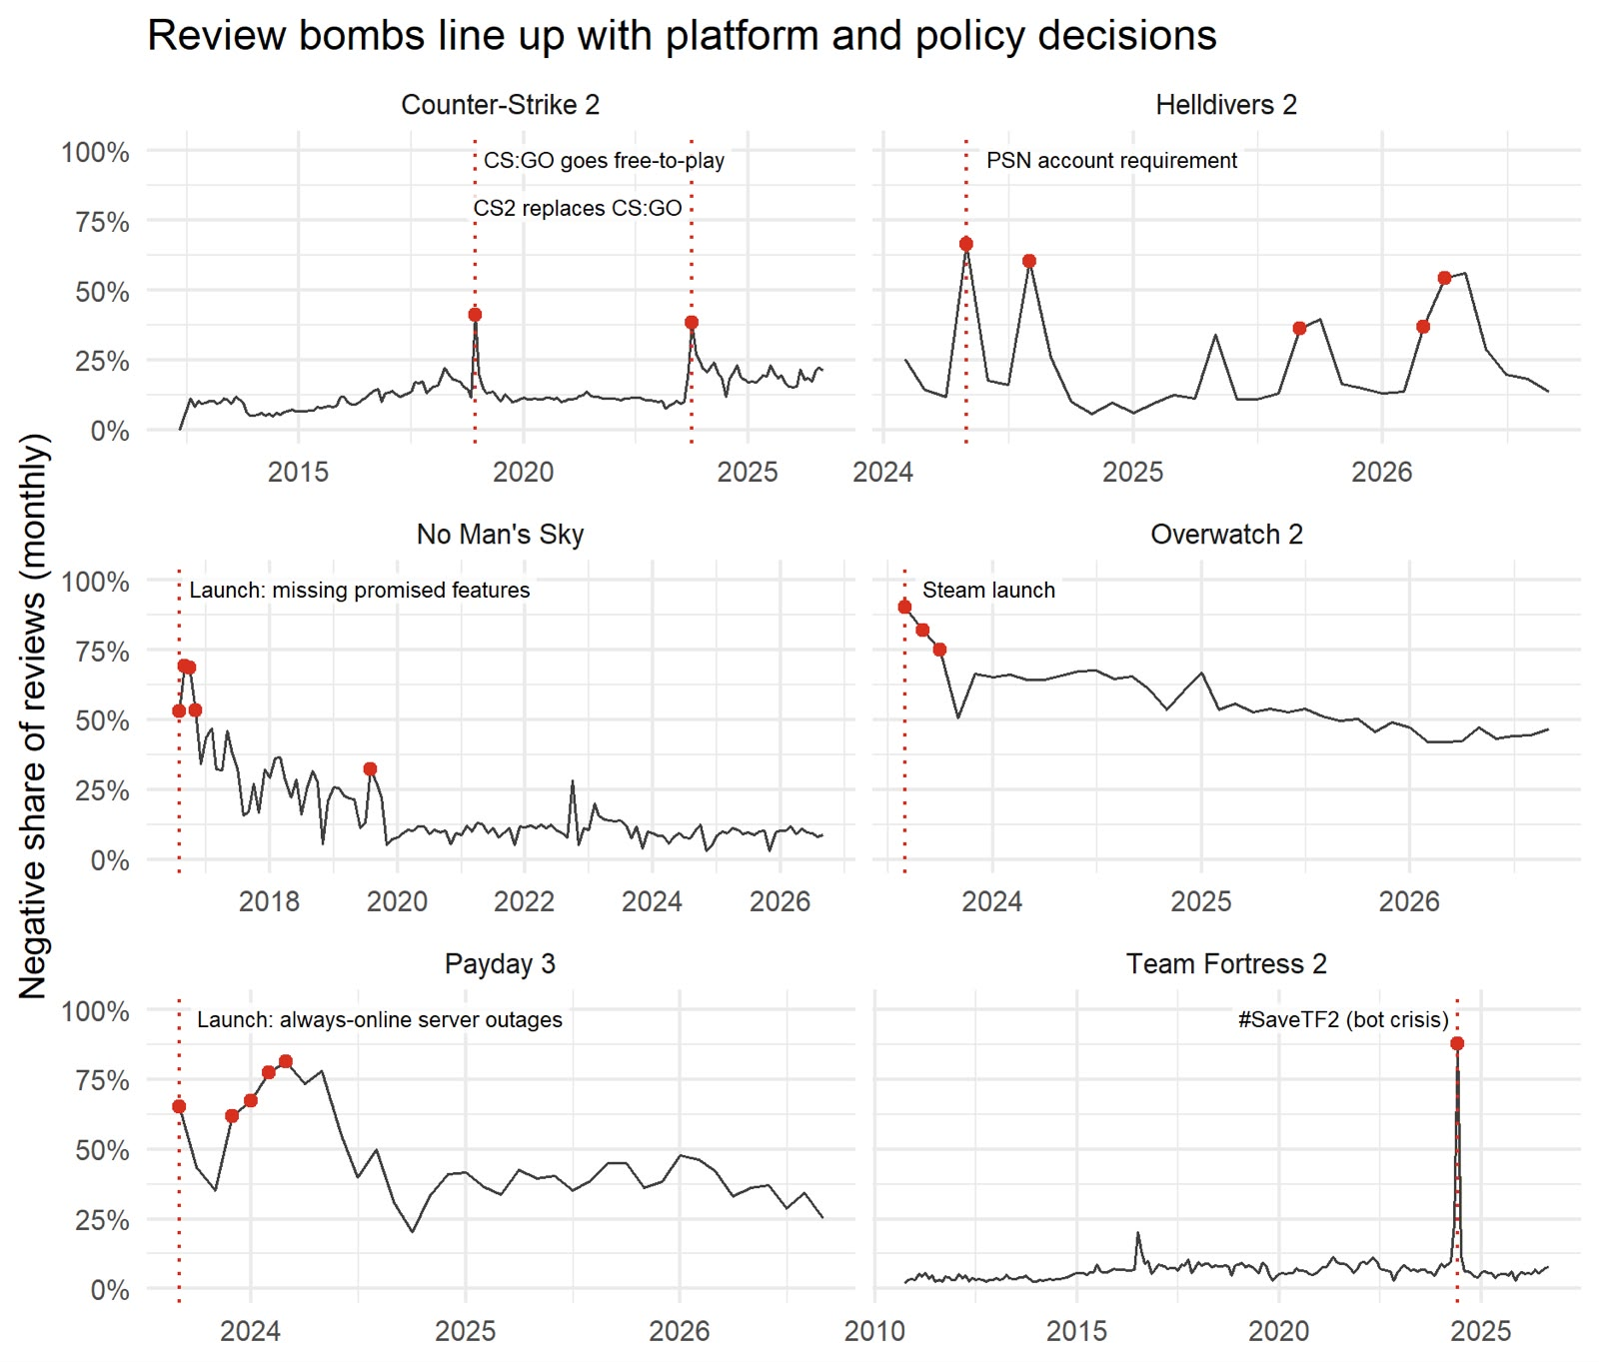
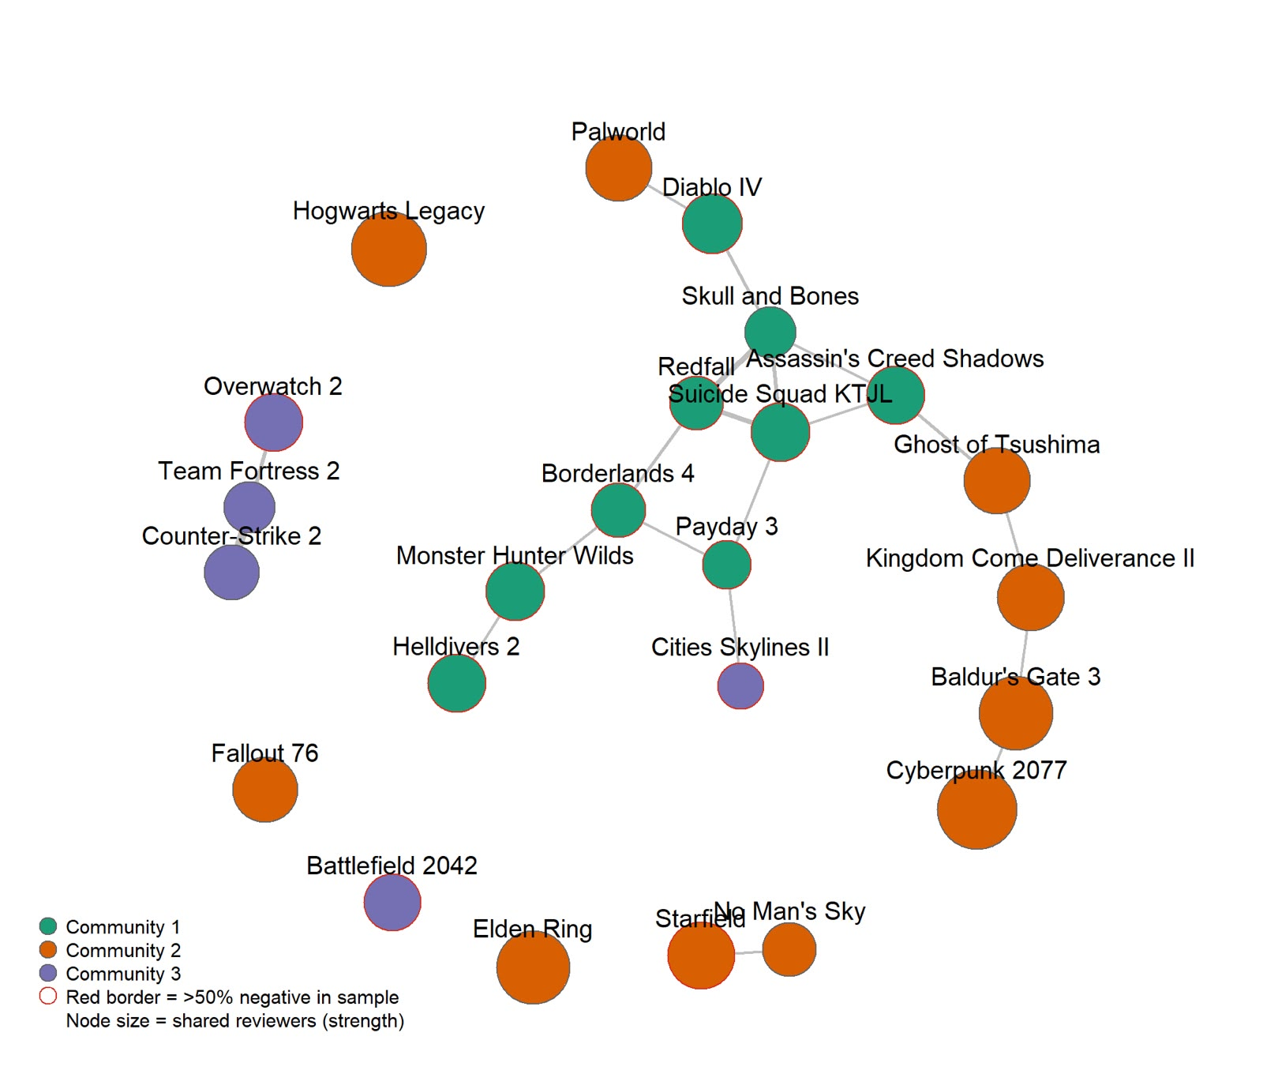
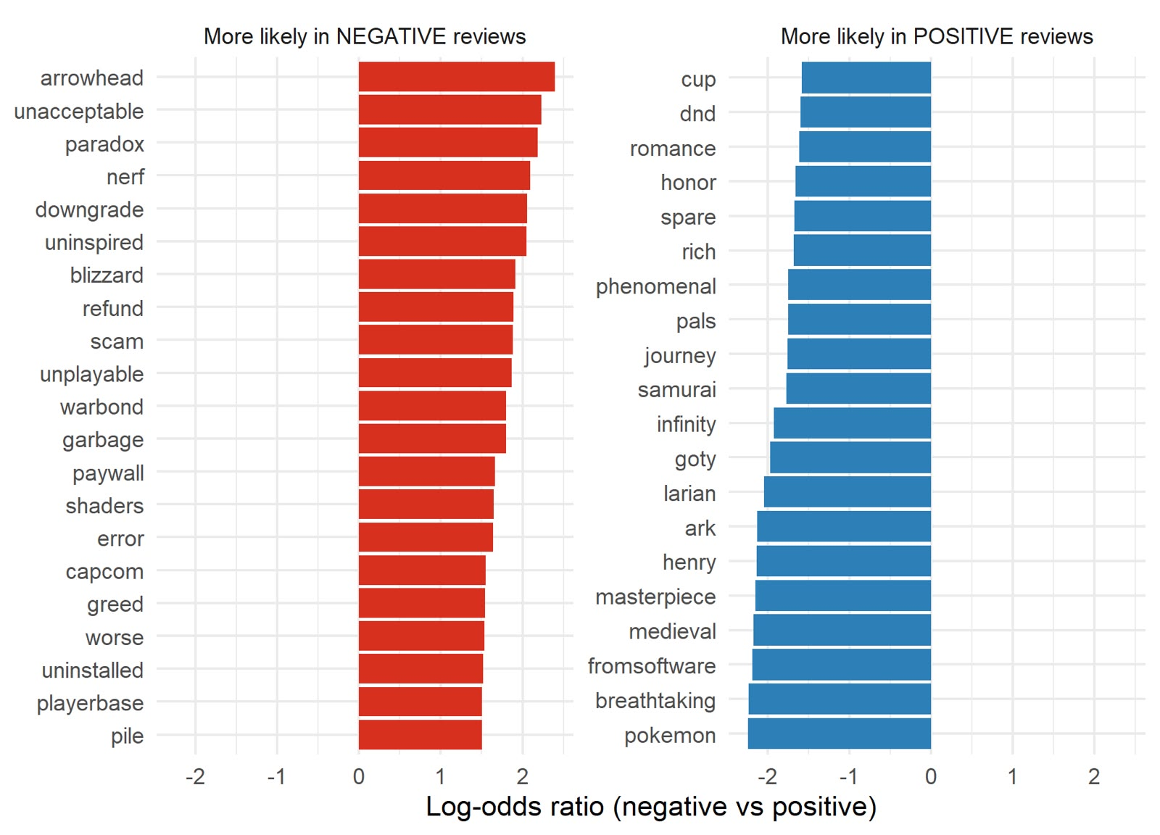
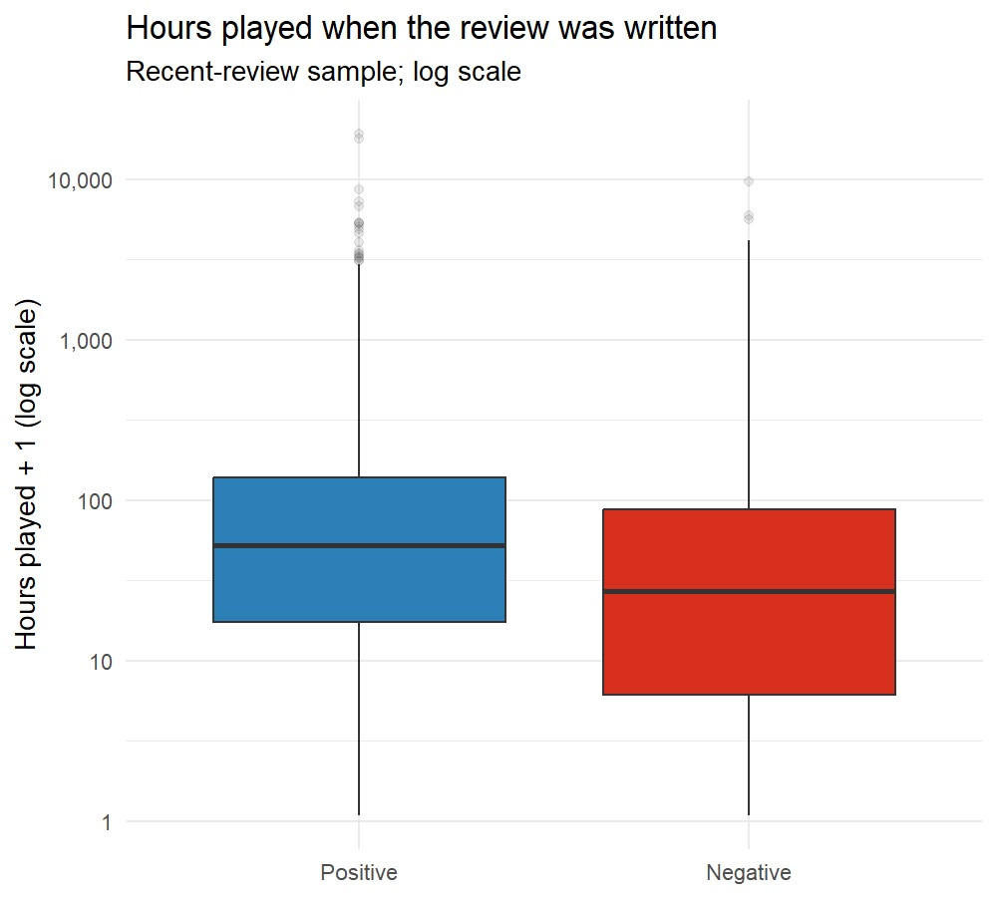
When Players Push Back
Review bombs, Complaint Types and Player Communities Across 24 Controversial Steam Games
COMP3020 Social Web Analytics
Group 5: [Tuyet Nghi Khuu – 22200297] [Le Khanh Chi Doan – 22165400] [Merina Phongsisattanak – 22172673]
Research questions: when → what → who → how
RQ3
What are the complaints?
RQ1 When do negative reviews spike, and do spikes match real events?
RQ2 Which words separate negative from positive reviews?
RQ3 What do people complain about, and do games fail in the same way?
RQ4 Do the same players review several games, and do those games share complaints?
RQ5 How do negative reviewers differ from positive ones?
k-means (k = 9, TF-IDF) on 19,370 negative reviews gave 9 complaint types
Most games have one dominant complaint: TF2 72% cheaters & bots, Payday 3 55% servers, Overwatch 2 48% monetisation, Helldivers 2 62% dev decisions
Caution: silhouette ≤ 0.008, so these are broad themes, not sharp groups
Data
Steam public store endpoints (no API key), collected 29 Sep 2026 with Python; analysed in R
24 games: 17 controversial, 4 well-received controls, 3 redemption stories
Per game: up to 1,500 “most helpful” + 500 most recent English reviews, plus monthly review counts (all languages)
Limitation: helpfulness ranking over-represents negative reviews
RQ1
When do negative reviews spike?
Heatmap: share of each game’s negative reviews in each complaint type (columns).
RQ4
Who shares players? Do they share complaints?
Spikes follow decisions, not just quality: PSN requirement (Helldivers 2), bot crisis (TF2: 88% negative in one month), CS2 replacing CS:GO. None of the 4 control games spiked.
Nodes = games; edges = shared reviewers, weighted by lift (vs. popularity). Raw graph was almost complete (273/276 edges), so only lift ≥ 1.3 is drawn.
3 communities: Q = 0.113 vs 0.026 for random networks (p < 0.005)
Games that share players share complaints: ρ = 0.26, p = 0.001. Cyberpunk 2077 is the key bridge (betweenness 0.42).
RQ2
Which words separate negative from positive?
RQ5
How do negative reviewers differ?
26 h vs 52 h
median playtime, negative vs positive (Wilcoxon, p < 10⁻¹⁶)
24 vs 8 words
median review length, negative vs positive
Negative reviews blame companies, money and technical failure (refund, scam, paywall, unplayable). Positive reviews praise the experience (masterpiece, breathtaking).
65% vs 16%
got ≥ 1 helpful vote (χ², p < 10⁻¹⁶)
Conclusions
Limitations
Code & data
Review negativity tracks decisions (platform, monetisation, servers, cheating), not just game quality
Each game fails in its own way; games sharing players share complaints
Loyal players lead protests against changes to their community
24 purposively chosen games, so not representative of Steam
English-only text vs all-language monthly counts
Helpfulness-ranked sample skews negative; clusters are weak
Snapshot (29 Sep 2026); associations, not causation
GitHub / GitLab:
[paste link here]
Python: data collection. R: tm, igraph, cluster, ggplot2. No API keys stored.

