Slide 1
Honours Thesis Skydot
Alexandra Brown

Slide 2
What is Skydot?
Skydot is a cloud-based architecture that allows companies to minimize the cost of cloud and on-premise services and provides an environment where developers can utilize any language that best suits their needs and/or skills.

Slide 3
Problems in Todays Industry
On-premise technology costs are very high
Maintenance costs increase as hardware gets older and therefore must be replaced
Many people are needed to manage the infrastructure of on-premise technologies
Disaster recovery sites are needed to reduce risk and are costly to maintain
Cloud resources can be expensive if not handled efficiently
Incorporating new technologies while maintaining old software frameworks can become unmanageable and can cause licensing and compatible issues
Lack of collaboration between teams causes duplication of code and effort, and risks reduction of data integrity

Slide 4
Project Goals
Decrease the number of people needed to maintain software and the cost of maintaining that software
Increase code integrity and decrease code development and integration time between teams
Counter long, multi-step manual deployment with simple, quick, autonomous cloud deployment
Handle cloud resources as efficiently as possible
Provide a common point of access for client applications
Create a layered, microservice framework that separates client applications from common services
Provide a common point of access to host services and data
Utilize Skydot as the server side of a mobile banking application to present the capabilities of the project

Slide 5
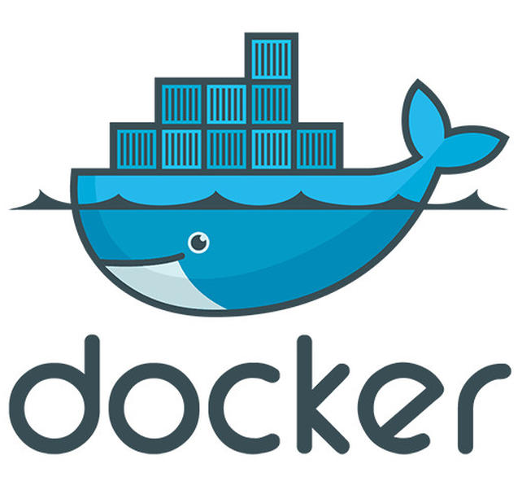
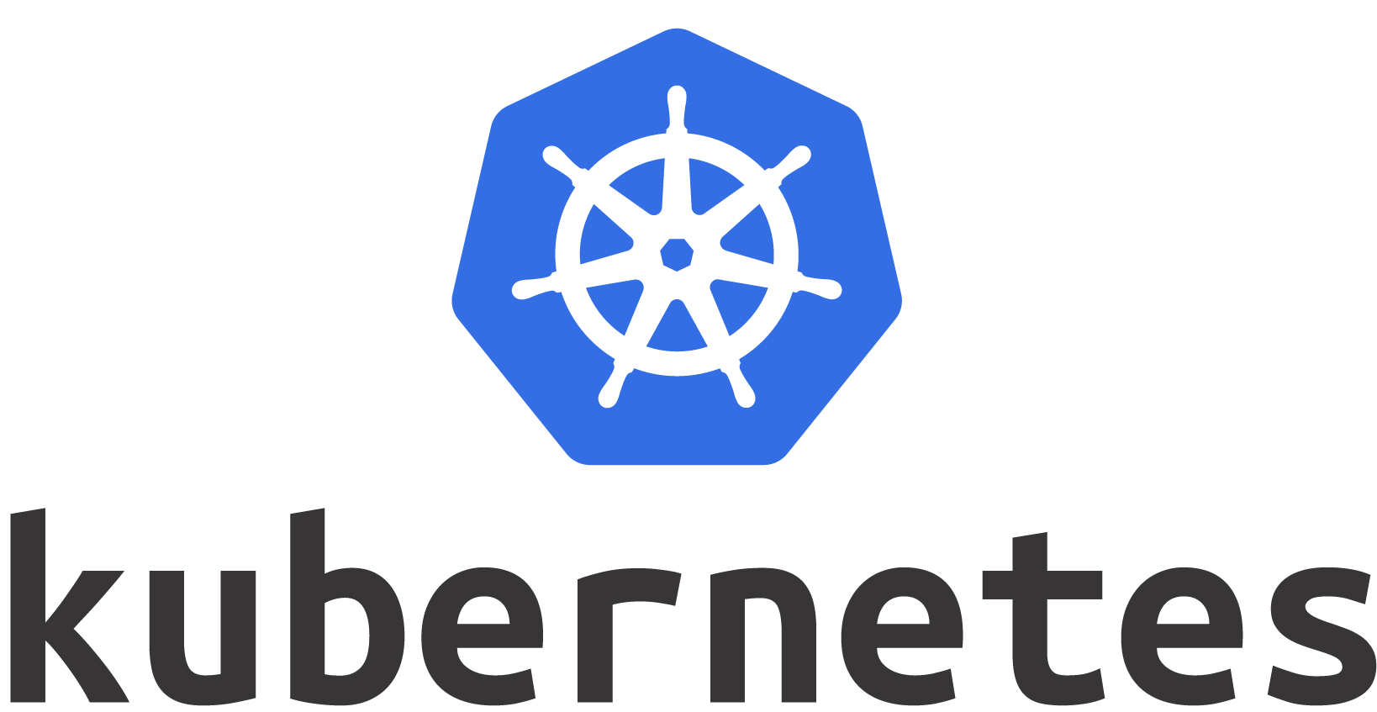

Background
Microservice Architecture
Docker
Kubernetes

Slide 6
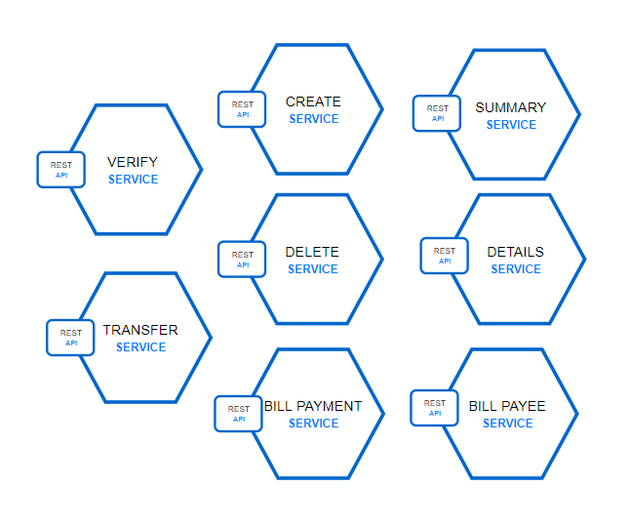
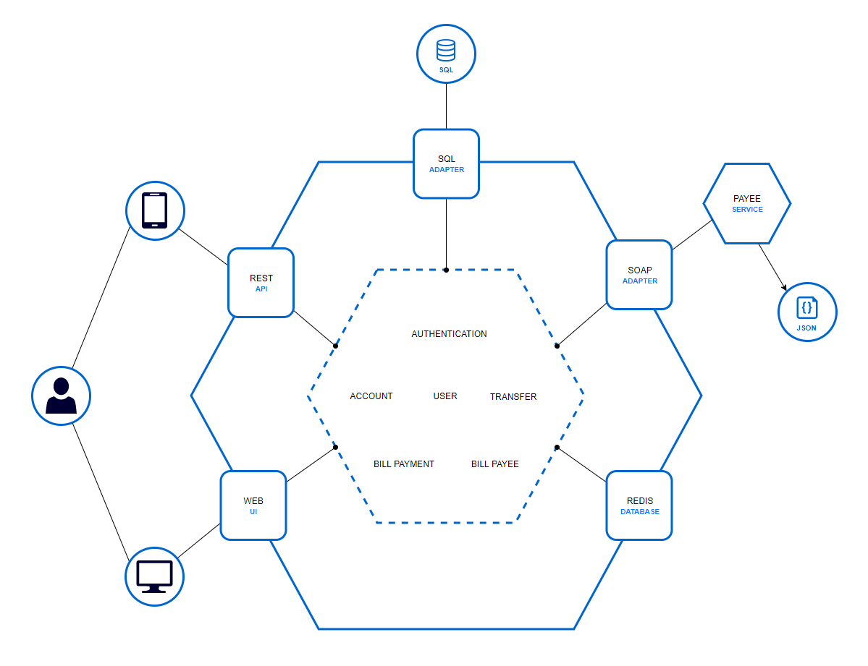
Microservice vs. Monolithic

Slide 7
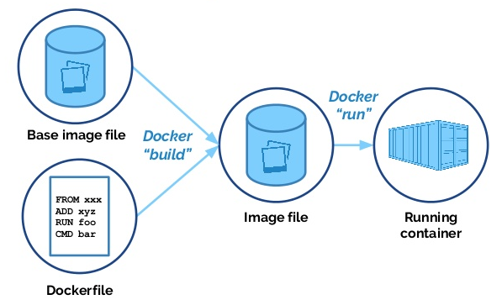
Docker
FROM python:alpine
ADD . /code
WORKDIR /code
RUN pip install -r requirements.txt
CMD ["python", "app.py"]

Slide 8
Kubernetes (Azure AKS)
Container Orchestration
Made by Google
Handles automatic deployment, scaling, and management of containerized applications
Running in Azure AKS (Azure Container Service)

Slide 9
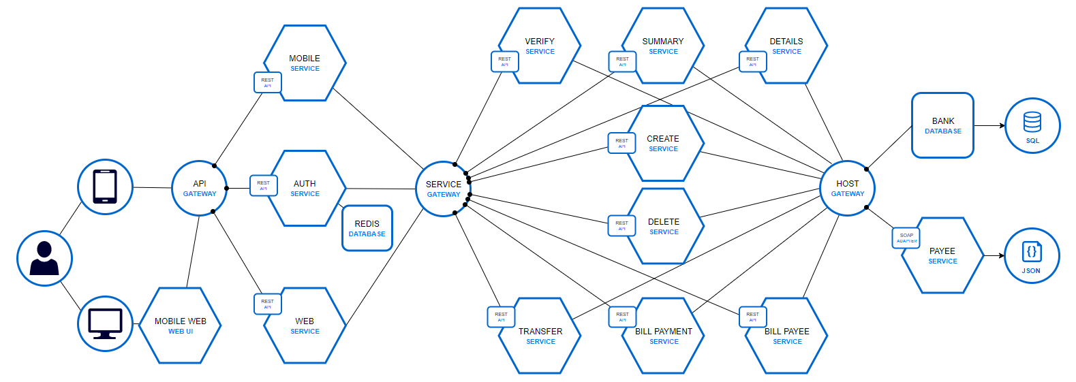
Solution
Micro-Apps
Micro-Services
Host Gateway

Slide 10
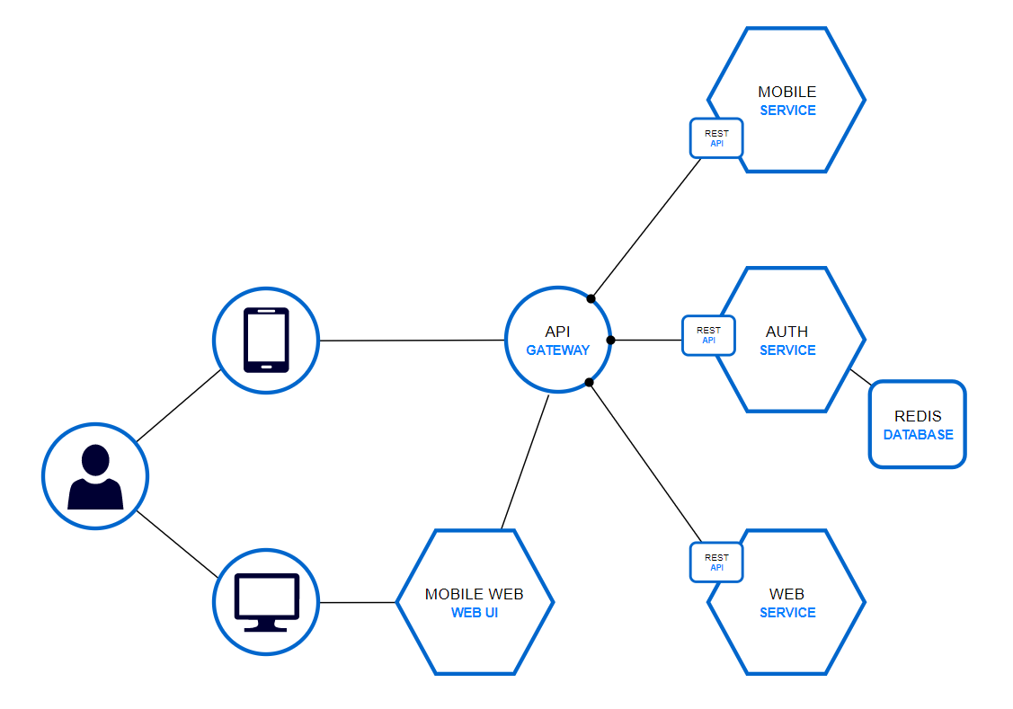
Micro-Apps
Application Layer
Handles session authentication
Each Micro-App services a specific type of client
Don’t do business logic other than basic validation
Transform data to fit clients needs (formatting, localization, etc.)

Slide 11
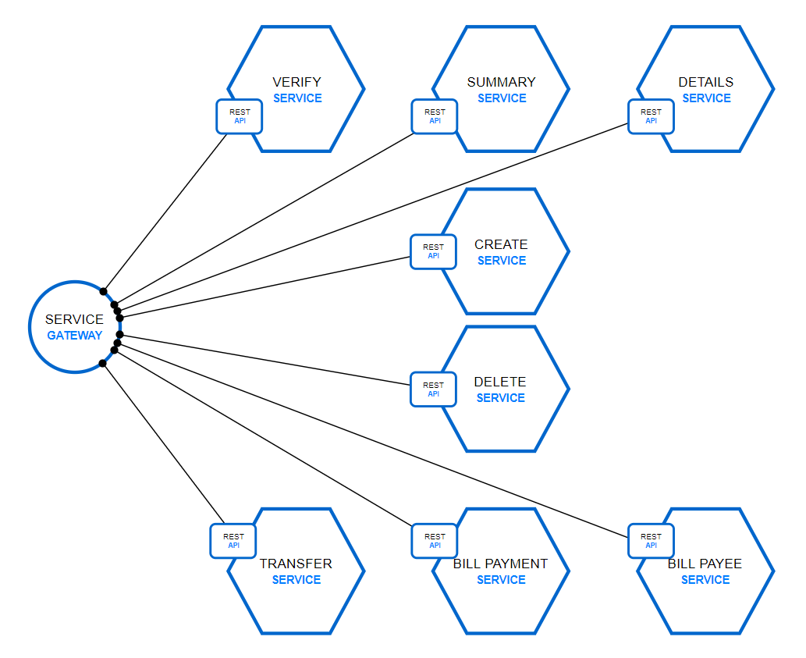
Micro-Services
Business Layer
Communicates within a private network
Don’t trim data to suit clients
Preforms business logic but no formatting or localization
Utilized service discovery

Slide 12
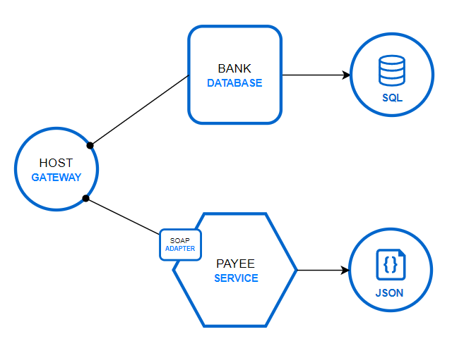
Host Gateway
Data Layer
Fronts backend legacy services and databases
Common data access point for micro-services
Payee SOAP service represents legacy systems
Bank SQLServer represents newer technologies

Slide 13
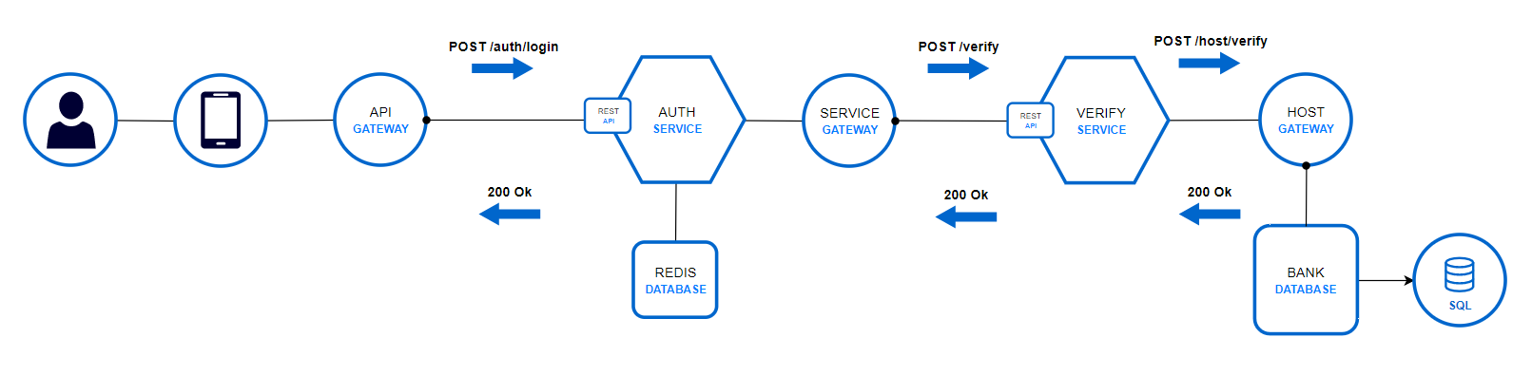
Login Flow

Slide 14
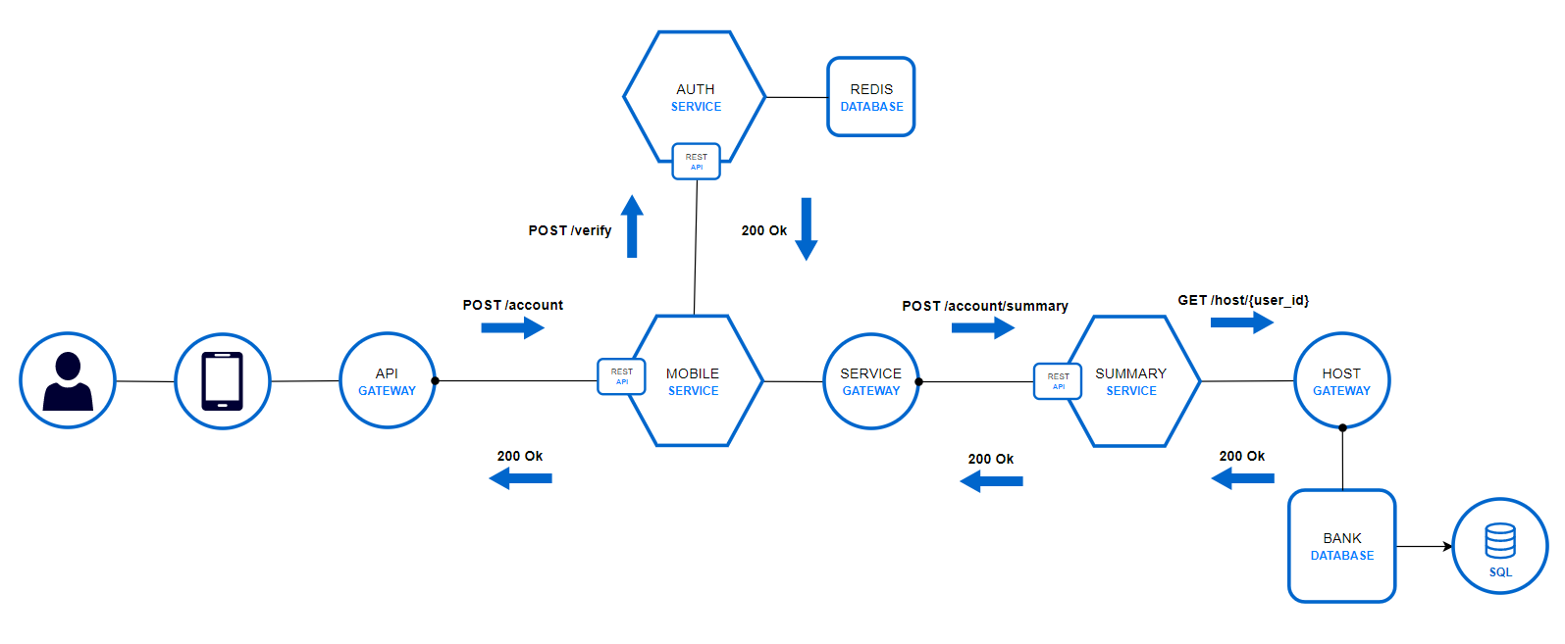
Account Summary Flow

Slide 15

Results
Research
Memory
Cost
Individual Development
Team Development
Production Environment

Slide 16
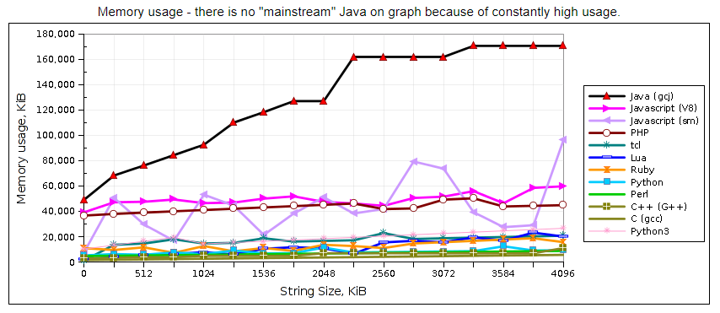
Research
Initial research lead to believe that Java and JavaScript perform poorly
On computer vs Dockerized image
Base Java vs Java with an additional framework
This lead to include metrics on Spring applications

Slide 17
Memory

Slide 18
Cost

Slide 19
Individual Development

Slide 20
Team Development

Slide 21
Production Environment
Step 1 Build
docker build –t lex13/<service>
docker push lex13/<service>
Step 3 Update
kubectl set image deployment/<service> container=lex13/<service>:latest
Step 2 Push

Slide 22
In Conclusion
Questions, comments, concerns?

Slide 23
Two content layout with table
First bullet point here
Second bullet point here
Third bullet point here
Class | Group 1 | Group 2
Class 1 | 82 | 95
Class 2 | 76 | 88
Class 3 | 84 | 90

