Slide 1
Honours Thesis Skydot
Alexandra Brown

Slide 2
What is Skydot?
Skydot is a cloud-based architecture that allows companies to minimize the cost of cloud and on-premise services and provides an environment where developers can utilize any language that best suits their needs and/or skills.

Slide 3
Problem - Issues in Todays Industry
On-premise technology costs are very high
Maintenance costs increase as hardware gets older and therefore must be replaced
Many people are needed to manage the infrastructure of on-premise technologies
Disaster recovery sites are needed to reduce risk and are costly to maintain
Cloud resources can be expensive if not handled efficiently
Incorporating new technologies while maintaining old software frameworks can become unmanageable and can cause licensing and compatible issues
Lack of collaboration between teams causes duplication of code and effort, and risks reduction of data integrity

Slide 4
Project Goals
Decrease the number of people needed to maintain software and the cost of maintaining that software.
Increase code integrity and decrease code development and integration time between teams.
Counter long, multi-step manual deployment with simple, quick, autonomous cloud deployment.
Handle cloud resources as efficiently as possible.
Provide a common point of access for client applications.
Create a layered, microservice framework that separate client applications from common services.
Provide a common point of access to host services and data.
Utilize Skydot as the server side of a mobile banking application to present the capabilities of the project.

Slide 5
Background
Microservice Architecture
Docker
Kubernetes

Slide 6
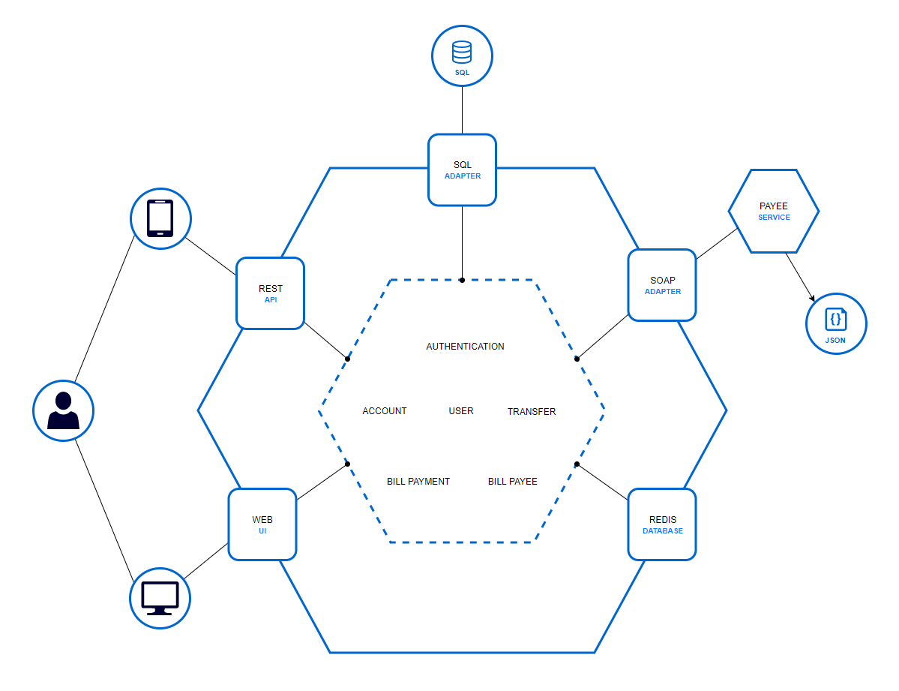
Microservice vs. Monolithic

Slide 7
Docker

Slide 8
Kubernetes (Azure AKS)

Slide 9
Solution
Micro-Apps
Micro-Services
Host Gateway

Slide 10
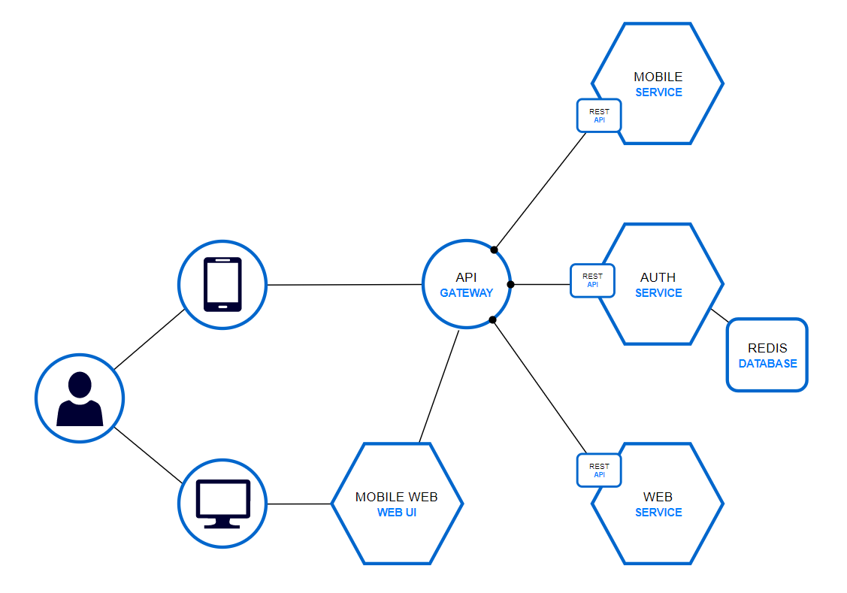
Micro-Apps
Application Layer
Handles session authentication

Slide 11
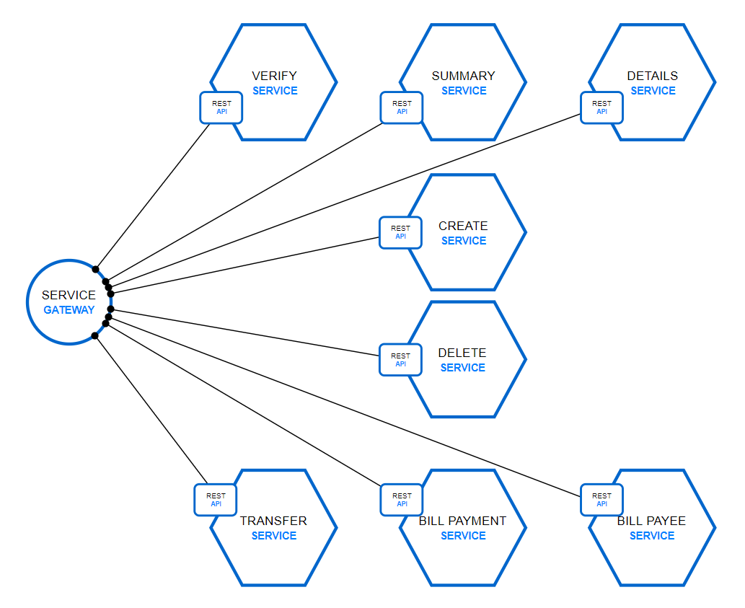
Micro-Services
Business Layer
Private network

Slide 12
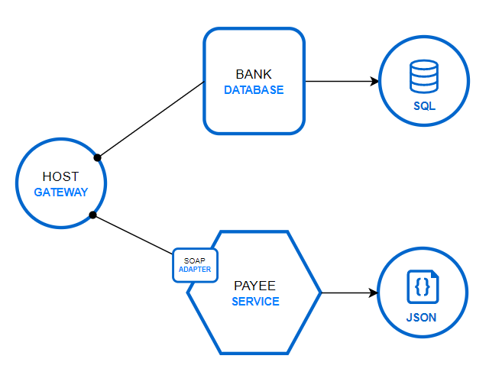
Host Gateway
Data Layer
Fronts backend legacy services and databases
Common data access point for micro-services
Payee SOAP service represents legacy systems
Bank SQLServer represents newer technologies

Slide 13
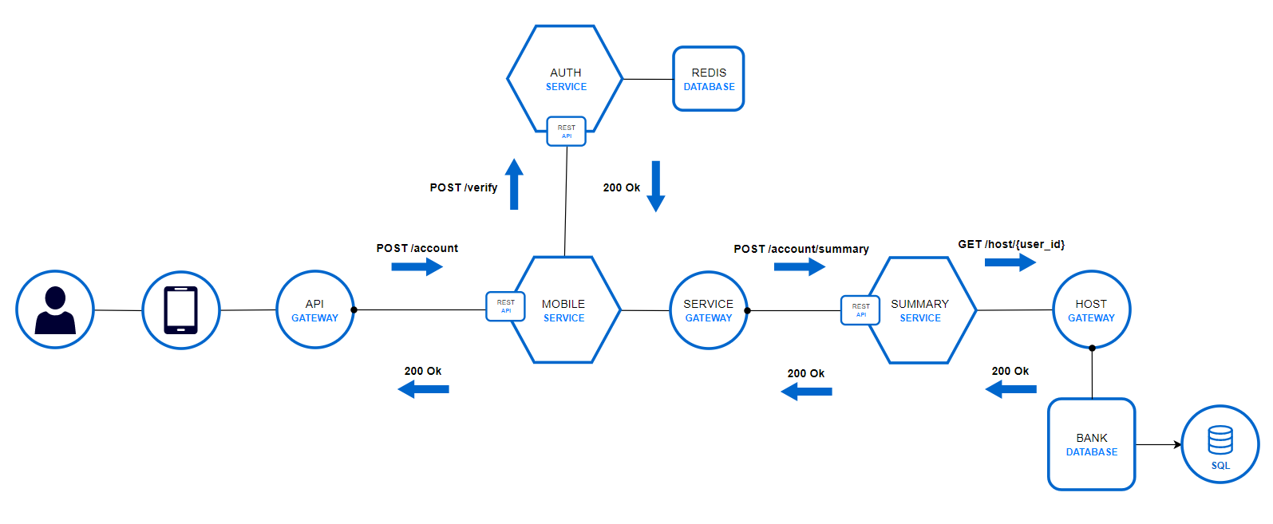
Login Flow

Slide 14
Account Summary Flow

Slide 15
Results
Research
Memory
Cost
Individual Development
Team Development
Production Environment

Slide 16
Research

Slide 17
Memory

Slide 18
Cost

Slide 19
Individual Development

Slide 20
Team Development

Slide 21
Production Environment
Step 1 Title
Task description
Step 2 Title
Task description
Step 3 Title
Task description

Slide 22
Conclusion
Summary
Future Work

Slide 23
Summary

Slide 24
Future Work

Slide 25
Thank You For Listening

Slide 26
Title and content layout with chart

Slide 27
Two content layout with table
First bullet point here
Second bullet point here
Third bullet point here
Class | Group 1 | Group 2
Class 1 | 82 | 95
Class 2 | 76 | 88
Class 3 | 84 | 90

