Slide 1
Honours Thesis Skydot
Alexandra Brown

Slide 2
What is Skydot?
Skydot is a cloud-based architecture that allows companies to minimize the cost of cloud and on-premise services and provides an environment where developers can utilize any language that best suits their needs and/or skills.

Slide 3
Problems in Todays Industry
On-premise technology costs are very high
Maintenance costs increase as hardware gets older and therefore must be replaced
Many people are needed to manage the infrastructure of on-premise technologies
Disaster recovery sites are needed to reduce risk and are costly to maintain
Cloud resources can be expensive if not handled efficiently
Incorporating new technologies while maintaining old software frameworks can become unmanageable and can cause licensing and compatible issues
Lack of collaboration between teams causes duplication of code and effort, and risks reduction of data integrity

Slide 4
Project Goals
Decrease the number of people needed to maintain software and the cost of maintaining that software
Increase code integrity and decrease code development and integration time between teams
Counter long, multi-step manual deployment with simple, quick, autonomous cloud deployment
Handle cloud resources as efficiently as possible
Provide a common point of access for client applications
Create a layered, microservice framework that separates client applications from common services
Provide a common point of access to host services and data
Utilize Skydot as the server side of a mobile banking application to present the capabilities of the project

Slide 5
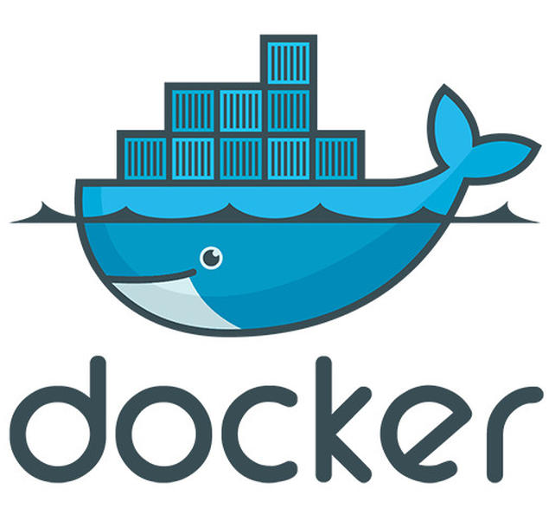
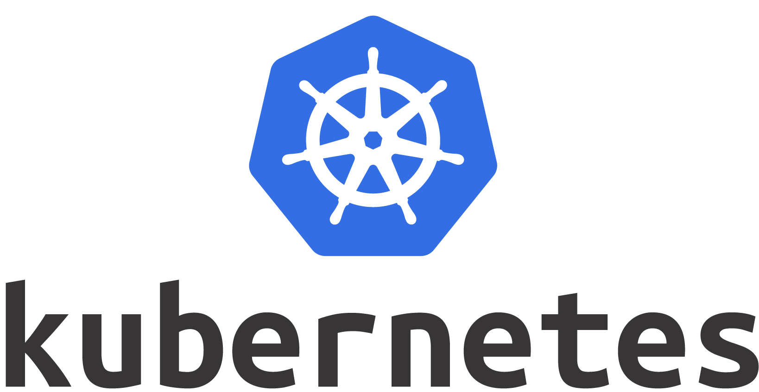
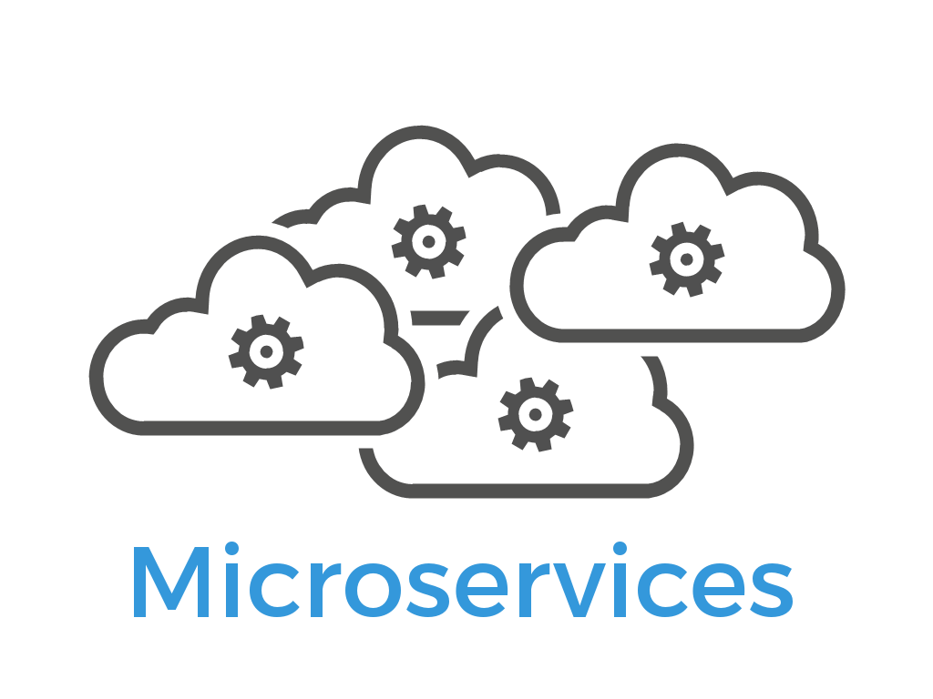
Background
Microservice Architecture
Docker
Kubernetes

Slide 6
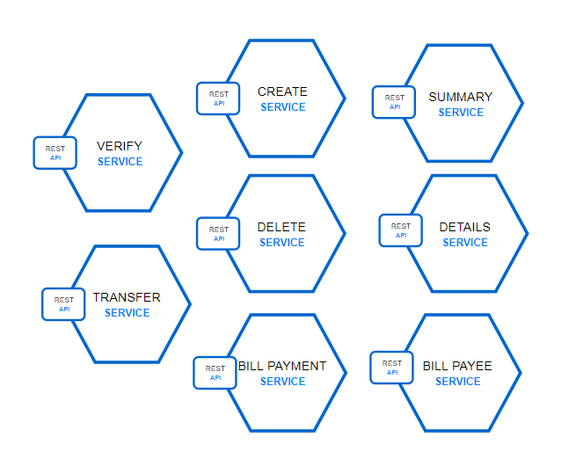
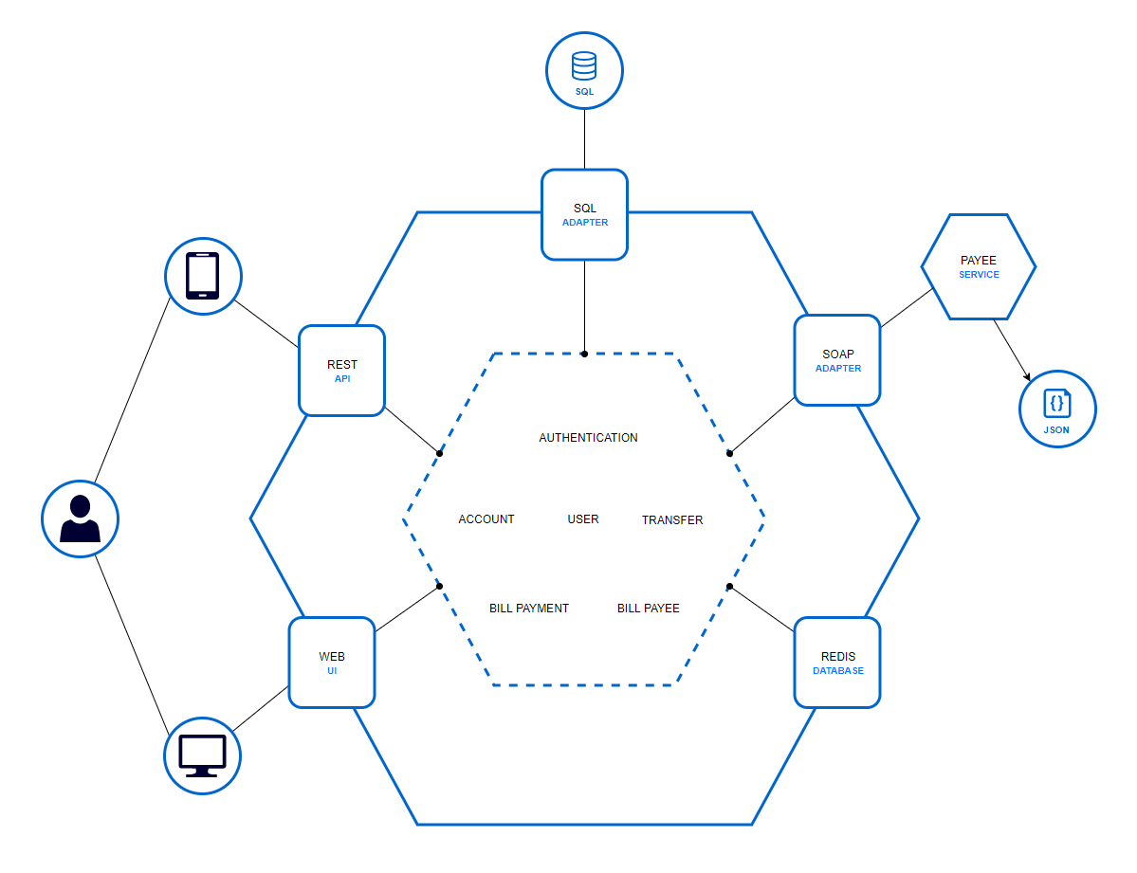
Microservice vs. Monolithic

Slide 7
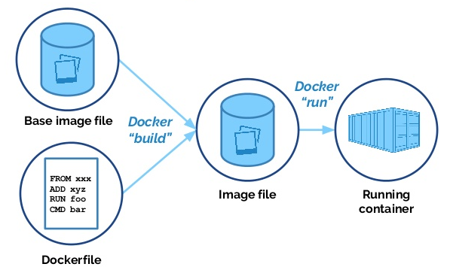
Docker
FROM python:alpine
ADD . /code
WORKDIR /code
RUN pip install -r requirements.txt
CMD ["python", "app.py"]

Slide 8
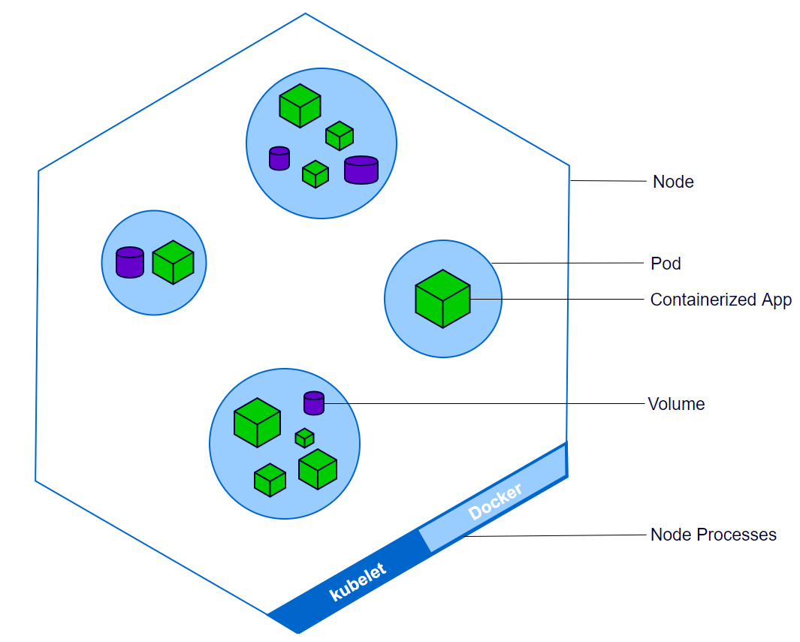
Kubernetes (Azure AKS)
Container Orchestration
Made by Google
Handles automatic deployment, scaling, and management of containerized applications
Running in Azure AKS (Azure Container Service)
Each node is a VM within Azure

Slide 9
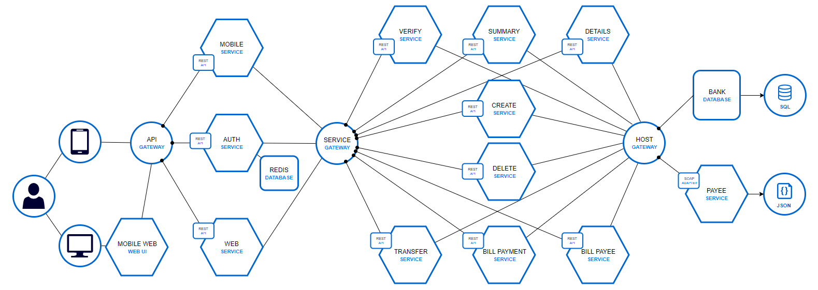
Solution
Micro-Apps
Micro-Services
Host Gateway

Slide 10
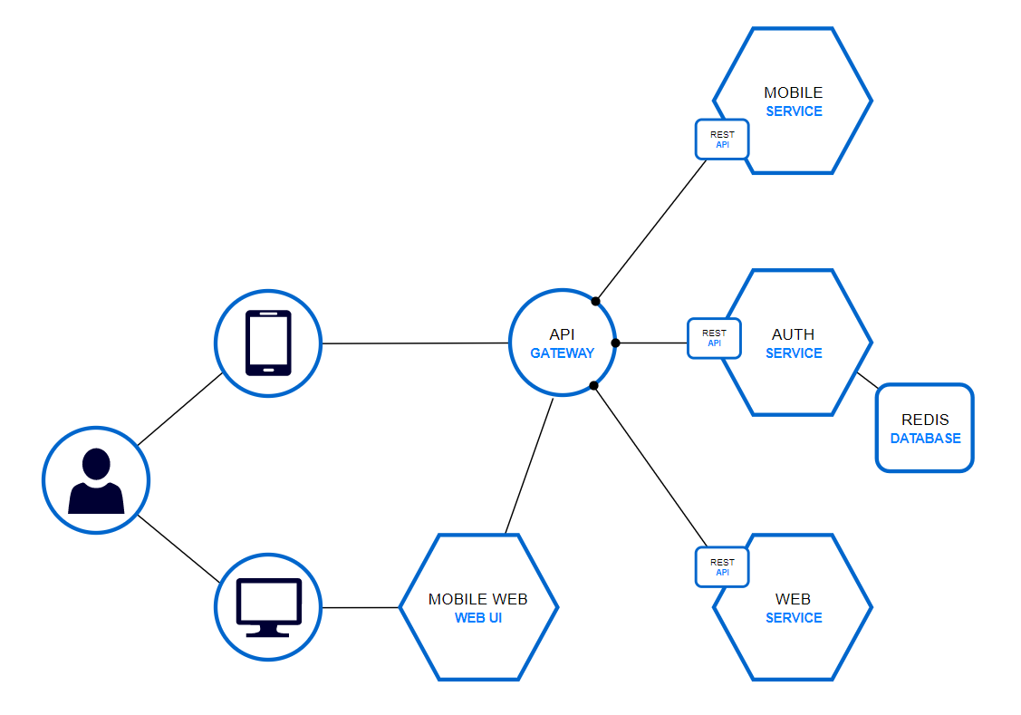
Micro-Apps
Application Layer
Auth Micro-App handles session authentication
Each Micro-App services a specific type of client
Doesn’t do business logic other than basic validation
Transform data to fit clients needs (formatting, localization, etc.)

Slide 11
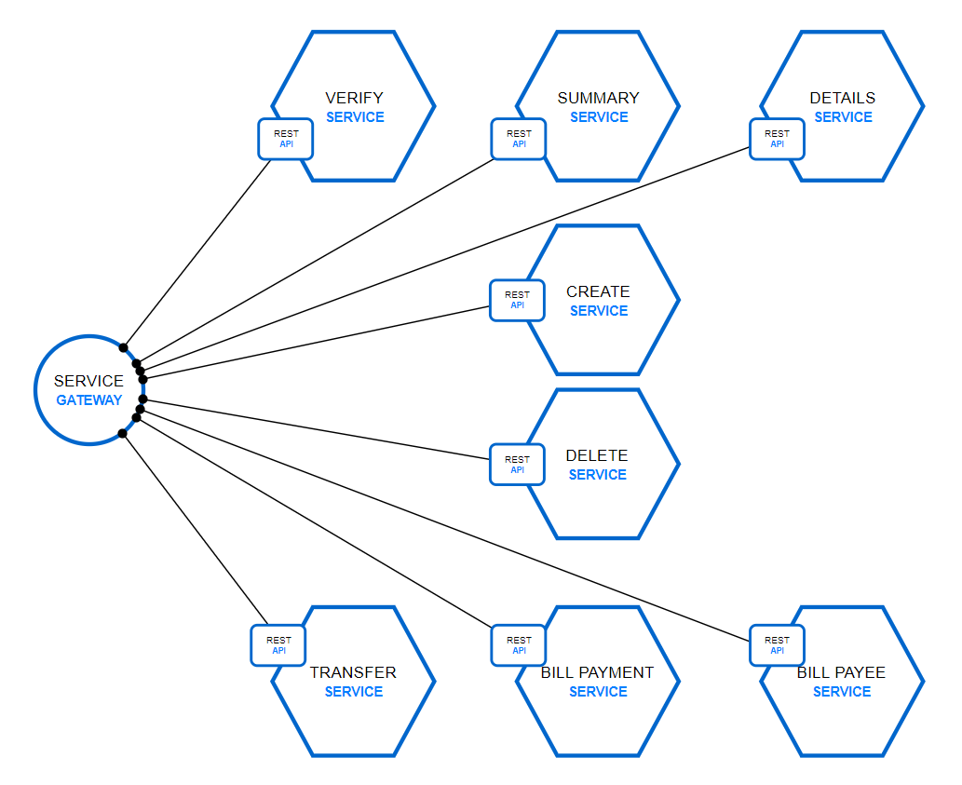
Micro-Services
Business Layer
Communicates within a private network
Doesn’t trim data to suit clients
Preforms business logic but doesn’t format or localize
Utilizes service discovery

Slide 12
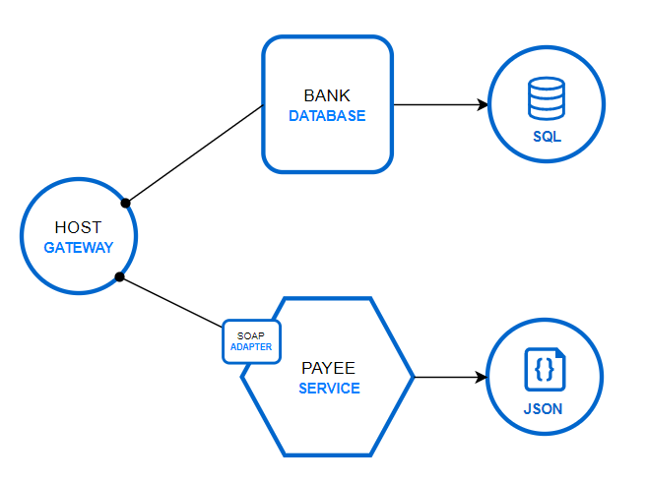
Host Gateway
Data Layer
Fronts backend legacy services and databases
Common data access point for micro-services
Payee SOAP service represents legacy systems
Bank SQLServer represents newer technologies

Slide 13
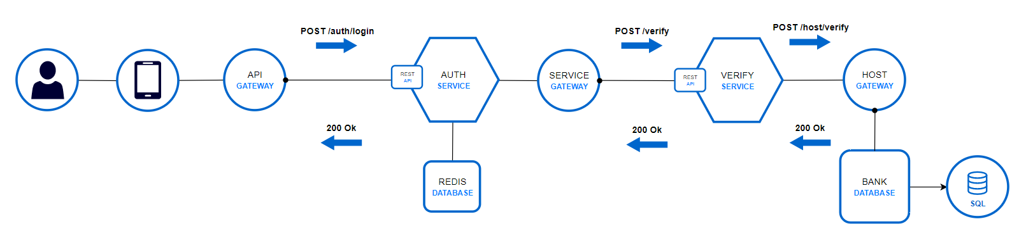
Login Flow

Slide 14
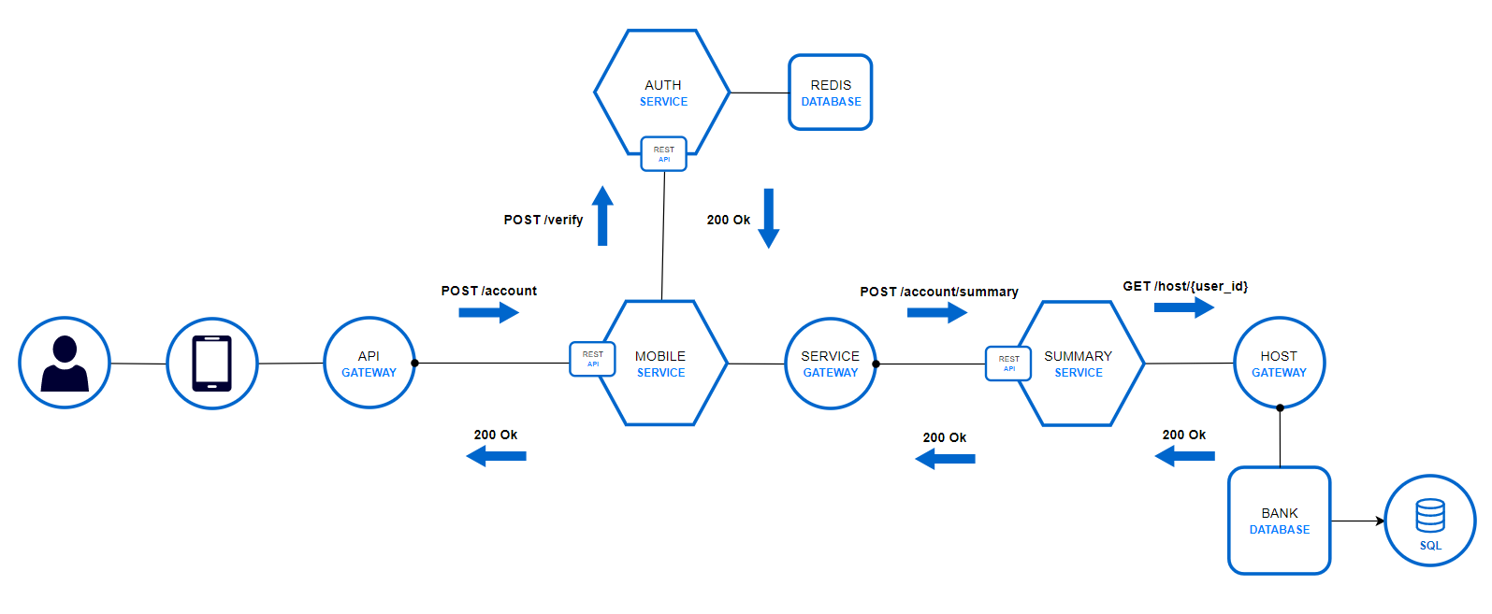
Account Summary Flow

Slide 15

Results
Research
Memory And Latency
Cost
Team Development
Production Environment

Slide 16
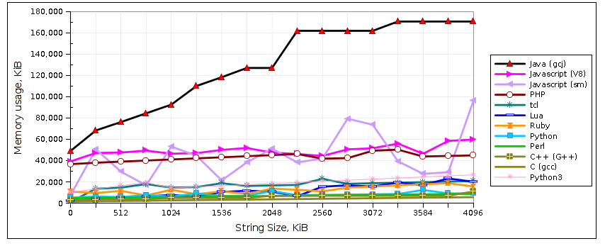
Research: Analyzing Languages
Initial research led to believe that Java, and JavaScript, would always perform poorly in comparison to other languages
Had to consider full JVM environment vs Dockerized image environment
Had to consider bare-bones Java vs Java with an additional framework
This lead to include metrics on Spring applications

Slide 17
Memory And Latency
*Now imagine scaling C++ and Spring 100 times
Memory Usage | Runtime Speed | Language | Memory Usage | Runtime Speed
High | Slow | Java | High | Fast
Low | Fast | C++ | Low | Fast
Low | Medium | Python | Medium | Medium
Medium | Slow | JavaScript | Low | Fast
Research
Predictions
Actual
Results

Slide 18

Cost
Using languages that allow less memory consumption opens up more virtual machine options
The more resources an application uses in an cloud environment, the more costly running it becomes
Azure provides virtual machine instances that vary in cost depending on how many resources are allocated to that virtual machine
Nodes Instance | Cores | RAM (GB) | Temporary Storage (GB) | Virtual Machines | Cost/hour | Cost/Month | Cost/Year
D14 | 16 | 112 | 800 | 100 | $1.542 | $112,566.00 | $1,350,792.00
D5 v2 | 16 | 56 | 800 | 100 | $1.170 | $85,410.00 | $1,024,920.00
 |  |  |  |  |  |  | $325,872.00
*All numbers are taken from Microsoft Azure’s Pricing Calculator
https://azure.microsoft.com/en-us/pricing/calculator/

Slide 19
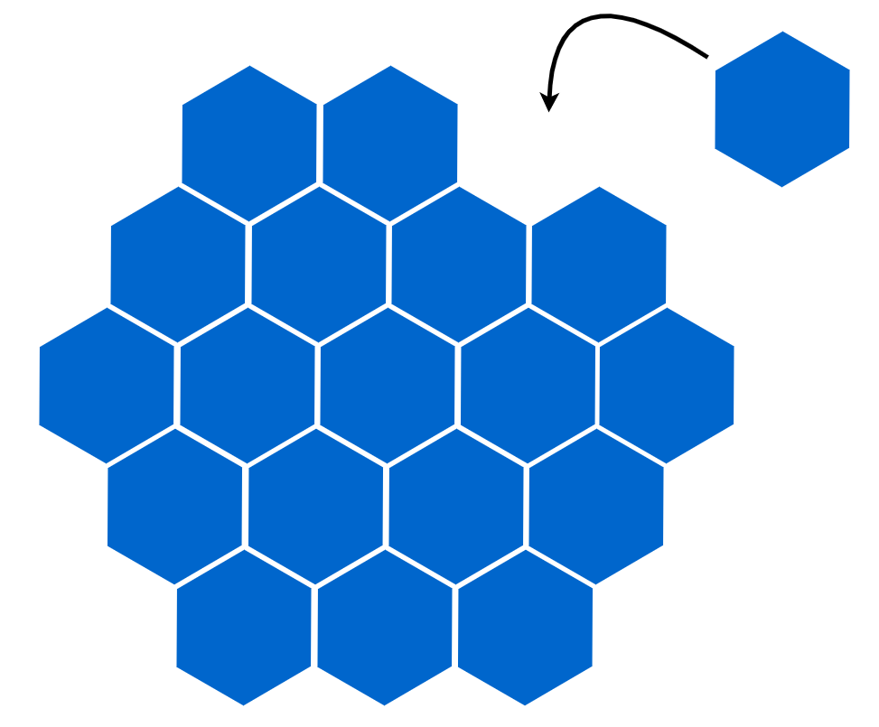
Team Development
Agile Development
Each ‘bit sized’ microservices can be a user story or a task
Microservices and Agile are both building block mentalities
Each microservice can be independently unit tested
Collaboration/Code Integrity
All Micro-App use the same common Micro-Services
No need to work duplicate services for each application
Any developer can build a Micro-Service and they can utilize languages they are most familiar with

Slide 20
Production Environment
No longer a need for circuit breaking when one server is being updated
Kubernetes provides rolling updates to deployments
Step 1 Build
docker build –t lex13/<app>
docker push lex13/<app>
Step 3 Update
kubectl set image deployment/<app> container=lex13/<app>:latest
Step 2 Push

Slide 21
In Conclusion
Skydot is not just to use a “Micro Architecture” within the cloud. It’s a culture and an end-to-end process. All the designs chosen for Skydot help met the project goals while allowing Skydot to be decoupled enough that integrating a new technology or shifting to a different technology would be trivial.

