Slide 1
Surf
Lexie
10.30

Slide 2
Activation operator: a function to add nonlinearlity to weight
Before:
After:
Source 7 ChemNODE new machine learning method for chemical reaction and providing new choice of optimizer. (Paper: ChemNODE: A Neural Ordinary Differential Equations Framework for Efficient Chemical Kinetic Solvers)
Data loss
source 3 modeling turbulent combustion with data constriants (Physics-informed neural networks for modeling turbulent combustion)
Acquiring actual data from cantera
Or calculate from source:
source 4 calculating chemical combustion kinetics
source 5 precomputation chemical reaction using kinetic monte carlo
source 6 kinetic monte carlo
source 8 Using DFT to calculate from the source
Physic loss: source 9 Sparse Learning, SL; good idea for LOSS FUNCTION!!!
A data-driven sparse learning approach to reduce chemical reaction mechanisms

Slide 3
Why PINN?
Source 1: A hybrid chemical source treatment for non-premixed combustion simulations
Does PINN even work?
Source 2: finding immeasurable states
Physics-Informed Neural Networks (PINNs) in the dynamic process operation of chemical engineering
Constant Energy and constant entropy is a differential equation. Here we may apply Simplied PINN in source 10:
Reduced-PINN: An Integration-Based Physics-Informed Neural Networks for Stiﬀ ODEs

Slide 4
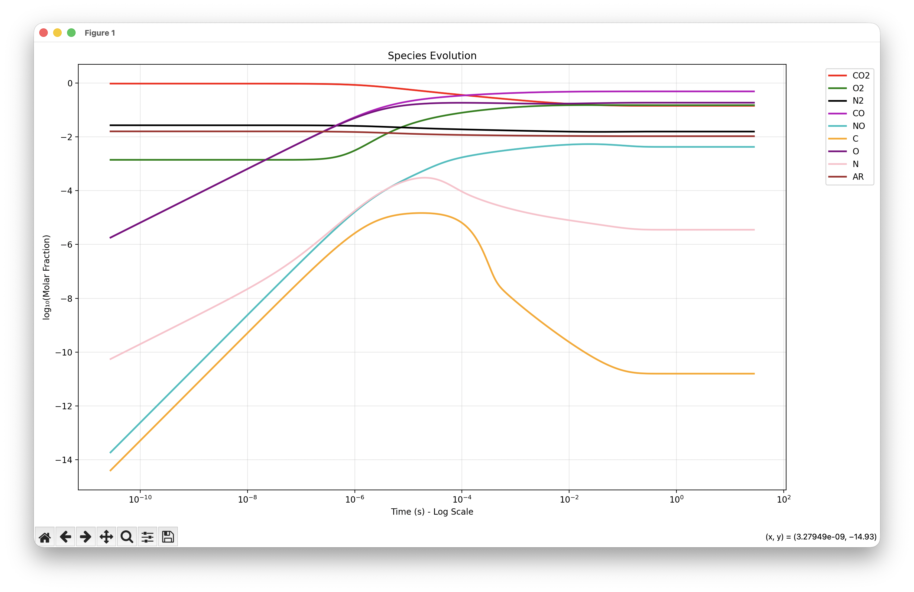
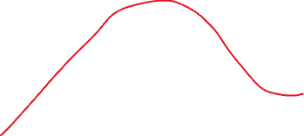
Species cantera

Slide 5
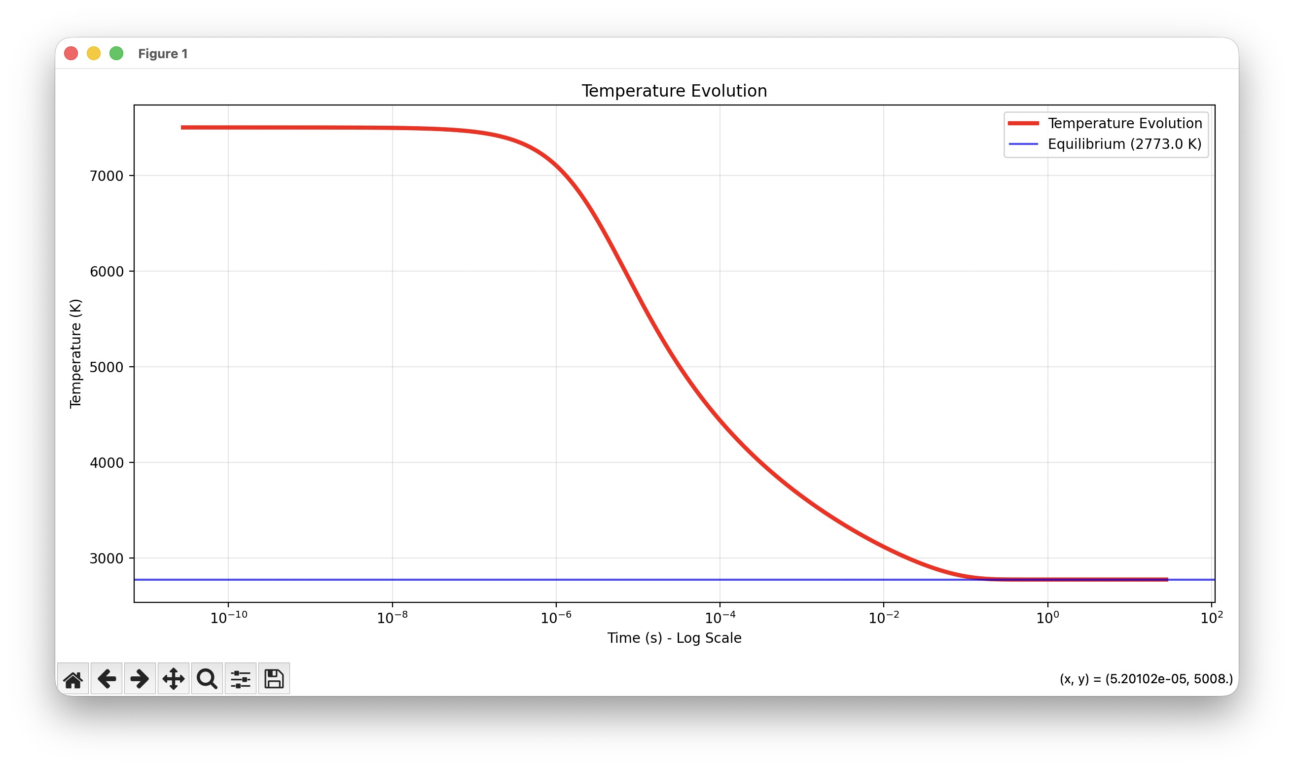
Temperature evolution

Slide 6
PINN structure
Input: [X_species (9), rho, T, dt] → 12 features
Output: [X_species (9), rho, T] → 11 features
Species: CO2, O2, N2, CO, NO, C, O, N, AR
Governing Equations (Physics Constraints):
Atom Conservation (C, O, N, Ar atoms)
Energy Conservation (constant internal energy at constant volume)
Volume Conservation (constant volume → constant density for ideal gas)
Loss function (with data constraint):
Activation operator: (adam?)

Slide 7
Loss function

Slide 8
Loss function

Slide 9

Governing equation
$\frac{dX}{dt}=\frac{\dot{ω}(X,T,P)}{ρ}$
$\dot{ω}$ is the chemical reaction rate
Rho is density of species
Reaction PINN:
Input: $(X_{t},T_{t},dt)$
Output: $\left(X_{t+dt},T_{t+dt}\right)$

Slide 10
Chemical reaction rate
A+B -k-> C
NN(t,\theta) = [A(t),B(t),C(t)]; theta is the weight
K be Trainable Parameter; can be optimized like weight

Slide 11
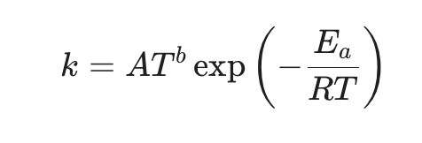
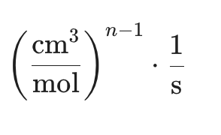
Chemical reaction rate
What’s in yaml file:
- equation: CO2 + M <=> CO + O + M # Reaction 1
type: three-body
rate-constant: {A: 6.9e+20, b: -1.5, Ea: 1.2575e+05}
efficiencies: {CO: 10.0, N: 20.0, C: 20.0, NO: 10.0, O: 20.0, C2: 10.0,
N2: 10.0, CN: 10.0, CO2: 10.0, AR: 1.0, O2: 10.0}
units: {length: cm, quantity: mol, activation-energy: cal/mol}

Slide 12
Loss function
https://www.youtube.com/watch?v=T6nHF3Pi9TM

