Slide 1
Surf reference
Lexie
12.30

Slide 2
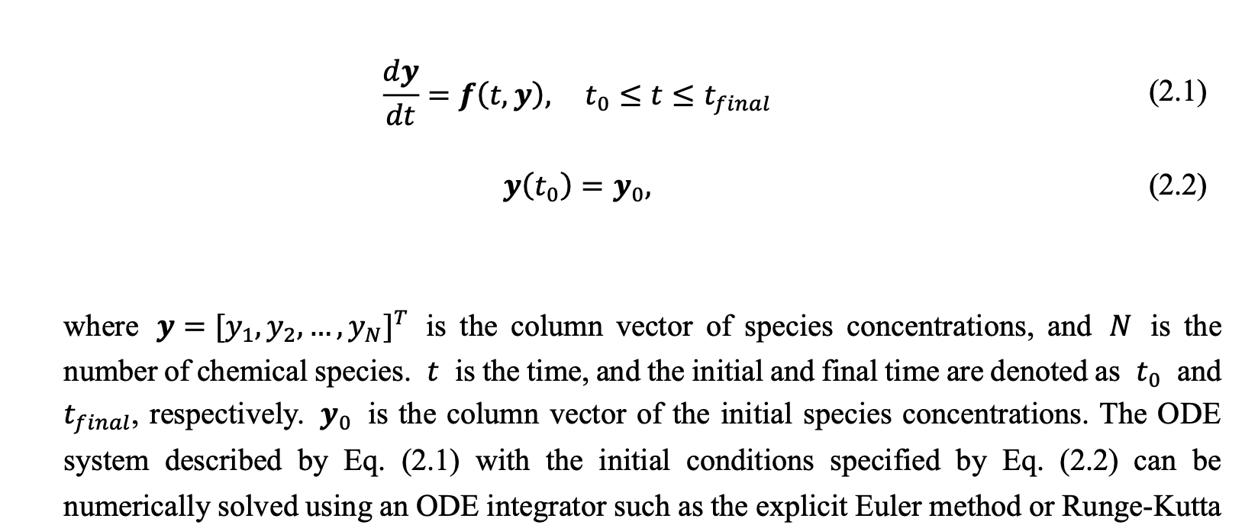
homogenous chemical reaction system ODE

