Slide 1
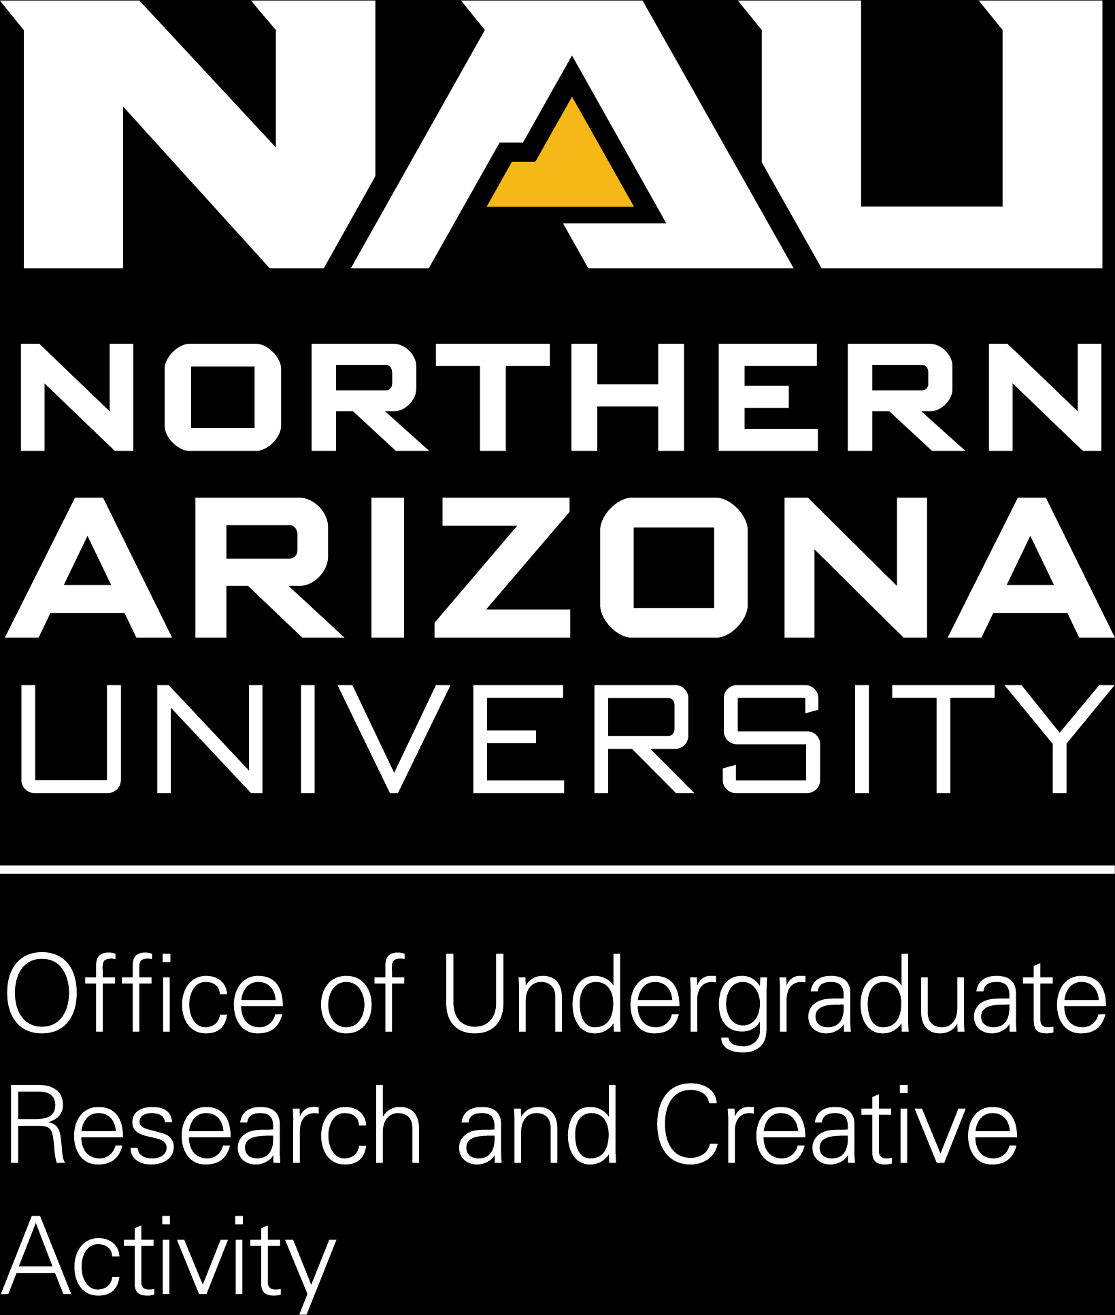
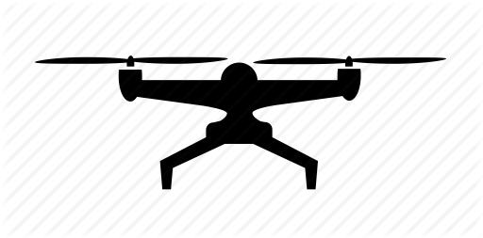
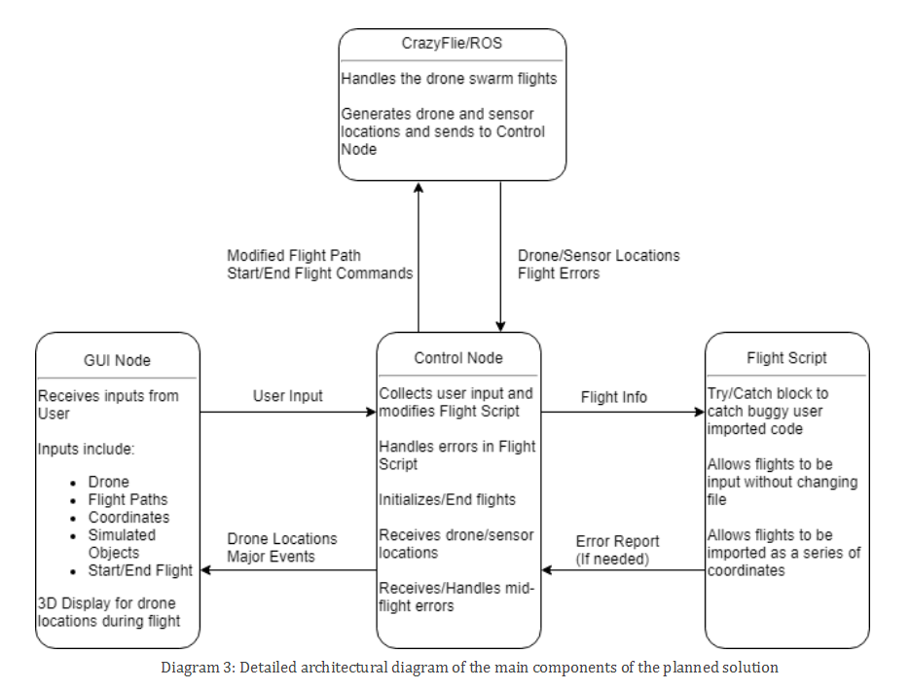
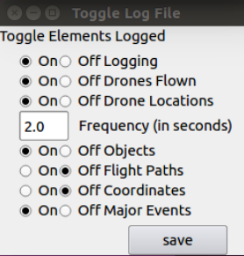
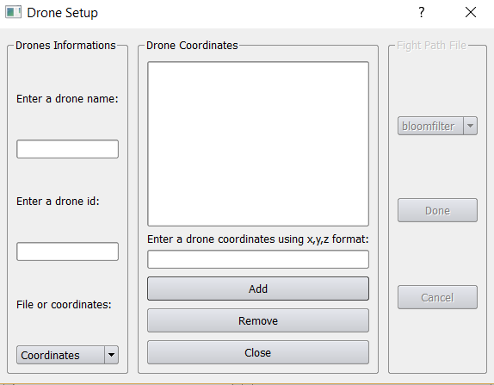
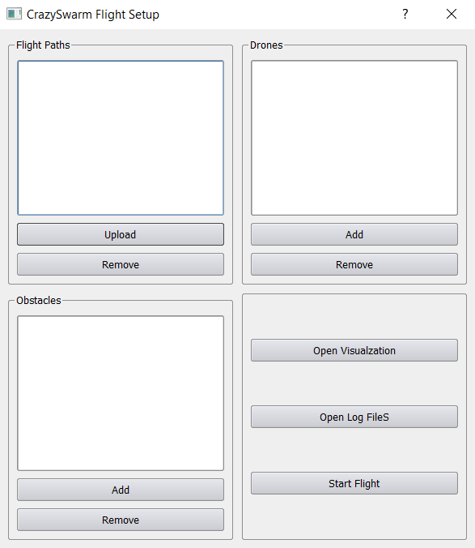

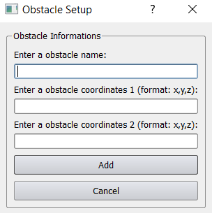

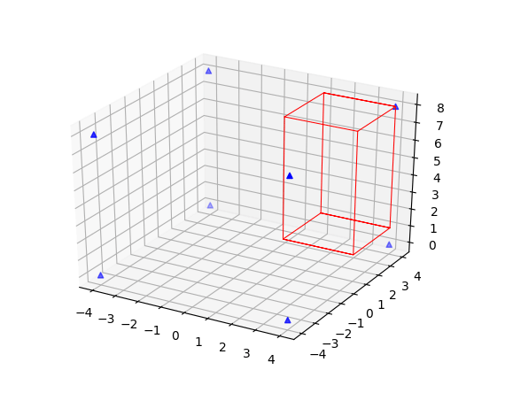


Control and Visualization for Drone Research
Alexis Alvarez, Austin Corum,
Adam Witzel, Gavin Valencia
We Are CompiledHive
For More Information Visit
bit.ly/compiledhive
3
Architecture
1
Problem
The architecture includes 3 main modules. The control module (the central hub for the application), the GUI module (the user’s entry point into the application), and the flight script (which is interpreted by the backend and passed into CrazyFlie/ROS to control the drones). This system is loosely based on the Model View Controller model. Focus on the view portion of the model is less important to the overall product, and is relegated to being a part of the control portion. The diagram to the right details these main modules
Dr. Nghiem researches various topics in the SICCS department. One particular topic is researching how swarms of drones are controlled autonomously. The eventual goal of this research is to find the optimal way to perform numerous concurrent tasks using the drone swarm. However, the current workflow Dr. Nghiem uses is cumbersome.
Currently, the drone flight system involves writing a new Python script for each flight, changing file pointers across a myriad of different files, and initiating the flight with a video game controller
4
Key Features
Test Logging
The ToggleLog class toggles the elements logged post flight. The elements are:
Drone Configuration setup
The active drones
The drone locations
The frequency of logging
The simulated objects
The flight paths
The coordinates entered
Major events that occurred
Save log information
The GUI allows the user to enter up to seven drones. The user can enter any name for the drone and the drone ID number. Then the user can select to choice a flight path or to manually enter coordinates. Theses coordinates can be added or removed.
Current lab system setup
3D Visualization
Simulated Obstacles
The 3D visualization module receive these coordinates from the control node and display elements based on the config file. The visualization will include one element, the visualization itself.
The ToggleVis class allows the user to determine which elements will be displayed in the visualization..
2
Solution
The Objects class allows the user to add and remove simulated obstacles to the flight area for the drones to navigate around.
To make analyzing the actual flights easier and simplify the system setup a graphical user interface (GUI) has been designed to:
connect with ROS, alleviating the need to manually connect
take in user inputs to set up all necessary details to start a flight
initiate and end a flight
display the flight in real time
log all requested details
5
Technologies
Python 2.7 is the main language used in this application. ROS and CrazyFlie both include numerous tools to interface with Python.
PyQt4 is the basis of the GUI portion of the application. The framework allowed all necessary user inputs to be stored and transferred to the control module.
MatPlotLib is a Python 2 based graphing tool. With slight modification it allows for continuous updating as more inputs are introduced. This is used to graph the real-time locations of each drone during a flight.
CrazyFlie 2.0 and its software Loco Positioning System (LPS), was used to control the drone swarms.
ROS Kinetic monitors all the information about the flight. In this application, ROS was used to monitor the locations of everything within the flight area, including the drone locations, the sensor locations, and simulated obstacle locations. Due to its compatibility with Python, all this information is passed into the control module through built-in ROS commands.
6
Challenges
7
Testing
8
Conclusion
During the course of this project we overcame several challenges the main challenges are the following.
The most recent issue the team faced was packet loss through ROS. Which caused the system to crash if it occurred during setup. This lead to our team re-writing the back end node to stop this error.
The initial implementation of the drone system was non-functional. Our team attempted to refactor the initial flight control system such that it could properly interface with ROS. Due to time constraints, we chose to simulate the hardware interfaces that are responsible for sending and receiving coordinates information to the drones. The simulation was designed to reflect the system so that when repaired, it can easily replace the simulation. Fixing the system wasn’t part of our requirements, however it did became a stretch goal.
The application will be put through numerous tests. The individual methods within the application will be tested using Unit tests. All methods that take in and modify information will be analyzed to ensure the data is returned as expected. The application also relies on multiple nodes communicating with each other to function, so extensive Integration testing will be held to confirm each link functions correctly.
Lastly, multiple third parties will be asked to initiate various tasks using the system. After obtaining their feedback, the front end will be re-designed. With these tests, the application will be fully functional and ready to be released.
In the future, the application can be improved upon but adding static analysis and add additional types of obstacles shapes. The application in a later version should allow the user to draw the path they want a drone to follow rather an entering coordinates to reduce the setup time of each test.
This application drastically reduces the logistical complexity of the parameterization and initialization of drone flights. By reducing this complexity, our client can save time. Having a strong foundation, our application can easily be expanded to serve our client’s future needs.
Current lab system setup

