Slide 1
Validation of Define-XML with
XML Schema and Schematron
Lex Jansen
2023-11-16

Slide 2
Validation of Define-XML
Validation of Define-XML has 3 phases:
Does the document follow the XML ground rules (well-formed)?
A single element contains all other elements
Properly nested tags
Properly quotes attributes
No illegal characters (correct encoding)
This is an absolute pre-condition for the next 2 phases.
Does the document follow the specific Define-XML grammar?
Names of elements and attributes that must/may be included
Order of elements
Cardinality of elements
Datatypes of attributes
Enumerations (valid values)
Uniqueness constraints
Does the data make sense (business rules)
Define-XML Specification, mostly implemented by XML Schema
Define-XML Specification

Slide 3
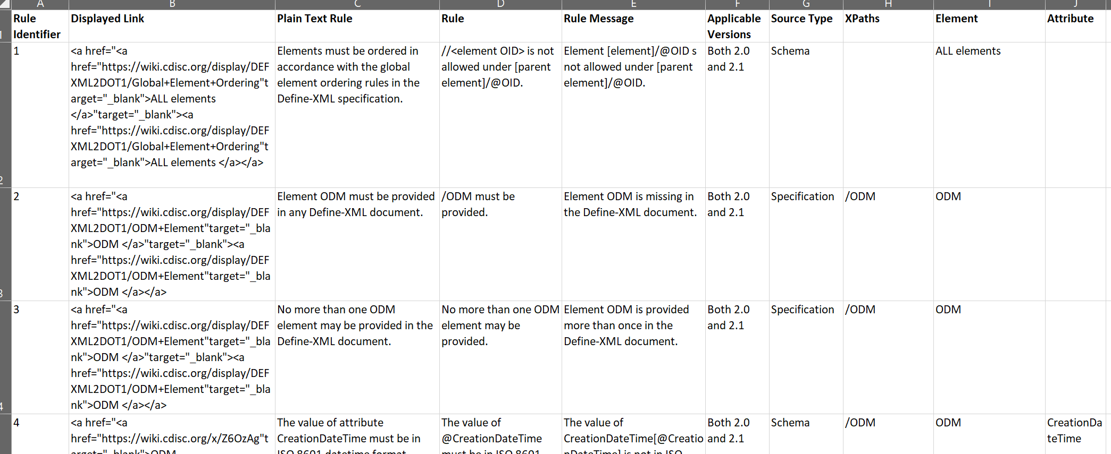
Validating XML - Define-XML Conformance Rules

Slide 4
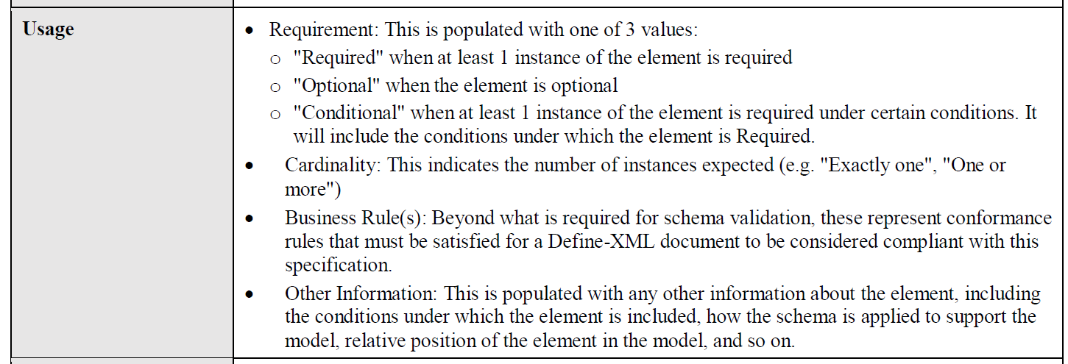
Validating XML - Define-XML Conformance Rules

Slide 5
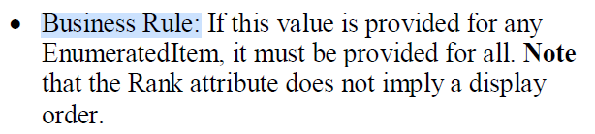
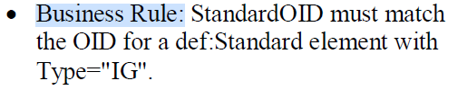
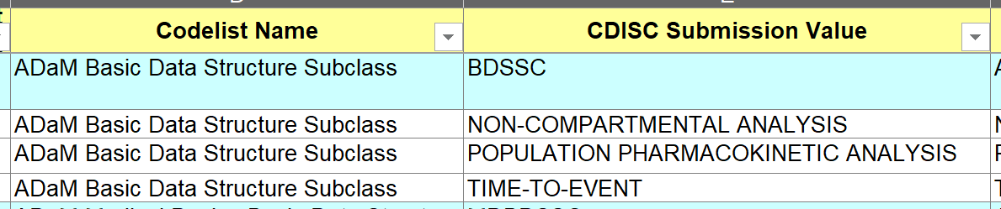
Validating XML - Define-XML Business Rules

Slide 6
Validating XML
XML schema languages:
Document Type Definitions (DTD)
XML Schema (W3C)
Schematron
XQuery
RELAX NG

Slide 7
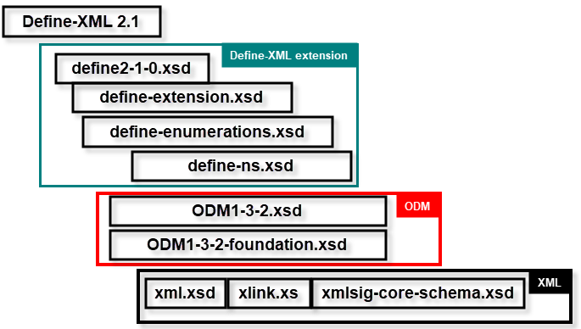
XML Schema for Define-XML v2.1

Slide 8
Validating XML – XML Schema
Limitations
XML Schema 1.0 provides no facilities to state that the value or presence of one data item is dependent on the values or presence of other data items (so-called co-occurrence constraints).
Error messages are not very human friendly

Slide 9
Validating XML - Schematron
Schematron
Can compare arbitrary nodes in an XML file
Namespace awareness
Customizable friendly error messages
Verify co-occurrence constraints
In a submission, if the ItemDef/def:Origin/@Type attribute is “Collected” then there has to be a def:DocumentRef child element
If the Purpose attribute is “Tabulations” then the def:Class/@Name attribute has to be “FINDINGS”, “EVENTS”, “INTERVENTIONS”, ...
Based on XSL transformations
Everything not forbidden is allowed
Schematron makes assertions about the document content

Slide 10
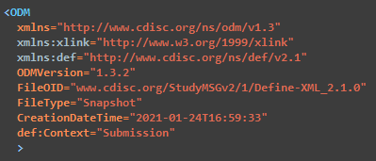
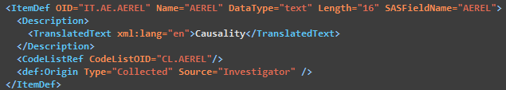
Validating XML - Schematron

Slide 11
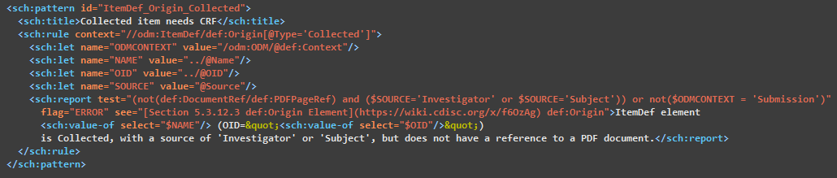
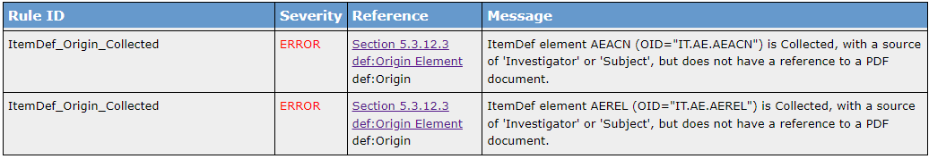
Validating XML –Schematron
"Assertions" and "Reports"

Slide 12
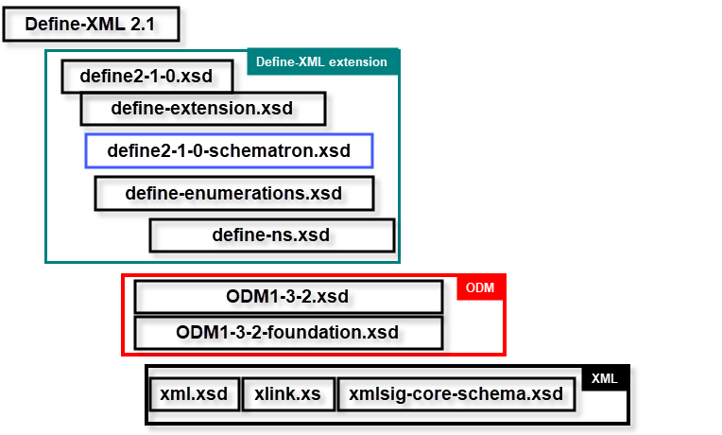
XML Schema for Define-XML v2.1 + Schematron

Slide 13
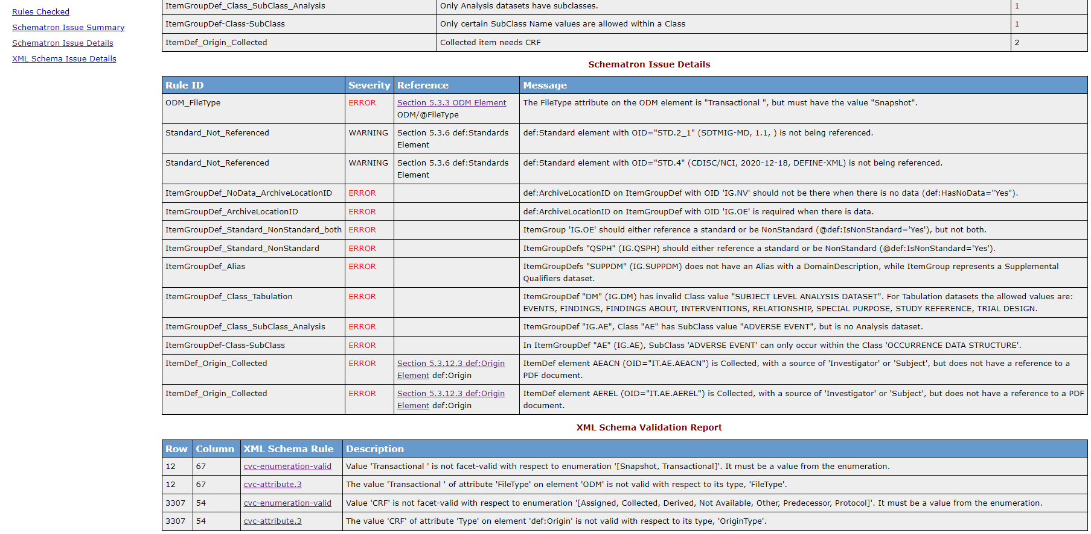
XML Schema for Define-XML v2.1 + Schematron

Slide 14
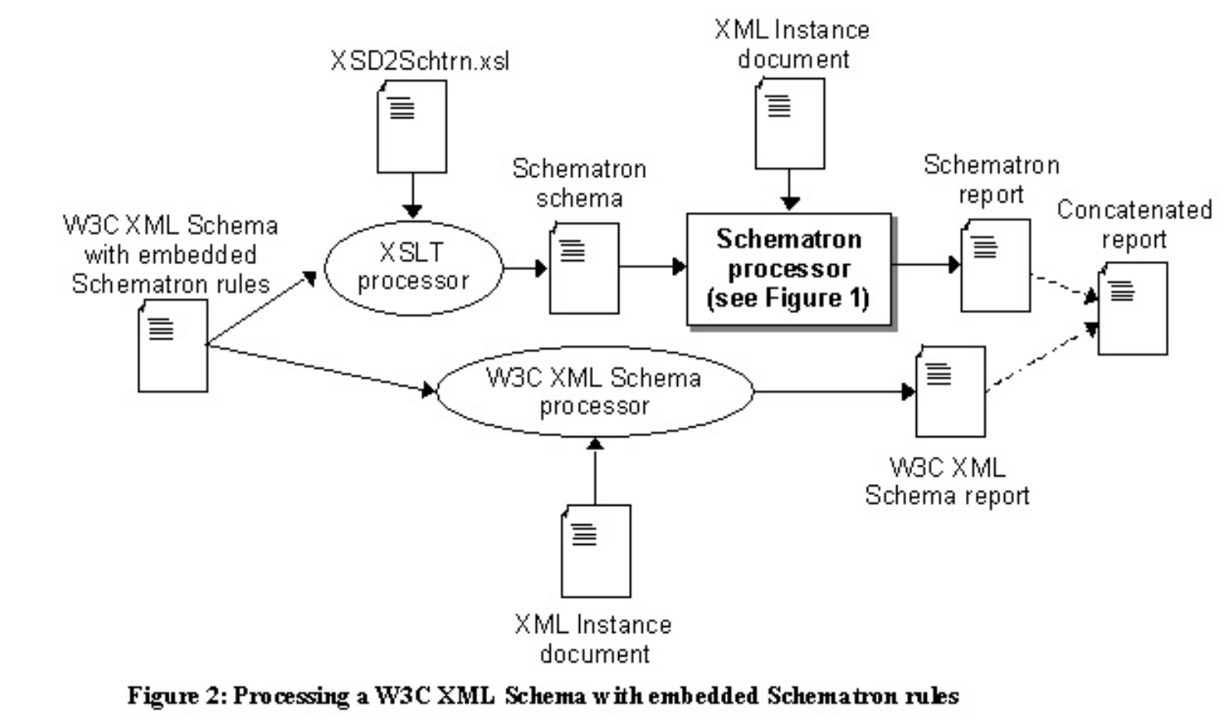
XML Schema for Define-XML v2.1 + Schematron - Technology

Slide 15
XML Schema for Define-XML v2.1 + Schematron - References
https://www.schematron.com/ A website for all things Schematron
https://github.com/schxslt/schxslt SchXslt [ʃˈɛksl̩t] – An XSLT-based Schematron processor
https://github.com/lexjansen/schematron4define

