Slide 1



Key Findings & Recommendations
Insights that matters
Summary | Observation | Follow-up Action
Revenue Performance | The company's revenue is driven by two distinct models: high-volume, low-price items (health_beauty) and high-price, low-volume items (computers). The Bed, Bath & Table category is a "sweet spot," generating high revenue from a combination of high order volume and a moderate average price. | Analyze the "sweet spot" categories to understand their success factors and apply those strategies to other product categories to drive growth. This could also help inform decisions on which product categories to prioritize.
Delivery Issues | A significant spike in late deliveries occurred in April 2018, marked by both higher volume and a notable rise in the severity of delays. Sellers locations are concentrated in Sao Paulo. Delivery route range from 71km to 1800km. | The delivery department should conduct a root-cause analysis of the April 2018 spike considering seller vs customer locations and delivery routes to prevent similar issues in the future.
Customer Loyalty | The vast majority of customers are single-purchase buyers, with a very low average of 1.03 orders per customer. The distribution chart shows a massive drop-off after the first purchase. | A customer retention strategy is needed. Focus on initiatives to encourage repeat purchases and improve the average orders per customer metric.

Slide 2
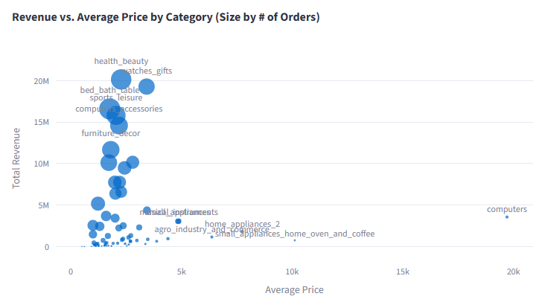
Analysis
Insight 1 - Revenue Performance

Slide 3
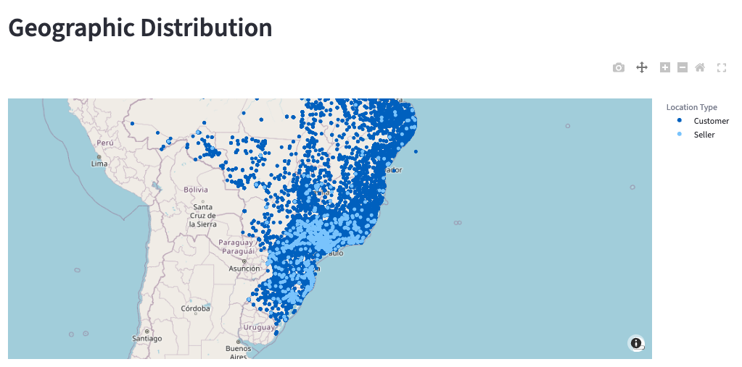
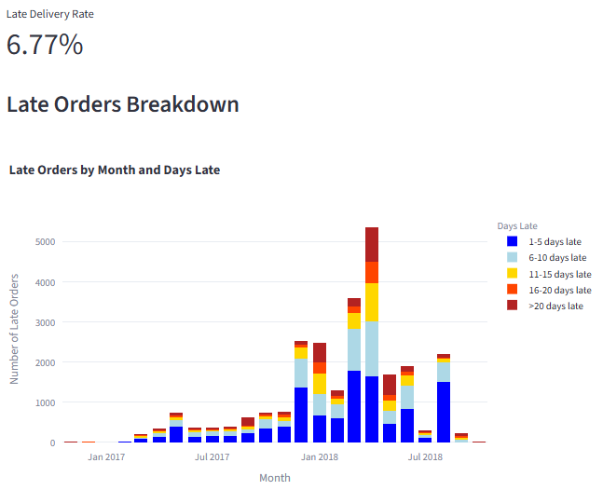
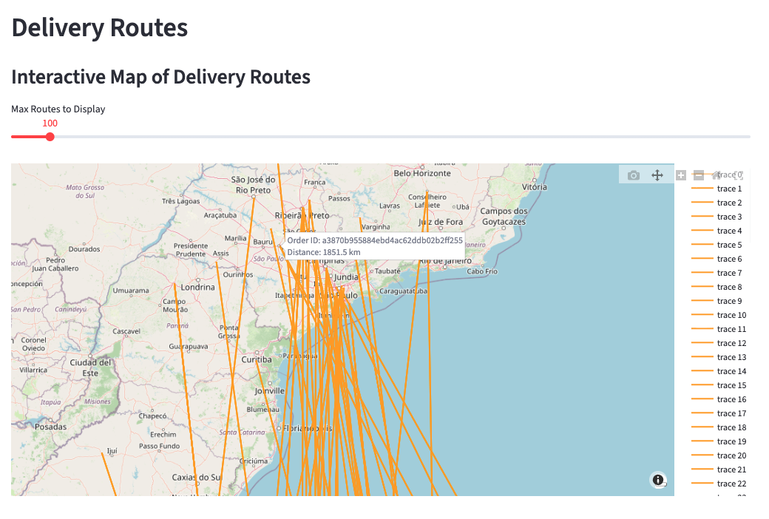
Analysis
Insight 2 – Delivery Issues

Slide 4
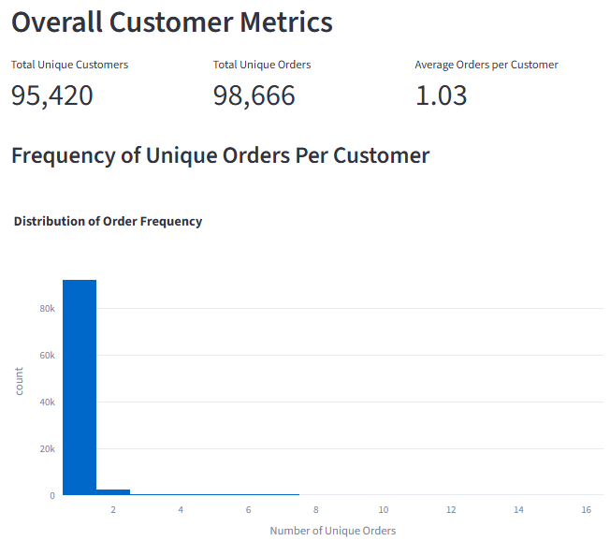
Analysis
Insight 3 – Customer Loyalty

