Slide 1
Building an End-to-End Data Pipeline for E-Commerce Insights
● From Raw Files to Business-ready Dashboards ●

Slide 2
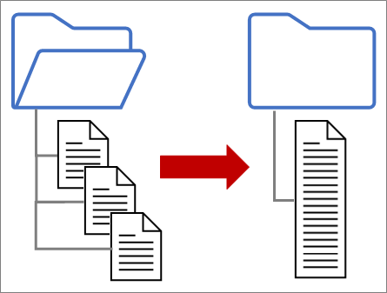
Problem Statement
Introduction & User Story
BI Analysts require access to clean, well-structured data consolidated in a single warehouse to enable efficient report generation without the need for manual data cleaning.
Problem Statement:
Data is scattered across multiple raw CSV files.
Inconsistent formats, missing values, and duplicate records hinder analysis.
Delays in decision-making occur due to the lack of timely, reliable data.
There is no centralized, analytics-ready dataset to support reporting and insights.
Goals
- Centralized warehouse for sales tracking
- Customer segmentation for marketing
- Product-level performance analysis
- Faster executive reporting

Slide 3
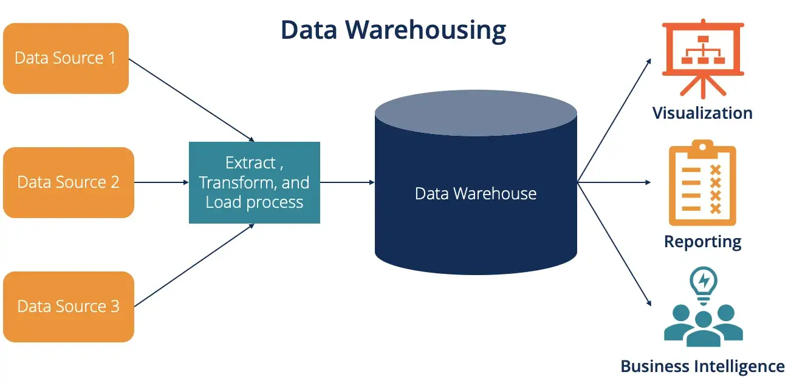
Problem Statement
Introduction & User Story
Goals
- Centralized warehouse for sales tracking
- Customer segmentation for marketing
- Product-level performance analysis
- Faster executive reporting

Slide 4
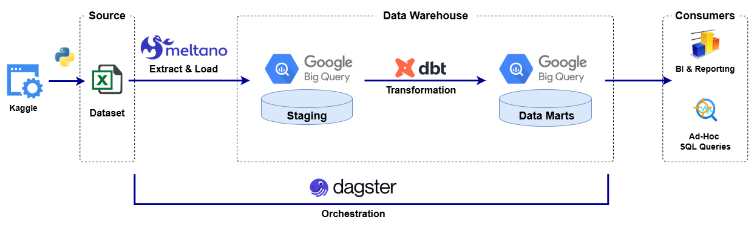
End to End Data Pipeline and Analysis Workflow
Methodology
Key Phases:
Ingest
Raw CSVs into staging tables
Design
Define target DB schema
ELT
Extract-Load—Transform
Data Cleansing
Quality Assurance
QA Testing
QA Report
Analysis
Data Visualization
Key Insights
Orchestration
Automate, Schedule, Monitor
Key Deliverables:
Ingestion python script
Exploratory Discovery
ERD
Data Modelling
CSV Extractor
Big-query Loader
Cleanse data
Transform to target schema
Check null
Duplicates
Data Analysis
Reports Development
Tech Stack:

Slide 5
Technology Stack
Tools

Slide 6
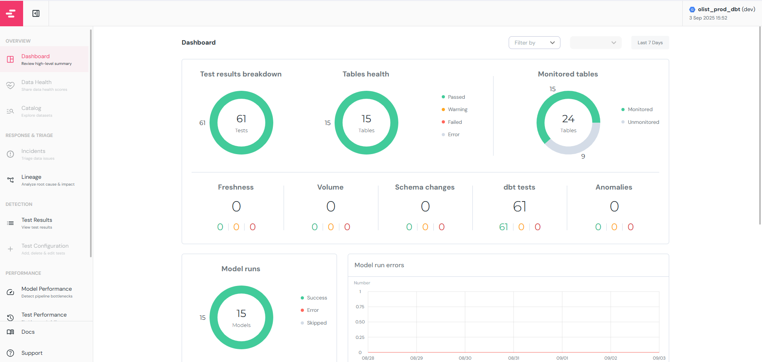
Quality Assurance
Testing Results

Slide 7
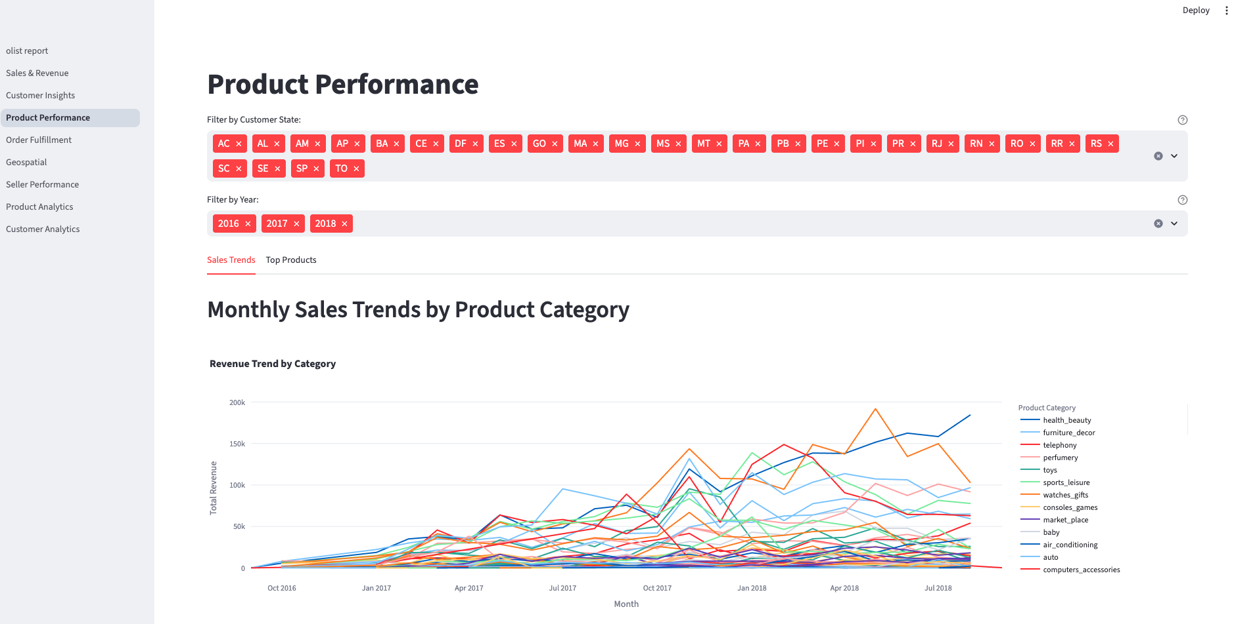
Analysis
Dashboard

Slide 8
Key Findings & Recommendations
Insights that matters
Enter title
Enter title
This Template Is Designed By Zuo An,It Will Help You Make You Report Easy And Fast.
This Template Is Designed By Zuo An,It Will Help You Make You Report Easy And Fast.
Enter title
Enter title
This Template Is Designed By Zuo An,It Will Help You Make You Report Easy And Fast.
This Template Is Designed By Zuo An,It Will Help You Make You Report Easy And Fast.

Slide 9
202X
THANK YOU
● Enter title ●
This Template Is Designed By Zuo An,it Will Help You Make You Report Easy And Fast. We Hope You Have A Wonderful Report！

Slide 10
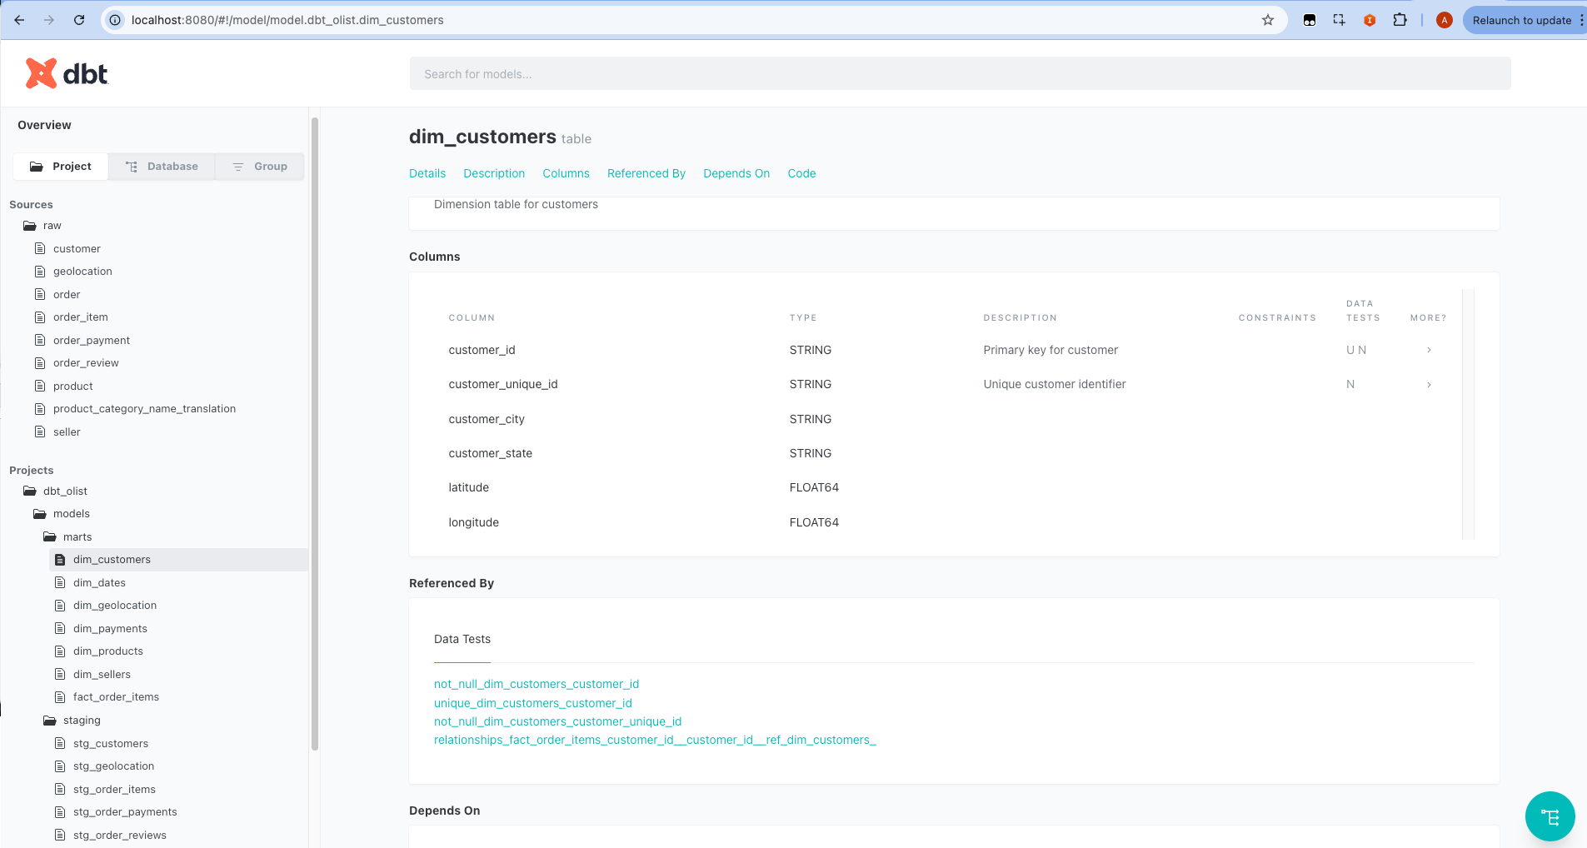
Documentation
Capturing the Configuration

Slide 11
Quality Assurance
Testing Results

Slide 12
01
Thank you
This Template Is Designed By Zuo An,It Will Help You Make You Report Easy And Fast.

Slide 13
Analysis
Dashboard
Product
This Template Is Designed By Zuo An,It Will Help You Make You Report Easy And Fast.
Customer
This Template Is Designed By Zuo An,It Will Help You Make You Report Easy And Fast.
Sales
This Template Is Designed By Zuo An,It Will Help You Make You Report Easy And Fast.

Slide 14
Tech Stack
Design decision
Meltano
Help You Make You Report Easy And Fast.
DBT
Help You Make You Report Easy And Fast.
Dagster
Help You Make You Report Easy And Fast.
Streamlit
Help You Make You Report Easy And Fast.

Slide 15
01
Enter title
It Will Help You Make You Report Easy And Fast.
02
Enter title
CONTENTS
It Will Help You Make You Report Easy And Fast.
Designed By Zuo An,It Will Help You Make You Report Easy And Fast.
Enter title
03
It Will Help You Make You Report Easy And Fast.
04
Enter title
It Will Help You Make You Report Easy And Fast.

Slide 16
Enter title
We Help You Make You Report Easy And Fast!
Enter title
Enter title
This Template Is Designed By Zuo An,It Will Help You Make You Report Easy And Fast.
This Template Is Designed By Zuo An,It Will Help You Make You Report Easy And Fast.
Enter title
Enter title
This Template Is Designed By Zuo An,It Will Help You Make You Report Easy And Fast.
This Template Is Designed By Zuo An,It Will Help You Make You Report Easy And Fast.

Slide 17


Enter title
We Help You Make You Report Easy And Fast!
Enter title
This Template Is Designed By Zuo An,It Will Help You Make You Report Easy And Fast.
This Template Is Designed By Zuo An,It Will Help You Make You Report Easy And Fast. This Template Is Designed By Zuo An,It Will Help You Make You Report Easy And Fast.

Slide 18
Enter title
We Help You Make You Report Easy And Fast!
Enter title
Enter title
This Template Is Designed By Zuo An,It Will Help You Make You Report Easy And Fast.
This Template Is Designed By Zuo An,It Will Help You Make You Report Easy And Fast.
80%
80%
58%
58%
76%
76%
80%
80%
58%
58%

Slide 19



Enter title
We Help You Make You Report Easy And Fast!
Enter title
Enter title
Enter title
This Template Is Designed By Zuo An,It Will Help You Make You Report Easy And Fast.
This Template Is Designed By Zuo An,It Will Help You Make You Report Easy And Fast.
This Template Is Designed By Zuo An,It Will Help You Make You Report Easy And Fast.

Slide 20
02
Enter title
This Template Is Designed By Zuo An,It Will Help You Make You Report Easy And Fast.

Slide 21




Enter title
Enter title
Help You Make You Report Easy And Fast.
Help You Make You Report Easy And Fast.
Enter title
Enter title
Help You Make You Report Easy And Fast.
Help You Make You Report Easy And Fast.

Slide 22
Enter title
We Help You Make You Report Easy And Fast!
Enter title
Enter title
Enter title
Help You Make You Report Easy And Fast.
Help You Make You Report Easy And Fast.
Help You Make You Report Easy And Fast.
Enter title
Enter title
Enter title
80%
80%
80%
Enter title
Enter title
Enter title
58%
58%
58%
Enter title
Enter title
Enter title
76%
76%
76%

Slide 23




Enter title
We Help You Make You Report Easy And Fast!
Enter title
Enter title
Help You Make You Report Easy And Fast.
Help You Make You Report Easy And Fast.
Enter title
Enter title
Help You Make You Report Easy And Fast.
Help You Make You Report Easy And Fast.

Slide 24
Enter title
We Help You Make You Report Easy And Fast!
Enter title
Enter title
Enter title
Enter title
This Template Is Designed By Zuo An,It Will Help You Make You Report Easy And Fast.
This Template Is Designed By Zuo An,It Will Help You Make You Report Easy And Fast.
This Template Is Designed By Zuo An,It Will Help You Make You Report Easy And Fast.
This Template Is Designed By Zuo An,It Will Help You Make You Report Easy And Fast.

Slide 25
03
Enter title
This Template Is Designed By Zuo An,It Will Help You Make You Report Easy And Fast.

Slide 26
Enter title
We Help You Make You Report Easy And Fast!
Enter title
Enter title
This Template Is Designed By Zuo An,It Will Help You Make You Report Easy And Fast.
This Template Is Designed By Zuo An,It Will Help You Make You Report Easy And Fast.
Enter title
Enter title
This Template Is Designed By Zuo An,It Will Help You Make You Report Easy And Fast.
This Template Is Designed By Zuo An,It Will Help You Make You Report Easy And Fast.

Slide 27
Enter title
We Help You Make You Report Easy And Fast!
Enter title
Help You Make You Report Easy And Fast.
Enter title
Help You Make You Report Easy And Fast.
Enter title
Help You Make You Report Easy And Fast.
Enter title
Help You Make You Report Easy And Fast.

Slide 28
Enter title
We Help You Make You Report Easy And Fast!
Enter title
Enter title
Enter title
Designed By Zuo An,It Will Help You Make You Report Easy And Fast.
Designed By Zuo An,It Will Help You Make You Report Easy And Fast.
Designed By Zuo An,It Will Help You Make You Report Easy And Fast.
Enter title
Enter title
Enter title
Designed By Zuo An,It Will Help You Make You Report Easy And Fast.
Designed By Zuo An,It Will Help You Make You Report Easy And Fast.
Designed By Zuo An,It Will Help You Make You Report Easy And Fast.

Slide 29
04
Enter title
This Template Is Designed By Zuo An,It Will Help You Make You Report Easy And Fast.

Slide 30
Enter title
We Help You Make You Report Easy And Fast!
Enter title
This Template Is Designed By Zuo An,It Will Help You Make You Report Easy And Fast.
Enter title
This Template Is Designed By Zuo An,It Will Help You Make You Report Easy And Fast.
Enter title
This Template Is Designed By Zuo An,It Will Help You Make You Report Easy And Fast.

Slide 31
Enter title
We Help You Make You Report Easy And Fast!
Enter title
Help You Make You Report Easy And Fast.
Enter title
Help You Make You Report Easy And Fast.
Enter title
Help You Make You Report Easy And Fast.
Enter title
Help You Make You Report Easy And Fast.

Slide 32
Enter title
We Help You Make You Report Easy And Fast!
01
Enter title
Help You Make You Report Easy And Fast.
02
Enter title
Help You Make You Report Easy And Fast.
03
Enter title
Help You Make You Report Easy And Fast.
04
Enter title
Help You Make You Report Easy And Fast.

Slide 33
Enter title
We Help You Make You Report Easy And Fast!
Enter text
Enter text
Enter text
10
20
50
$
$
$
/month
/month
/month
1 GB Bandwith
10 GB Bandwith
Unlimited Bandwith
10 MB Ma9 File Size
50 MB Ma9 File Size
No Ma9imum File Size
3 GHZ CPU
5 GHZ CPU
8 GHZ CPU
2 GB Memory
4 GB Memory
30 GB Memory
Enter text
Enter text
Enter text

Slide 34
Enter title
We Help You Make You Report Easy And Fast!
CEO
Answer A
Answer B
Answer C
Answer A1
Answer A2
Answer B1
Answer B2
Answer C1
Answer C2

Slide 35
Enter title
We Help You Make You Report Easy And Fast!
01
Enter title
This Template Is Designed By Zuo An,It Will Help You Make You Report Easy And Fast.
02
Enter title
This Template Is Designed By Zuo An,It Will Help You Make You Report Easy And Fast.
03
Enter title
This Template Is Designed By Zuo An,It Will Help You Make You Report Easy And Fast.

