Slide 1
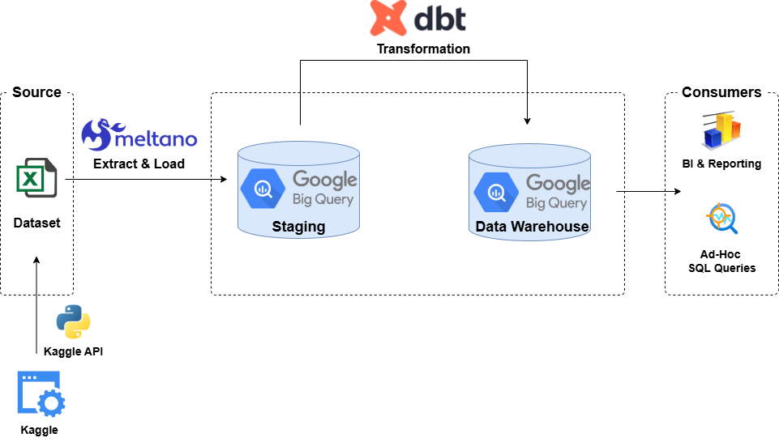
End to End Data Pipeline & Analysis Workflow
Key Phases:
Ingest
Raw CSVs into staging tables
Design
Define target DB schema
ELT
Extract-Load—Transform
Data Cleansing
Quality Assurance
QA Testing
QA Report
Analysis
Data Visualization
Key Insights
Orchestration
Automate, Schedule, Monitor
Key Deliverables:
Ingestion python script
Exploratory Discovery
ERD
Data Modelling
CSV Extractor
Big-query Loader
Cleanse data
Transform to target schema
Check null
Duplicates
Data Analysis
Reports Development
Technology Stack:

