Slide 1
Building an End-to-End Data Pipeline for E-Commerce Insights
From Raw Files to Business-ready Dashboards
Presented by:
TEAM 2 - Automated Analytics for Fact, Staging and Warehouse
Alex
Alvin
Faizal
Sharon
Wei Hong
https://github.com/lexman29125/5m-data-m2-project

Slide 2
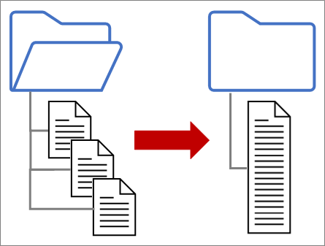
Problem Statement
Introduction & User Story
BI Analysts require access to clean, well-structured data consolidated in a single warehouse to enable efficient report generation without the need for manual data cleaning.
Problem Statement:
There is no centralized, analytics-ready dataset to support reporting and insights.
Data is scattered across multiple raw CSV files.
Inconsistent formats, missing values, and duplicate records hinder analysis.
Delays in decision-making occur due to the lack of timely, reliable data.

Slide 3
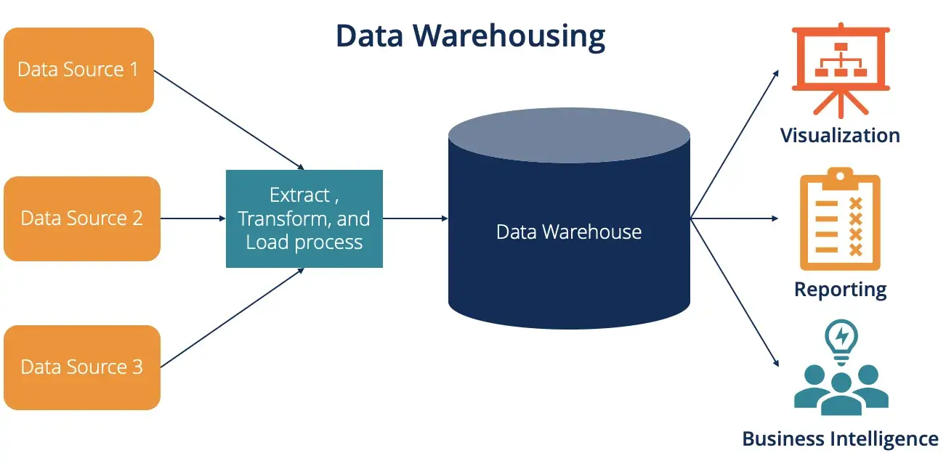
Problem Statement
Introduction & User Story
Goals
Build centralized warehouse for sales tracking
Enable customer segmentation for effective marketing
Support product-level performance analysis
Provide faster executive reporting

Slide 4
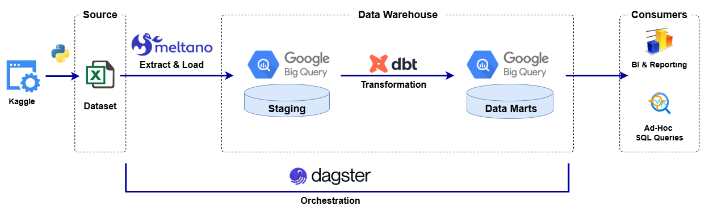
End to End Data Pipeline and Analysis Workflow
Methodology
Key Phases:
Ingest
Raw CSVs into staging tables
Design
Define target DB schema
ELT
Extract-Load-Transform
Data Cleansing
Quality Assurance
QA Testing
QA Report
Analysis
Data Visualization
Key Insights
Orchestration
Automate, Schedule, Monitor
Key Deliverables:
Ingestion python script
Exploratory Discovery
ERD
Data Modelling
CSV Extractor
Big-query Loader
Cleanse data
Transform to target schema
Check null
Duplicates
Data Analysis
Reports Development
Tech Stack:

Slide 5
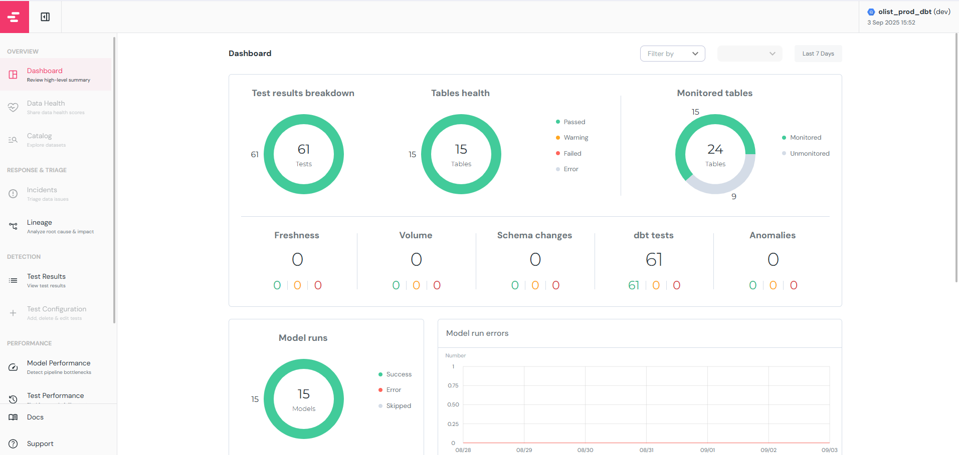
Quality Assurance
DBT Testing Results

Slide 6
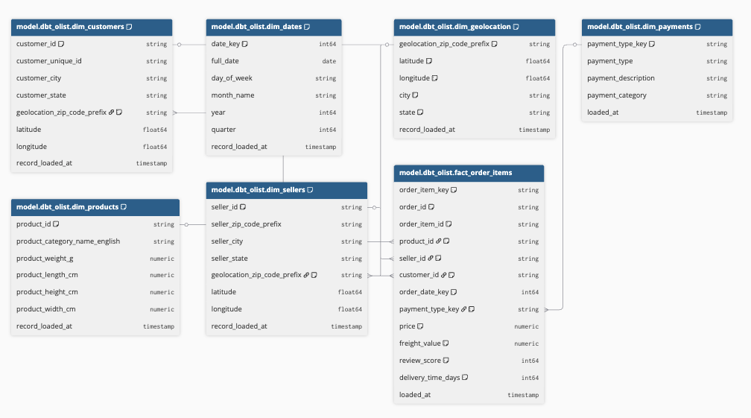
Quality Assurance
DBT ERD generated schema diagram

Slide 7

Analysis
Dashboard Live Demo

Slide 8
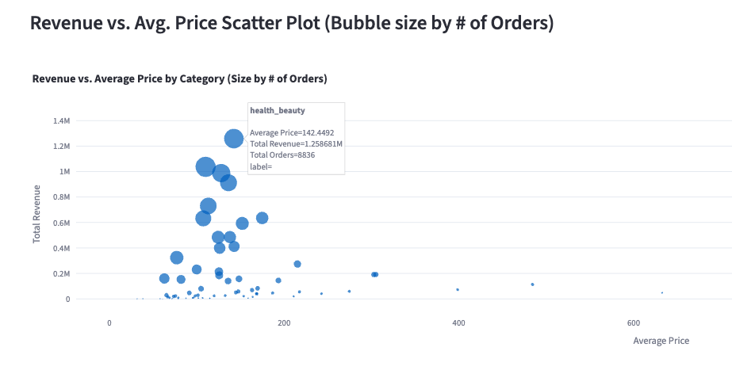
Analysis
Insight 1 - Revenue Performance

Slide 9
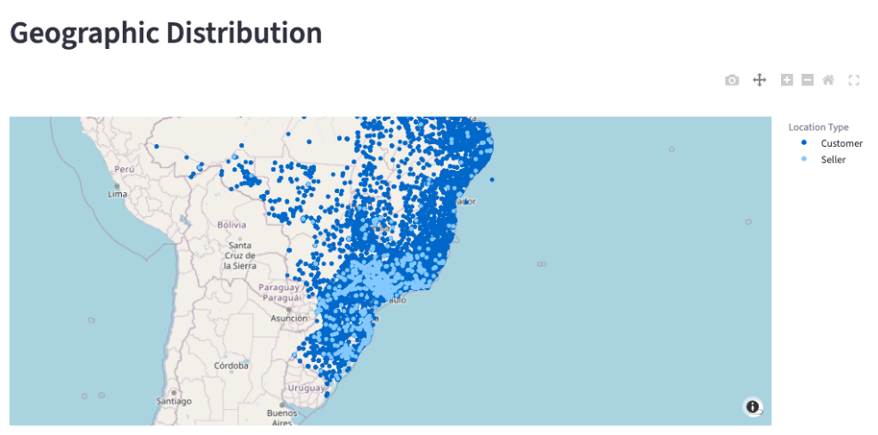
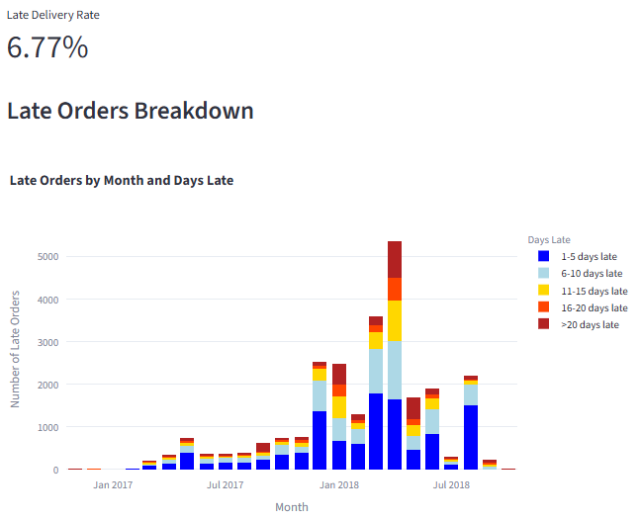
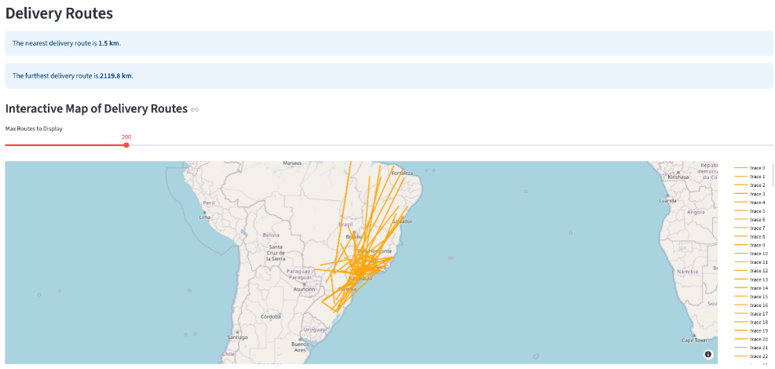
Analysis
Insight 2 – Delivery Issues

Slide 10
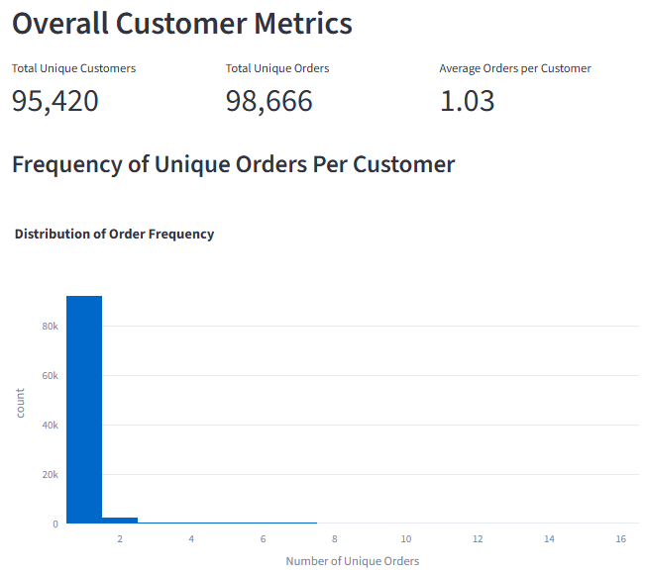
Analysis
Insight 3 – Customer Loyalty

Slide 11



Key Findings & Recommendations
Insights that matters
Summary | Observation | Follow-up Action
Revenue Performance | The company's revenue is driven by two distinct models: high-volume, low-price items (health_beauty) and high-price, low-volume items (computers). The Bed, Bath & Table category is a "sweet spot," generating high revenue from a combination of high order volume and a moderate average price. | Analyze the "sweet spot" categories to understand their success factors and apply those strategies to other product categories to drive growth. This could also help inform decisions on which product categories to prioritize.
Delivery Issues | A significant spike in late deliveries occurred in April 2018, marked by both higher volume and a notable rise in the severity of delays. Sellers locations are concentrated in Sao Paulo. Delivery route range from 1.5km to 2,119.8km. | The delivery department should conduct a root-cause analysis of the April 2018 spike considering seller vs customer locations and delivery routes to prevent similar issues in the future.
Customer Loyalty | The vast majority of customers are single-purchase buyers, with a very low average of 1.03 orders per customer. The distribution chart shows a massive drop-off after the first purchase. | A customer retention strategy is needed. Focus on initiatives to encourage repeat purchases and improve the average orders per customer metric.

Slide 12
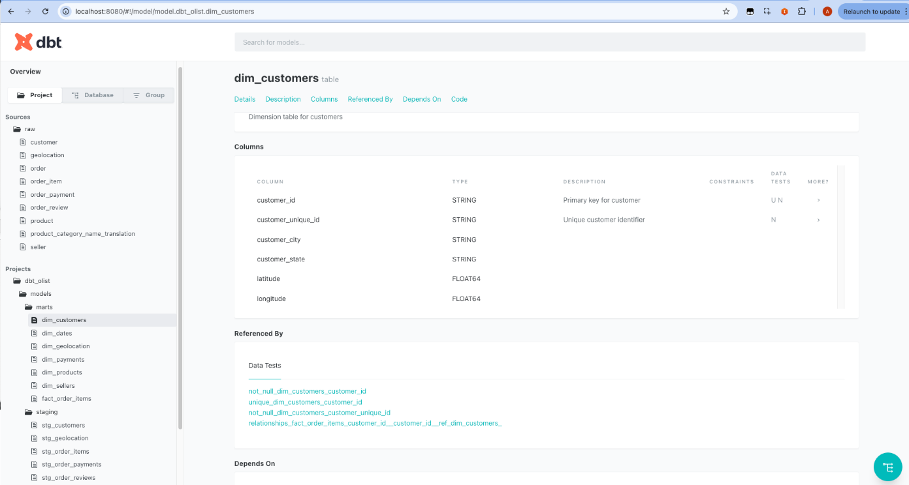
Documentation
Capturing the Configuration

Slide 13
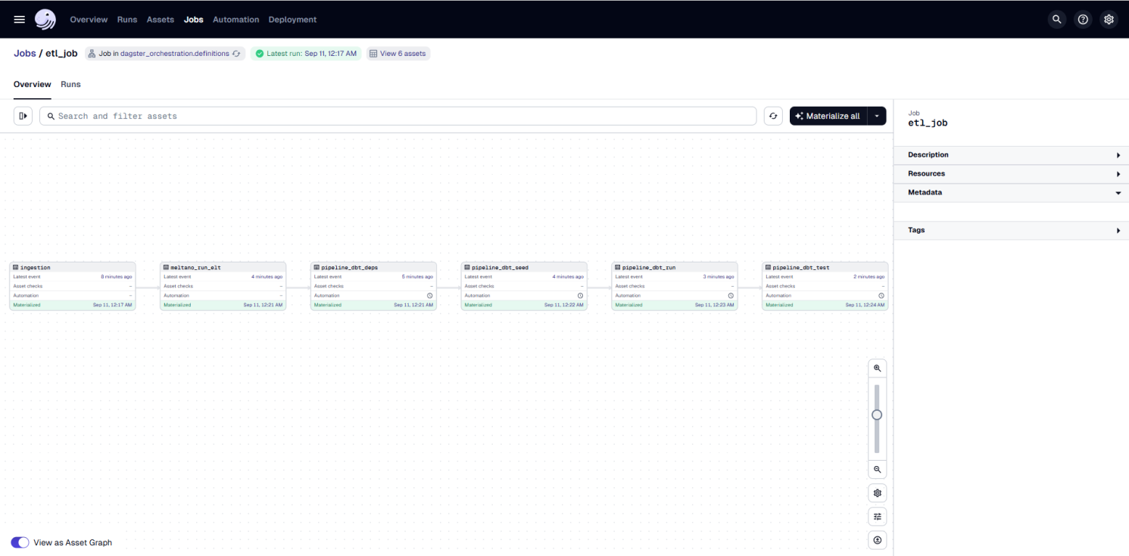
Documentation
Capturing the Configuration

Slide 14
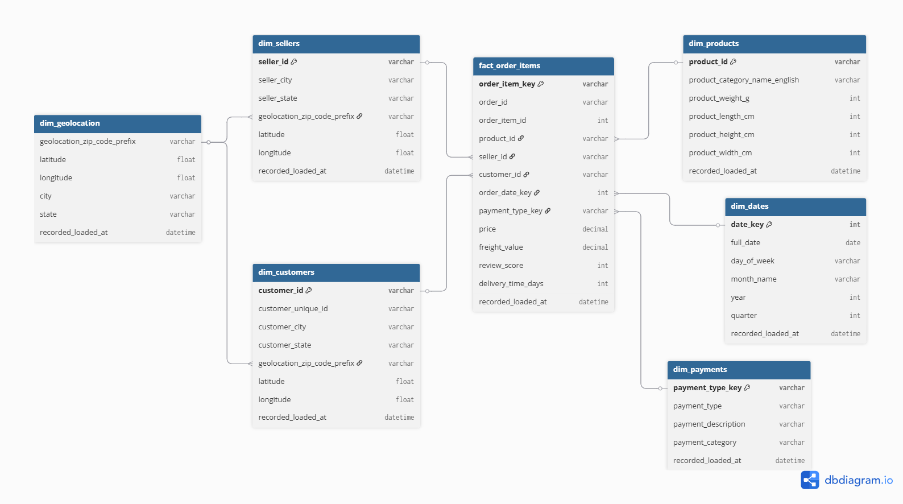
Documentation
Capturing the Configuration

Slide 15
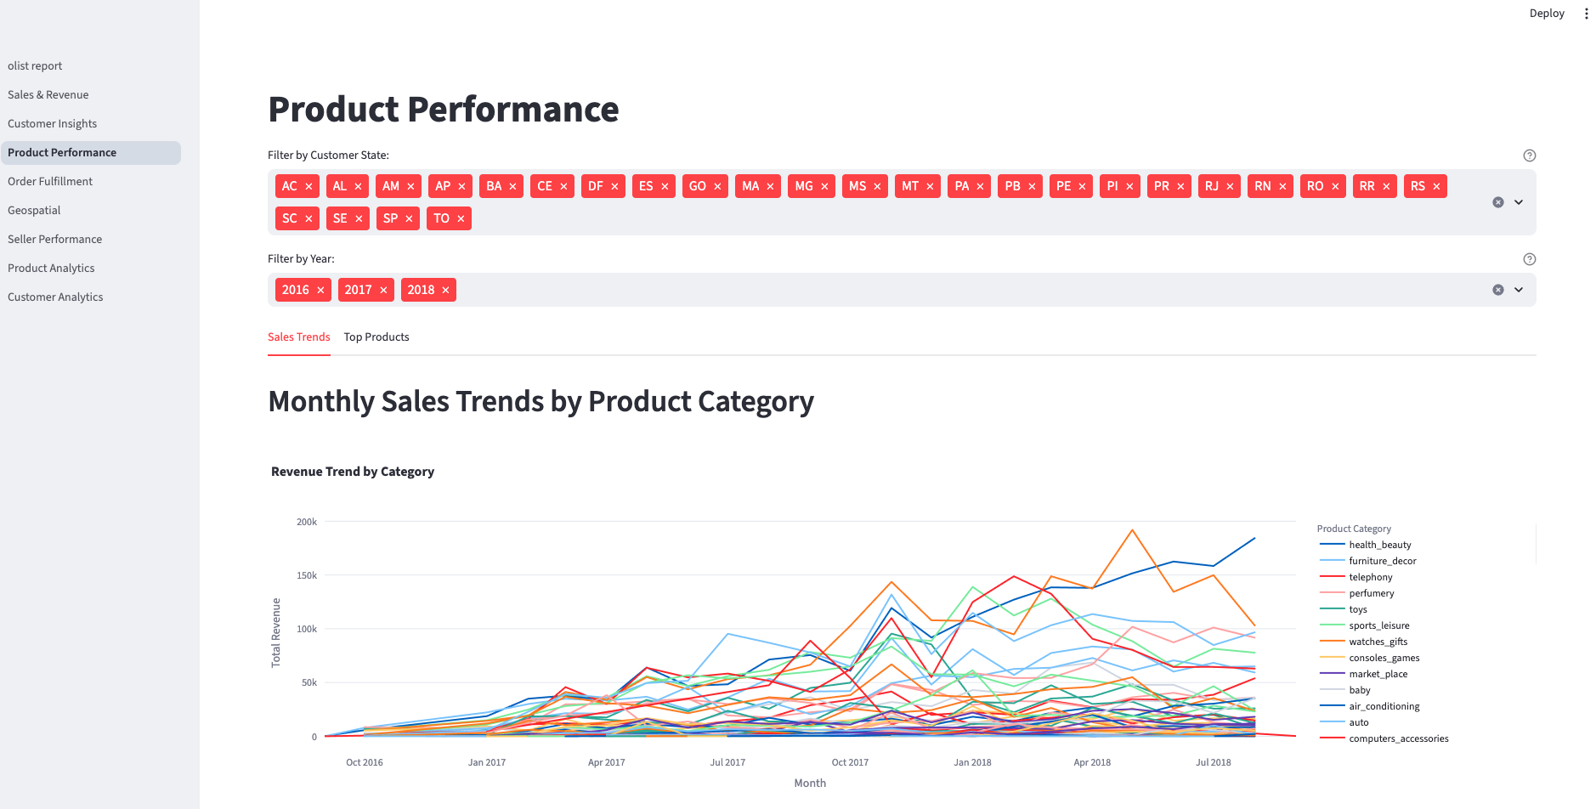
Analysis
Dashboard
Product
This Template Is Designed By Zuo An,It Will Help You Make You Report Easy And Fast.
Customer
This Template Is Designed By Zuo An,It Will Help You Make You Report Easy And Fast.
Sales
This Template Is Designed By Zuo An,It Will Help You Make You Report Easy And Fast.

Slide 16
Thank you

