Slide 1



De novo assembly of 454 reads with Newbler

Slide 2
Learning Points
How to start a newbler assembly
Basic understanding of parameters

Slide 3
Newbler
Check out my blog ('manual') at
contig.wordpress.com
input
parameters
output
much much more

Slide 4
Practical
Data
1) GS FLX+ reads → peak at 800 bases
2) 8 kb Paired End (Mate Pair) run
Newbler 2.8

Slide 5
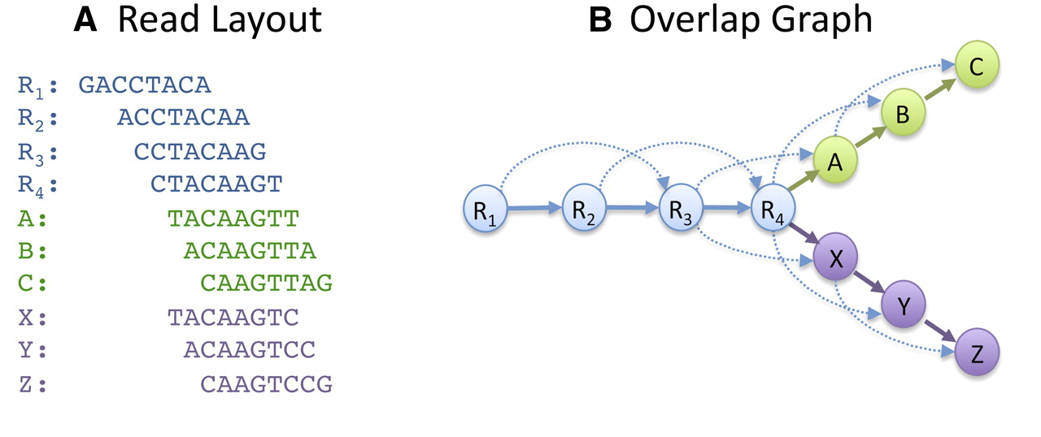
Newbler
Overlap Layout Consensus approach

Slide 6
Newbler
Easy use
runAssembly –o foldername sfffile(s)
Can add parameters to finetune

Slide 7
Practical
Start your assembly
around 15 minutes

Slide 8
Read alignment
Stringency
Read 1
Read 2
Overlap

Slide 9
Read alignment
Stringency
minimum overlap length
-ml
default 40 (bases)
can be anything of at least 1 bases
OR
% of the read length (1-100%)

Slide 10
Read alignment
Stringency
minimum overlap identity
-mi
default 90 (%)
can be anything between 1-100%

Slide 11
Read alignment
Examples
runAssembly -o stringent -ml 100 -mi 98% /data/*.sff
runAssembly -o loose -ml 30 -mi 80% /data/*.sff
runAssembly -o percent -ml 50% /data/*.sff

Slide 12
Read alignment
When to use
contaminated datasets
too low coverage

Slide 13
Read trimming
removing unwanted reads
→ contamination
removing unwanted parts of reads
→ e.g. adaptors

Slide 14
Read trimming
removing unwanted reads
→ 'vector screening' -vs
removing unwanted parts of reads
→ 'vector trimming' -vt

Slide 15
Read trimming
Examples
Trimming 'database' fasta file: adaptors.fasta
runAssembly -o trim1 –vt adaptors.fasta /data/*.sff
Screening 'database' fasta file: ecoli_genome.fasta
runAssembly -o trim2 –vs ecoli_genome.fasta /data/*.sff

Slide 16
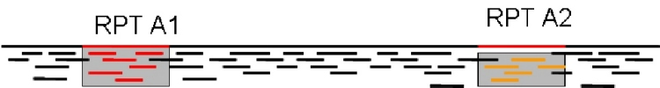
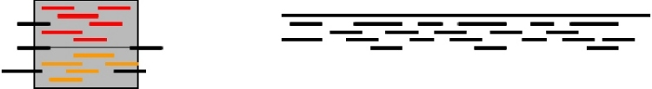
Scaffold gap filling
-scaffold option
Repeat copy 1
Repeat copy 2
Contig orientation?
Contig order?
Collapsed repeat consensus
http://www.cbcb.umd.edu/research/assembly_primer.shtml

Slide 17
Scaffold gap filling
-scaffold option
adds repeat consensus sequence in gaps

Slide 18
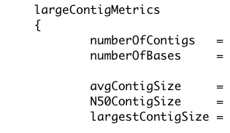
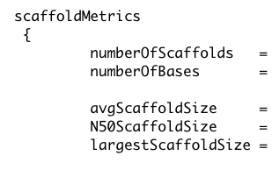
Newbler
Reports contig N50
minimum length 500 bp
so-called 'large' contigs
reports scaffold N50

Slide 19
Newbler
Newbler scaffolds
two or more contigs with gap(s)
unscaffolded contigs of at least 2 kb

Slide 20
Assembly viewing
Uses the 'ace' file
contigs
read alignments
read sequences
no scaffolding info

Slide 21
Homopolymer errors
Undercall
in two reads
Overcall
in three reads
AGAAAGTCAGCGGCAAATTTGGTTTTAGACGAA-TTGTCCCTTTGACATAACGACTAAAGG
AGAAAGTCAGCGGCAAATT-GGTTTTAGACGAA-TTGTCCCTTTGACATAACGACTAAAGG
AGAAAGTCAGCGGCAAATTTGGTTTTAGACGAAATTGTCCCTTTGACATAACGACTAAAGG
AGAAAGTCAGCGGCAAATTTGGTTTTAGACGAA-TTGTCCCTTTGACATAACGACTAAAGG
AGAAAGTCAGCGGCAAATTTGGTTTTAGACGAA-TTGTCCCTTTGACATAACGACTAAAGG
AGAAAGTCAGCGGCAAATTTGGTTTTAGACGAAATTGTCCCTTTGACATAACGACTAAAGG
AGAAAGTCAGCGGCAAATTTGGTTTTAGACGAA-TTGTCCCTTTGACATAACGACTAAAGG
AGAAAGTCAGCGGCAAATTTGGTTTTAGACGAAATTGTCCCTTTGACATAACGACTAAAGG
AGAAAGTCAGCGGCAAATT-GGTTTTAGACGAA-TTGTCCCTTTGACATAACGACTAAAGG
AGAAAGTCAGCGGCAAATTTGGTTTTAGACGAA-TTGTCCCTTTGACATAACGACTAAAGG
AGAAAGTCAGCGGCAAATTTGGTTTTAGACGAA-TTGTCCCTTTGACATAACGACTAAAGG
AGAAAGTCAGCGGCAAATTTGGTTTTAGACGAA-TTGTCCCTTTGACATAACGACTAAAGG
Consensus

