Slide 1



De novo assembly of short reads using Velvet
Adapted from Nick Loman
University of Birmingham
https://github.com/lexnederbragt/denovo-assembly-tutorial

Slide 2
Velvet
One of the first short read assemblers
Developed by Daniel Zerbino of EBI
A de Bruijn graph assembler, like:
SOAPdenovo
ABYSS
ALLPATHS
Etc.

Slide 3
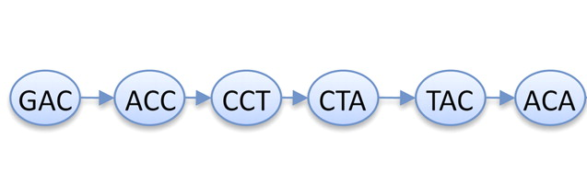
K-mers again
Read
GACCTACA
GAC
ACC
CCT
CTA
TAC
ACA
de Bruijn graph
K-mers (K=3)
K-1 bases overlap

Slide 4
Counting k-mers
Plotting k-mer frequencies is a quick and easy way of:
Estimating genome size
Seeing copy number variation in genome
Estimating sequence read error
Planning a short-read assembly

Slide 5
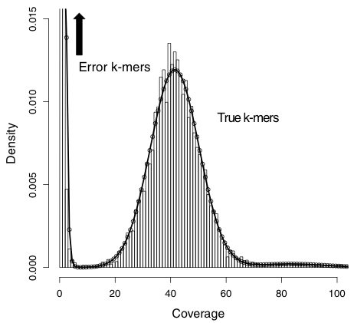
Idealised k-mer plot

Slide 6
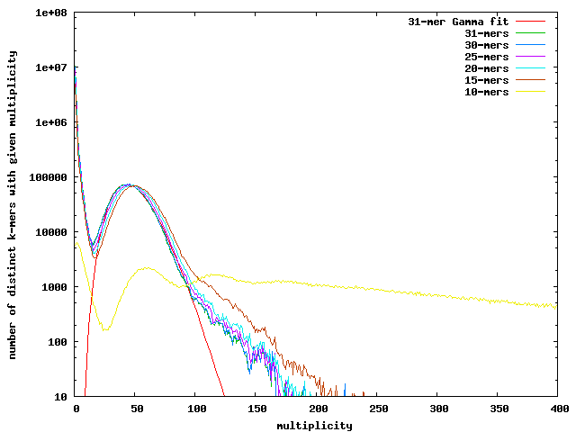
A real K-mer plot
https://banana-slug.soe.ucsc.edu/bioinformatic_tools:jellyfish

Slide 7
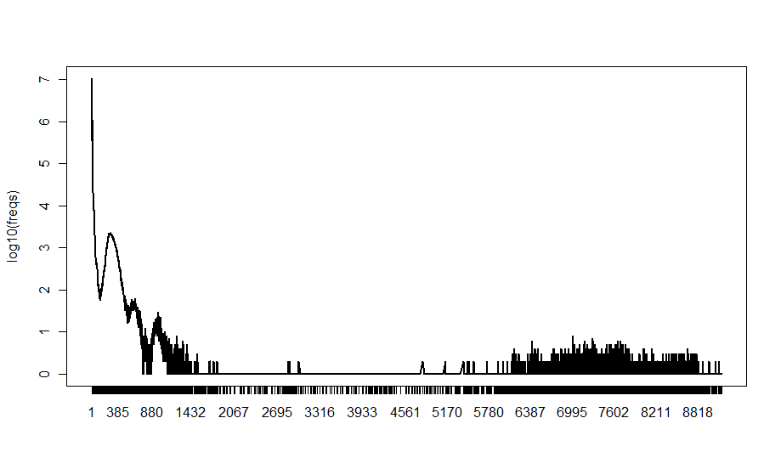
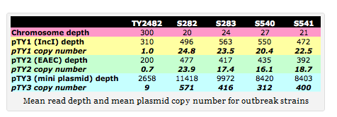
E coli O104:H4
2011 outbreak strain
MiSeq
Plasmids!

Slide 8
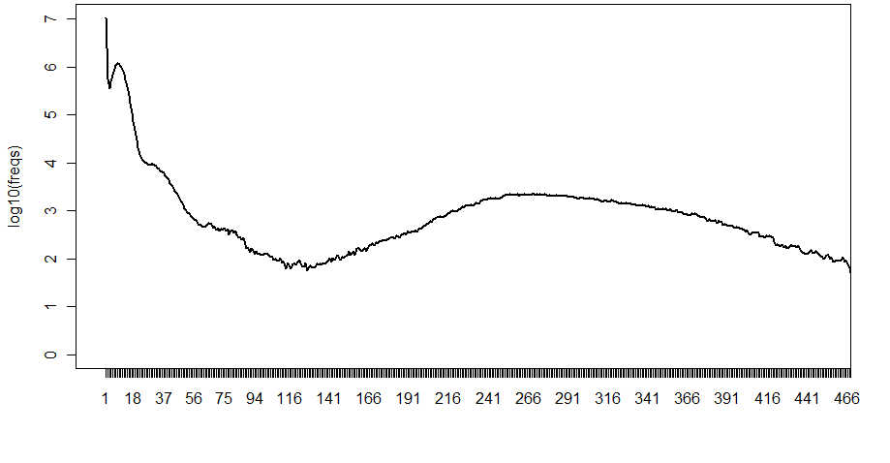

Slide 9
K-mers and K
no magical value of k
Depends on
read length
sequencing error
rate of polymorphism
coverage

Slide 10
K-mers and K
Some rules:
k must be less than the read length
k can't be an even number (can produce palindromes)

Slide 11
K-mers and K
Bigger k
Solves more repeats
fewer overlaps
lower k-mer coverage
Lower k
more overlaps
higher k-mer coverage

Slide 12
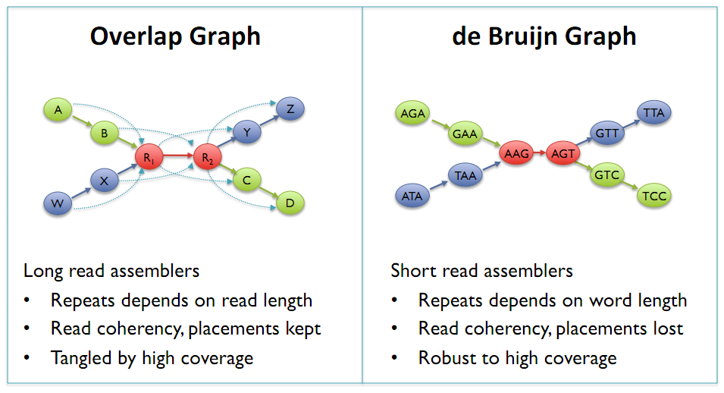
de Bruijn Graphs
Mike Schatz

Slide 13
K-mer coverage
The relation between
k-mer coverage Ck and
standard (nucleotide-wise) coverage C
Ck = C ∗ (L−k +1)
L
k →hash length L →read length

Slide 14
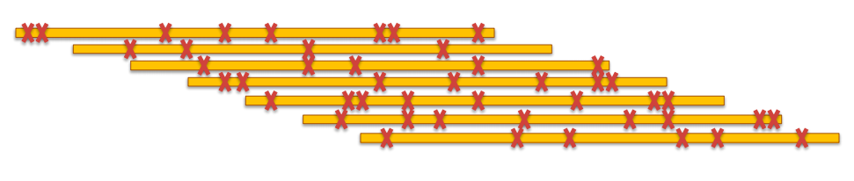
More errors require shorter k-mers

Slide 15
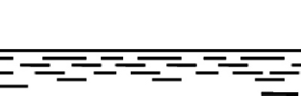
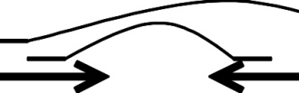
What do you get?
reads
contigs
scaffolds

Slide 16
Metrics
contigs
how many
total bases
N50
scaffolds
how many
total bases
N50
how many gaps
total gap bases

Slide 17
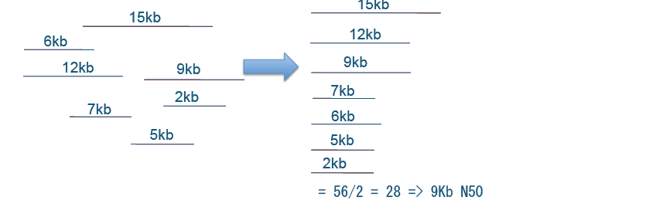
N50
Size of contig such that 50% of total bases are in contigs of this length or more
Sum of lengths: 56 kb
Thomas Keane and Jan Aerts, Wellcome Trust Sanger

Slide 18
N50
Size of contig such that 50% of total bases are in contigs of this length or more
OR
Shortest of the longest contigs that together make up 50% of the assembly

Slide 19
N50
Size of contig such that 50% of total bases are in contigs of this length or more
longer N50 is better
N50 count:
number of contigs of at least N50 size

Slide 20
N50 – NG50
N50:
Size of contig such that 50% of total bases are in contigs of this length or more
NG50:
Replace 'total bases' with 'genome length'

Slide 21
N50
Minimum contig length influences N50
Take away shorter contigs → N50 goes up

Slide 22
N50
High N50 → better assembly
BUT
says nothing of quality

Slide 23
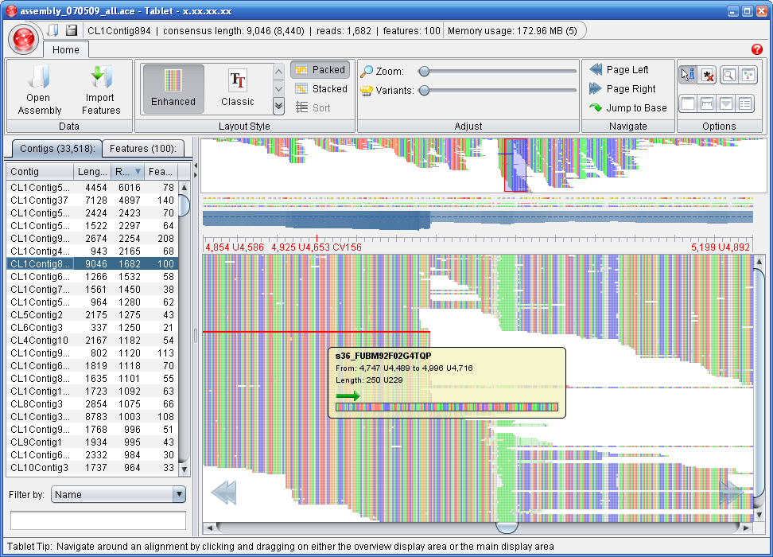
Assembly viewing
We will use Tablet
http://bioinf.scri.ac.uk/tablet/

Slide 24
Exp_cov
Can make a big difference to your assembly if you have long (e.g. 2*k) or paired-reads
But can also introduce misassemblies if set too high
Velvet can estimate it for you (auto)
But the estimate may not always be best
Assumes even coverage – won’t work with transcriptomes or ChIP-seq

Slide 25
Cov_cutoff
Simplifies the assembly graph by removing nodes with less than a given cut-off
Removes low frequency k-mers which may result from sequencing error
Higher cov_cutoff gives more stringent assembly

Slide 26
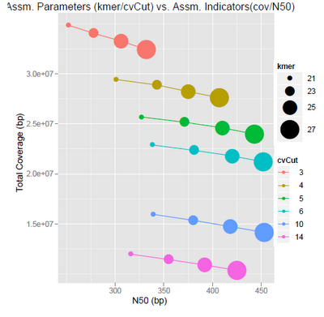

Slide 27
Comes back to question: what do I want from my assembly?
Max coverage
Max accuracy
Max contiguity
You can have some .. But perhaps not all!

Slide 28
Insert size
Experimental evidence
Allow Velvet to guess
Map reads and calculate

Slide 29
Mate-pair data
Orientation different
Read contamination
PE => insert <=
mate-pair <= insert =>

Slide 30
Useful scripts for Velvet
http://code.google.com/p/standardized-velvet-assembly-report/

Slide 31
Software derived from Velvet
Meta Velvet
For meta genomic assemblies
OASES
For transcriptome assemblies

Slide 32
Advanced technique
Gap closing for finishing
Add Sanger reads
32kb limit
Does not work well with 454 reads
http://www.baseclear.com/landingpages/sspacev12/

