Slide 1



Planning a sequencing project
Adapted from Nick Loman
University of Birmingham
https://github.com/lexnederbragt/denovo-assembly-tutorial

Slide 2
Generating sequence is easy

Slide 3
Assembly is difficult … because of
Repeats
Ploidy
Size
Contamination

Slide 4
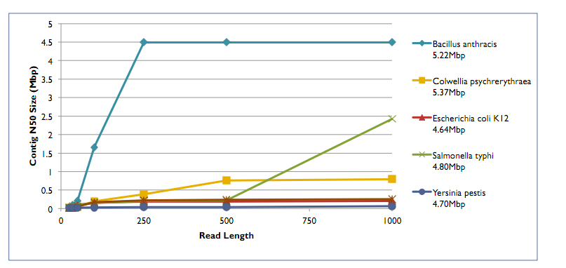
Repeats and read length
Mike Schatz

Slide 5
Difficulty levels
Easy
Chlamydia genome (small, no repeats)
E. coli (small, some repeats)
Small eukaryotic
Large, diploid (Homo sapiens)
Large, polyploid (wheat)
Hard

Slide 6

Biology comes first
How long do you want to spend on this?
Where’s the value to you?
Gene finding only (RNA-Seq, very draft WGS)
Draft incomplete
Draft complete
Contiguous / circular complete
Finished – the holy grail

Slide 7
Resources to help you decide
What have others done already?
Close reference available?
What’s your budget?
What’s your timescale?
What are your bioinformatics resources?
What choice of sequencing technology?

Slide 8
Choosing technologies
Strengths/weaknesses
“Cut your cloth to suit your purse”
454
Long reads
Low throughput
Homopolymeric tract errors
Expensive!

Slide 9
Choosing technologies
Illumina, short reads (but getting longer)
High throughput
Cheap
Short reads (2x150 best)
SOLiD – NO!
Ion Torrent – short reads, low throughput, medium-cost

Slide 10
Choosing technologies
PacBio
Loooooong reads
Low quality per base
Low throughput
Need short reads for correction
(or need better software)

Slide 11
Mate-pairs
454
3 to 20kb protocols
Illumina
3 to 10 kb protocols
IonTorrent
demonstrated 3 and 9 kb protocols

Slide 12
What size is it?
How many sequencing reads to you need?
Rule of thumb: 30x for short reads, 10x for long reads

Slide 13
What is the repeat structure?
Transposons
LINEs
SINEs
IS elements
Number, length, size
Best read length
Determine mate-pair strategy, or decide to give up on completeness!

Slide 14
What is the minimum information I need?
Genes
Regulatory regions
Contiguous chromosomes
Finished

Slide 15
Bioinformatics
Large assemblies require large amount of memory
Estimating requirements may be difficult
Sometimes still not possible – wheat
Hybrid assemblies not always straight-forward

Slide 16
Hybrid assembly
Challenge: short read + long reads
use de Bruijn graph?
use Overlap Layout Consensus?

Slide 17
Hybrid assembly
Use a single program with all data
OR
Correct assembly with data from other technology/technologies
OR
Use different programs for each dataset
→ merge into one

Slide 18
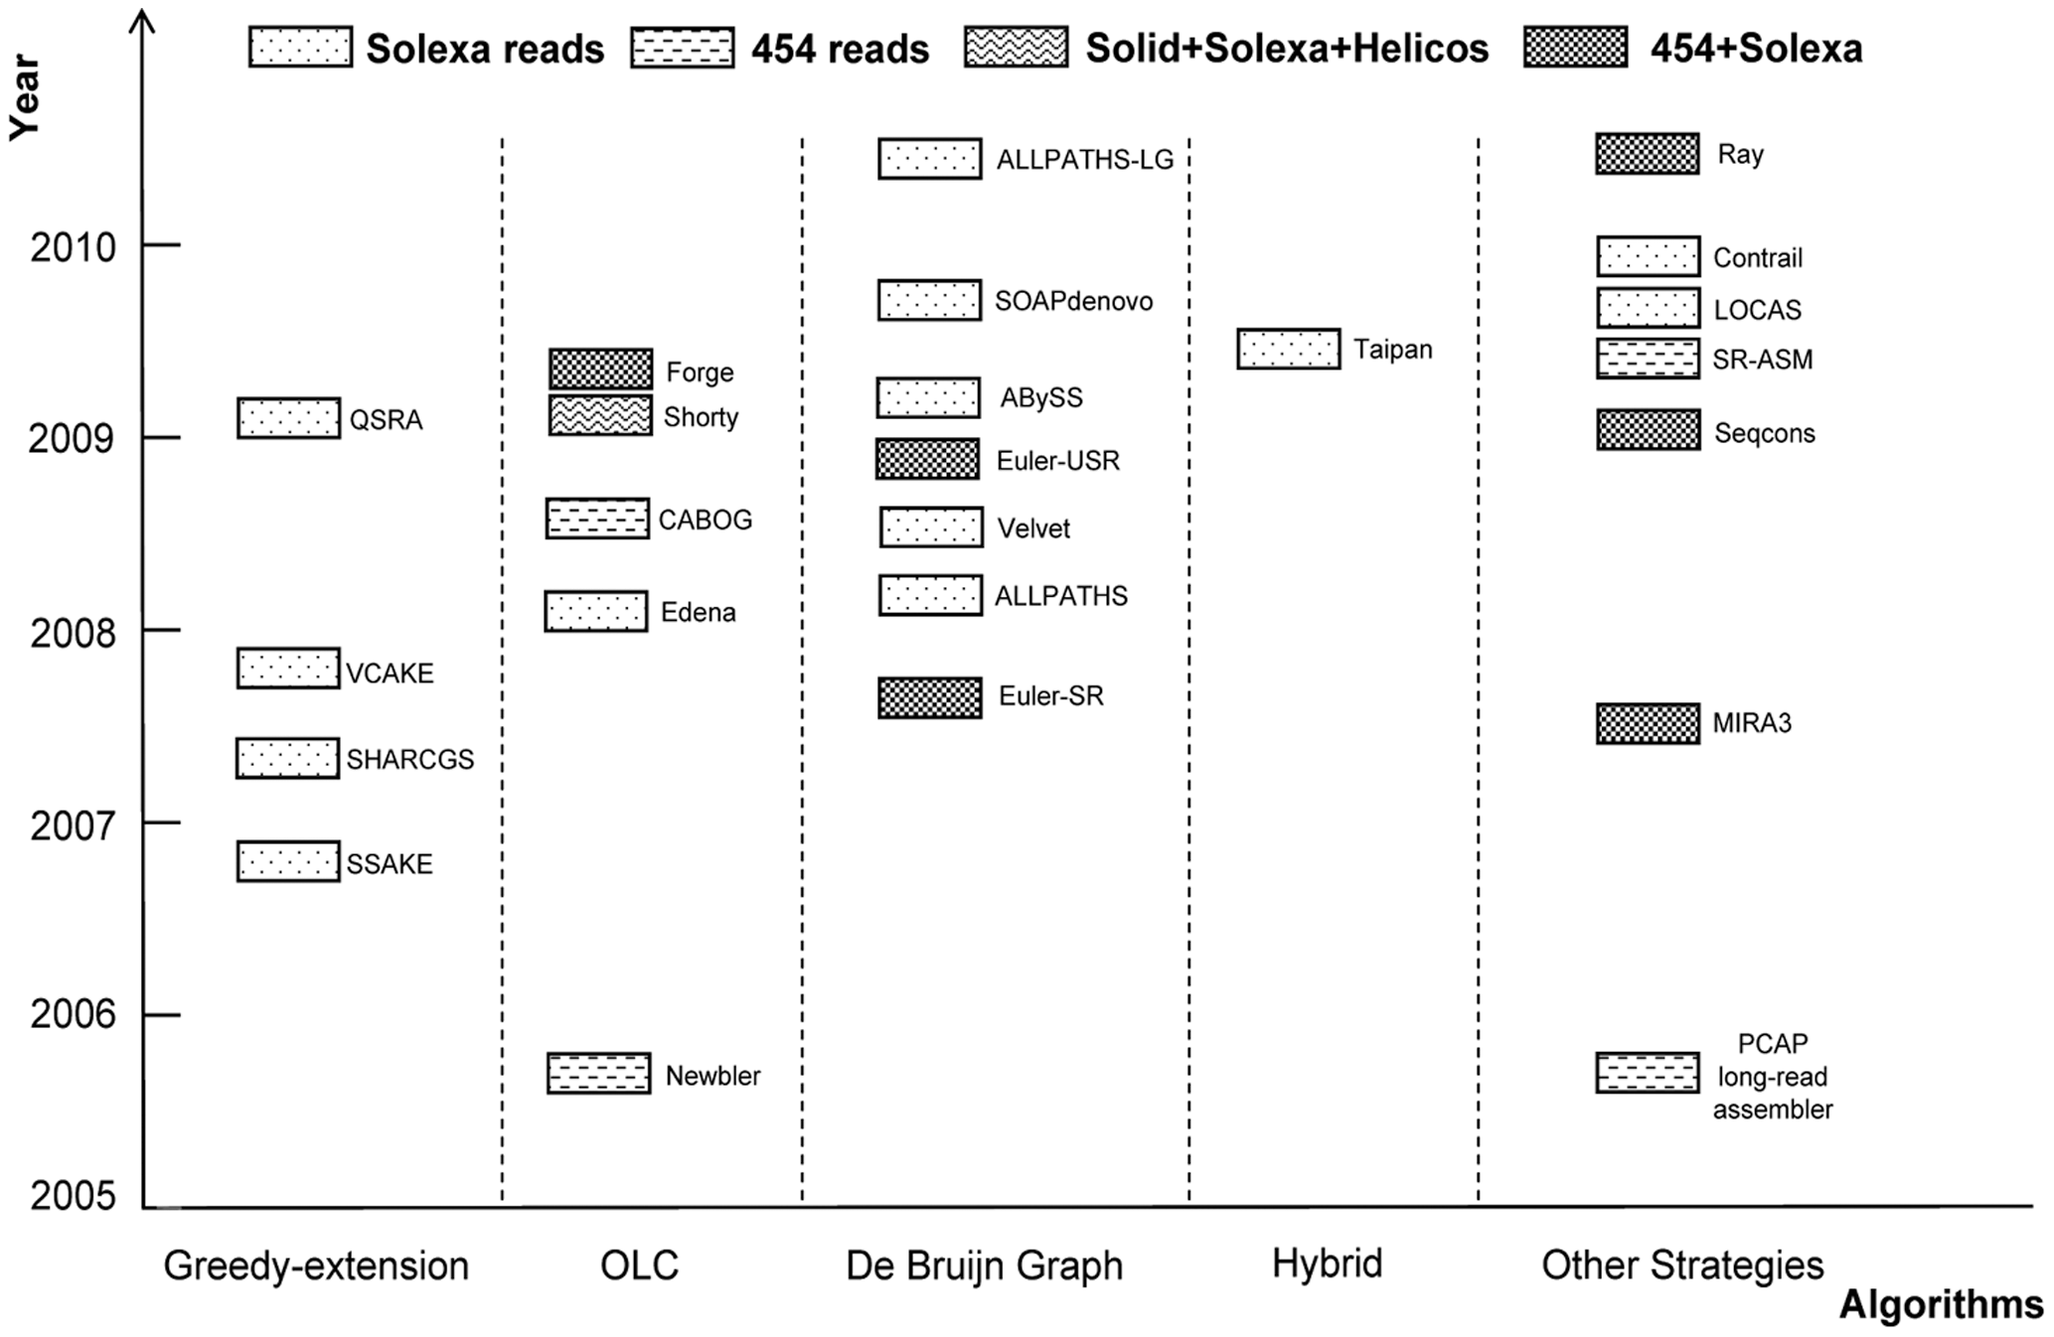

Hybrid assembly
http://www.crystalinks.com/blackholeeye350.jpg
Zhang et al. PLoSOne 2011

Slide 19
Hybrid assembly options
Celera
sanger
454
Illumina
PacBio

Slide 20
Hybrid assembly options
Ray, Abyss, ...
→ 454 and Illumina
Newbler
→ 454
→ Illumina?

Slide 21
Hybrid assembly
Does it work?
Are we there yet?

Slide 22
Non-sequence data
Closely related genome
→ requires synteny

Slide 23
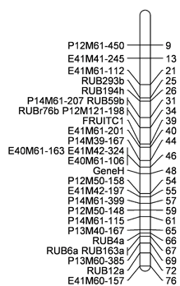
Non-sequence data
Linkage map
→superscaffolds
→ pseudochromosomes
http://www.hutton.ac.uk

Slide 24
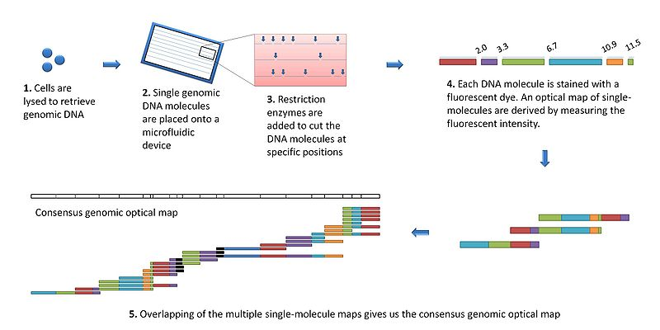
Non-sequence data
Optical maps
http://en.wikipedia.org/wiki/File:Optical_mapping.jpg

Slide 25
Basic recipes for genome
Bacterial - 454
some shotgun (~10x)
8kb PE library (low coverage)
→ should give 1 scaffold per chromosome
Homopolymer errors
Bacterial – Illumina
Paired-end reads required
the more mate pair libraries, the better

Slide 26
Basic recipes for genome
Bacterial – PacBio
~10x in long reads
50X in short reads (454, Illumina)
may give 1 scaffold per chromosome
Supplement with mate pairs?

Slide 27
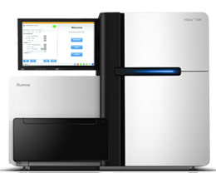
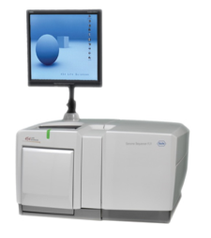
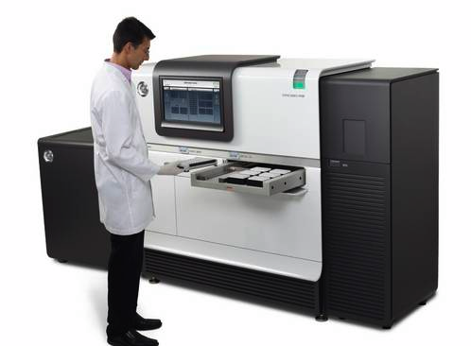
How to sequence a genome
Eukaryote
Foundation of Illumina data
100x coverage Paired End reads (2x100bp)
several Mate Pair libraries
2kb, 3kb, 8k, 10kb, bigger?
this is now very cheap!
Fill gaps with long reads
454 or PacBio

Slide 28

How to sequence a genome
Add lots of bioinformatics...
http://cores.montana.edu/index.php?page=bioinformatics-core-facility

