Slide 1

Effective c++ 1주차

Slide 2
Item 2 – Prefer consts, enums, and inlines to #defines
#define converts defined name into designated number as below.
Ex) #define ASPECT_RATIO 1.653
However, if compile error occurs, error message may be written as 1.653 instead of ASPECT_RATIO.
Preferring const variables to #defines may comfort you because it makes you easy to distinguish errors, and smaller codes are generated in the case of a floating point constant.

Slide 3
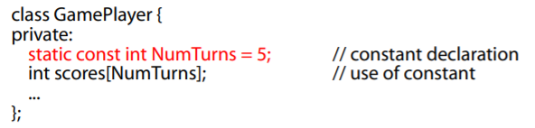
Item 2 – Prefer consts, enums, and inlines to #defines
Constant pointers:
Class-specific constants:
static member ensures there’s at most one copy of the constant.
#defines cannot narrow down its scope.

Slide 4
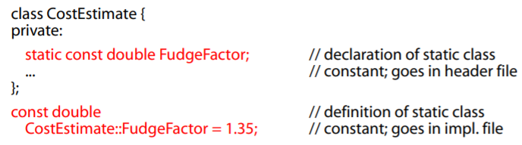
Item 2 – Prefer consts, enums, and inlines to #defines
Constant pointers:
Class-specific constants:
static member ensures there’s at most one copy of the constant.
#defines cannot narrow down its scope.
However, if the compiler needs declared value when compiling class, it might cause an error.

Slide 5
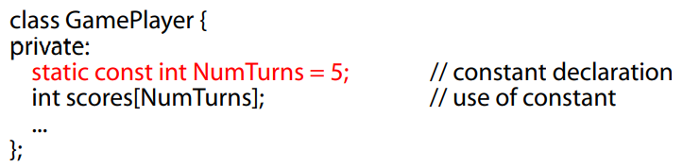
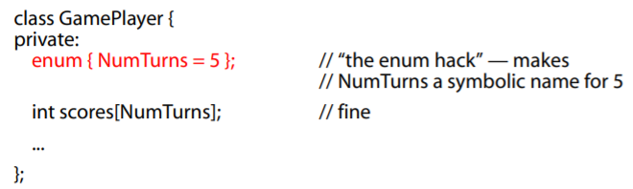
Item 2 – Prefer consts, enums, and inlines to #defines
Enum hack:
Enum hack behaves more like a #define than a const does.
For example, taking address of const is allowed, but not for enum and #define, either.

Slide 6


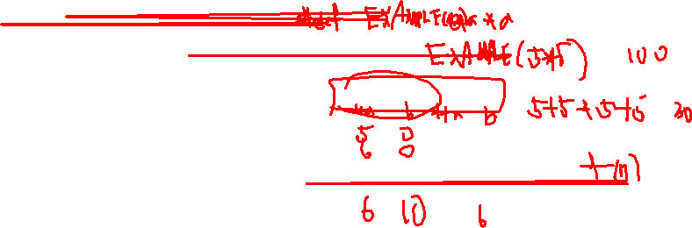
Item 2 – Prefer consts, enums, and inlines to #defines
Macros have bunch of drawbacks.
To use macros preventing errors, every argument in the macro body requires to be parenthesized.
INEFFICIENT!!!

Slide 7
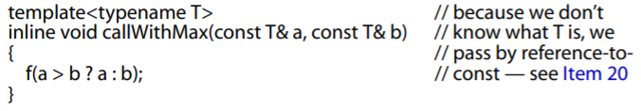
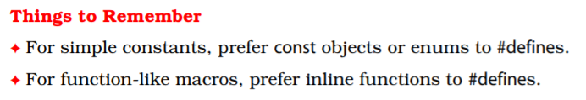
Item 2 – Prefer consts, enums, and inlines to #defines
Instead, you can deploy template for an inline function.
No parenthesize of parameters.
No need to worry about evaluating parameters multiple times.
It obeys scope and access rules of real function.
Necessity of using #define is reduced, but other preprocessors still play important roles.

Slide 8
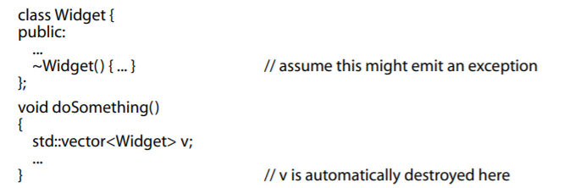
Item 8 – Prevent exceptions from leaving destructors.
If multiple exceptions are generated when multiple destructors are invoked, it will yield undefined behavior or termination of the program.

Slide 9
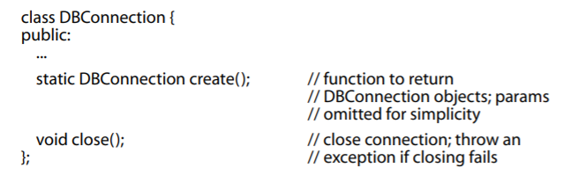
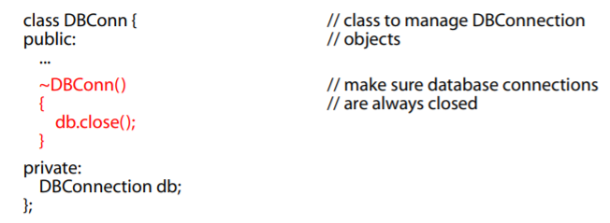
Item 8 – Prevent exceptions from leaving destructors.
If the class destructor needs to perform an operation that may fail by throwing an exception, you might want to consider resource-managing class.

Slide 10
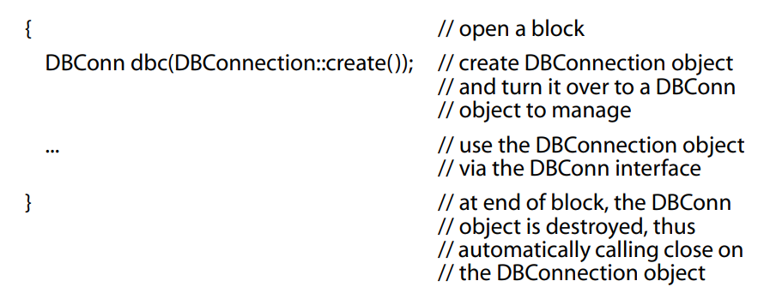
Item 8 – Prevent exceptions from leaving destructors.
If the class destructor needs to perform an operation that may fail by throwing an exception, you might want to consider resource-managing class.
Even if erroneous destructor generates exception, it is allowed to leave the destructor.

Slide 11
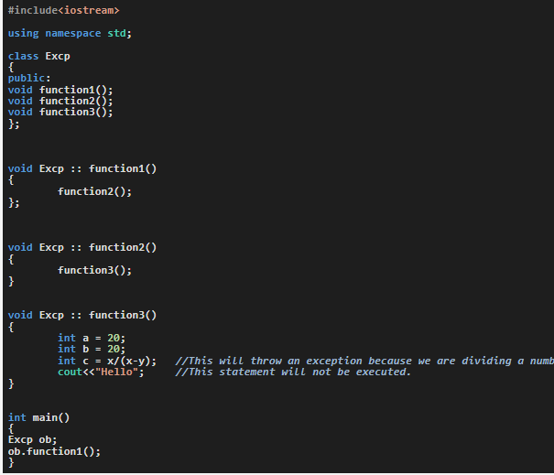
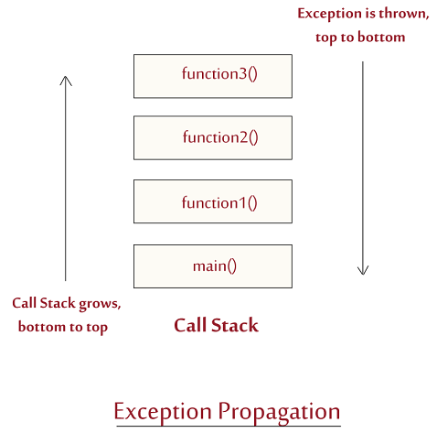
Item 8 – Prevent exceptions from leaving destructors.

Slide 12
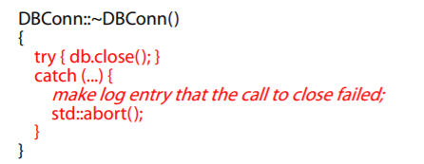
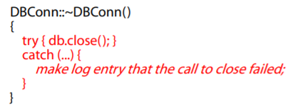
Item 8 – Prevent exceptions from leaving destructors.
Terminate the program:
Swallow the exception:
Both approaches do not enable the function to react to the condition that may throws the exception.

Slide 13
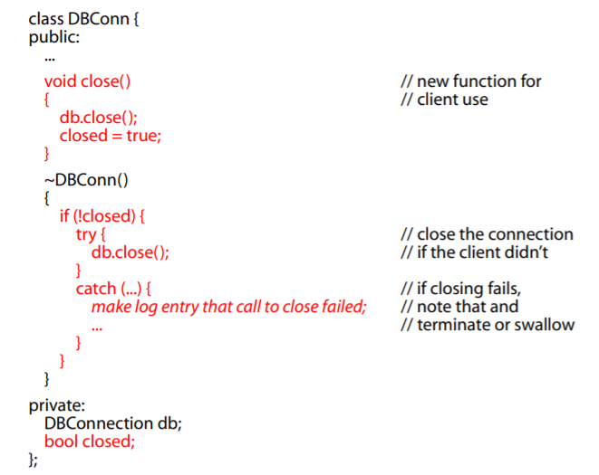
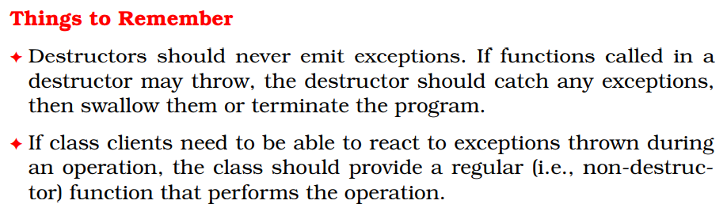
Item 8 – Prevent exceptions from leaving destructors.
Hence, give an opportunity to react to problems that may arise.

