Slide 1
The Government Approach
Overview:
      Carbon Pricing
        Carbon Tax
        ETS (Emissions trading) aka Cap & Trade

Slide 2
ALEX

Slide 3
Carbon Pricing
Purpose:
  To limit total amount of emission levels in the most cost-effective way

Slide 4
Copenhagen Accord 2009
World government's agreed that:
  “Increase in global temperature should be below 2 degrees Celsius”
IPCC 4th Assessment Report
  Developed countries need to make cuts between 80 to 95% for a 450 parts per million CO2-eq concentration
  450ppm associated with a 2 degree Celsius warming.

Slide 5
Targets
Cuts are below the 2000 baseline
2020
  5% cut
  (bi-partisan support: both Labor & Coalition)
2050
  Labor target of 80% (inline with IPCC recommendations)
  Coalition doesn't have a 2050 target at all
  New independent Climate Change Authority to recommend future targets

Slide 6
5% isn't 5%
2020 targets is:
  Cut by 5% below 2000 levels
  This is a cut of 23% below current levels
  This is equals to 159 million tonnes of CO2-eq of abatement in 2020
Australia's 2009 total emissions were 565 million tonnes
  (latest year we have data for)

Slide 7
Simonetta

Slide 8
Carbon pricing
Carbon Tax:
  Government sets the carbon price, the amount of emissions vary
ETS (Emissions Trading or Cap & Trade)
  Government sets the amount of emissions, the price on carbon varies
  Advantage: This puts a total cap on the level of emissions
Long term price signal to business investment

Slide 9
Carbon Pricing vs Government Regulation
Alternative: government tells each company how much to cut, and how to cut it.
Disadvantages:
  Requires government bureaucrats to know everything about each business: CEO's know their business better than the government
  More costly
  Inflexible: no incentives to make deeper cuts

Slide 10
Emissions Trading 101 - I
Government sets the maximum emissions for a given year
  e.g. 500 million tonnes of CO2-eq/year
Business needs to purchase one permit for each tonne of emissions they produce
If cost of reducing emissions is less than cost of buying permits, companies will reduce emissions

Slide 11
Emissions Trading 101 - II
In each companies interest to make the maximum amount of reductions that are cost effective:
  Compared to regulation: if legislated 10% cut, no incentive to cut by 15% or 20% if possible.
Government reduces the amount of emissions allowed each year:
  e.g. Year 1: 500 Mt, Year 2: 400 Mt, Year 3: 350 ...
Price of permits increase as cap lowers

Slide 12
Banana Analogy
Banana crops wiped out by recent floods & cyclones. Examples of:
Scarcity leads to price increases:
  Prices have shot up due to lack of bananas
  As fewer permits in future years, increase price
Price increase leads to behavioural change:
  People buying less bananas
  As permit price increases, business changes behaviour

Slide 13
LEX

Slide 14
Carbon Tax only Temporary
Only a temporary carbon tax, a permanent emissions trading scheme
1st 3 years carbon tax
2016 onwards ETS

Slide 15
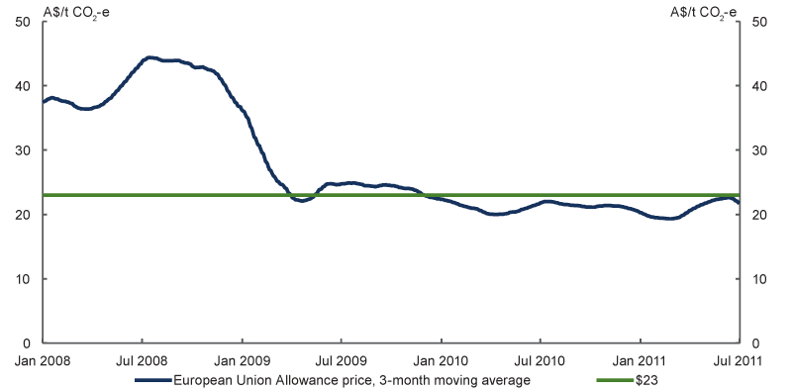
What price? (source: Treasury)
$23/tonne initial price increasing 5% annually
  Current World price is approx $23
  Expected 2016 world price is $29/tonne

Slide 16
Who pays
Approximately 500 companies:
  List not publicly available
Not based on company's total emissions, based on each facility
Have to pay carbon price for having a facility emitting greater than 25,000 tonnes CO2-eq/year
Excluded: agriculture & petrol

Slide 17
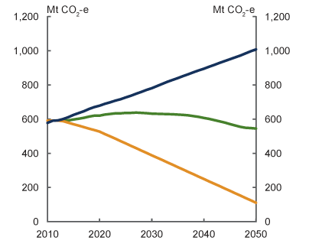
Source: Treasury modelling

Slide 18
International linking
Once ETS begins, can buy permits from overseas
Means abatement purchased at lowest cost
Atmosphere doesn't care where abatement occurs
  e.g. Cheaper to plant trees overseas?

Slide 19
Assistance
Households (50%+ of revenue raised)
  9/10 receive assistance
  6/10 fully compensated
Industry (40% of revenue raised)
  Trade-exposed, carbon-intensive industries (e.g. Steel) receive assistance to prevent “carbon leakage” and support jobs

Slide 20
Renewables Investment
New Clean Energy Finance Corporation
$10 billion investment over 5 years:
  In renewables & low-carbon technologies
  Excludes CCS (Coal Capture & Storage)

Slide 21
Coalition's Direct Action Policy
5% cut by 2020
  Entirely sourced within Australia
Limited amount of detail
60% of abatement from soil carbon
  Unproven technology currently
Tax payers, not polluters
No renewables investment, just pay for abatement
No long term price signal

Slide 22
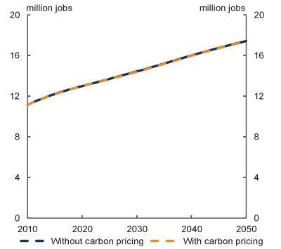
Jobs (Treasury Modelling)

Slide 23
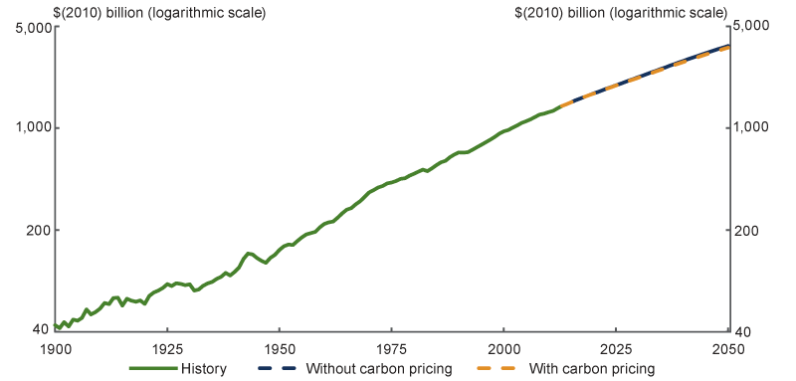
GDP (Treasury Modelling)

Slide 24
Key Points/Conclusion
As much abatement occurs overseas, vital that quality of international permits assured
Temporary tax, permanent ETS
ETS is long term solution, Direct Action is not:
  Poll of 140 Australian economists:
  ““nearly 85 per cent ... said they do not think the Coalition’s Direct Action Plan is a sound economic proposal to reduce carbon emissions.”
      Economic Society of Australia, 2011

Slide 25
NEXT

