Slide 1

REVENUE PREDICTION PROJECT

Slide 2
02
01
04
Agenda
03
INTRODUCTION
Present: Giang Vo
Team: Data Scientist
Director: Dr. Phuoc, Mn. Thai
RESULTS
BENEFIT DATA ANALYSIT
OPERATION SYSTEM

Slide 3

1. INTRODUCTION
Revenue Prediction

Slide 4

The slide title goes here!
Do you know what helps you make your point clear? Lists like this one:
Because they’re simple
You can organize your ideas clearly
And because you’ll never forget to buy milk!
And the most important thing: the audience won’t miss the point of your presentation

Slide 5
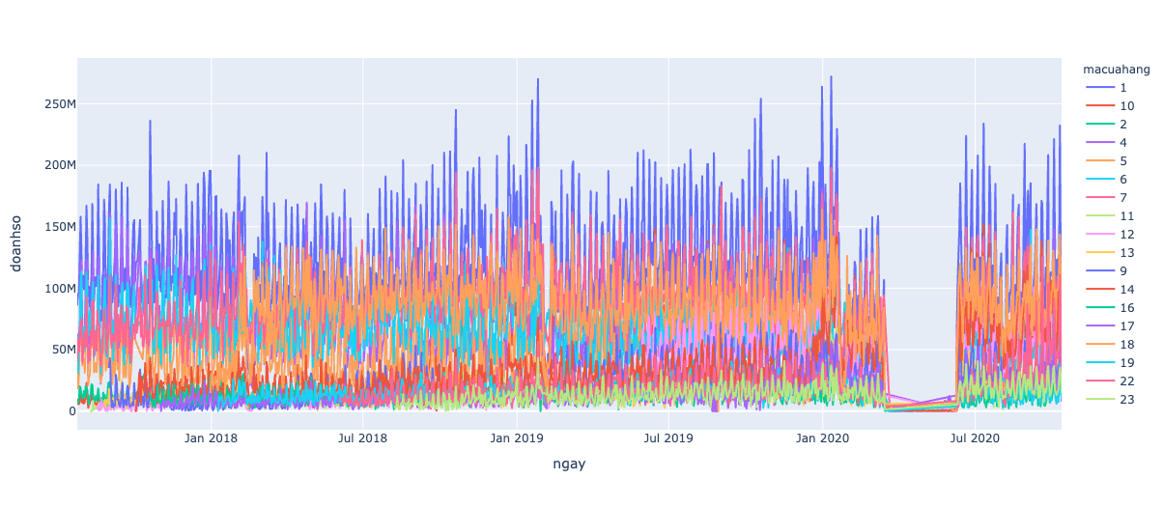

Data Mining
Prediction
VENUS
Revenue
Intents Marketing
Client behavior
Venus has a beautiful name and is the second planet from the Sun. It’s terribly hot—even hotter than Mercury—and its atmosphere is extremely poisonous. It’s the second-brightest natural object in the night sky after the Moon

Slide 6


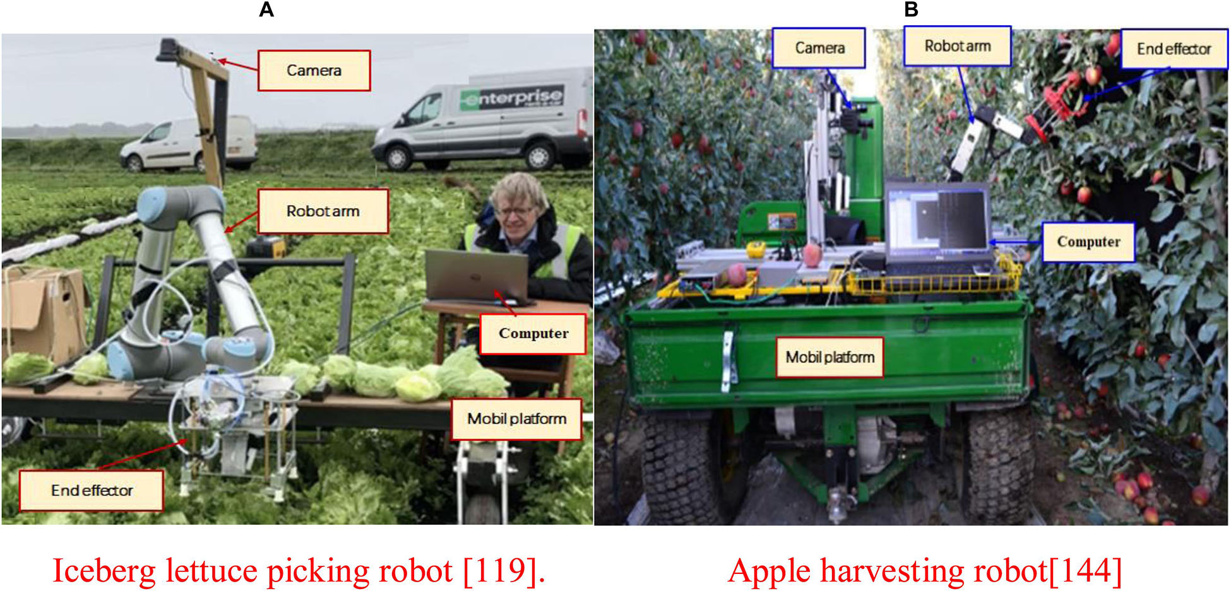
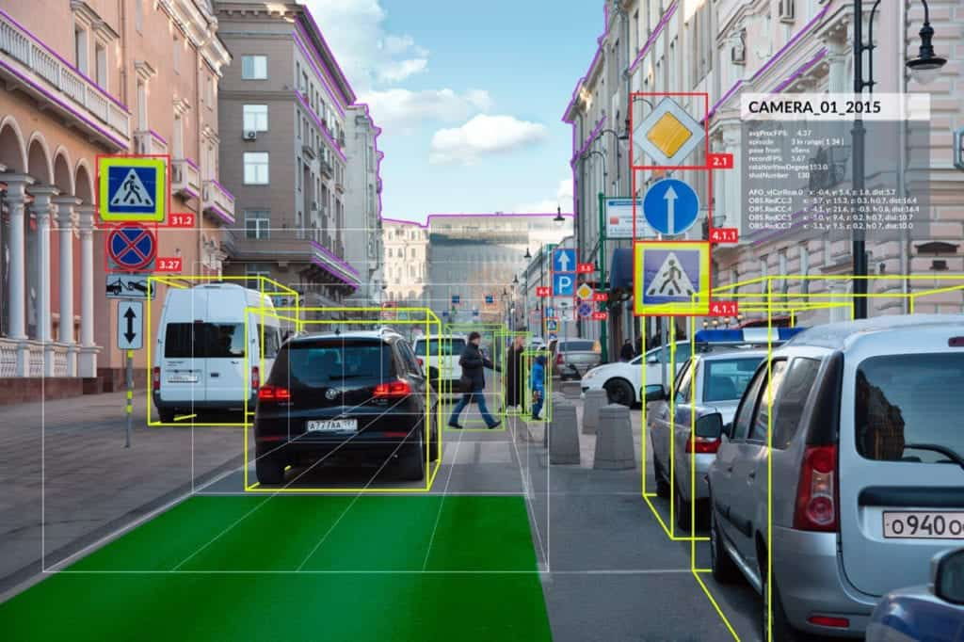
AI Applications

Slide 7

2. BENEFITS

Slide 8
Revenue Prediction
01
01
01
Executes strategic planning
Brings in more investors
02
02
Improves production
scheduling
Budgets business expenses
03
03
Sales and product analysis
Justifies hiring decisions

Slide 9
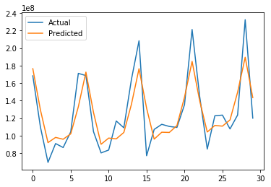
4. RESULTS
Raw data
Machine Learning

Slide 10
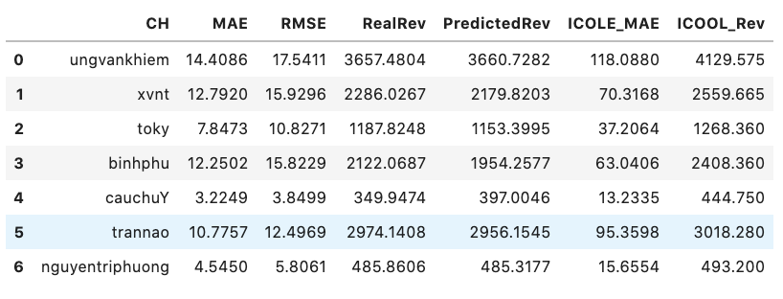
4. RESULTS

Slide 11
Thank For Your Attention

