Slide 1
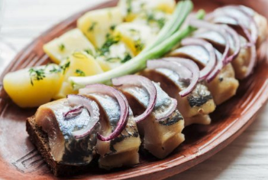
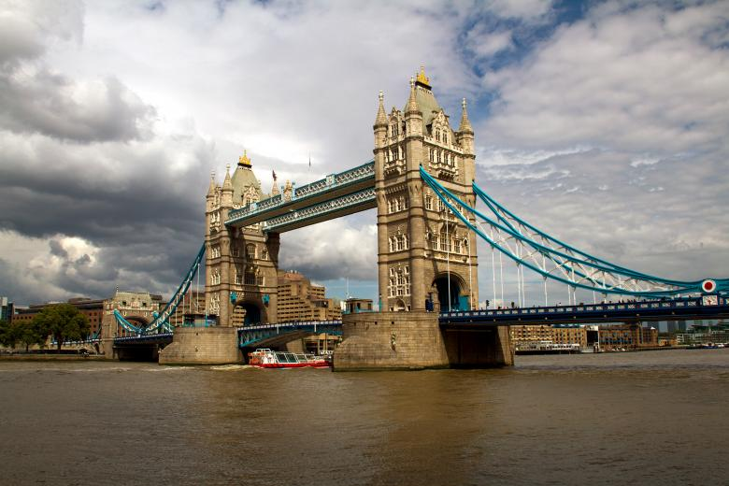
The best borough to open a Russian restaurant in Greater London
IBM Capstone Project: Applied Data Science Capstone
By Ustinov Aleksey
May 2020

Slide 2
Main goal is to find the best borough in Greater London to open a Russian restaurant
Main Goal

Slide 3
Find boroughs with ’a center of attraction ’. A lot of restaurants is good!
Avoid boroughs with existent Russian restaurants;
Select clusters are similar to boroughs where Russian restaurants are located.
Analytic approach

Slide 4
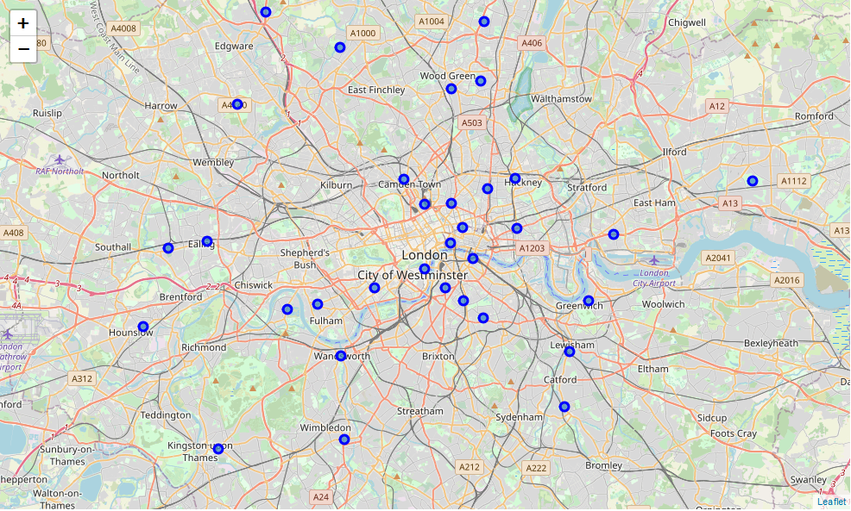
Greater London Boroughs and City of London
1600 square km
9 million people
33 government districts
multicultural city
tourism

Slide 5



Data sources
Foursquare API
https://ru.foursquare.com/
The London Datastore
https://data.london.gov.uk
TripAdvisor
https://www.tripadvisor.com

Slide 6
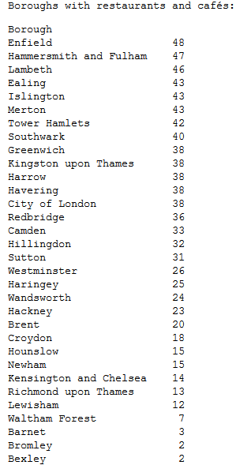
Boroughs vs restaurants
Boroughs vs restaurants,
cafes,
pubs,
bars

Slide 7
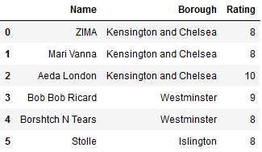
Existent Russian restaurants
Only 6 well-known Russian restaurants in Greater London;
3 of them are located in Kensington and Chelsea borough, 2 in Westminster and 1 in Islington;
All restaurants have good rating (equals or more than 8) and reviews.

Slide 8
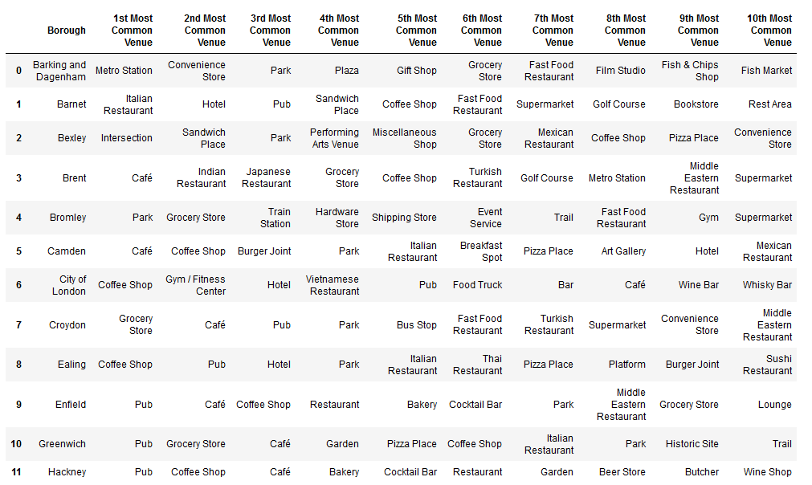
Top 10 venues for each borough

Slide 9
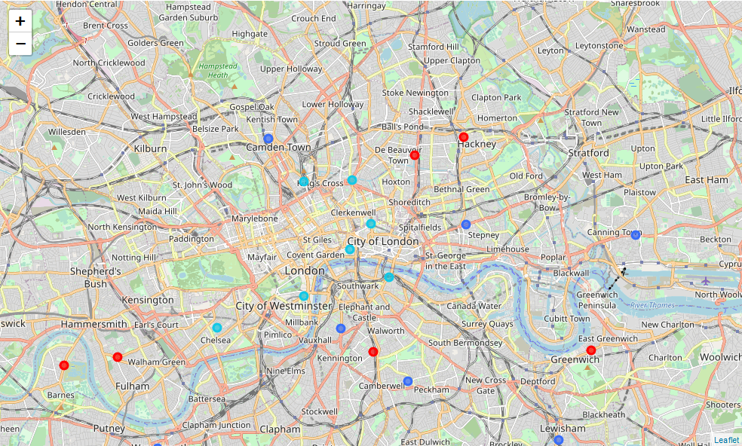
K-means clustering: similar boroughs

Slide 10
Results
The best boroughs to open a Russian restaurant are Lambeth and Tower Hamlets;
Greater London do not have a lot of Russian restaurant;
Existent Russian restaurant have relatevily compact location: Kensington and Chelsea, Westminster and Islington and have high rating and reviews;
Lambeth and Tower Hamlets are similar to boroughs with existent Russian restaurant;

Slide 11


Conclusions
The best boroughs to open a Russian restaurant:

