Slide 1


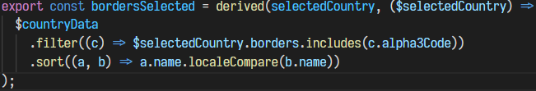

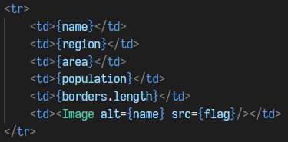
This app is built using Svelte, a framework similar to React or Angular, but differs by shifting work to compile time and updates the DOM directly when the app state changes.
When the CountyData component is built this triggers fetching the country data from the API.
Multiple stores are created, these are observable variables that notify subscribers when their values change.
Component prop values are bound to these stores which allows us to both load the component before the data is available and to reactively update it later.
Prop values are used to populate the values directly in html and the component will automatically be re-drawn when the bound value is updated. All of this together allowed me allow a user to select multiple countries rather than just China and to increase/decrease the number of countries in the top by boarders table with minimal adjustments.

Slide 2
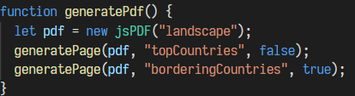
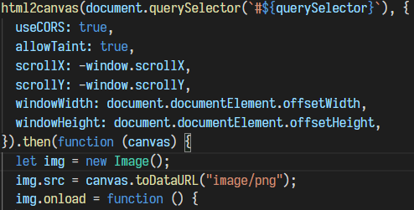
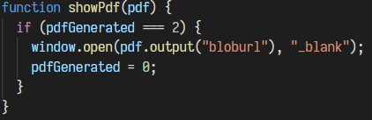
jsPDF is the javascript library for producing the PDF files. First we create a new jsPDF and then populate it with screenshots of the two relevant components.
html2canvas is used to build a ‘screenshot’ of the DOM. We dispatch the query slector for both components and await the completed screenshot for each.
Once both images are complete these are added to the pdf and finally the a blob url is created for the pdf and opened in a new browser.

