Slide 1
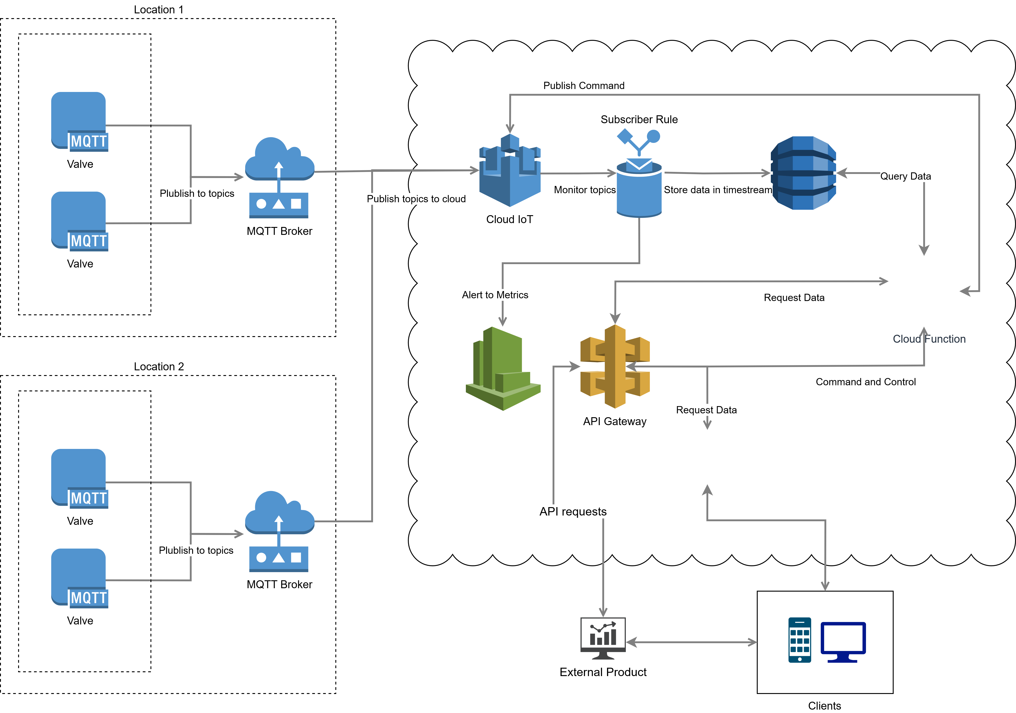
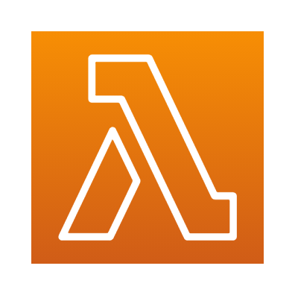

Dashboard

Slide 2
Valve Devices publish key:value data via an MQTT broker to IoT core. MQTT is a lightweight, reliable and highly scalable protocol supported by cloud providers (AWS, Azure, Google Cloud) The topics should be of the form: customer/location/deviceid/topic
This will allow us to easily provide customized alerting rules for different customers and locations
Data is stored in AWS timestream. Designed to ingest huge data volume from IoT devices, keeping recent data in memory and moving historic data to storage. Timestream can be queried with standard SQL and provides interpolation functions even for complex data aggregations
Topics are monitored by IoT rules and values outside of given thresholds will trigger alerts in CloudWatch. These alerts can be configured to notify the customer via sms, email or push notification, details of the alert, the location and the id of the valve that triggered it
The public facing API is used to trigger Lambda functions which query the data and return it via the API. Lambdas automatically scale to match the demand on the API and rate limits can be applied to the API on a per-customer basis. API gateway also supports web-socket connections allowing us to report real-time data to subscribers

Slide 3
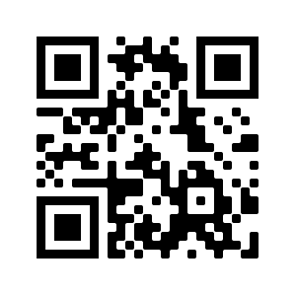
This architecture is designed not just to extract data from IoT devices but also to enable command and control. Approved commands can be invoked from the dashboard and sent back via IoT core to the target device. This is two way and so will allow us to retrieve the resulting logs from the device and display them in the dashboard
Valve devices could be supplied with a QR code that encodes the IoT device id. Using the dashboard app to scan the code with a camera will contact the API gateway to query data for that specific device.
This will allow customers to immediately find diagnostic data for any device they own and even invoke command and control for a specific device, without needing to keep track of device numbers internally

