Slide 1
Identifying Woodblocks from the Bukan Collection
Thomas Leyh
2019/12/16

Slide 2
Overview
What I did the last two weeks:
Extracting image features
Matching these against other images’ features
Collecting metrics

Slide 3
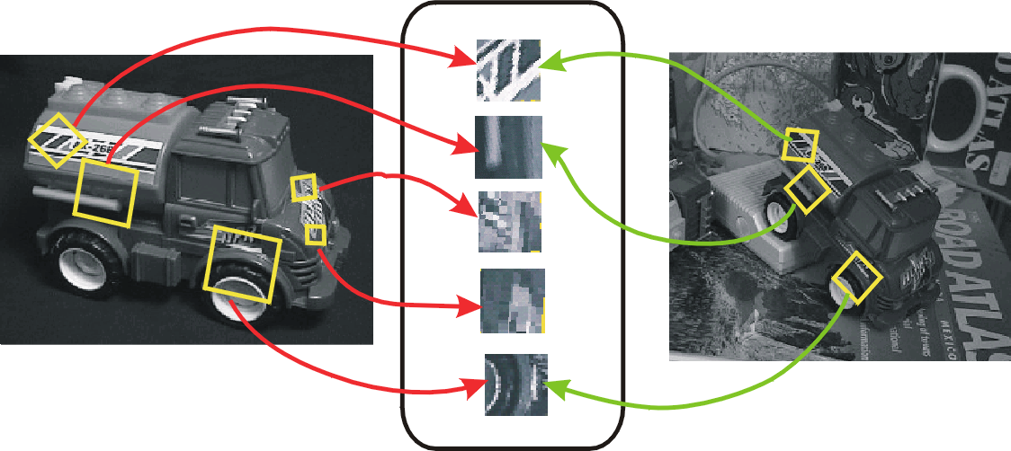
Image Features (1/3)
From: http://www.cs.cornell.edu/courses/cs5670/2019sp/

Slide 4
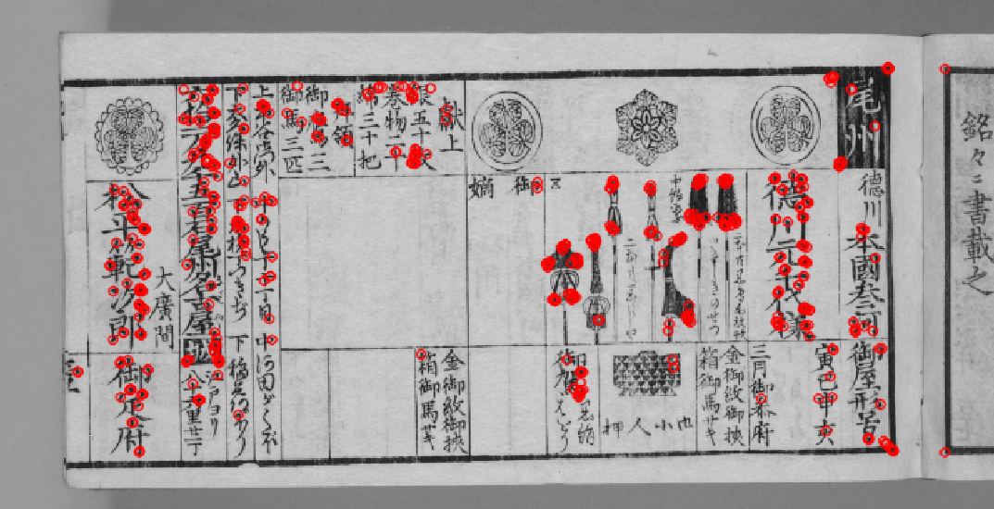
Image Features (2/3)

Slide 5
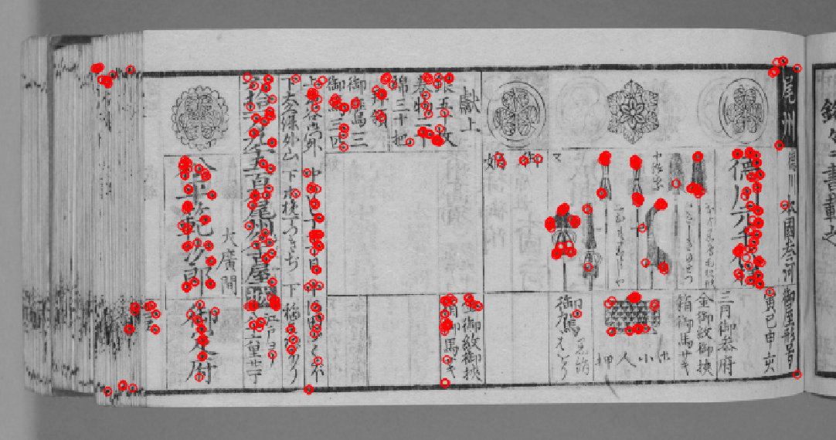
Image Features (3/3)
?
What now?

Slide 6
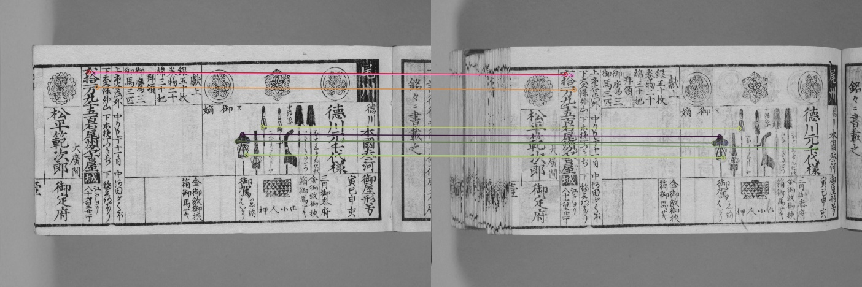
Image Matching (1/3)

Slide 7
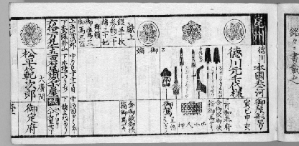
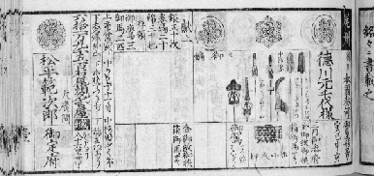
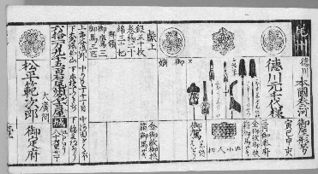
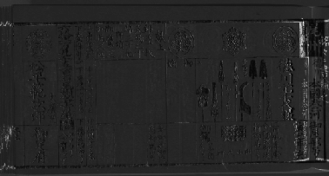
Image Matching (2/3)
Now it’s easy to do some basic aligning…
align
difference

Slide 8
Image Matching (3/3)
But are matching pages really from the same woodblock?
After all, letters look quite similar if you just look at them without being able to read.

Slide 9
Metrics (1/4)
Dataset for Validation
袖珍武鑑 (Shūchin Bukan)
From 1864 to 1865
12 books
Each with 154 pages
From the same woodblock

Slide 10
Metrics (2/4)
Matching all ‭1,848‬ pages against each other
Finding best matches by thresholding feature distance
Calculating Precision and Recall, using different threshold values

Slide 11
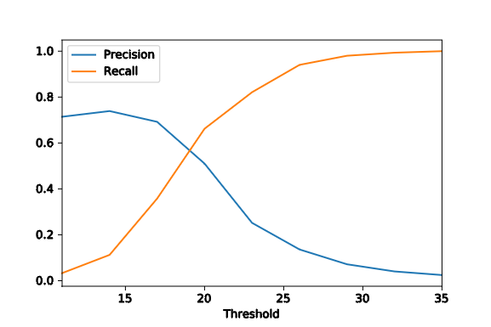
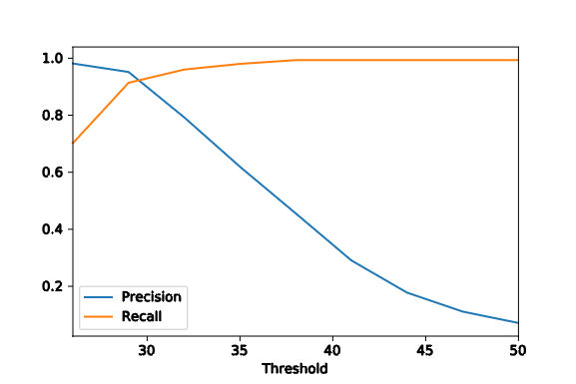
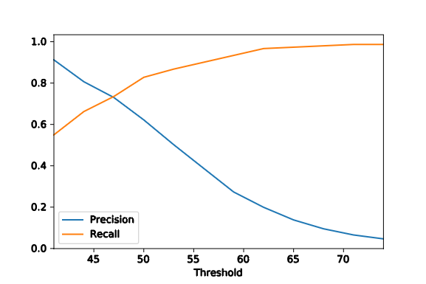
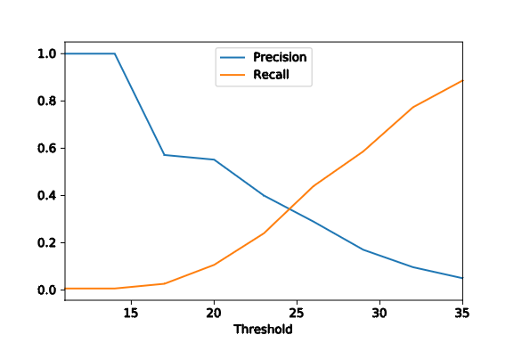
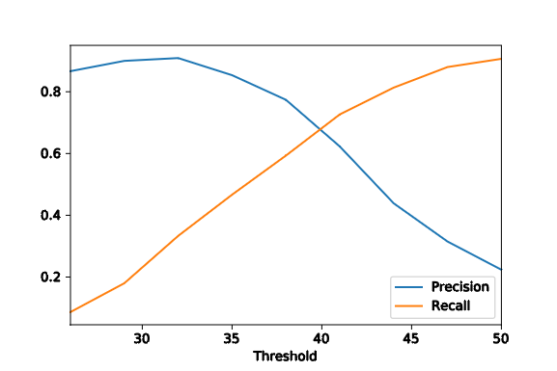
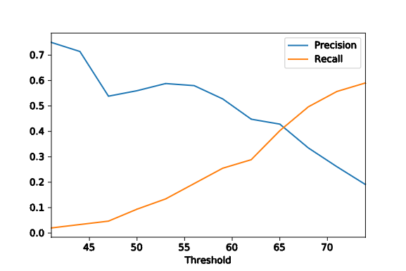
Metrics (3/4)
ORB
AKAZE
BRISK

Slide 12
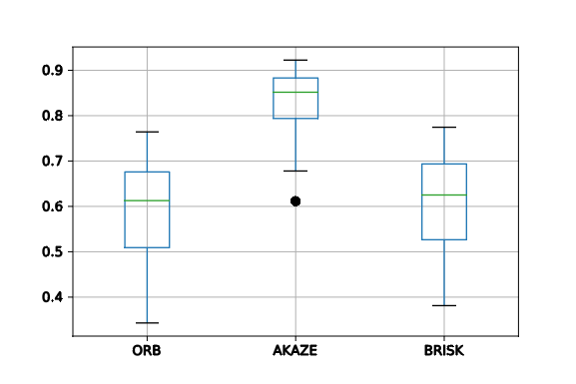
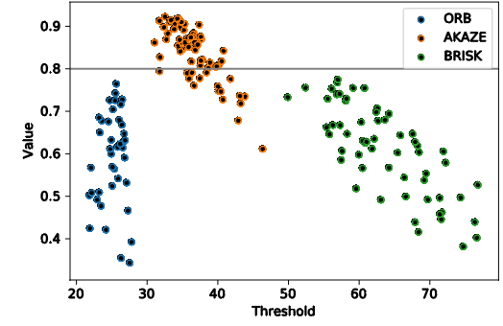
Metrics (4/4)

Slide 13
How to proceed
Parameter tuning
Introducing more prior information (e. g. about locality)
Modify descriptor detectors
Faster matching
currently O(|images|² · |features|²)
Using KuroNet for extracting features
Testing on other books

