Slide 1



Computer Vision-based Comparison of Woodblock-printed Books and its Application to Japanese Pre-modern Text, Bukan
ROIS-DS
Center for Open Data in the Humanities
National Institute of Informatics
University of Freiburg
Thomas Leyh
Asanobu KITAMOTO

Slide 2
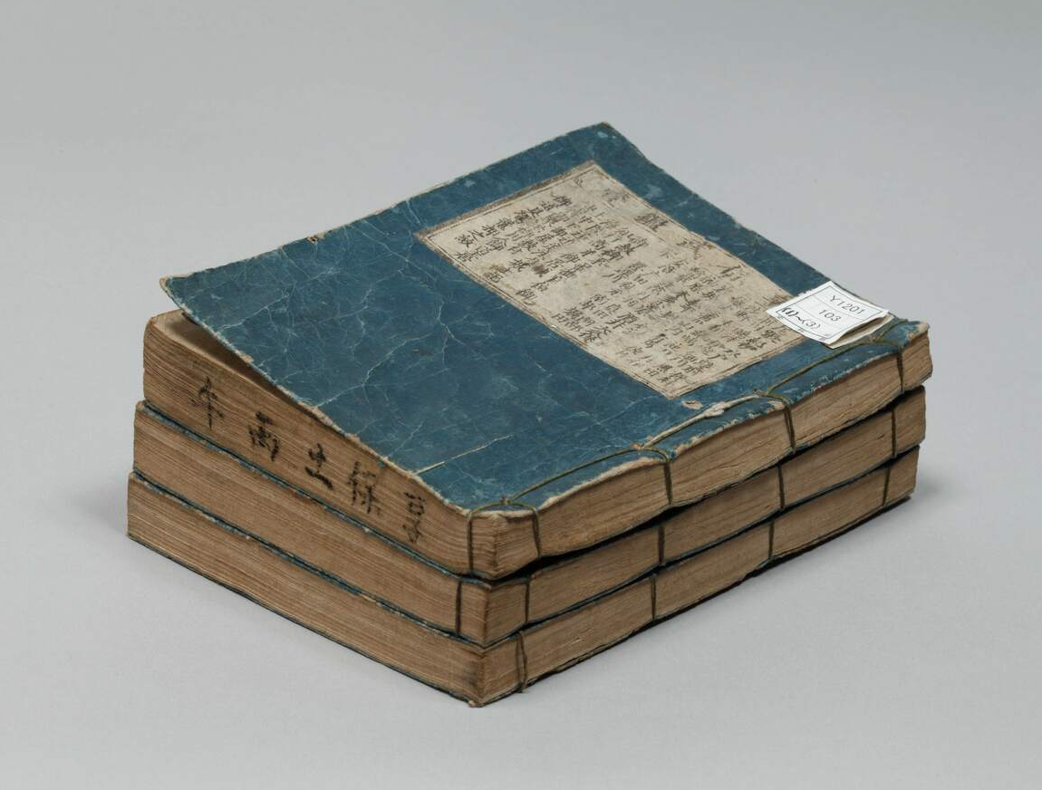
Bukan Collection
It’s about books like this:
Kyōhō Bukan – 享保武鑑
from approx. 1726
Around 300 books are available on http://codh.rois.ac.jp/bukan/

Slide 3
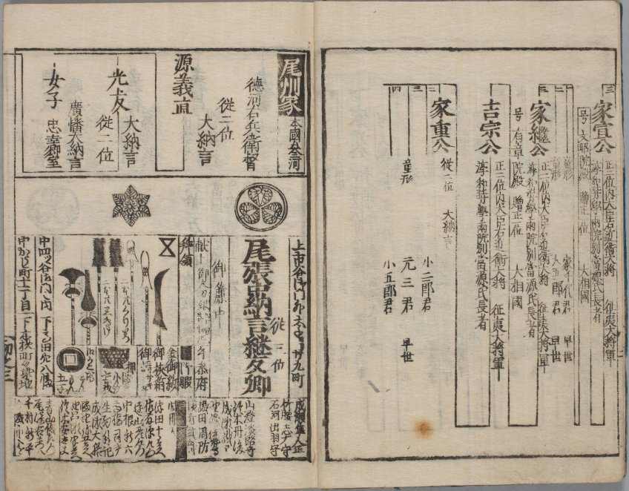
Bukan Collection
Woodblock printed
Published 1603-1868
List of government officials and similar VIPs
Written in pre-modern Japanese

Slide 4
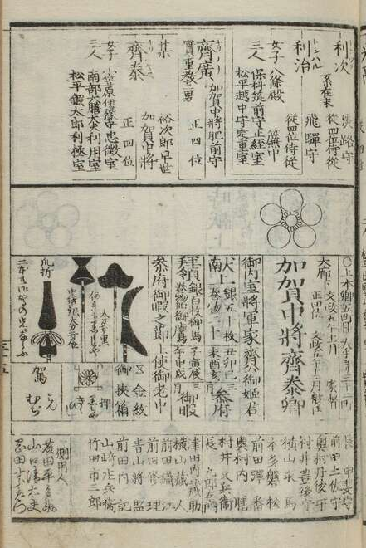
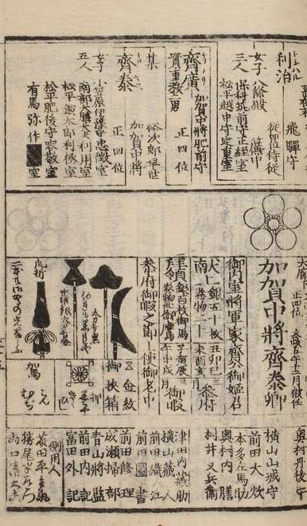
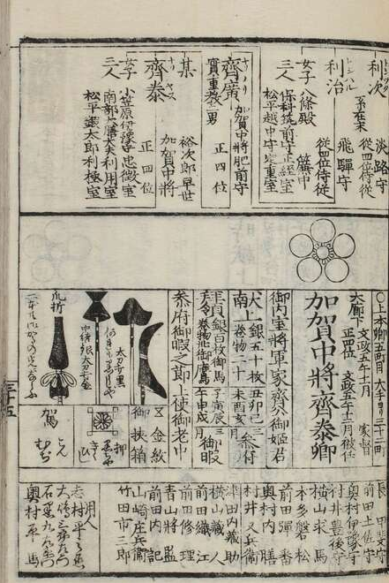
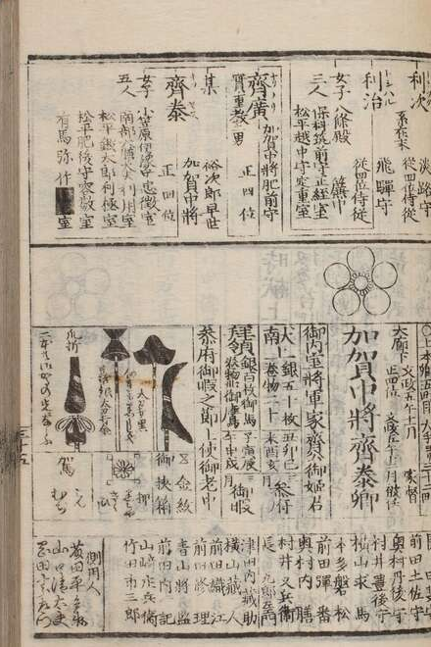
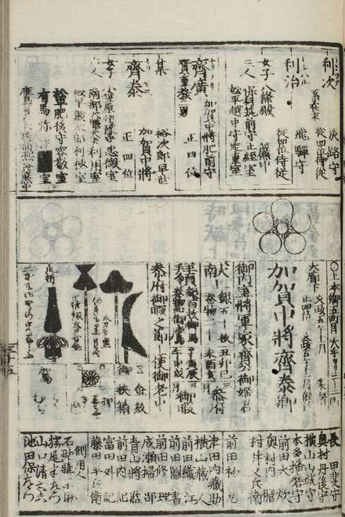
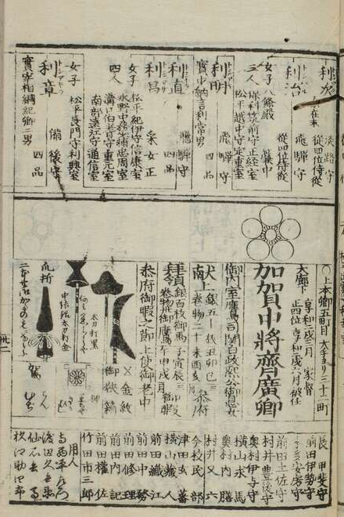
One Book – Multiple Editions
Bunsei Bukan – 文政武鑑 from 1819 to 1830

Slide 5















Computer Vision: Feature Matching
Like doing a jigsaw puzzle…
Dissect pages in small pieces
Remember “interesting” features
Compare to pieces of another page with similar features

Slide 6
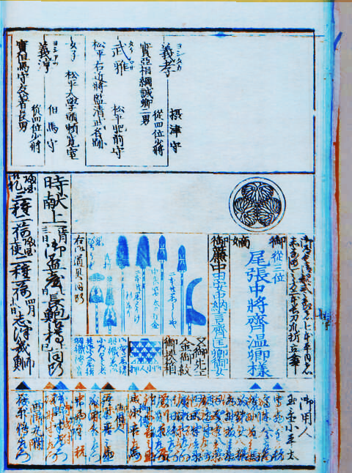
Computer Vision: Feature Matching
Finally, count matching features.
Example of two aligned pages
with 44 matching keypoints.
Blue and Red indicate differences.

Slide 7
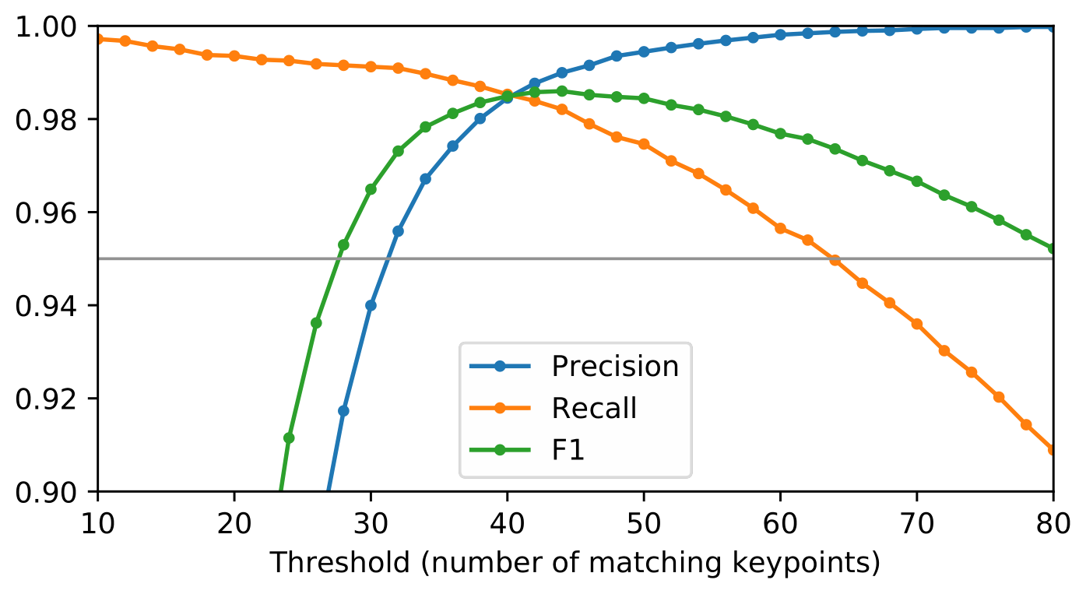
Metrics
Page matching performance over 1,800 annotated pages

Slide 8
Future
Providing a tool for interactive comparisons,
thus reducing the cognitive burden on the humanities scholar.

