Slide 1
Finding Woodblock Differences from the Bukan Collection
Thomas Leyh
2020/2/21

Slide 2
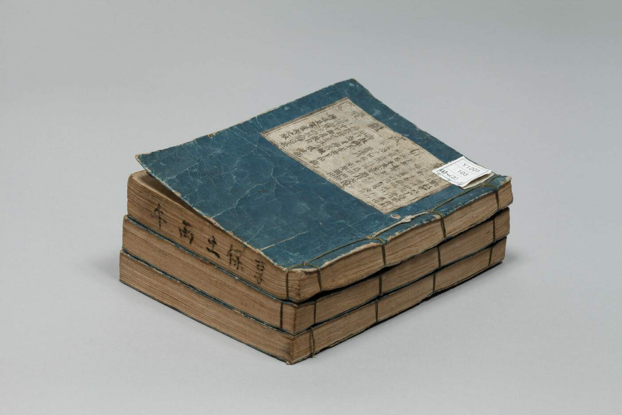
Bukan Collection? (1/2)
It’s about books like this:
(Kyōhō Bukan from approx. 1726)
Around 300 books are freely available on http://codh.rois.ac.jp/bukan/

Slide 3
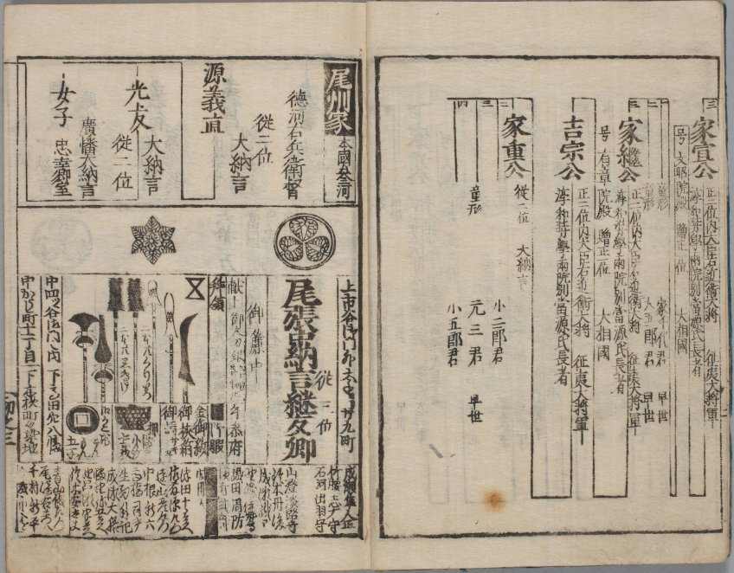
Bukan Collection? (2/2)
Woodblock printed
Published 1603-1868
List of government officials and similar VIPs
Written in pre-modern Japanese

Slide 4
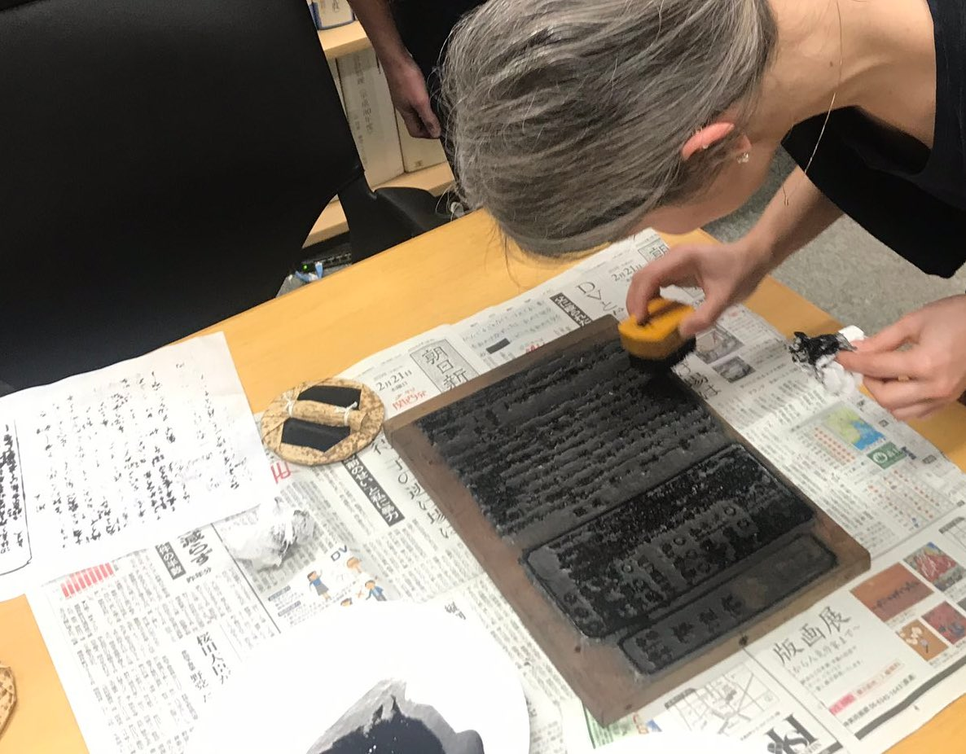
Goals
Detecting if the same woodblock was used for printing different books
(Matching)
Detecting and visualizing modifications of a woodblock from its prints
(Distinction)

Slide 5
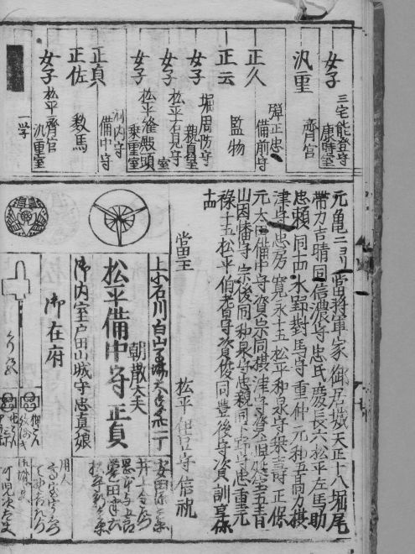
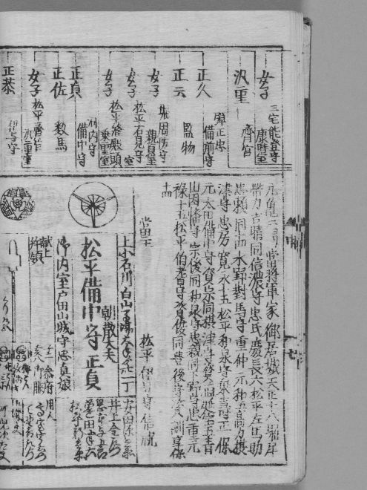
Current Status (1/2)
⇄

Slide 6
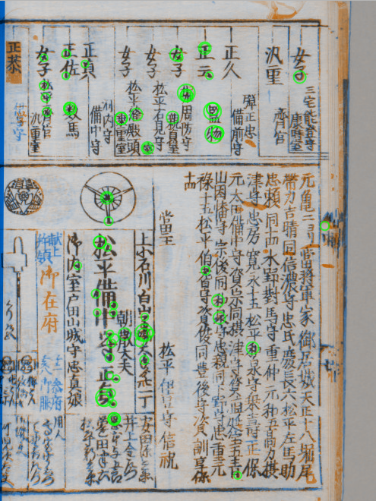

Current Status (2/2)
Just google
”opencv homography”
to get an idea about this.

