Slide 1
Identifying Woodblocks from the Bukan Collection
Thomas Leyh
2020/3/19
Roundup and Outlook

Slide 2
Pipeline (1/2)
Features of
one image
Matching
Filtering
Matches
RANSAC
on
Matches
Filtering
by
Perspective
Features of
other image
Then write everything to the Database

Slide 3
Pipeline (2/2)
Features of
one image
Matching
Filtering
Matches
RANSAC
on
Matches
Filtering
by
Perspective
Features of
other image
Many parameters, nevertheless quite robust.
(Except for a final threshold.)
Precision and Recall easily above 95% !

Slide 4
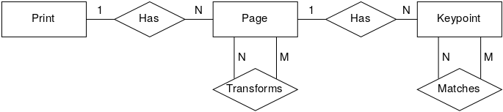
Database (1/4)

Slide 5
Database (2/4)
SELECT COUNT(*) FROM …;
336 Books
143,891 Pages
48,200,561 Keypoints
86,587,374 Matches

Slide 6
Database (3/4)
Inserting new book → Easy
Inserting new page → Easy
Inserting new keypoints → Easy
But not matching these new keypoints… HARD
SELECT COUNT(*) FROM …;
336 Books
143,891 Pages
48,200,561 Keypoints
86,587,374 Matches

Slide 7
Database (4/4)
Inserting new book → Easy
Inserting new page → Easy
Inserting new keypoints → Easy
But not matching these new keypoints… HARD
Yet, I suspect there are existing solutions, looking
into Data Structures for speeding up the calculation
of Hamming Distances.

Slide 8
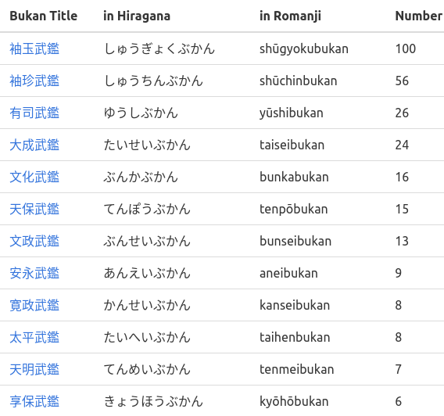
Change in Assumptions (1/3)
Because matching all the keypoints to each other would result in trillions of combinations…
I grouped matches by title.

Slide 9
Change in Assumptions (2/3)
Yet, it might be more precise and more elegant to group by year.
This allows for some kind of sliding window approach when matching the keypoints.
Thus, also allowing for transitivity, i.e. when
A matches B and
B matches C then
A matches C.

Slide 10
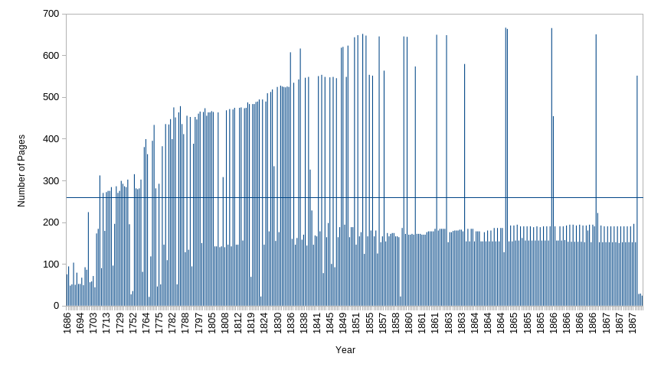
Change in Assumptions (3/3)
Unfortunately, the real data looks much less elegant than the idea itself.

Slide 11
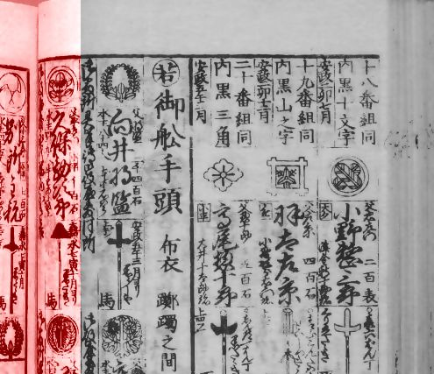
Moreover…
Flattening out pages would be cool, but this must be reliable.
Really reliable.
At least 95% reliable.
Better yet close to 100% to not hurt the original algorithm.

Slide 12

Thank You and Good Luck
ありがとうごさいました
© Kizuna AI (A.I.Channel)

