Slide 1
Identifying Woodblocks from the Bukan Collection
Thomas Leyh
2020/1/9

Slide 2
Overview (1/2)
Since the last meeting, I arrived at the current pipeline:
Extracting image features
Matching these against other images’ features
Select a coherent subset of these matches
using spacial information
Collecting metrics

Slide 3
Overview (2/2)
1
2
3
4
Features of one image
Matching
Filtering
Matches
RANSAC
on
Keypoints
Features of other image

Slide 4
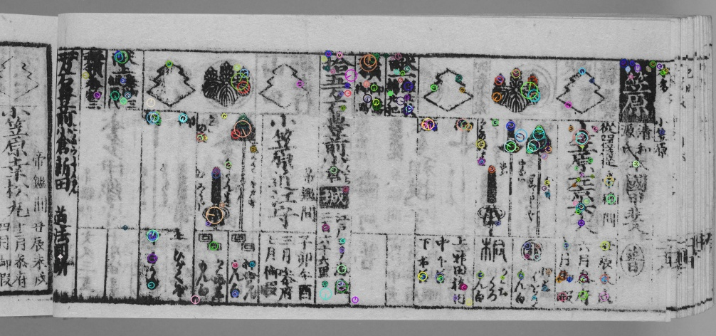
Image Features (1/2)
1. Keypoint Detection

Slide 5
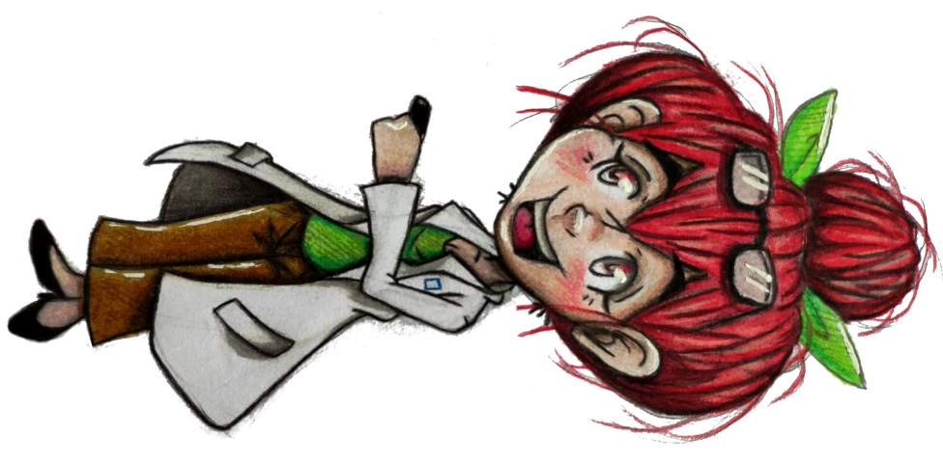
Image Features (2/2)
This is an arbitrary 2D matrix
with each element ∈ {0, …, 255}.
2. Descriptor Extraction

Slide 6
Descriptor Matching
Book z, Pages …

Slide 7
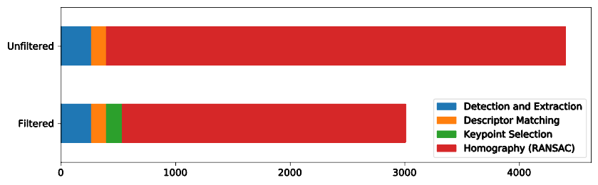
Filtering Matches
I tried several strategies for reducing the number of matches…
However!
This seems to be more about runtime, not overall performance.

Slide 8
RANSAC on Keypoints (1/2)
Taking RANdom SAmples of keypoints until Consensus
Consensus?
When a perspective transformation with minimal error is found
“Homography”
This is a
3x3 transformation matrix.

Slide 9
RANSAC on Keypoints (2/2)
We also get the subset of relevant features.
If we count these features…
we can assume that
more features correlate
with matching pages

Slide 10
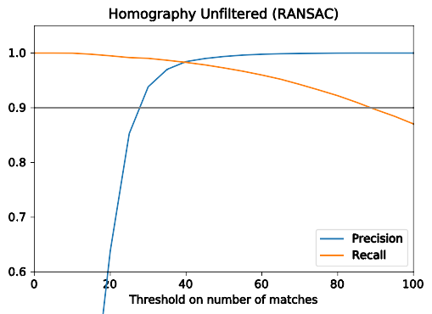
Metrics (1/2)

Slide 11
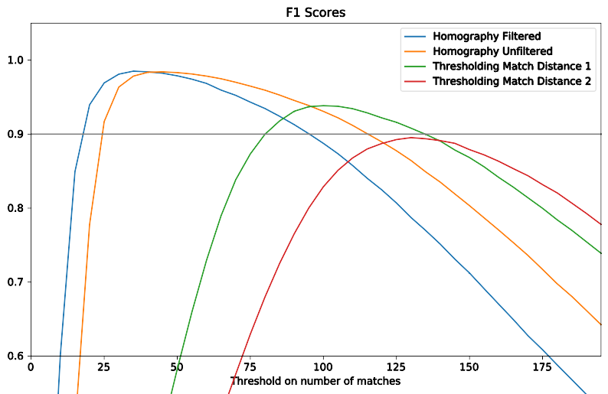
Metrics (2/2)

Slide 12
Examples
The Good
the Bad
and the Ugly
True Positives
False Negatives¹
False Positives²
¹ Not enough matches
² Many wrong matches

Slide 13
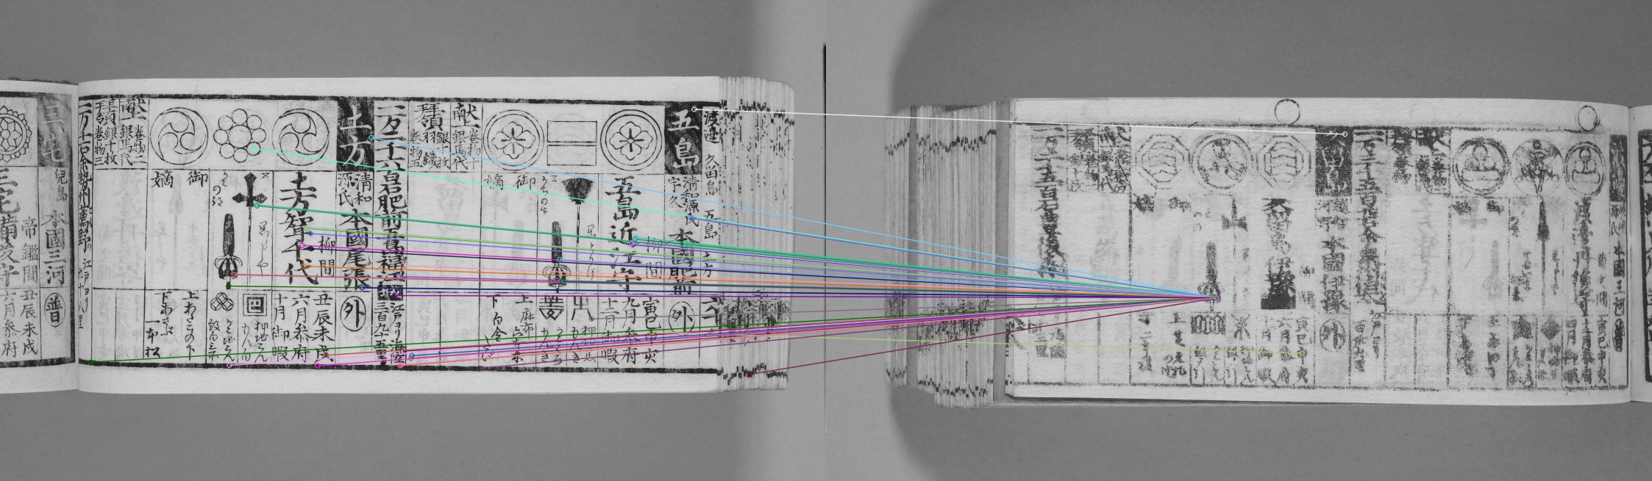
Interesting case of False Positives (1/2)

Slide 14
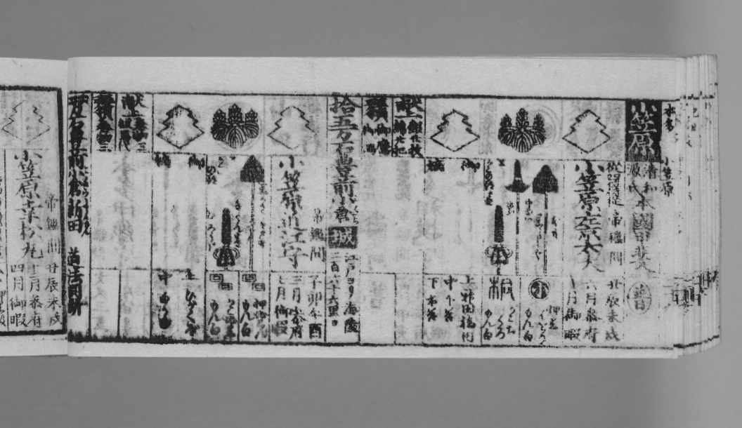
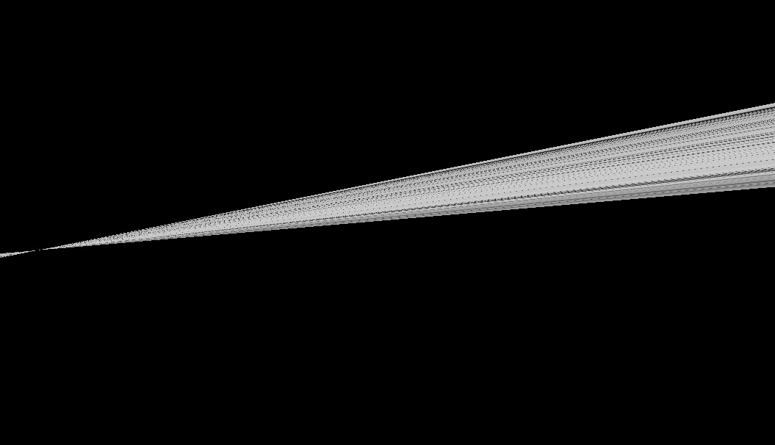
Interesting case of False Positives (2/2)
Good homography
Bad homography

Slide 15
How to proceed…
Filtering out nonsensical homography matrices
Attempting page detection using Hough transforms
Pixelwise image registration

