Slide 1
„Implementing Cast Calculus for Label Dependent Lambda Calculus“
Master’s Thesis
Thomas Leyh

Slide 2
Etymology of the Term
Type Systems
Computation Models
Dependent Types
Functional Models
Cast Calculus Label Dependent Lambda Calculus

Slide 3
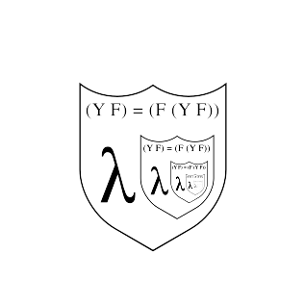
Lambda Calculus
Variables x
Abstraction λx.M
  λx.x
  λx.(x+x)
  λx.λy.(x+y)
Application M N
  λx.(x+x) 5 ↓ 10
  λx.λy.(x+y) 5 8 ↓ 13

Slide 4
Label Dependent Types
Dependent Types are types that depend on values
  Types: Integer, List<Integer>
  Dependent Types: List<Integer, length=5>, List<Integer, length=6>
Label Dependent Types may only depend on labels
Labels: ‘T, ‘F, ‘foo, ‘bar, …
Label Type = finite non-empty Set of Labels
  ‘T ∈{‘T, ‘F}
  ‘foo ∉{‘T, ‘F}

